Slide 1
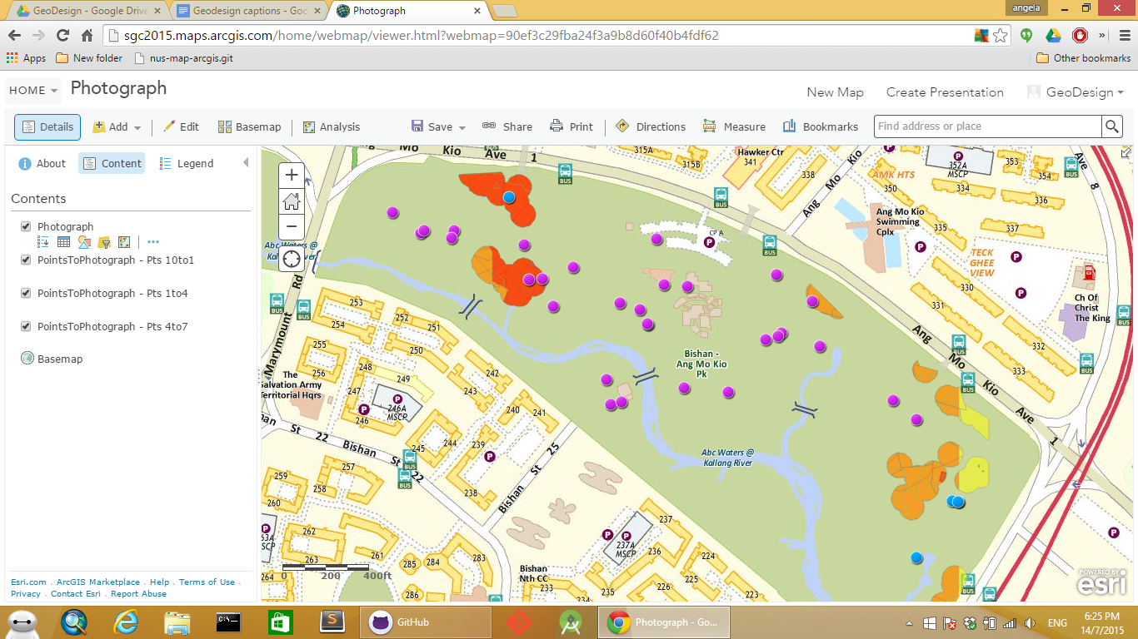
PARK 1 – Nearer to the MRT
P11
P10
P28
P3
P26
P30
P14
p2
P8
P9
P1
P29
P6
P5
P13
P7
P4
P23
P12

Slide 2
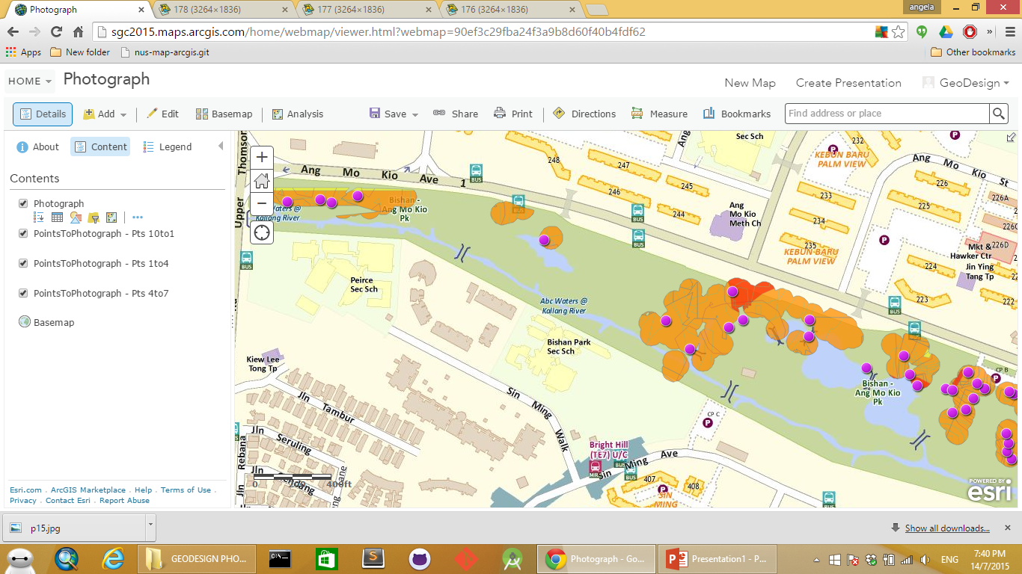
PARK 2 – Further away from the MRT
P15
P16
P19
P17
P18
P20
P21

Slide 3
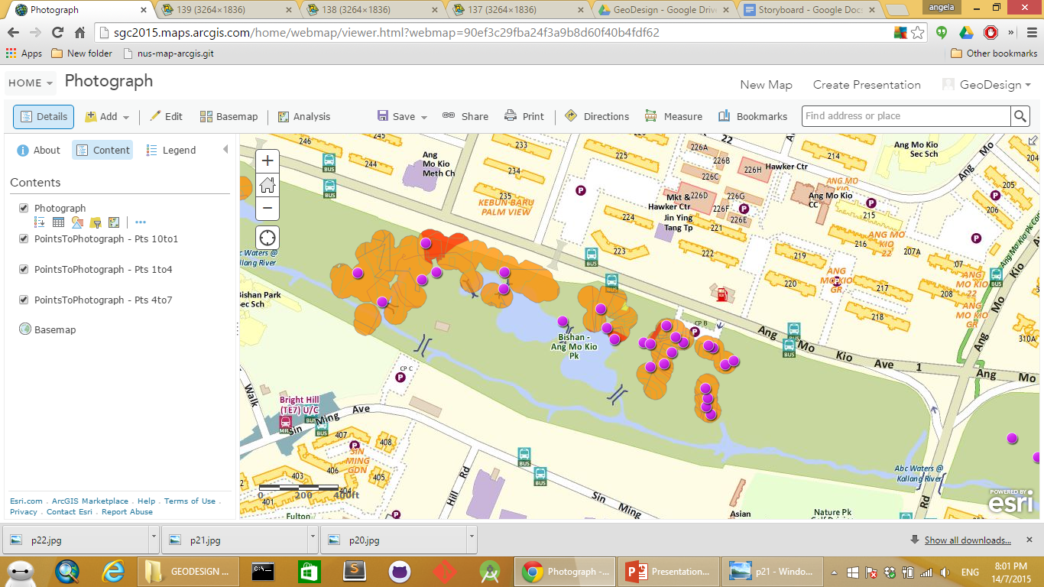
P22
P25
P24
P27

