Slide 1
A guide to Mt. Mitake
Ayumu Tanaka
Aoyama Gakuin University
As of October 27, 2024
Version 2
Subject to change

Slide 2
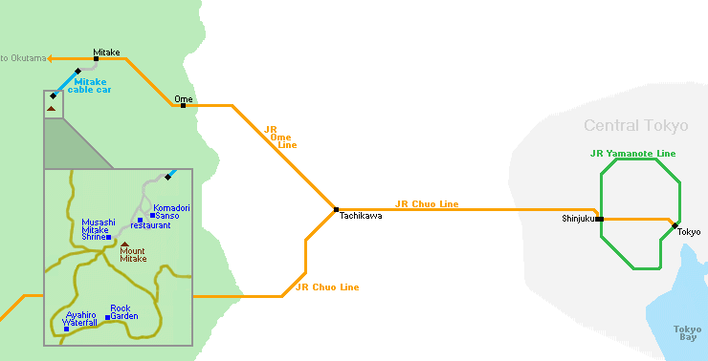
The access to Mt. Mitake
https://www.japan-guide.com/ad/tama-mitake/

Slide 3
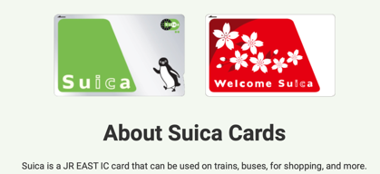
General instruction
No reservation is needed for trains.
You need the SUICA card at the station gates and bus doors during the travel. The estimated cost for trains/buses from Tokyo station is 4,540 yen for a round trip. In addition, you need 500 yen to buy the SUICA card at the JR stations/airports for the first time.
If you have the ICOCA card, you can use it and you don’t have to buy the SUICA card.
Mt. Mitake is 929 meters high. The mountain and other places have steep slopes. Well-fitted shoes are necessary. Gloves are helpful.
Google Maps is good for checking the time and direction of the trains/buses.
You are expected to bring your lunch and have lunch at Mt.Mitake. Otherwise, you can go to the restaurants at Mt.Mitake (about 1000—2000 yen for lunch).
Bring cash with you. The availability of credit cards is limited in the mountain area.
Meet at 10:32 on Nov. 27 (Wed.) at JR Mitake Station.

Slide 4
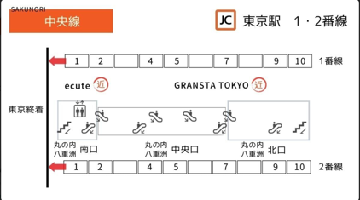
1. JR Tokyo Station to JR Mitake Station
At the Tokyo station, trains of Chuo and Ome lines depart at the same platform (No.1 and 2) which can be accessed through the long escalator from the ground floor.
Tokyo station is the starting point of the Chuo and Ome lines. Check the electric timetable at the platform.
Every five minutes, a train departs.
Even if you take the wrong train, don’t be nervous. All trains will go to JR Tachikawa; then, you can change the train to Ome. Check Google Map.
Typically, trains have a restroom in the middle.

Slide 5
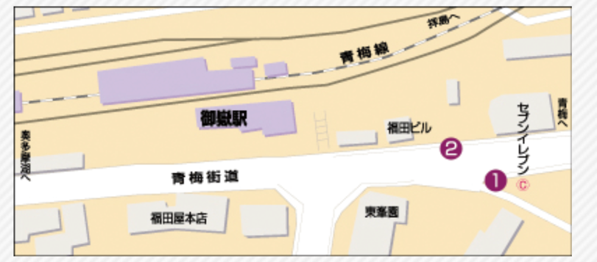
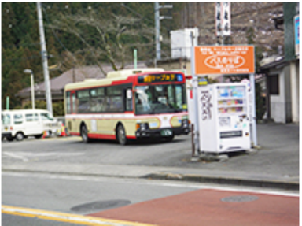
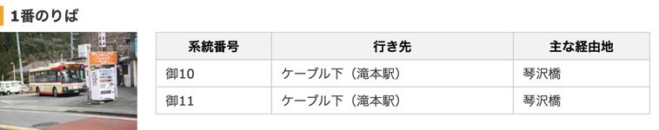




2. Bus: JR Mitake Station to Takimoto Station (Mitaketozan Cable)
Meet around 10:32 on Nov. 27 (Wed.) at JR Mitake Station.
It is a small station. We can meet each other easily,
JR Mitake Station
2 min walk
Bus Stop
https://www.nisitokyobus.co.jp/rosen/noriba/mitake.html

Slide 6
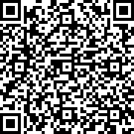
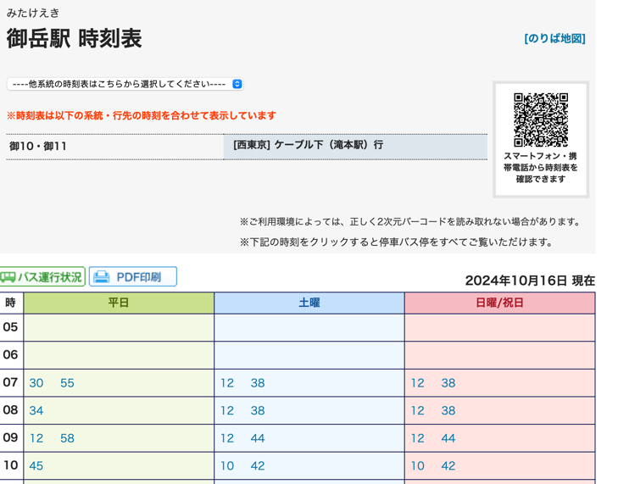
Bus time table
Note: Bus capacity (max. 50 passengers) is limited.
The bus will be crowded. The company will manage to run an additional bus.
If not, we have to wait for the next bus. Or we have to walk to the Takimoto Station on foot (2.5km).
https://transfer.navitime.biz/bus-navi/pc/diagram/BusDiagram?orvCode=00042608&course=0000445702&stopNo=1

Slide 7
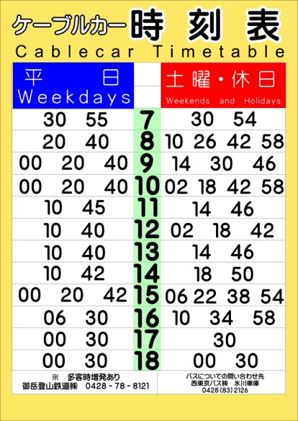
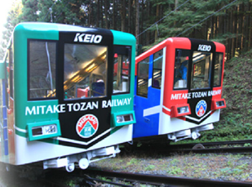
3. Cable: Takimoto Station to Mitakesan Station
Two cable cars start at the same time on both stations.

Slide 8
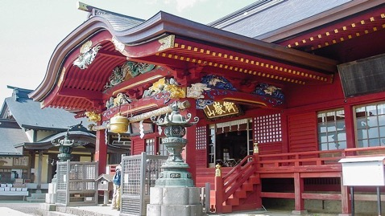
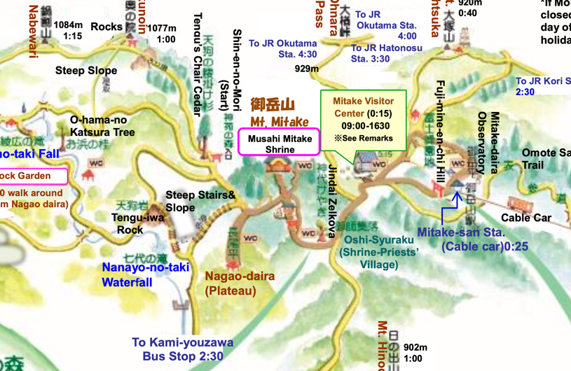
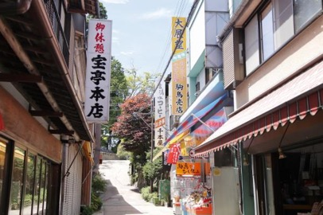
4. Walk: Mitakesan Station to Musashi Mitake Shrine
On the way to the shrine, there are shops, restaurants, traditional hotels, and the Mitake visitor center.
Musashi Mitake Shrine
https://www.japan-guide.com/e/e3036.html
https://www.ces-net.jp/mitakevc/downloads.html

Slide 9
10:30 am—1:20 pm, Lunch
After we arrive at the cable car’s Mitake-san Station.
Going to the Musashi Mitake Shrine (top of the mountain).
There are brochures and maps in English at the station. If you ride a lift, you will have to walk a mountain road.
I don’t recommend the Rock Garden and other places that need sufficient time and good pieces of equipment.
Go back to the cable car’s Mitake-san Station by 1:20 pm.

Slide 10

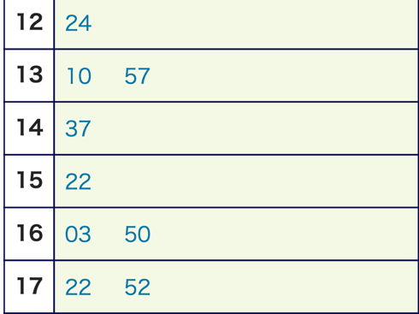
5. Mt. Mitake to JR Mitake Station
Bus time table to JR Mitake Station

Slide 11
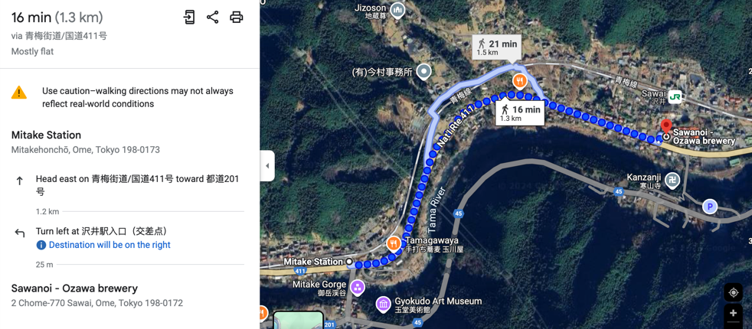
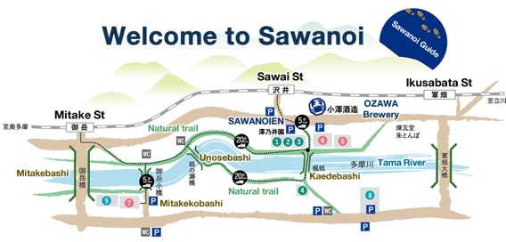
6. Walk along the river: JR Mitake Station to Sawanoi (Ozawa brewery)
http://www.sawanoi-sake.com/en/group-guide/#garden

Slide 12
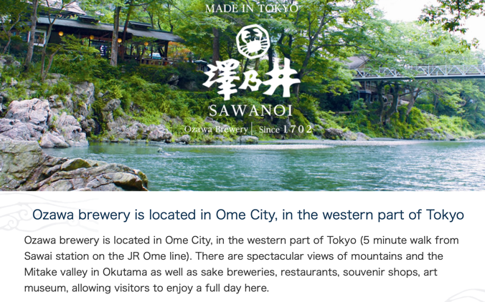
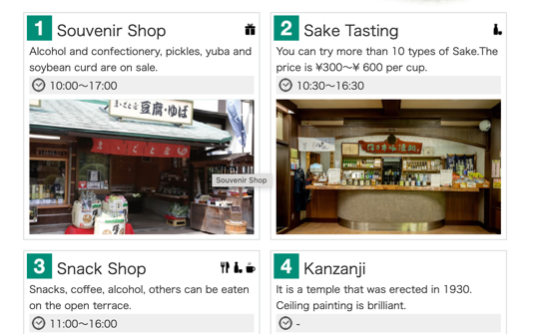
7. Sawanoi (Ozawa Brewery)
Meet at 3:45 pm in Sawanoi (Ozawa Brewery).
http://www.sawanoi-sake.com/en/

Slide 13
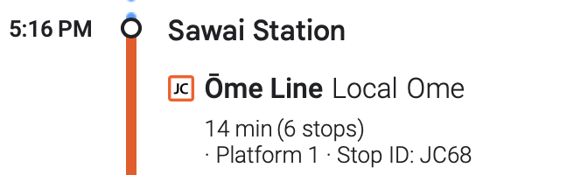
8. JR Sawai Station to JR Tokyo Station

