Slide 1
FIFA WORLD CUP 2026
Exploratory Data Analysis
Adolfo Yunes
Bernardo del Rio
Data Science Project · Monte Carlo Simulation · Machine Learning

Slide 2
PRESENTATION OUTLINE
01
Introduction
Project overview, datasets & objectives
02
Transfermarkt Analysis
Market values, player worth, confederation gaps
03
Qualifiers Performance
Win rates, attack vs defense, status comparison
04
FIFA Ranking Analysis
Ranking evolution, volatility & stability
05
World Cup History
Titles, goals, tournament evolution (1930–2022)
06
General Conclusions
Cross-dataset insights & key takeaways

Slide 3
INTRODUCTION
This project combines Machine Learning and Monte Carlo Simulation to predict the 2026 FIFA World Cup champion. We analyze 4 datasets to build a comprehensive view of each team's strength.
Transfermarkt
Qualifiers
FIFA Ranking
World Cup History
70 teams · Market values,
avg player worth, squad age
76 teams · Win%, goals,
attack & defense metrics
2,176 records · Historical
ranking 1993–2026
900 matches · Results
from 1930 to 2022

Slide 4
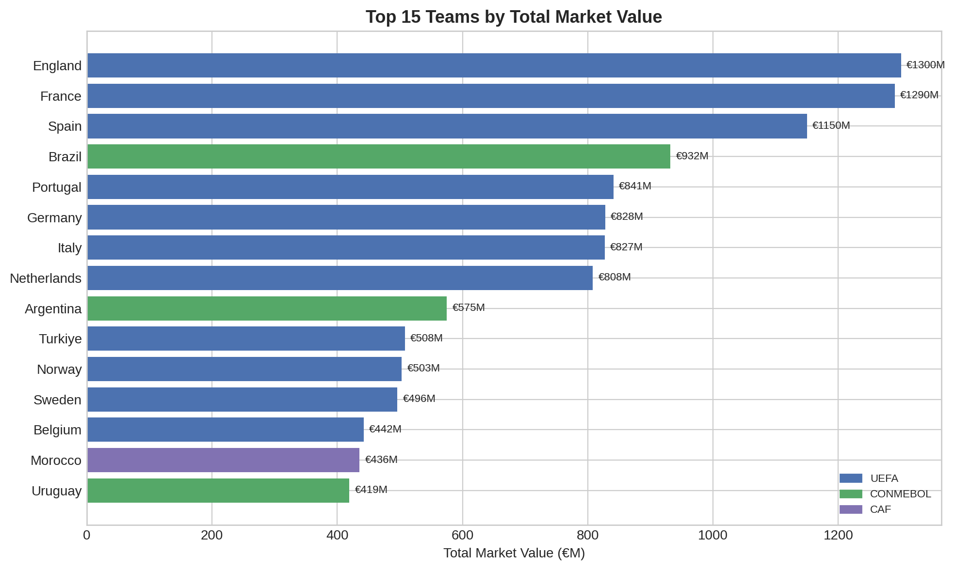
TRANSFERMARKT — Top 15 by Market Value
Key Insights
England leads at €1,300M
Top 3 are all UEFA teams
Brazil ranks 4th (€932M) — highest non-European team
UEFA dominates: 12 of top 15 are European
Value gap between #1 and #15 is ~5×
Source: Transfermarkt

Slide 5
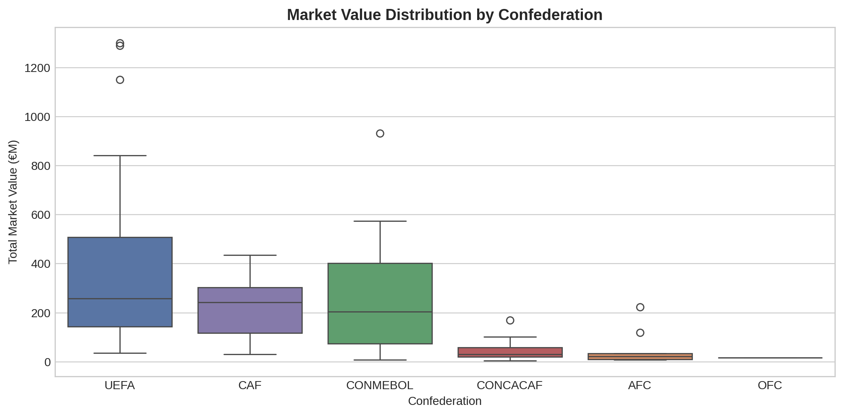
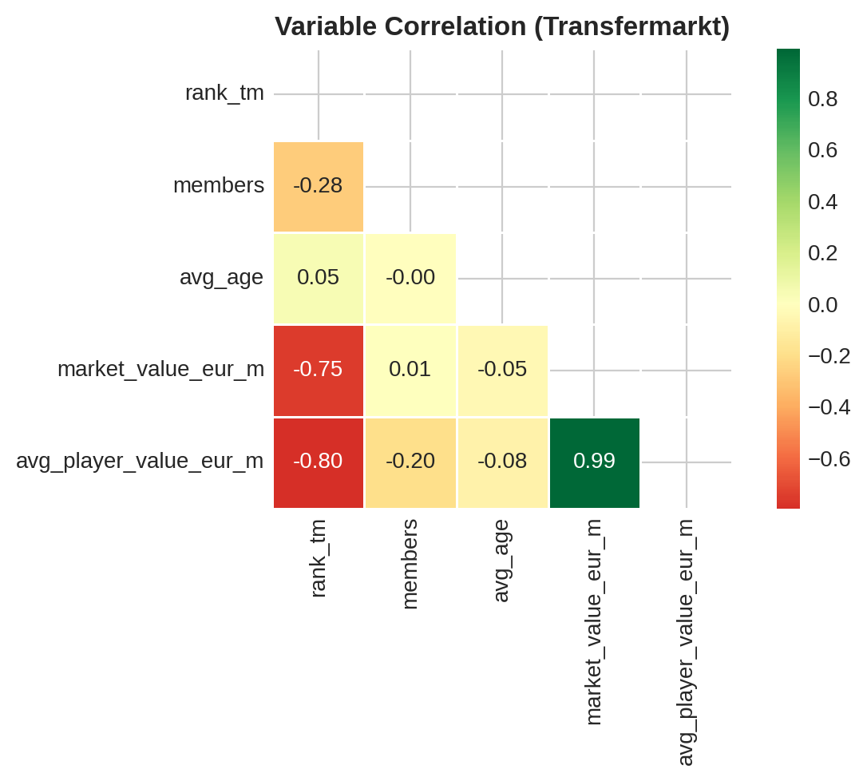
TRANSFERMARKT — Distribution & Correlations
Market value is heavily right-skewed — a small group of elite UEFA teams holds the bulk of the total value. The correlation between total squad value and average player value is very high (r ≈ 0.98), meaning individual talent and squad depth go hand in hand.

Slide 6
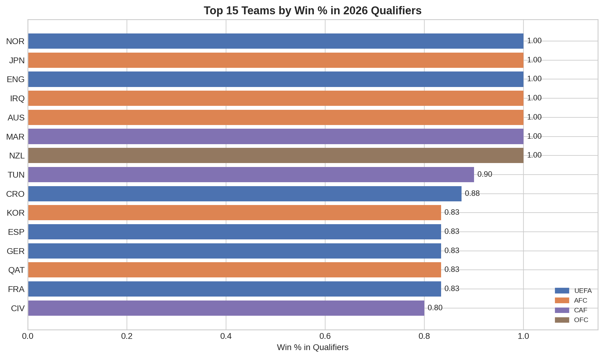
QUALIFIERS — Top Win Rates
Key Insights
Norway, England, Japan and Australia achieved 100% win rate in group stages
UEFA has the most qualified teams (28), followed by CAF (10) and AFC (9)
Confirmed teams have ~2× higher win% than playoff teams
Source: Combined qualifier data from all 6 confederations

Slide 7
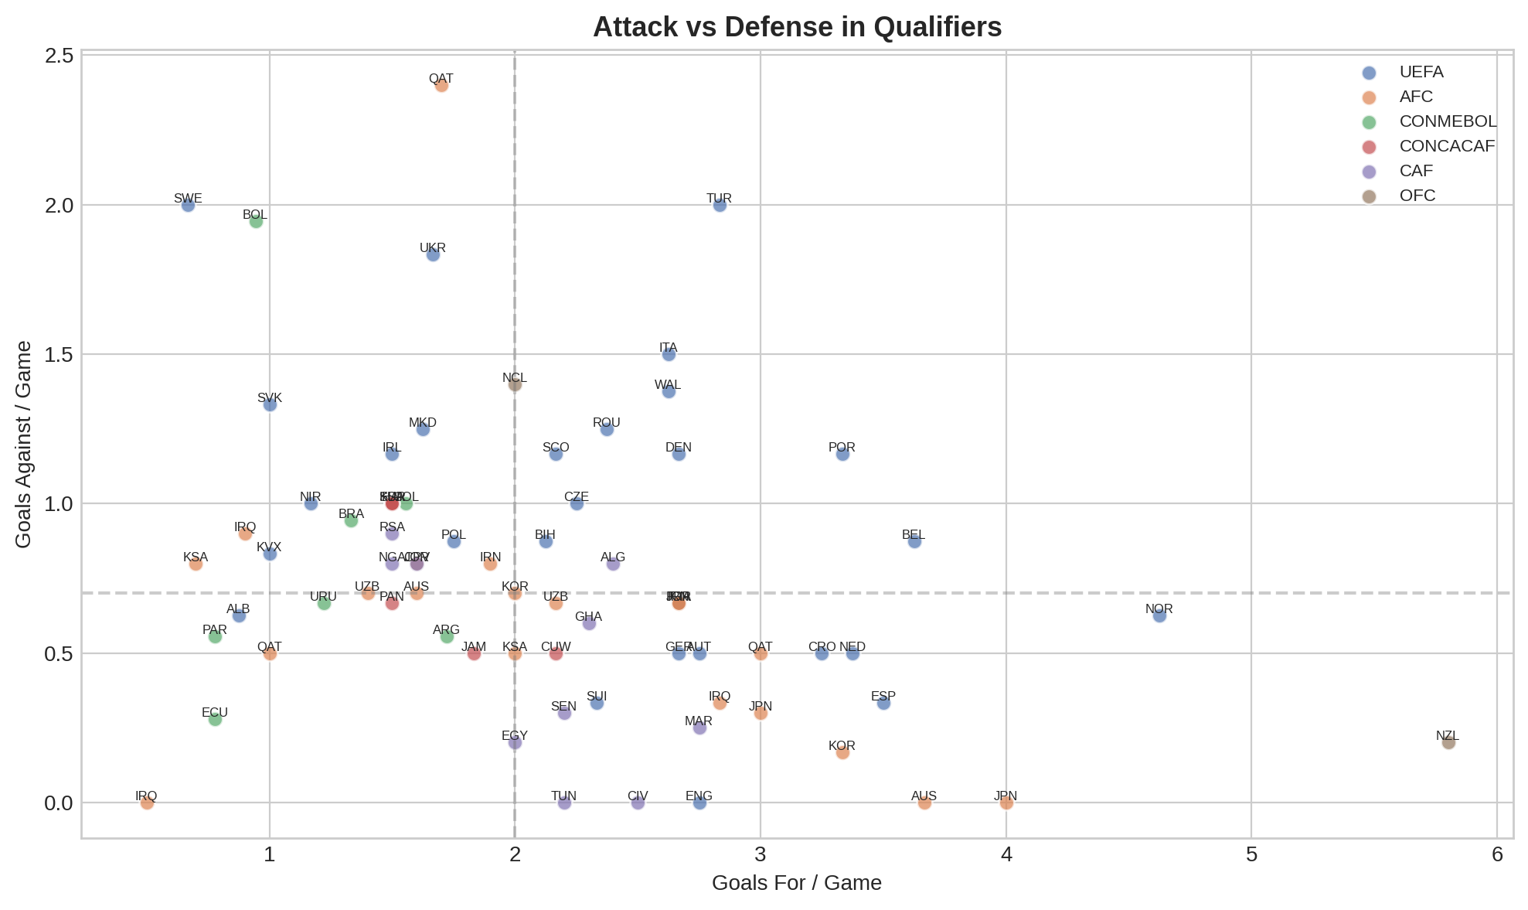
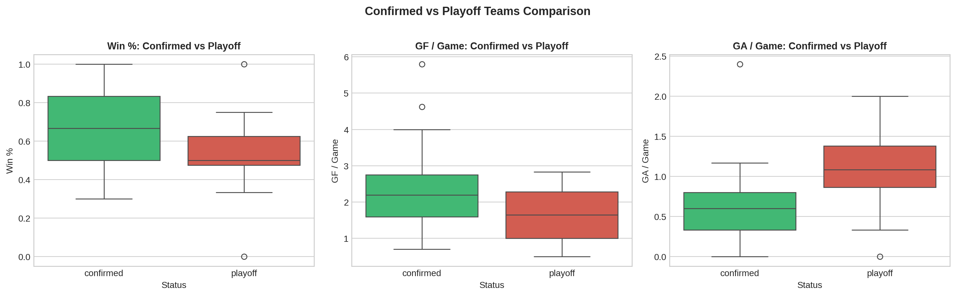
QUALIFIERS — Attack vs Defense & Status Comparison
The ideal quadrant (high attack, low goals conceded) is dominated by UEFA teams. Confirmed teams consistently outperform playoff teams across all metrics — win%, goals scored, and goals conceded — showing that direct qualification is a reliable quality indicator.

Slide 8
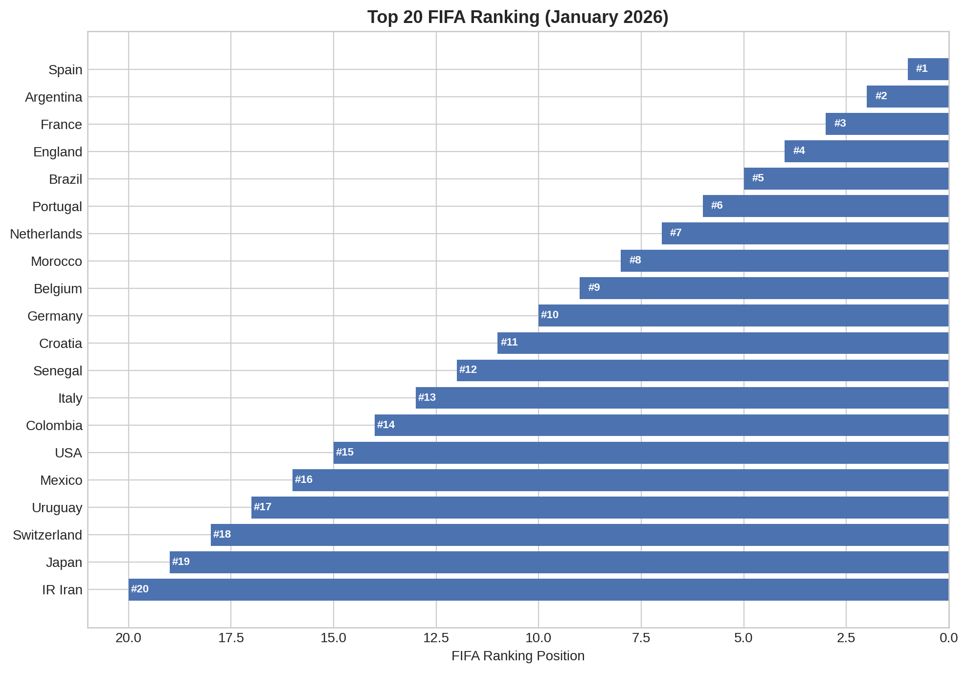
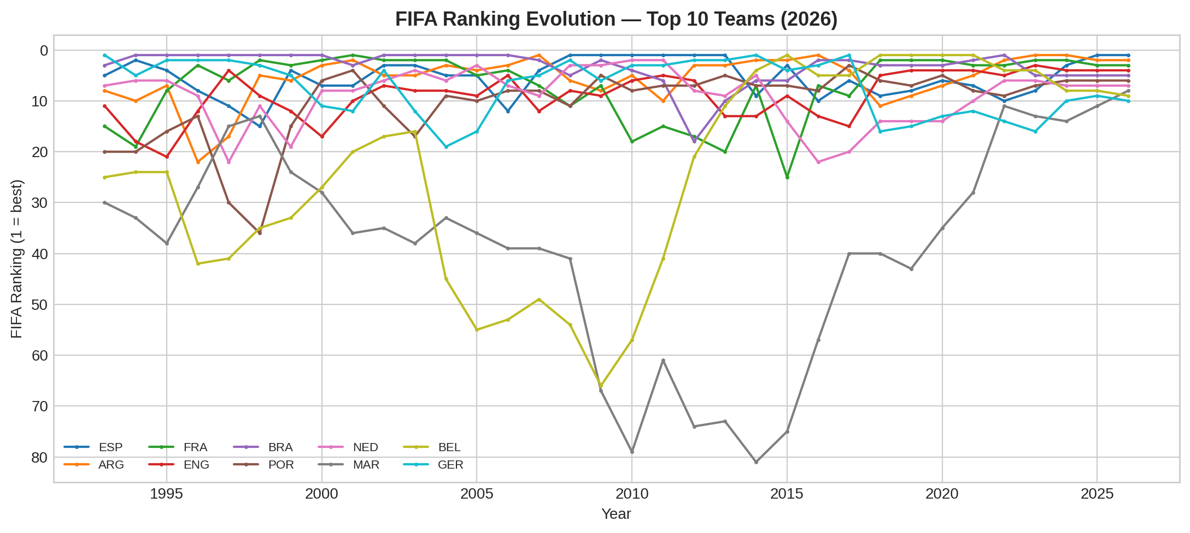
FIFA RANKING — Top 20 (2026) & Historical Evolution
UEFA dominates the top positions. Brazil, Argentina, and France have consistently stayed in the top 10 over the past three decades. Elite teams show remarkable ranking stability compared to emerging sides.

Slide 9
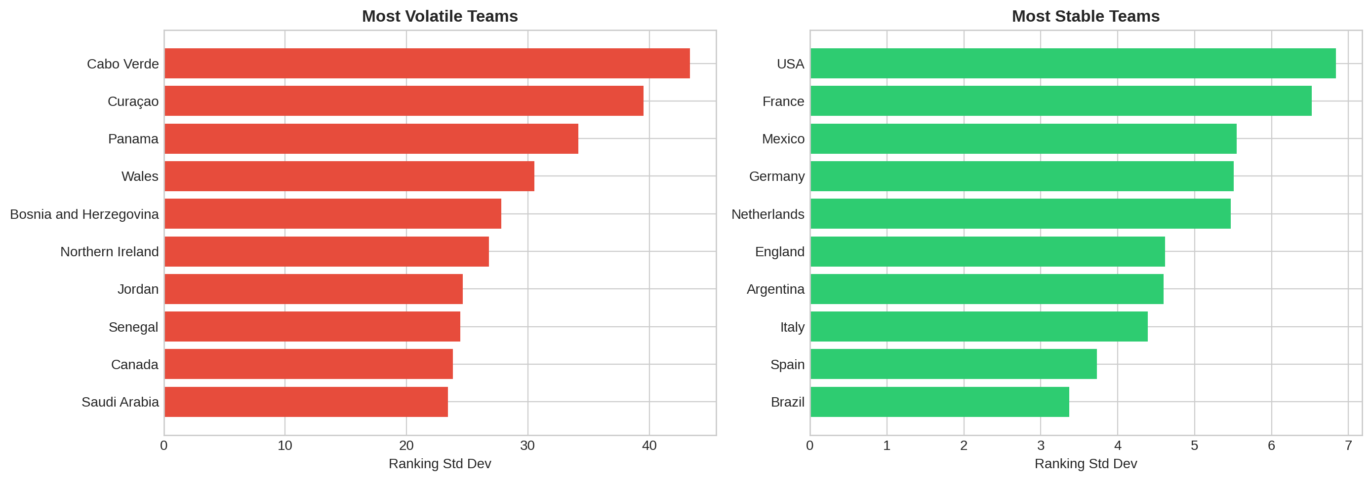
FIFA RANKING — Stability vs Volatility
The most volatile teams have experienced dramatic rises or falls — often newly emerging sides. In contrast, traditional powerhouses like Brazil, Germany, and France maintain remarkably low ranking deviation over the 1993–2026 period.

Slide 10
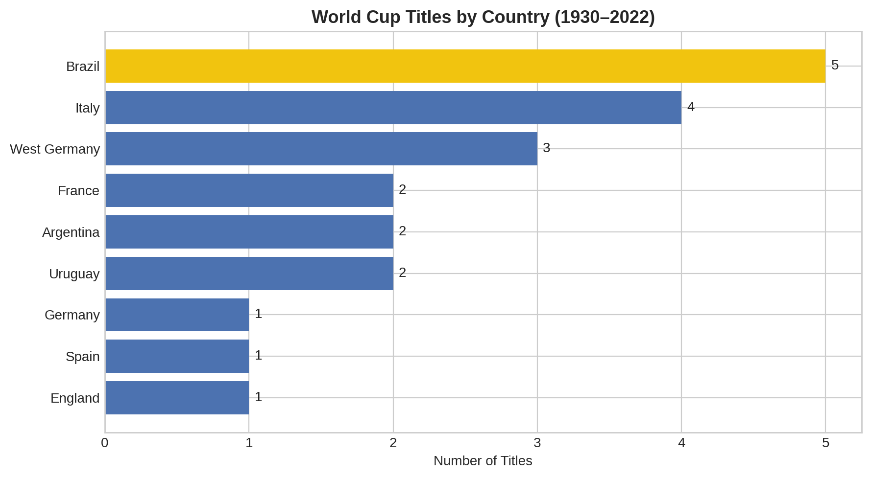
WORLD CUP HISTORY — All-Time Champions
21
1930 – 2022
900
across 92 years
Brazil (5)
followed by Germany & Italy (4)

Slide 11
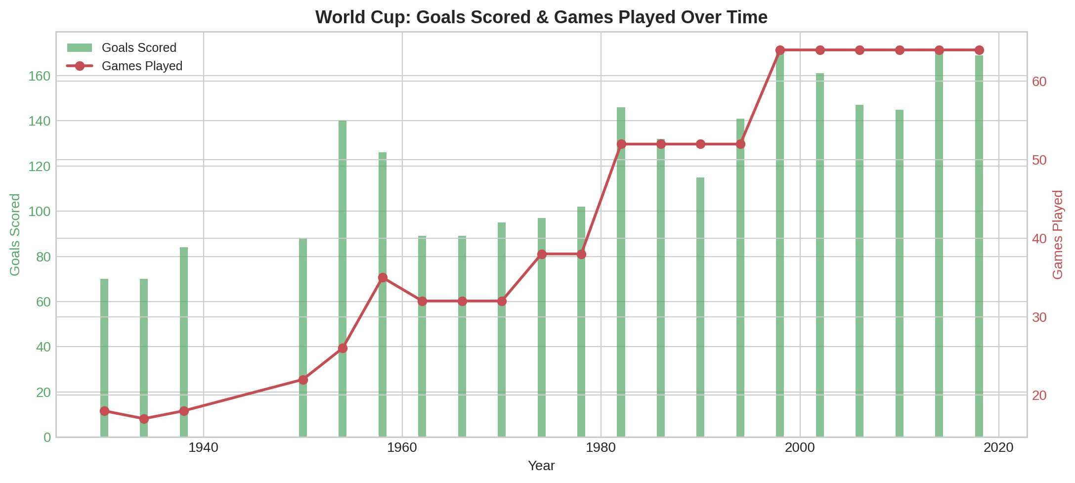
WORLD CUP HISTORY — Tournament Evolution
The tournament has grown from 13 teams and 18 games (1930) to 32 teams and 64 games (1998–2022). Goals per game have remained relatively stable despite the expansion. The 2026 edition will be the largest ever with 48 teams and 104 games.

Slide 12
GENERAL CONCLUSIONS
UEFA Dominance Is Structural
European teams lead in market value, FIFA ranking, and qualifier performance. 12 of the top 15 most valuable squads are from UEFA.
Three Predictive Pillars Emerge
FIFA ranking, market value, and qualifier win% are the most correlated variables with overall team strength — forming the predictive core of our model.
History Predicts, But Doesn't Determine
World Cup historical win% correlates positively with current form, but several teams have improved or declined relative to their tradition.
The Top Contenders
Composite scoring across all datasets places Brazil, France, Spain, Germany and Argentina as the most complete teams heading into 2026.
Qualification = Quality Signal
Confirmed teams show ~2× higher win rates and better defensive records than playoff teams across all confederations.

