Slide 1
mysql

Slide 2
Introduction of mysql
What is MySQL?
MySQL is an open-source relational database management system (RDBMS) that is widely used for storing, managing, and retrieving structured data. It is based on the Structured Query Language (SQL) and is known for its speed, reliability, and ease of use.
Key Features of MySQL:
Open-source: Free to use with a strong community.
Scalability: Can handle small to large databases.
High Performance: Optimized for fast transactions.
Secure: Supports user authentication and encryption.
Cross-platform: Runs on Windows, Linux, and macOS.
Why Use MySQL?
Popular choice for web applications (e.g., WordPress, Facebook).
Used in data-driven applications, analytics, and reporting.
Integrates well with programming languages like PHP, Python, and Java.

Slide 3
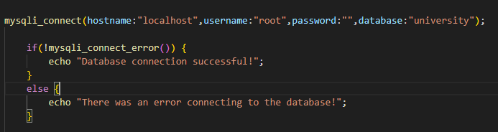
1:database connection
To interact with a MySQL database, you need to establish a connection using a database client or a programming language like Python, PHP, or Java.
Below are different ways to connect to MySQL:
Connecting with php:

Slide 4
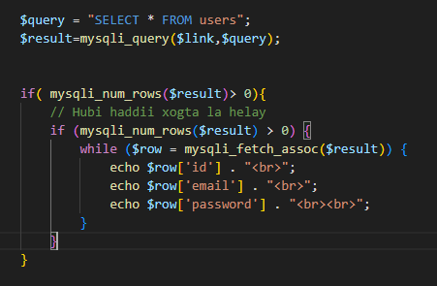
2:Retrieving Data from a MySQL Database
Retrieving data from a MySQL database is done using the SELECT statement.
You can use different clauses to filter, sort, and group data based on your needs.
1
abdi said@gmailcom
abdi4321
2
maxamed jama@gmail.com
mo122

Slide 5
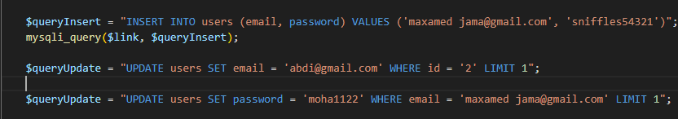
3:Inserting and Updating Data in MySQL
In MySQL, you use the INSERT statement to add new records to a table and the
UPDATE statement to modify existing records.

Slide 6
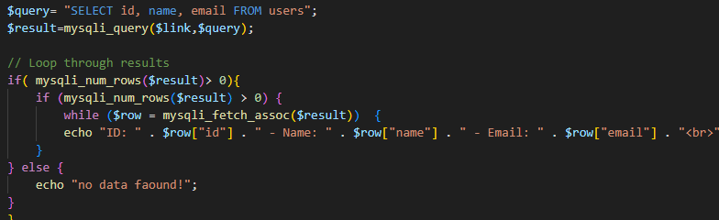
4:Looping Through Data in MySQL
When retrieving multiple rows from a MySQL database,
You often need to loop through the data to process or display

Slide 7
5:session and Cookies
A cookie is a small piece of data stored in the user’s browser by the web server (using languages like PHP, JavaScript, etc.).
It helps remember user-specific data between different visits or pages — such as login status, preferences, or user ID.
A session variable in MySQL is a temporary variable that is specific to a database connection (session).
These variables are used to store values that persist only while the session is active. Once the session is closed, the variables are automatically deleted.
MySQL provides two types of variables:
Global Variables → Affect all connections (require SUPER privilege).
Session Variables → Affect only the current connection/session.

