Slide 1
Sentiment analysis using cnn
Made by:
AYUSH RANJAN & GNANENDRA BODI

Slide 2
iNTRODUCTION
Minor project
The process of computationally identifying and categorising opinions is called Sentiment analysis.
Most of the world’s data is unstructured and not organised in a predefined manner. Most of this comes from text data, like emails, chats, social media, surveys, articles and documents.
WHY ? Sentiment analysis systems help companies make sense of this sea of unstructured data by automating business processes, thus saving hours of manual data processing.

Slide 3
Why cnn?
Minor project
In Deep Learning, a convolutional neural network(CNN), is a class of deep neural networks, most commonly applied to analysing Images while RNN’s are traditionally used to analyse Texts as RNNs are trained to identify pattern across time while CNN across space.
But researchers have come up with the idea of using CNN for Text Classification. At EMNLP 2014 a paper “Convolutional Neural Networks for Sentence Classification ” was published by Association of Computational Linguistics which dealt with this .

Slide 4
How does deep learning work?
Minor project
Deep Learning uses algo inspired by structure and function of human brain’s neural network and , CNN is a type of ANN i.e. Artificial Neural Network .
Neurons are organised into layers which are broadly divided into input layer , hidden layer and Output layer .
On a broader aspect , We pass our inputs to the input layer ,which are passed on to the hidden layer(s) which recognise some pattern and output is provided via output layer.

Slide 5
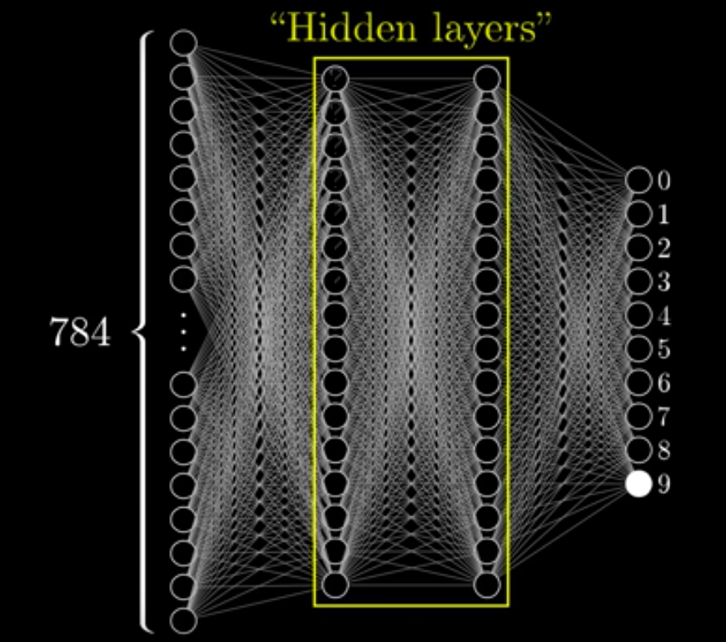
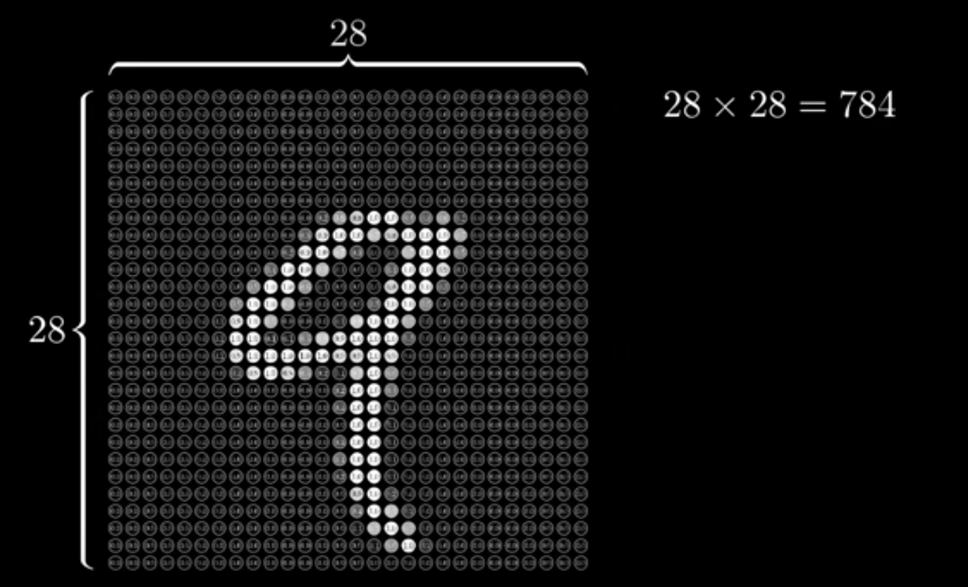
Now let’s get deeper into how does deep learning works
Minor project
To understand how does a neural network lets take an example of famous MNIST dataset ,which comprises of 60k images of hand written digits ranging from 0-9 of 28*28 pixels each .
Each pixels have a value between 0-1,and these 784 pixel's value are passed as a inputs to the input layer which has 784 neuron in this case.

Slide 6
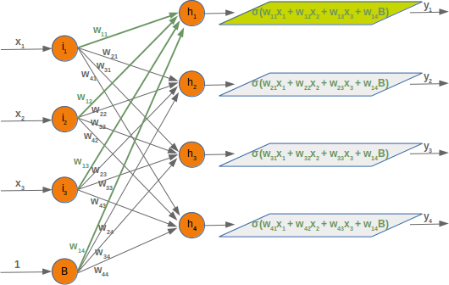
Now let’s get deeper into how does deep learning works
Minor project
Each neuron connection has a weight associated with it which range from 0-1 and represent the strength of connection .These weights are arbitrary .
Input is multiplied to the weight and then the weighted sum is passed to an activation function ,which again transforms the number to a number between 0-1 .
Why are we converting every number to 0-1 ? Neural networks are trying to copy our brain's working and neutrons are either active or inactive .
This output number is the input to the next layer and this process goes on till we reach the output layer and the output is predicted .
But is our output the correct output ? This depends on the weight of network but isn't the weight arbitrary?
This is where training our model comes into picture .

Slide 7
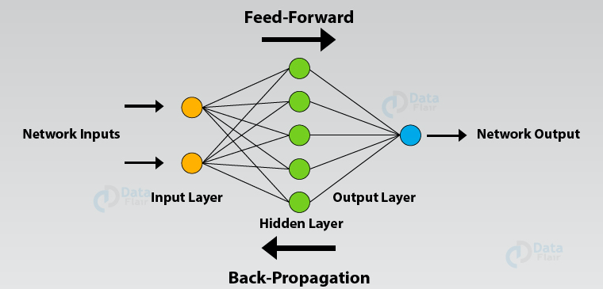
What do you mean by training a neural network ?
Minor project
While training ,a network is given inputs and its corresponding output or labels .
During training, we do a forward pass. Once the output is obtained, we compare the predicted output to the actual labels, and once we know how close the predicted values are from the actual labels, we tweak the weights inside the network in such a way that the values the network predicts move closer to the true values (labels).

Slide 8
What do you mean by training a neural network ?
Minor project
The loss computation depends upon the chosen loss function.
After the loss is calculated ,the gradient of this loss is calculated with respect to the each of the weights within the network .
This calculation is done using technique called back propagation .
new weight = old weight - ( learning rate * gradient )
Learning rate tells us how large of a step we should take in direction of minimising loss. It ranges from 0.01 to 0.0001 .Learning rate on higher side may result into Overshooting while on lower side will take more time to reach the point of minimum loss.

Slide 9
How does cnn work?
Minor project
CNN has been so far used for analysing images as it has some type of specialisation for being able to pick out or detect patterns .
CNN typically involves 2 operations - Convolution and Pooling

Slide 10
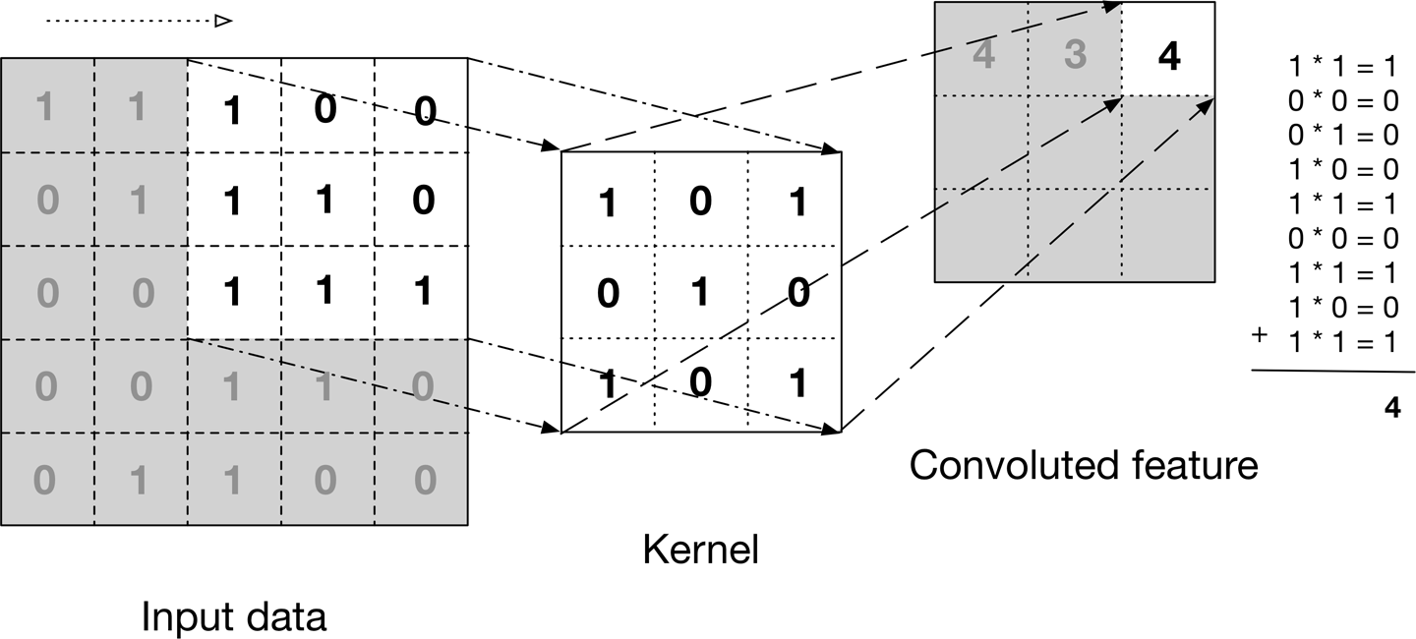
Convolution
Minor project
With each convolutional layer we need to specify the filters or kernel .These filters detect patterns.
Typically filters are randomly set and during training, machine fine tunes these values .
The output of this process is a matrix with all it's entity filled , called convolutional feature or input feature map
The input image can be convolved with multiple filters ,creating one output for each filter .

Slide 11
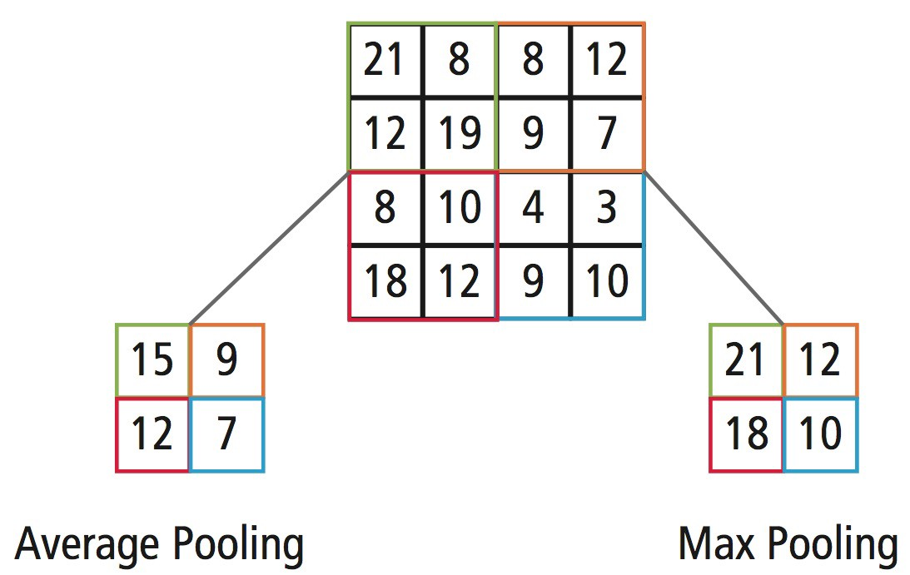
Pooling
Minor project
Pooling is done following individual convolutional Layers
It is generally of 2 types :- Max pooling and Average pooling
Max pooling is used to extract the sharpest and most important feature of an image

Slide 12
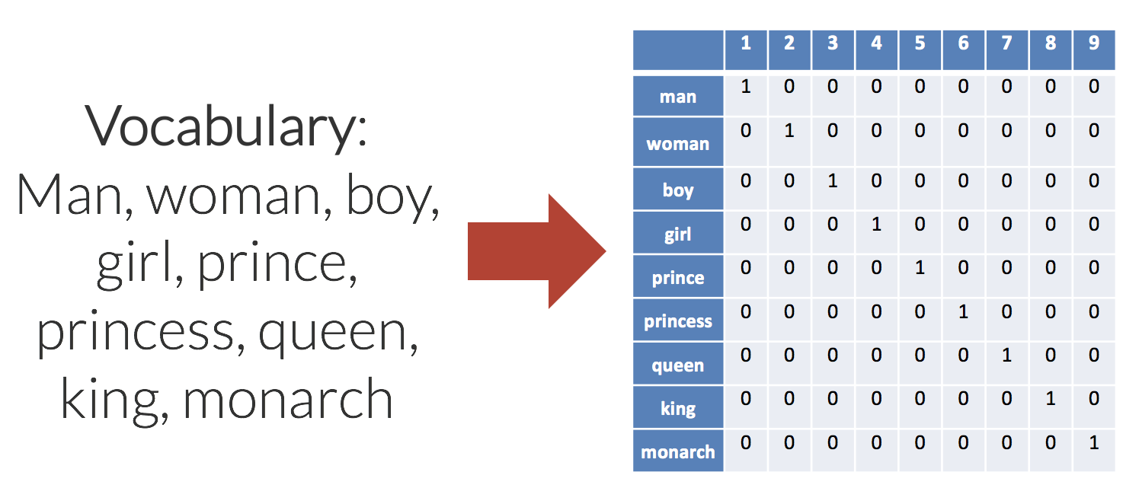
How can we Apply cnn to text?
Minor project
Images are 3d or 2d(if we ignore the colour dimension) but Text are 1 d .
Steps involved in applying CNN to text :-
1. CONVERT WORDS TO WORD EMBEDDINGS:-
This is how we visualise our words in 2d . Previously we use 1 Hot encoding but it took a lot of space and we can't find resemblance between similar words .

Slide 13
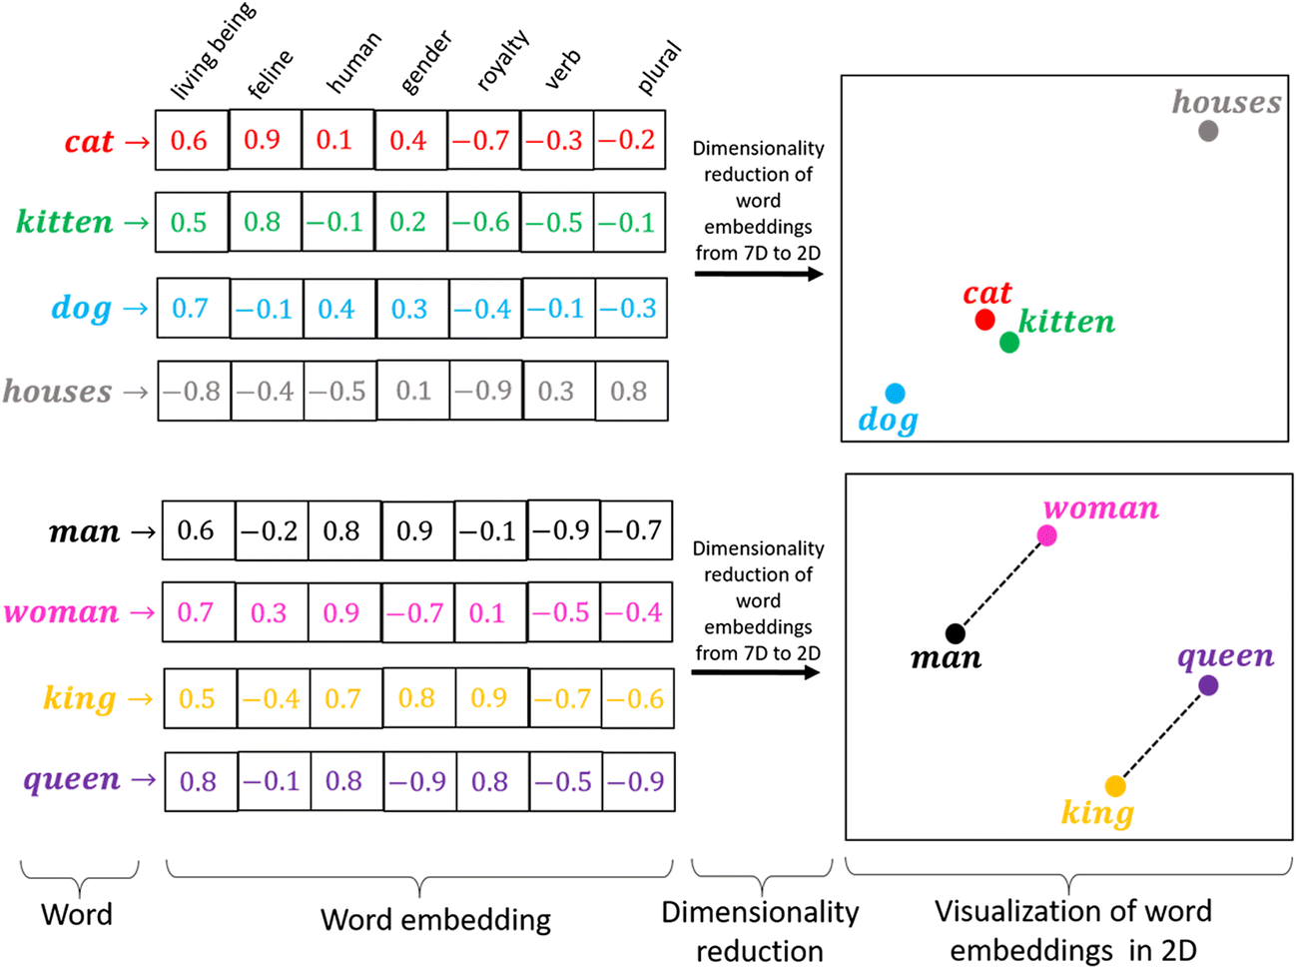
How can we Apply cnn to text?
Minor project
In Word Embeddings each word is along one axis and elements of vector across other . Similar words can be identified by looking at the vectors .

Slide 14
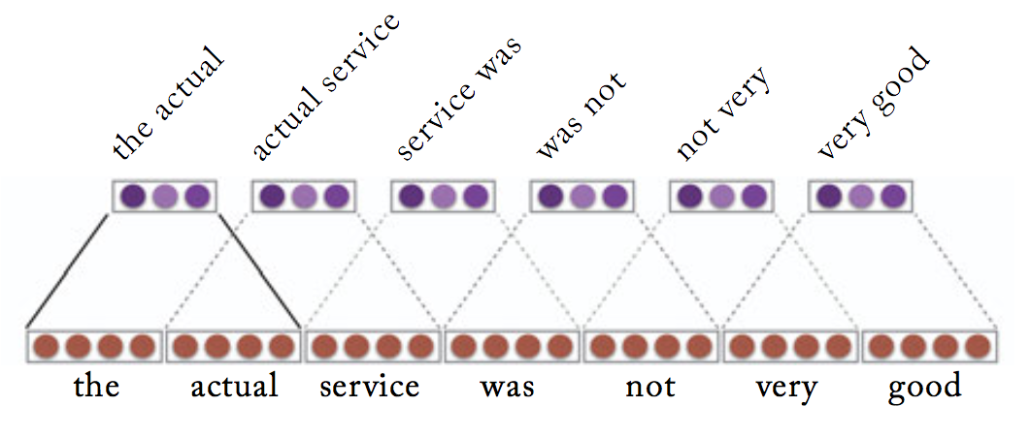
How can we Apply cnn to text?
Minor project
2. DECIDING FILTER FOR CONVOLUTION
We use filter of dimension ( n * embedding dimension ) . It means ,it will cover n sequential words entirely creating n grams
We will use different size filter and a number of filters of each size to learn different features to extract

Slide 15
How can we Apply cnn to text?
Minor project
3. POOLING:-
Max Pooling is the most important feature for determining sentiment review which corresponds to the most important n-gram.
Pooling also requires filter . So here we will use a filter with same size as number of features to spot the most important feature in whole text .
We don't have to know which is the most important n-gram.Through Back propagation the weights of the filters are changed to suit accordingly
To understand this we have to get deeper into this. Let's begin implementation of this project .

Slide 16

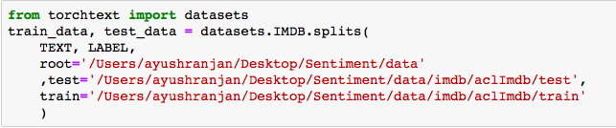

Preparing the data
Minor project
We are using IMDb reviews dataset from TorchText package .
We will create TEXT field and LABEL field which is our input i.e. reviews and corresponding Sentiment .
We used Spacy as it provides a one-stop-shop for tasks commonly used in any NLP project, including: Tokenisation, Lemmatisation,Part-of-speech tagging,Entity recognition,Dependency parsing,Sentence recognition,Word-to-vector transformations,Many convenience methods for cleaning and normalising text.CNN want the batch dimension first so we used batch_first =True
We use inbuilt "splits" method to which divides the dataset into training and test data into equal parts ,each of 25k reviews
We will then create a validation set by splitting the test data using data.split() which divides data in ratio 70:30
We use random function so that the we get same splits everytime.
Finally we will be left with 25k training data, 7.5k validation data and 17.5k test data.

Slide 17
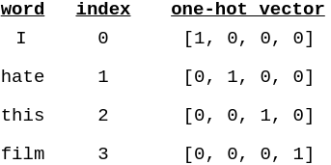

Building vocabulary
Minor project
Since computers don't work on strings we have to create a vocabulary .It is just a look up table where every unique word has a corresponding index (integer)
For this we use build_vocab() function .This function takes the Data was argument and gives every word a index.
We have to set a limit for out one hot encoding dimensiomns since we have a very large number of words in this dataset . We just arbitary set the numbers of words in ou vocab to 50 k
Each index is used to create 1 Hot Encoding for each word which will be later passed to embedding layer which would convert them into word embeddings .
Now we have vocab length of text as 50002 . Extra 2 for <pad> token and <unk> token . And length of label vocab as 2 i.e. 'neg' and 'pos' for negative and positive respectively .

Slide 18
ITERATORS
MINOR PROJECT
Iterators are used to iterate over our data in batches rather than single element iteration like loop .
There are different types of iterators for texts predefined in TorchText.
We'll use a BucketIterator which is a special type of iterator that will return a batch of examples where each example is of a similar length, minimizing the amount of padding per example.
We can make iterators of test ,train and validation data in a single go using BucketIterator.splits() and passing corresponding data and a batch size .
We used a Batch size of 64 . Which is an arbitrary number .

Slide 19
MODEL ARCHITECTURE
MINOR PROJECT
This is the fun and most tricky part in our project .
We are using 4 different convolution layers of filter size 2 ,3 ,4 and 5 which will identify the most important bi-gram ,tri-gram ,4-gram and 5-gram in the text .
The next step will be to concatenate the outputs of each individual layer and then pass it through a linear layer to predict sentiment .
We will also use dropout which is a regularisation technique for reducing overfitting .It randomly "drops out" or omit units /neurons so that our model isn't dependent on a certain set of units .

Slide 20
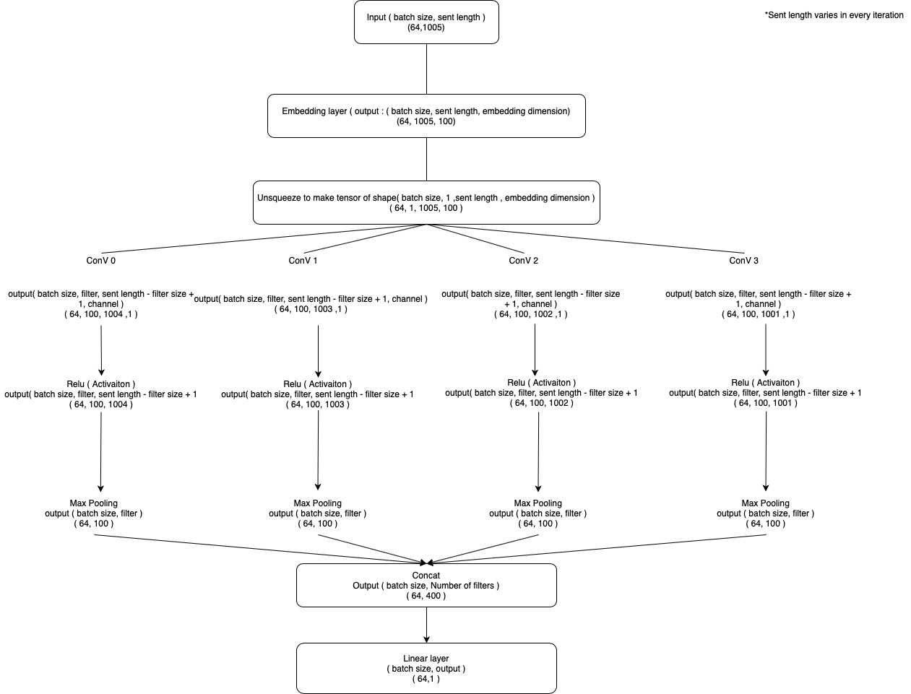
MODEL ARCHITECTURE
MINOR PROJECT
To understand in more detail let's see how does out model looks like along with a input example

Slide 21
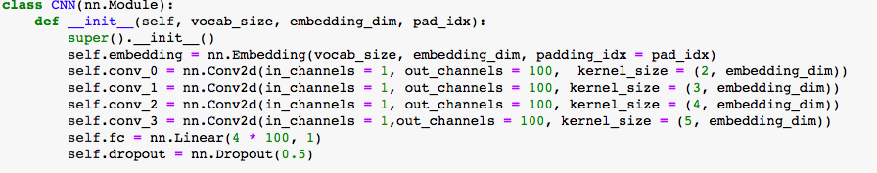
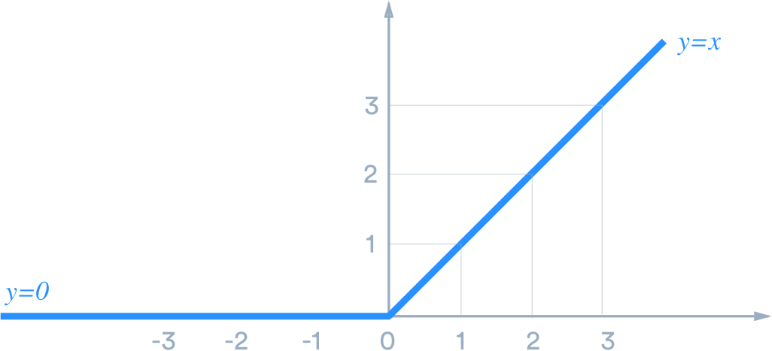
MINOR PROJECT
Let's define our model and forward function in Pytorch.
As described in methology we use 4 convolution layer of filter/kernel size of 2,3,4 and 4 each . Out channel is number of filters i.e 100 . In channel is image channel ,which is 3 in rgb image , but here it is 1 . Linear layer has 400 input features , 100 from each convolution layer . We also use droupout .
Next comes the most difficult part i.e completing the forward method .
First we pass the text which is of shape [batch size, sent len] to embedding layer .Now our data is of shape [batch size, sent len, emb dim] . Since convolutional layer expects a tensor of shape [ batch size , channel , height , width ] and to do so we unsqueezed our tensor at dimension at 1 . So now our tensor is of shape [batch size, 1, sent len, emb dim] . We pass this tensor to 4 different convolutional layer separately .
After the convolution layer our output tensor will be of shape [batch size , no of filters ,sent len - filter size +1 , channel] .We then squeeze the tensor at channel dimension and pass it to the relu activation function , which sets all negative values to 0 while positive remains same .
The purpose of an activation function is to add some kind of non-linear property to the function

Slide 22
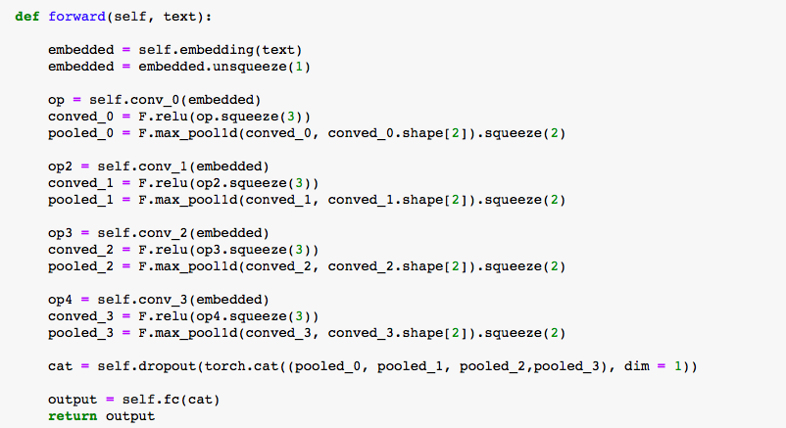

MINOR PROJECT
We then pass this tensor to max pooling with filter / kernel size of [sent len - filter size + 1] and get a output of shape [batch size , no of filters] i.e [64,100] in this case . We now have 4 [64,100] shape tensors from 4 different convolutional operations .
We concatenate these 4 tensor and perform dropout on them . Finally this tensor of shape [64,400] is passed to a linear layer to predict sentiment of all 64 reviews . So our output tensor is of shape [64,1] .
Now we have to make an object of our CNN class .

Slide 23

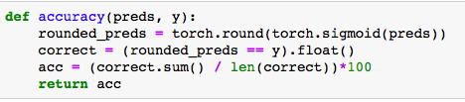
MINOR PROJECT
Since our model are ready now . We have to create train , evaluate and accuracy functions . Before any of that we have to define our optimisers and loss function .
We use Adam here as Adam adapts the learning rate for each parameter making it a very effective .The BCEWithLogitsLoss function carries out both the sigmoid and the binary cross entropy steps ,and is used where the outcome is binary ,just like in our case .
Now its time we define our function . Let's define a function to calculate accuracy "accuracy " .
This function takes 2 argument as input - prediction tensor and label tensor .sigmoid squash the preds to a range between 0 and 1 ,and rounded to nearest 0 /1 . those values which are same is converted into 1 while those different to 0 and then converted into float for division .We then calculate the sum of correct tensor . Since same value are denoted by 1 so the sum will be the number of correct prediction . We then divide it by length of correct i.e. batch size i.e 64 and then multiple with 100 to get the percentage.
Next comes the train and evaluate function .

Slide 24
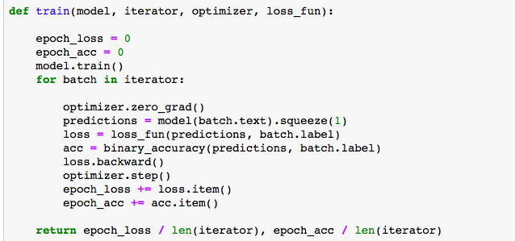
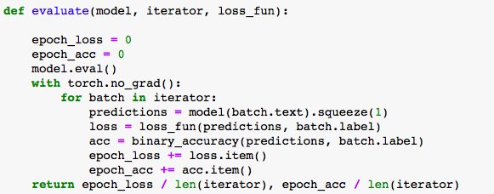
MINOR PROJECT
Train method takes model , iterator , optimizer and loss function as input . First it sets epoch loss and accuracy to 0 as every epoch yield different loss and accuracy . Model.train() is just to tell that our model is in training mode and gradient is to be calculated to update weights.
In the loop the first thing we do is set the gradient to zero because pytorch accumulates gradient on subsequent backward passes. Then we pass our text to model and get the prediction output of shape [64,1] we then squeeze it to make a tensor of shape [64] i.e. prediction for every review in the batch of 64 reviews .Then we calculate the loss by passing prediction and label to loss function and similarly the accuracy . This is loss and accuracy of just a batch in a epoch.
To calculate the loss and accuracy of a epoch we simply add the loss and accuracy of each batch to epoch_loss and epoch_acc and turn sum total divided by length of iterator . Now we have to explain 2 line of code i.e. loss.backward() and optimizer.step() . Loss.backward() Calculate Gradients while optimizer.step() updates the weight .These 2 lines of code are missing in evaluation method as they are just to test the model . Let's look at evaluate method :-

Slide 25
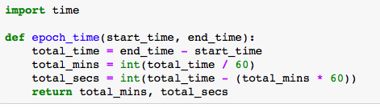
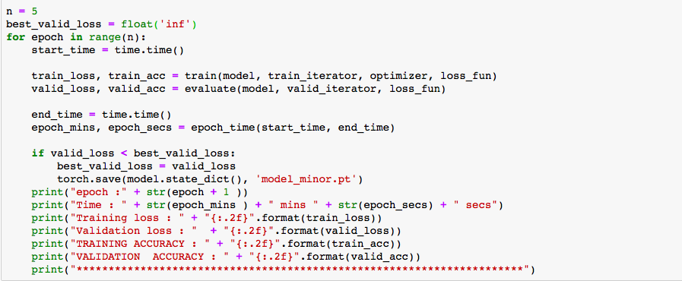
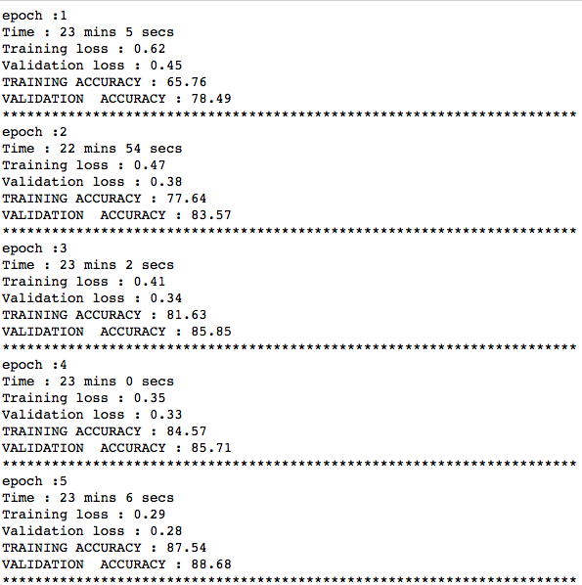
MINOR PROJECT
In evaluate method we use model.eval() although it is optional ,it reduces memory consumption and speed up computations . You will not be able to backpropagate in this mode so no updating of weights .The rest of the code is same as train method.
The next method we are using is epoch_time() to calculate time duration of a epoch . Let's look how does this method look like .
For this we imported the time module .This method takes start time and end time calculate the difference and return mins and secs taken for a epoch .
Now let's train our model . Let's look on that code
Here n is the number of epochs . best_valid_loss acts as a upper bound for loss .Inside the loop we first use time module and set the starting time . Then we call train and evaluate method and pass train iterator and valid iterator respectively along with the other required arguments .After then we again calculate time and set is as end time . Then we call epoch_time method to find the epoch min and secs . We then save the model if our validation loss is less than the upper bound and replace upper bound with that model's validation loss .
The last thing we do is print everything related to the training and validation phase and the output would be :-

Slide 26
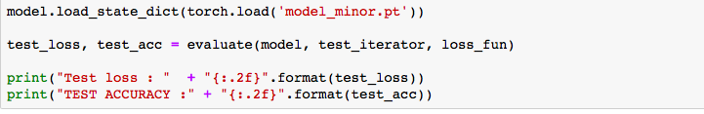

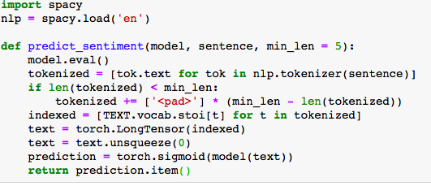
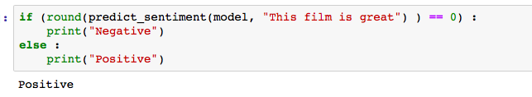
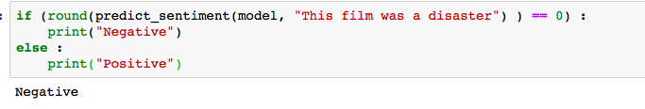
MINOR PROJECT
We can check our model on test data which we made by loading our saved model and then passing it through evaluate method just like :-
And the output will be :-
So the test accuracy of our model is 87.39% .
The next thing we do is to check our model on user input data .To do so we define a predict_sentence function .
This taken model ,sentence and min len as argument . min_len is the min number of words that should be present in the sentence .The input sentence should be larger than the largest filter used so min_len = 5 . The model is in evaluate phase . We first tokenizes the sentence into a list of tokens. If the tokenized input sentence is less than min_len tokens, we append padding tokens (<pad>) to make it min_len tokens.indexes the tokens by converting them into their integer representation from our vocabulary. We converts the indexes, which are a Python list into a PyTorch tensor.We then add a batch dimension by unsqueezeing. Then squashes the output prediction from a real number between 0 and 1 with the sigmoid function. The last thing we do is converts the tensor holding a single value into an integer with the item() method.Let's predict sentiment of few sentence using the above function :-

Slide 27
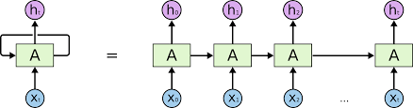
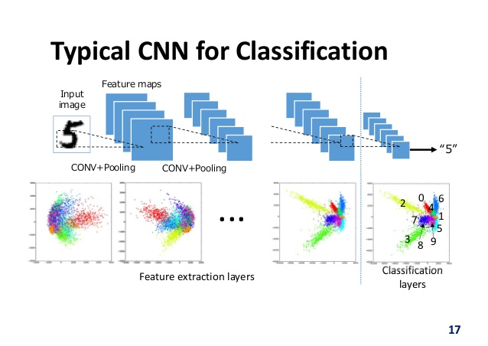
RNN's work sequentially so we feed it one word at a time. Breaking up a sentence into word sequences
RNN
vs
CNN
CNN WORKS PARALLELLY AS EACH FILTER TRIES TO EXACT A DIFFERENT PATTERN
SINCE NO SEQUENTLY DEPENDENCY OF INPUT ARE PRESENT, ALL 4 BRANCHES OF CNN LAYER CAN DO FORWARD PROPAGATION PARALLELY IN OUR CASE .
HOW THEY DOES IT ? THAT'S FOR THE LIBRARY TO DO . LIBRARY WILL OPTIMIZE EXCECUTION.

Slide 28
THANK YOU!

