Slide 1

InsightPilot AI
Accenture Innovation Challenge 2026 · Detailed Business Proposal
Team SignalCraft · IIT Patna · Track 3: BusinessIntelligence.ai

Slide 2



Team details
TEAM NAME: Team SignalCraft
Ayush Nathani (Team Leader)
Amrit Sugandh
College: Indian Institute of Technology, Patna
Stream: MCA
Year of graduation: 2027
College: Indian Institute of Technology, Patna
Stream: MCA
Year of graduation: 2027
Rajababu Kumar
Photo
College: Indian Institute of Technology, Patna
Stream: MCA
Year of graduation: 2027

Slide 3
Problem Statement
The Investigation Latency Paradox: modern enterprises detect revenue and supply-chain anomalies within seconds, but diagnosing root causes and formulating a verified operational response takes 14 to 28 business days of manual, cross-silo investigation.
This delay results in irreversible market-share attrition, distributor order cancellations, and unrecovered revenue.
-$1.23M
14 Days
29 POs
+310%
NA-East Net Revenue Deficit · 7.97% vs Q2 Baseline
SKU-8821 Zero-Stock Duration (Atlanta DC)
Distributor Orders Deferred · $240K Value
Customer Escalations ·
34 → 142 Tickets
Why this matters now:
Generic BI dashboards and GenAI chat tools show what happened, but cannot reliably explain why, prove it with verifiable evidence, or simulate the financial outcome of a fix — leaving executives to make high-stakes calls on incomplete, unverified information.
INSIGHTPILOT AI · ACCENTURE INNOVATION CHALLENGE 2026
01 / 17

Slide 4
Why Existing Business Intelligence Falls Short
Fragmented Enterprise Data
Dashboards indicate what happened.
Diagnosing why requires weeks of manual cross-silo triage across ERP, CRM, and EDI systems — by which time distributor orders are cancelled and market share is lost.
Generic GenAI chat tools compound the problem:
they can invent metrics and lack a verifiable audit trail, which makes them unsuitable for high-stakes, auditable executive decisions.
+
Disconnected Analytics
+
Slow Decision Making
+
AI Without Grounded Evidence
Poor Business Decisions
INSIGHTPILOT AI · ACCENTURE INNOVATION CHALLENGE 2026
02 / 17

Slide 5
Proposed Solution
InsightPilot AI is an enterprise decision-intelligence platform that closes the Investigation Latency Paradox — reducing decision latency from 3 weeks to under 30 seconds by unifying deterministic analytics with LangGraph multi-agent intelligence, and verifying every conclusion with SHA-256 cryptographic evidence lineage.
“Don’t just tell executives what happened. Explain why it happened, prove it with evidence, recommend what to do, and simulate the potential business impact.”
Anomaly
Root Cause
Verified Evidence
Decision Mechanics
Recommended Action
Predicted Outcome
100%
0%
11 Nodes
Mathematical Precision — Deterministic Core Owns Truth
Speculative Hallucinations Permitted
LangGraph Multi-Agent Orchestration
INSIGHTPILOT AI · ACCENTURE INNOVATION CHALLENGE 2026
03 / 17

Slide 6
How InsightPilot AI Works
Anomaly
Root Cause
Verified Evidence
Decision Mechanics
Recommended Action
Predicted Outcome
Each stage is produced by a deterministic engine or a grounded AI agent — never a free-form language-model guess — so every number an executive sees traces back to a verifiable source system.
1
2
3
4
Detect
Investigate
Verify
Recommend & Simulate
A statistically significant KPI deviation is flagged the moment it crosses threshold.
LangGraph agents decompose the anomaly into ranked, quantified root-cause drivers.
Every driver is corroborated against SHA-256-hashed ERP, CRM, and EDI evidence.
Prioritized actions are scored by recovery value, feasibility, and confidence.
INSIGHTPILOT AI · ACCENTURE INNOVATION CHALLENGE 2026
04 / 17

Slide 7
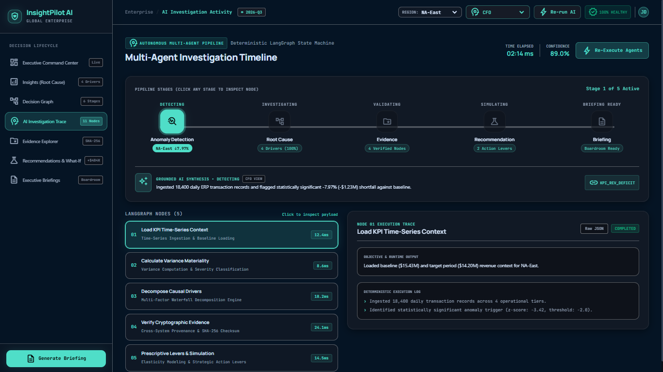
Technology & AI Architecture
Core principle: deterministic systems own quantitative truth. LangGraph orchestrates investigation.
AI explains grounded facts — it is never allowed to calculate metrics or invent evidence.
Data Sources
Investigation Agents
Orchestration Layer
Evidence Verification
Decision & Recommendation Engine
Executive Briefing
ERP · CRM · EDI · POS
LangGraph 11-Node StateGraph
Groq LLaMA 3.3 70B + Gemini 2.5 routing
SHA-256 Cryptographic Lineage
Deterministic Python Core Analytics
Role-Tailored Boardroom Synthesis
11 Nodes
LangGraph StateGraph Orchestration
2 Engines
Groq + Gemini Multi-Model Pool
SHA-256
Product interface — AI Investigation Trace (LangGraph node-by-node execution log)
Cryptographic Evidence Lineage
INSIGHTPILOT AI · ACCENTURE INNOVATION CHALLENGE 2026
05 / 17

Slide 8
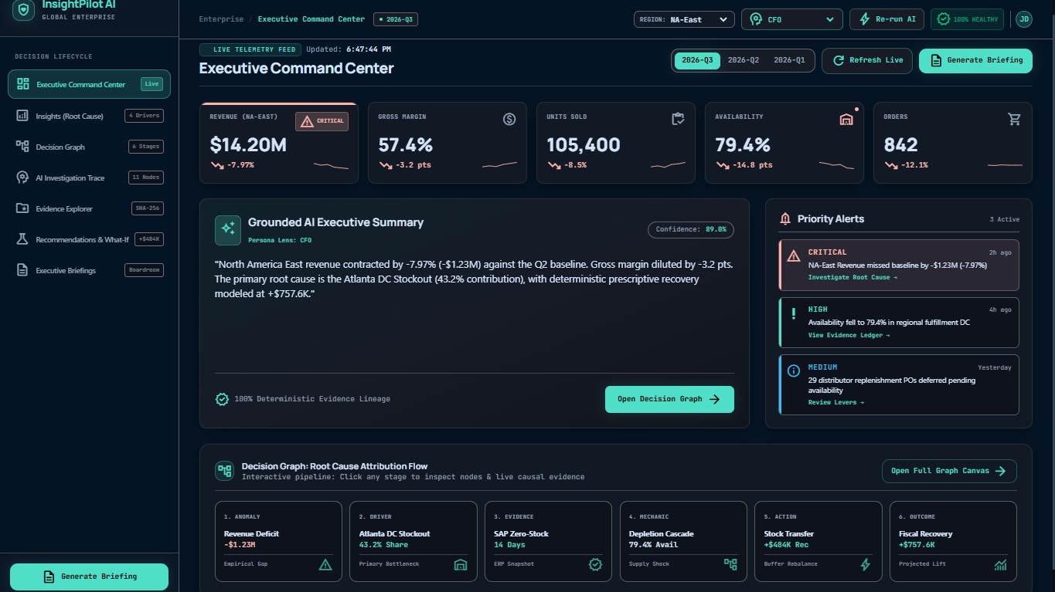
Working Prototype — Executive Command Center
Real-Time KPI Telemetry
Revenue, gross margin, units sold, availability, and orders synced live across every connected enterprise system.
Grounded AI Executive Summary
A plain-English narrative of what changed, generated only from grounded, verified data — never invented.
One-Click Drill-Down
Any priority alert opens directly into the Decision Graph, tracing the anomaly straight to its root cause.
8 Sources
Enterprise Data Systems Synchronized Live
Live product interface — InsightPilot AI Executive Command Center
INSIGHTPILOT AI · ACCENTURE INNOVATION CHALLENGE 2026
06 / 17

Slide 9
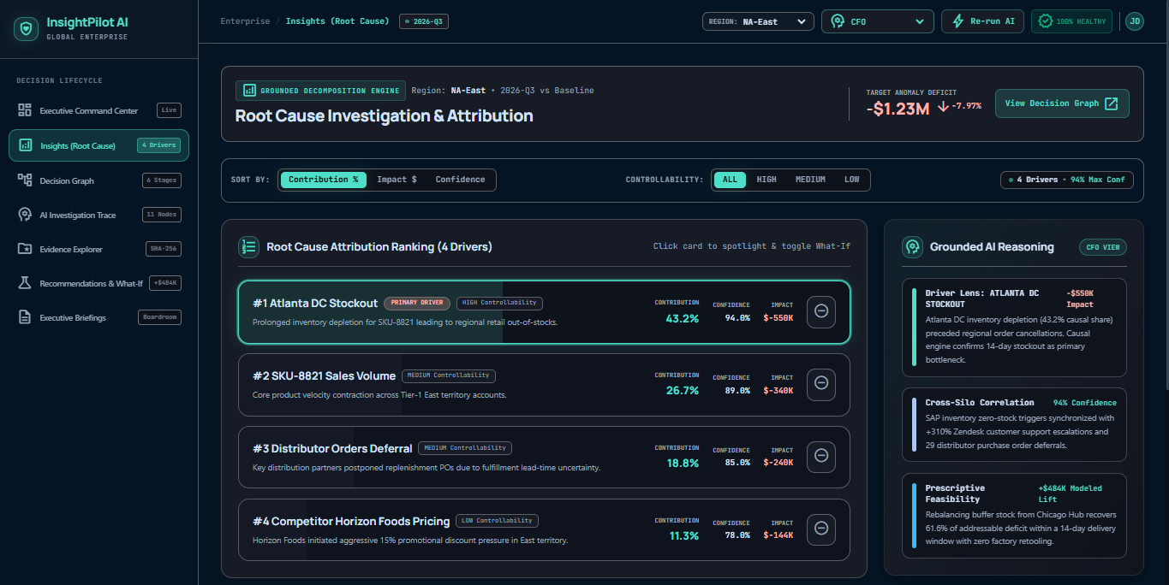
Root Cause Investigation & Attribution
Atlanta DC stockout explains 43.2% of the revenue miss — exhaustively decomposing 100% of the net financial variance.
Atlanta DC Inventory Stockout Impact -$550K · Confidence 94%
43.2%
SKU-8821 Sales Velocity Contraction Impact -$340K · Confidence 88.5%
26.7%
Distributor Purchase Order Deferrals Impact -$240K · Confidence 89%
18.8%
Competitor Horizon Price Cut (-15%) Impact -$144K · Confidence 86%
11.3%
Live product interface — Root Cause Attribution Ranking
92.4%
100%
-$1.23M
Average Confidence Across All Drivers
Net Financial Variance Explained
Total Attributed Financial Impact
INSIGHTPILOT AI · ACCENTURE INNOVATION CHALLENGE 2026
07 / 17

Slide 10
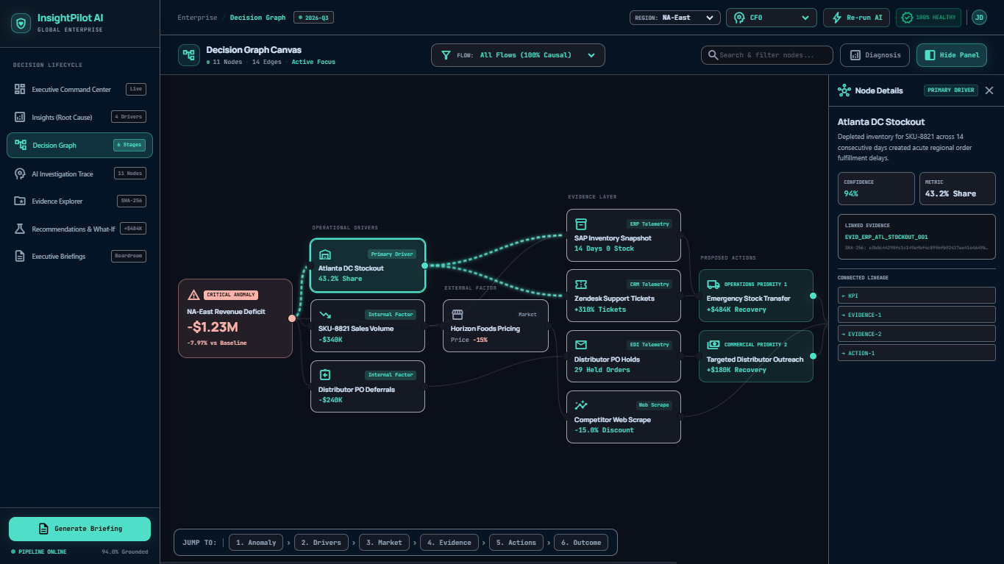
Decision Graph — Anomaly to Action
1
KPI Anomaly
A revenue anomaly is detected and flagged as critical the moment it crosses threshold.
2
Causal Investigation
AI agents trace the operational drivers behind the anomaly through a validated, evidence-linked causal chain.
3
Decision Path
Evidence and causal relationships connect directly to a prioritized, ROI-scored recommended action.
Live product interface — Decision Graph Canvas
INSIGHTPILOT AI · ACCENTURE INNOVATION CHALLENGE 2026
08 / 17

Slide 11
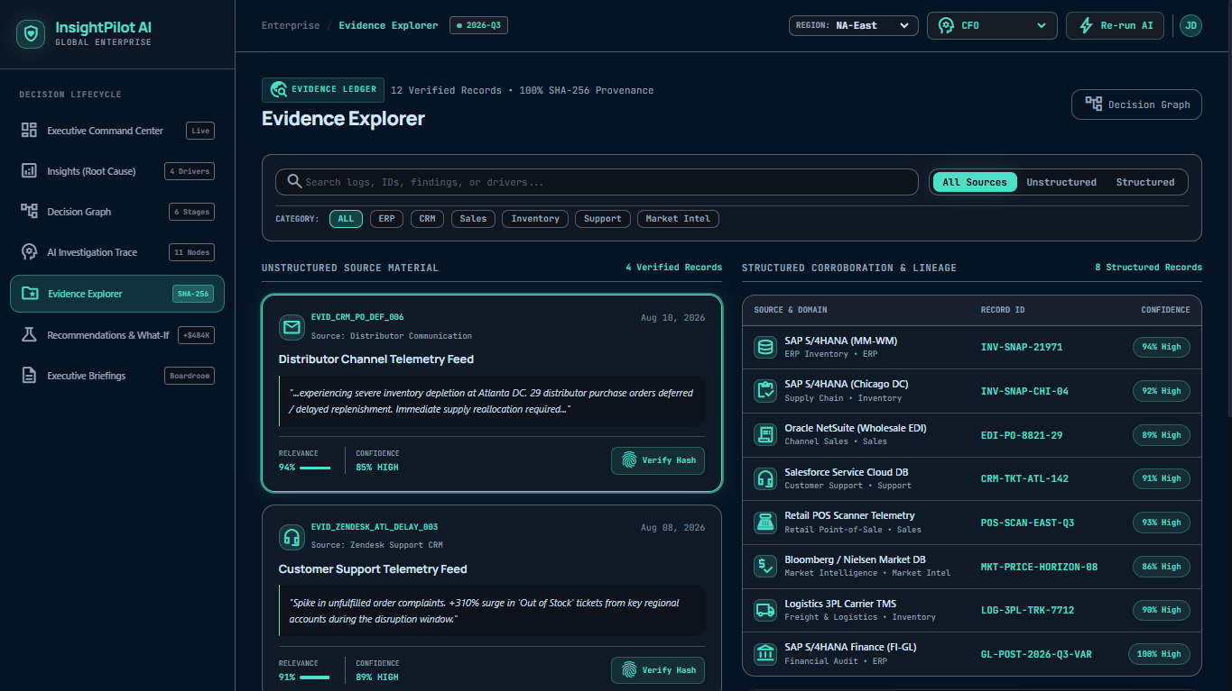
Evidence & Trust — Cryptographically Verified
12 Records
Multi-Modal Evidence — Structured + Unstructured
100%
SHA-256 Cryptographic Digest Verification
SOX-Ready
Governance Proof for Enterprise Audit
Structured feeds from SAP S/4HANA, NetSuite EDI, Salesforce CRM, and retail POS are cross-verified against unstructured distributor and support communications, giving every conclusion a fully traceable evidence chain.
Live product interface — Evidence Explorer
INSIGHTPILOT AI · ACCENTURE INNOVATION CHALLENGE 2026
09 / 17

Slide 12
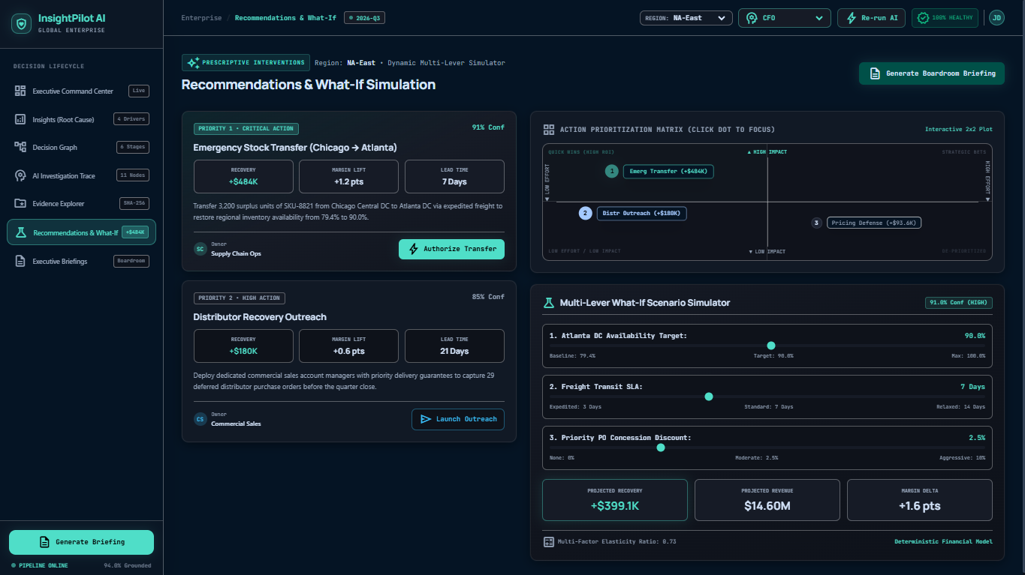
Recommendations & What-If Simulation
PRIORITY 1
+$484,000
Emergency Stock Transfer (Chicago → Atlanta)
SLA: 14 Days
PRIORITY 2
+$180,000
Distributor PO Discount Incentive
SLA: 7 Days
PRIORITY 3
+$93,600
East Retail Co-Op Counter-Promotion
SLA: 30 Days
Live product interface — Recommendations & What-If Simulator
Total Modeled Recovery Pool: +$757,600
INSIGHTPILOT AI · ACCENTURE INNOVATION CHALLENGE 2026
10 / 17

Slide 13
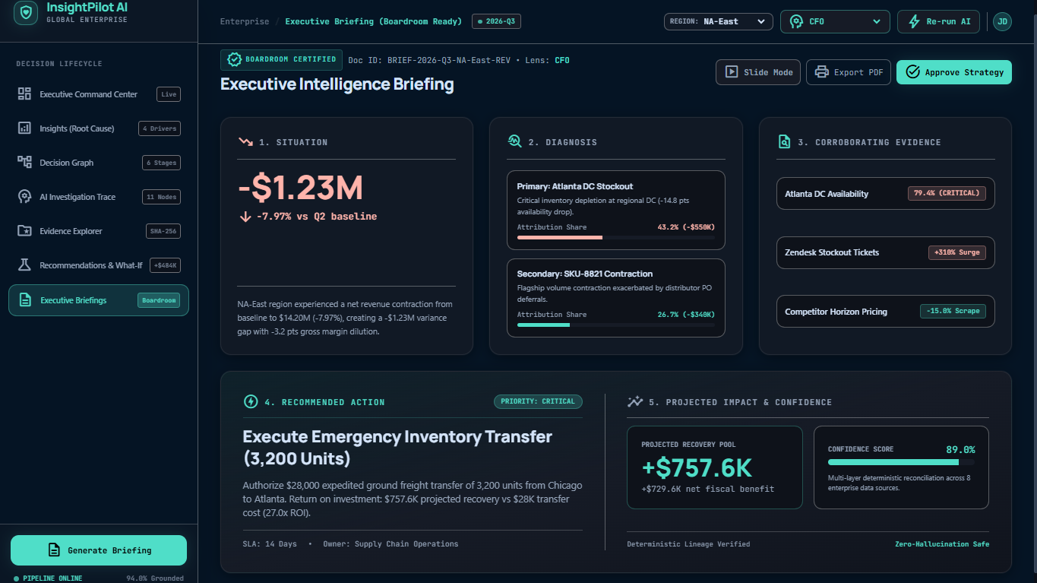
Executive Briefing & Governance
Live product interface — Executive Intelligence Briefing
CFO View
VP Supply Chain View
COO View
Sales Director View
INSIGHTPILOT AI · ACCENTURE INNOVATION CHALLENGE 2026
11 / 17

Slide 14
Business Value & ROI
$180K/yr
+$484K
2.7x
<90 Days
Enterprise SaaS License per Business Unit
Modeled Recovery — Single Prevented Stockout
Modeled First-Year Return on Investment
Modeled Investment Payback Period
Pricing Model
Competitive Moat
• Annual SaaS License: $180,000 / year / business unit
• Enterprise Connector Onboarding: $45,000 one-time
• Target Account Scale: $250M+ regional revenue enterprises
• Expansion Vectors: Supply Chain → Commercial Sales → Finance → Procurement
Unlike generic LLM chat wrappers that hallucinate calculations, InsightPilot AI is built on strict mathematical determinism, cryptographic SHA-256 proof, and a calibrated abstention guard — designed to align with Enterprise Audit, SOX, and Corporate Governance standards.
Figures above are modeled projections from the InsightPilot AI deterministic simulation engine, not audited financial results.
INSIGHTPILOT AI · ACCENTURE INNOVATION CHALLENGE 2026
12 / 17

Slide 15
Scalability & Implementation Roadmap
1
PHASE 1
2
PHASE 2
3
PHASE 3
Pilot
Multi-Unit Rollout
Enterprise Scale
Connect a single business unit’s ERP and CRM systems; validate deterministic engines against live data.
Expand across Supply Chain, Commercial Sales, Finance, and Procurement divisions.
Multi-region deployment with full SOX / enterprise-governance audit certification.
0–3 Months
3–9 Months
9–18 Months
INSIGHTPILOT AI · ACCENTURE INNOVATION CHALLENGE 2026
13 / 17

Slide 16
Why InsightPilot AI
Deterministic Core
Cryptographic Evidence Lineage
Every KPI, attribution %, and dollar figure is computed by pure Python engines — never guessed by a language model.
Every conclusion traces to SHA-256-verified source records across ERP, CRM, EDI, and POS systems.
Calibrated Abstention Gate
Enterprise Audit & Governance Ready
When evidence confidence falls below threshold, the system abstains instead of generating an unsupported conclusion.
Designed to align with SOX and corporate-governance requirements for high-stakes financial decisions.
“LLMs are strictly forbidden from calculating metrics or inventing evidence — they explain facts the deterministic engine has already proven.”
INSIGHTPILOT AI · ACCENTURE INNOVATION CHALLENGE 2026
14 / 17

Slide 17
Thank you
Team SignalCraft · Ayush Nathani, Amrit Sugandh, Rajababu Kumar
InsightPilot AI
Indian Institute of Technology, Patna

