Slide 1
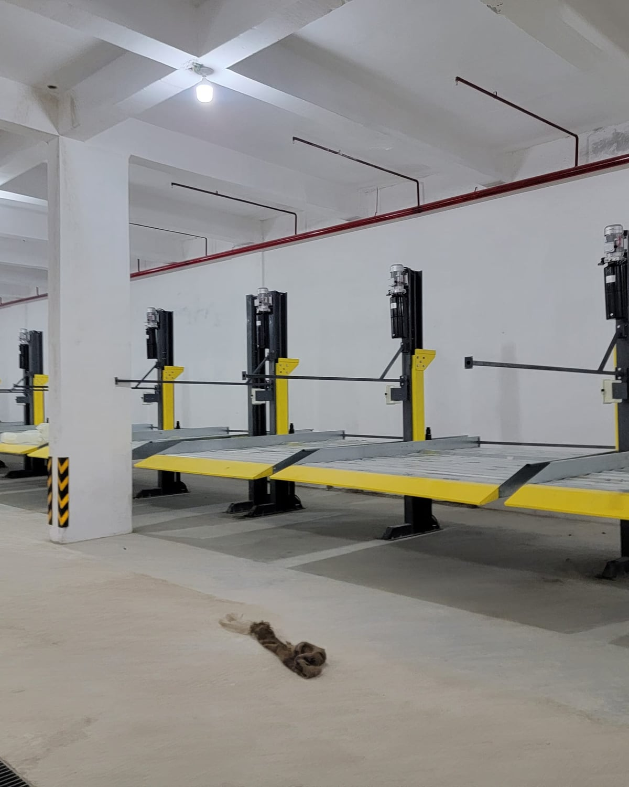
Automated car parking systems, designed and built in-house.
SmartPARX
Do it the smart way
COMPANY PROFILE
Two-post stackers · Heavy-duty · Puzzle · Pit · Custom
Ahmedabad, India · Since 2017 · ISO 9001:2015
Notes:
SmartPARX Parking Solutions LLP designs, manufactures and installs car parking systems from Ahmedabad. This profile covers who we are, the product range, planning guidance, manufacturing, projects and how to start a project.

Slide 2




2500+ parking systems installed since 2017
AT A GLANCE
2500+
70+
10+
2+5
Parking systems installed
Builder & enterprise clients
Two-level stacker models
Years warranty with AMC
ISO 9001:2015 certified
Two production units
Indigenous hydraulics
EV charging compatible
Technical training and quality control at the centre of every project.
In-house manufacturing at Vatva GIDC, Ahmedabad.
Cylinders and power units built through our Shalin Hydraulics partnership.
Every SmartPARX system supports EV charging provisions.
Notes:
Headline numbers from the SmartPARX brochure: 2500+ systems installed, 70+ clients, 10+ two-level stacker models, and a 2-year zero-pay warranty plus 5 more years with an AMC.

Slide 3
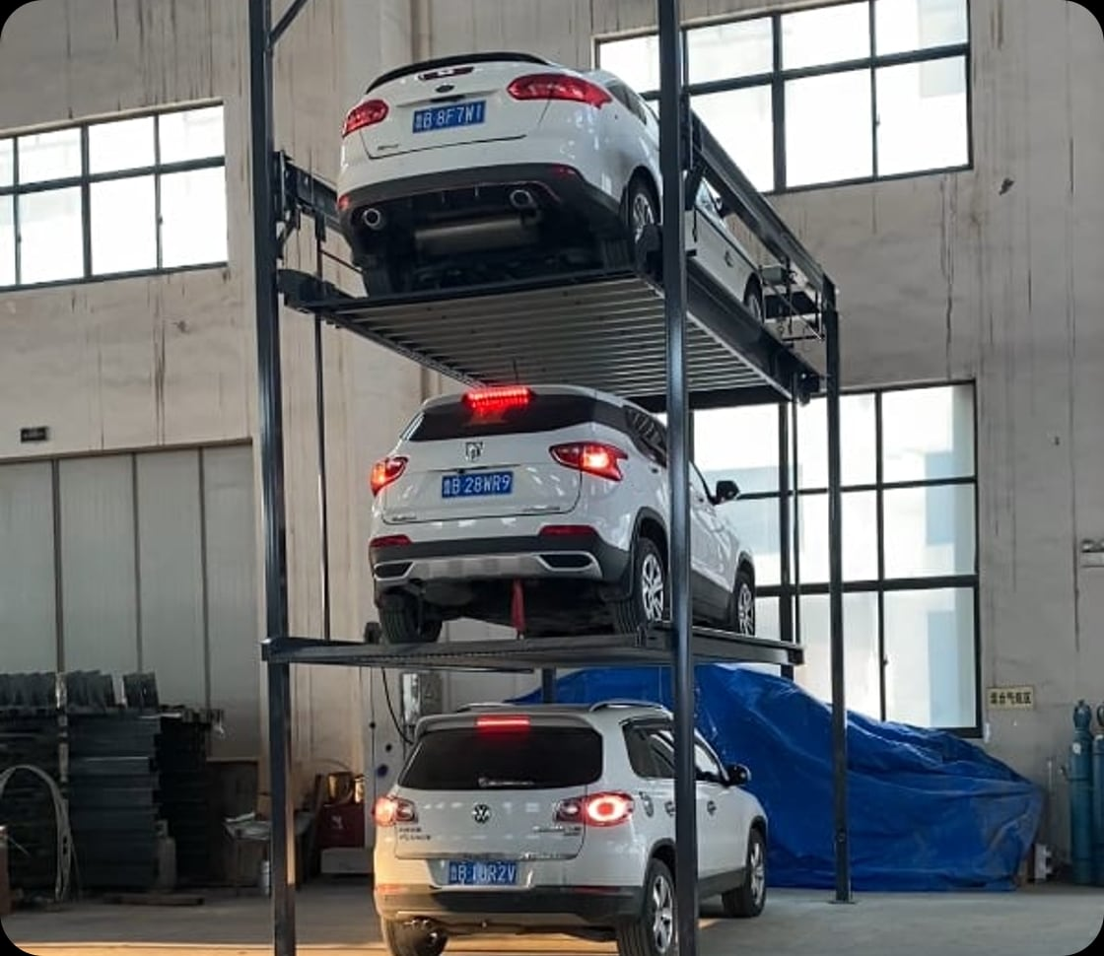
Specialists in one thing: fitting more cars
ABOUT US
SmartPARX is a specialty car parking manufacturing brand, established in 2017 and founded by Mr. Aakash Contractor. We design, manufacture and execute customised parking equipment.
Our partnership with Shalin Hydraulics makes us the only brand in the market with indigenous hydraulic solutions and an in-house manufacturing plant.
From stacker parking to tower, puzzle and pit systems, our engineers and technicians work to ISO 9001:2015, with quality control built into every step.
Notes:
Founded 2017 by Aakash Contractor. Key differentiator: indigenous hydraulics through Shalin Hydraulics plus our own manufacturing plant, so cylinders, power units and structures are built and tested under one roof.

Slide 4






Six reasons developers choose us
WHY SMARTPARX
Dynamic, robust design
Built in-house
Quick, accurate installation
In-house R&D team and state-of-the-art engineering practice. Zero tolerance on quality.
Steel, cylinders and power units made in our two Ahmedabad units.
Installed right the first time, so service calls stay rare.
Customisation
Widest range
2 + 5 year warranty
Parking lifts from 1.8 m to 10 m, built around walls and D-walls.
The only company offering 10+ two-level stacker models.
2 years zero-pay warranty, plus 5 more years with an AMC.
Notes:
Brochure differentiators: robust in-house design, in-house manufacturing, quick installation, customisation from 1.8 m to 10 m, the widest range (10+ models) and the 2 + 5 year warranty.

Slide 5
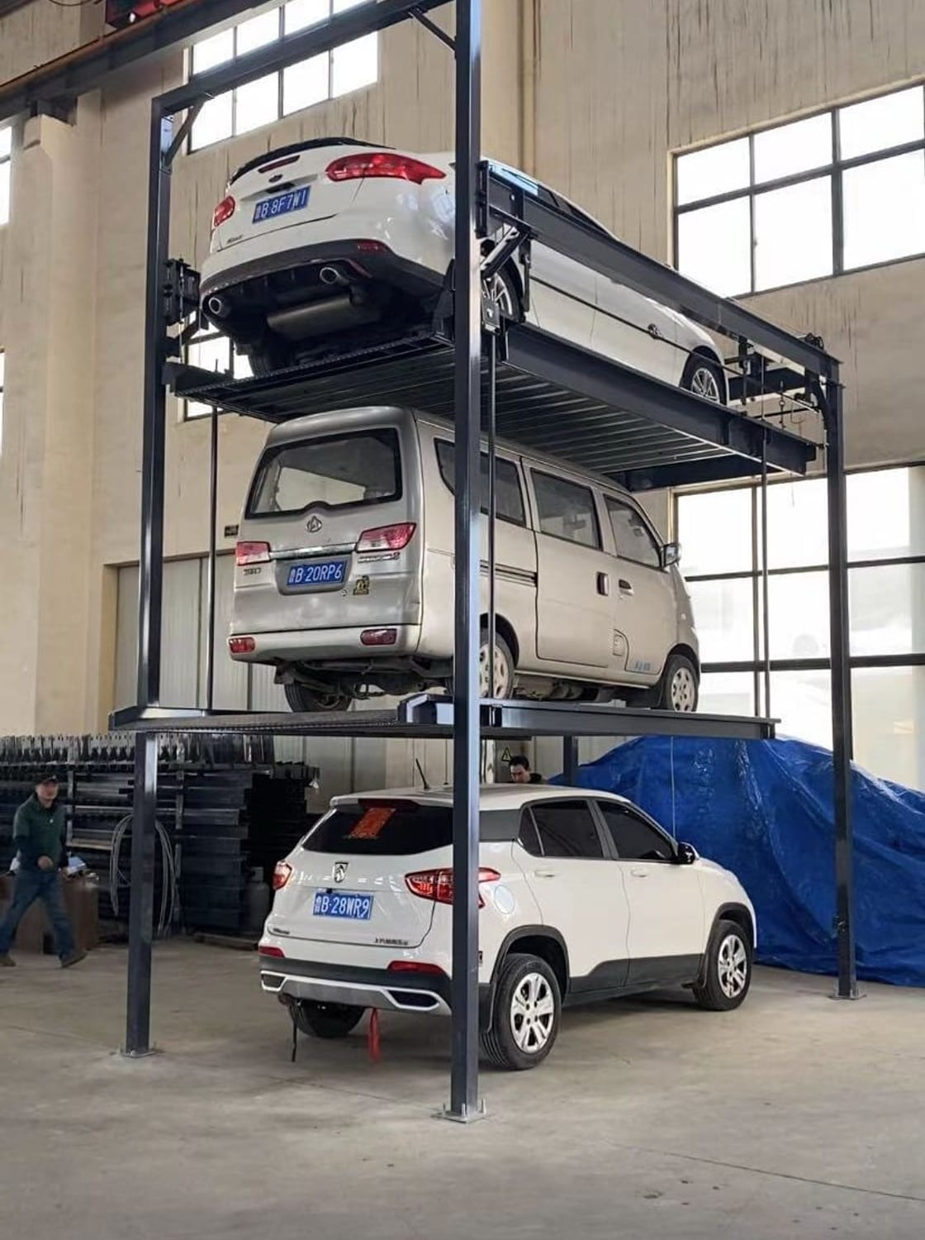
Product range
01
Twelve systems across four families: two-post stackers, heavy-duty, multi-level and puzzle, and specialised builds.
Notes:
The range covers two-post stackers (Economy, Premium, Premium+, Luxury+), heavy-duty systems (2L3PS+, four-pole suspended), multi-level and puzzle systems (puzzle, TPP+ three-level, pit) and specialised builds (single post, two-wheeler, customised).

Slide 6
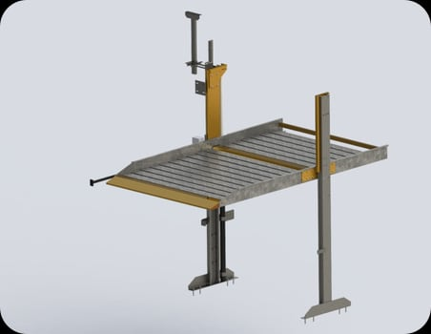
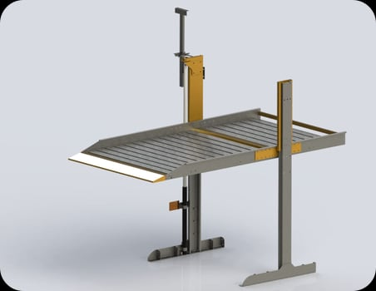
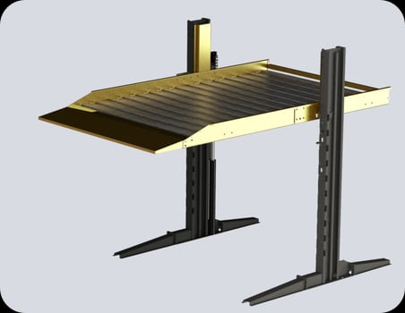
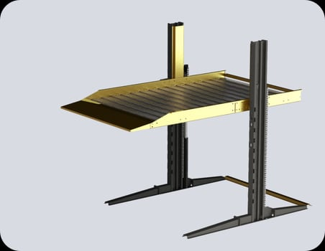
Four models, one for every car and budget
TWO-POST STACKERS
 | Economy | Premium | Premium+ | Luxury+
Variants | DPE01–06 | DPP01–03 | DPP+ | DPL+
Lifting capacity | 2,000 kg | 2,300 kg | 2,500 kg | 2,700 kg
Reverse parking | Up to 1,450 kg | Up to 1,800 kg | Up to 2,000 kg | Up to 2,350 kg
Base length | 1000 mm | 1800 mm | 2500 mm | 3200 mm
System weight | 700 kg | 800 kg | 880 kg | 1020 kg
Lift mechanism | Telescopic cylinder + balancing chain | Larger telescopic cylinder, Italian DAS seals | Single-stroke cylinder, 2:1 chain | Dual cylinders + dual chains
Finish | Enamel, red-oxide primer | All-weather PU, zinc epoxy | Powder coat; HDG on request | Powder coat; HDG on request
Notes:
All four share platform widths of 2100–2400 mm (Luxury+ 2200–2400) and a 3 HP motor. Premium+ and Luxury+ use robotic-welded heavy-gauge columns with extra-long bases, so no upper supports or slab punctures are needed.

Slide 7
Choose by the heaviest car, and whether it parks in reverse
CHOOSING A MODEL
Load limits by model (kg)
3,000
Everyday sedans
2,700
Economy lifts up to 2,000 kg for budget-friendly projects.
2,500
2,300
2,350
2,000
2,000
2,000
1,800
Reverse parking
1,450
Premium and Premium+ raise the reverse limit to 1,800 and 2,000 kg.
1,000
Luxury cars & SUVs
Luxury+ lifts 2,700 kg, load-tested to 3 tonnes for reverse parking.
0
Economy
Premium
Premium+
Luxury+
Lifting capacity
Reverse parking limit
Notes:
Reverse parking puts more load on the cantilever, so each model has a lower advised limit for reverse-parked cars. Figures from the brochure spec sheets.

Slide 8
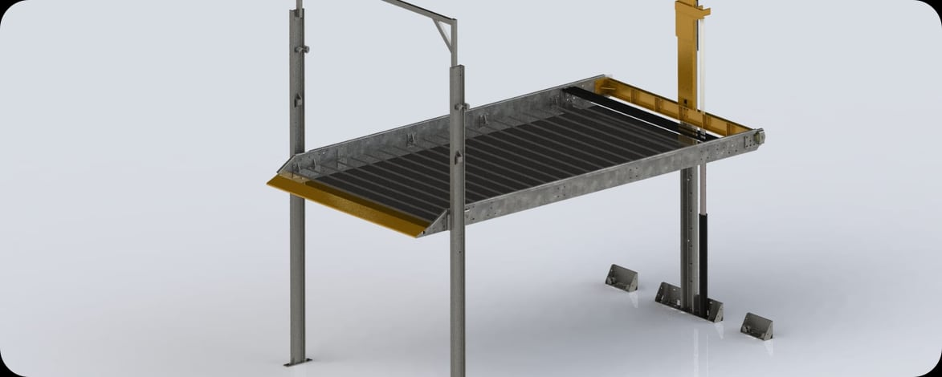
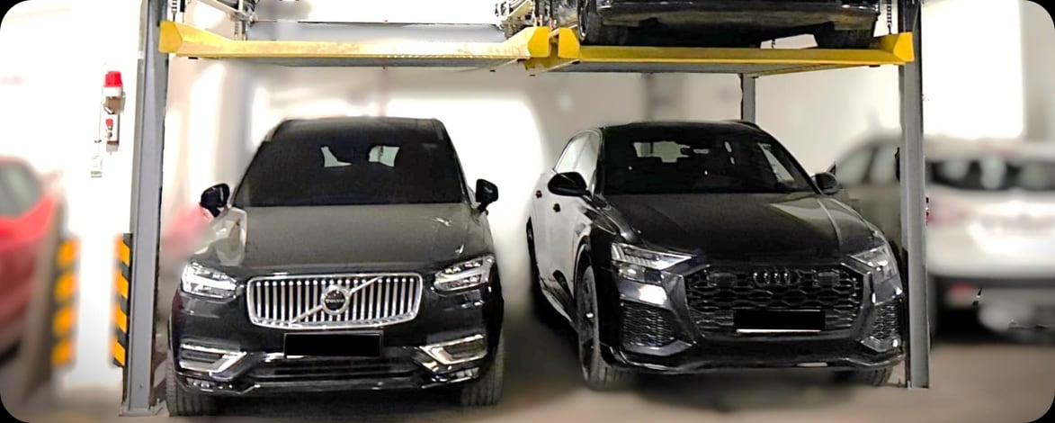
Structural-steel frames for wide platforms and long spans
HEAVY-DUTY SYSTEMS
Three Pole System 2L3PS+
Four Pole Suspended (2×2 / 2×3)
CAPACITY
STRUCTURE
CAPACITY
STRUCTURE
2,500 kg
ISMB 150 × 75 columns, ISMC channel
2,200 / 2,700 kg
I-section / H-beam frame
PLATFORM
DRIVE
PLATFORM
DRIVE
2,200 – 2,700 mm
Telescopic cylinder, double rope, 3 HP
2,100 – 2,700 mm
Motor gearbox 3 / 5 HP, 4-way lifting
WEIGHT
WEIGHT
1,080 kg
550 kg per car space
Notes:
Both support add-ons: limit switch, car presence, height and length sensors, EV charging provision and wider platforms. All-weather powder coating with zinc epoxy primer; hot-dip galvanizing on request.

Slide 9
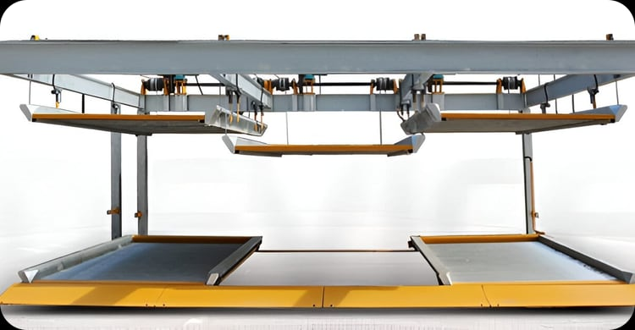
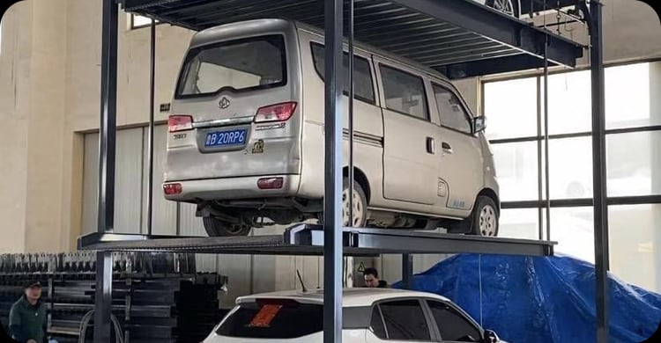
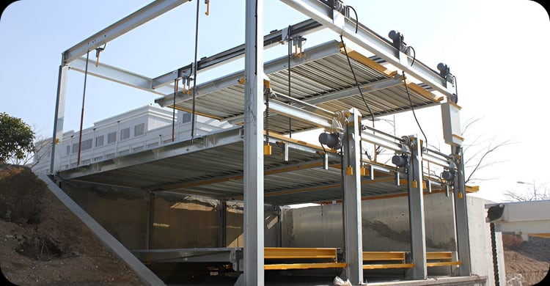
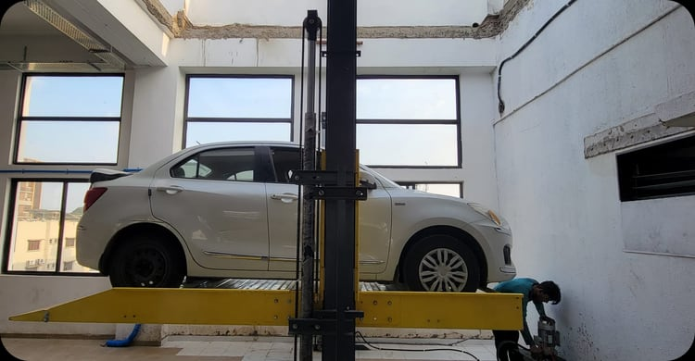
More levels, tighter sites, unusual structures
MULTI-LEVEL, PUZZLE & SPECIALISED
ALSO FOR TIGHT SPACES
Single Post
2,000 kg · 2,100 mm platform. One laser-cut column for bays against walls or D-walls.
Puzzle Parking
Motorised pallets; any car on demand
Three Level TPP+
Three cars in one bay
Two Wheeler
300 kg · 800 – 1,400 mm platforms on shared hydraulic lines. Doubles bike parking.
Before or after BU/OC
Specialised systems can be installed before or after permission, fitted around existing structure.
Pit / Pit-Puzzle
2,000 / 2,500 kg, below grade
Customized
Lifts from 1.8 m to 10 m
Notes:
Puzzle and three-level specifications are configured per site after a survey. Pit systems suit sites where overhead clearance is limited.

Slide 10
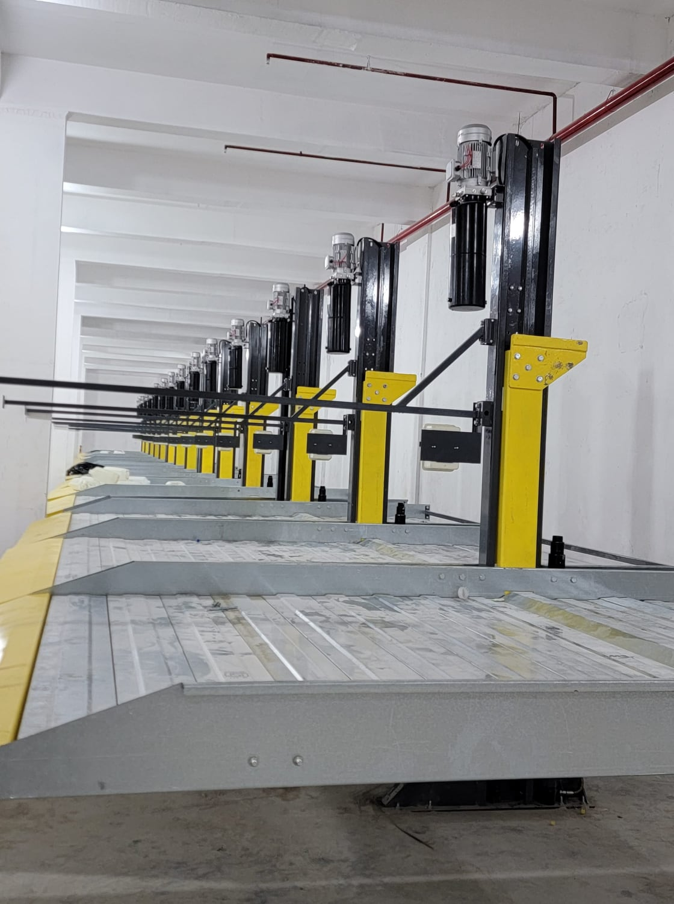
Planning & safety
02
The clear heights, column spacing and driveway widths our engineers plan for, and the protections built into every system.
Notes:
Planning guidance from the brochure stacker guidelines, followed by built-in safety features and house rules for residents.

Slide 11
Will it fit? Clear height, width and driveway
STACKER PLANNING GUIDE
SEDAN + SEDAN
SUV + SEDAN
SUV + SUV
5,150 mm
3,400 mm
3,800 mm
4,300 mm
Bay length for cars up to 5 m (4,000 + 700 front)
Clear height · lower level 1,700 mm
Clear height · lower level 2,100 mm
Clear height · lower level 2,100 mm
5,500 mm
Minimum driveway
Width between columns (mm)
6,000 mm
Usable platform | 1 bay | 2 bays | 3 bays
2,100 mm | 2,480 | 4,960 | 7,440
2,200 mm (recommended) | 2,580 | 5,160 | 7,740
2,300 mm | 2,680 | 5,360 | 8,040
2,400 mm | 2,780 | 5,560 | 8,340
Driveway for cars longer than 4.7 m
2,200 mm
Recommended minimum platform width
Notes:
Heights exclude fire-suppression pipes, plumbing and other services. Column clearance varies ±100 mm between standard models. A free site survey confirms the final layout.

Slide 12



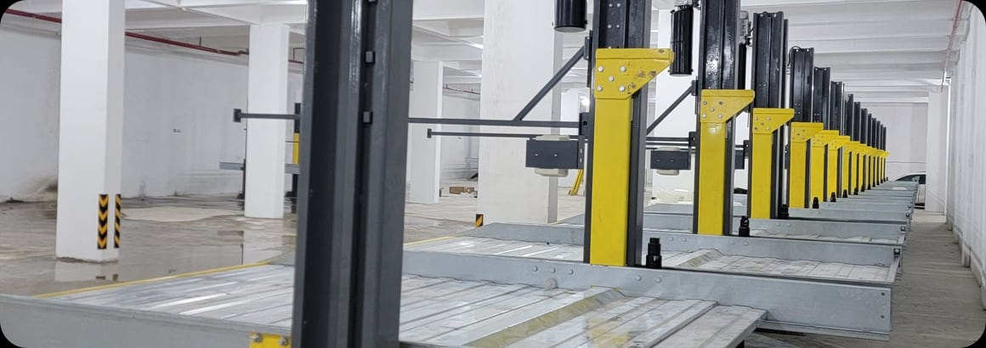
Three protections built into every system
SAFETY
Auto-lock on both columns
Height-adjustable limit switch
Presence + height sensors
Spring-return mechanical locks hold the platform if hydraulics ever fail or leak. Standard on every model.
Prevents motor overload and over-travel, and sets the top position to your slab or beam.
Stops the platform lowering onto a parked car, and stops tall cars touching the slab or services.
House rules for drivers
Drive onto the platform at 5–10 km/h
The car must touch the platform stop bar
Never wash cars on or below the platform
Keep approach slopes at 4% or less
Keep column anchors out of standing water
Notes:
The three built-in protections are standard. The house rules come from the brochure and should be shared with residents and drivers at handover.

Slide 13
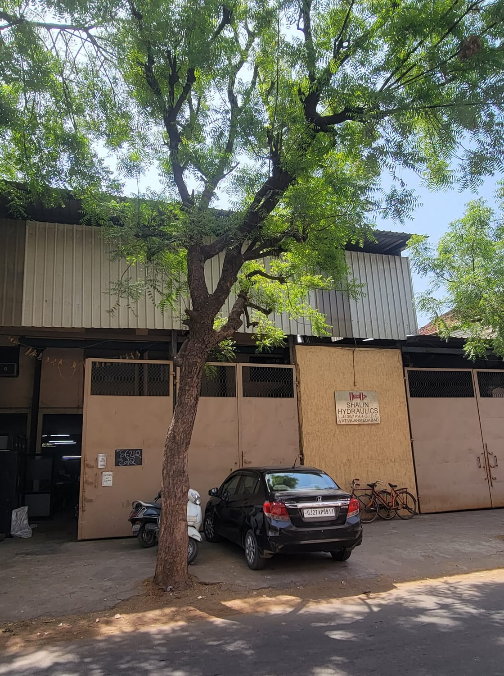
Made in Ahmedabad
03
How we build, where we have installed, and who trusts us.
Notes:
Manufacturing process, installations and clients.

Slide 14
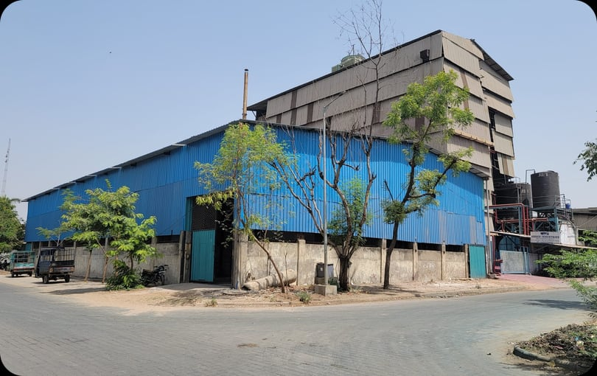
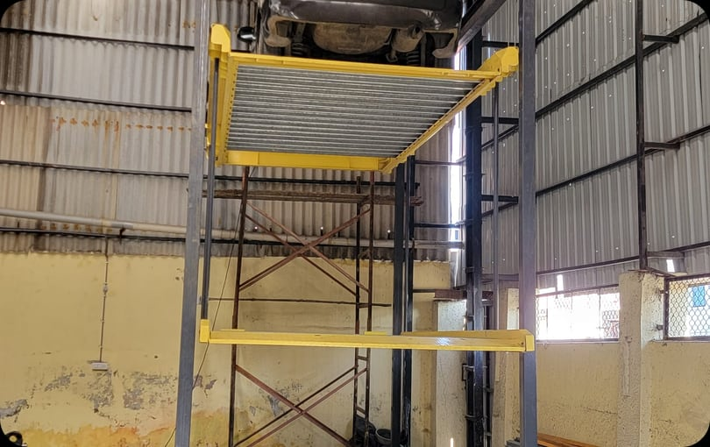
We make the steel and the hydraulics
MANUFACTURING
A fleet of Indian, American, Chinese, Swiss and German machinery, from laser cutting to honing. Every power unit is tested for its maximum rated capacity before it leaves the plant.
Unit 1 · Vatva GIDC, Phase-IV
Frames fabricated in-house
01
Laser / plasma cutting
02
Shearing & bending
03
Robotic / MIG welding
04
CNC turret / VMC
05
Honing
06
Fabrication
07
Assembly
08
Coating & paint
09
Testing
10
Packaging & delivery
Notes:
Ten-step in-house process from the brochure: cutting, forming, welding, machining, honing, fabrication, assembly, coating, testing and delivery.

Slide 15
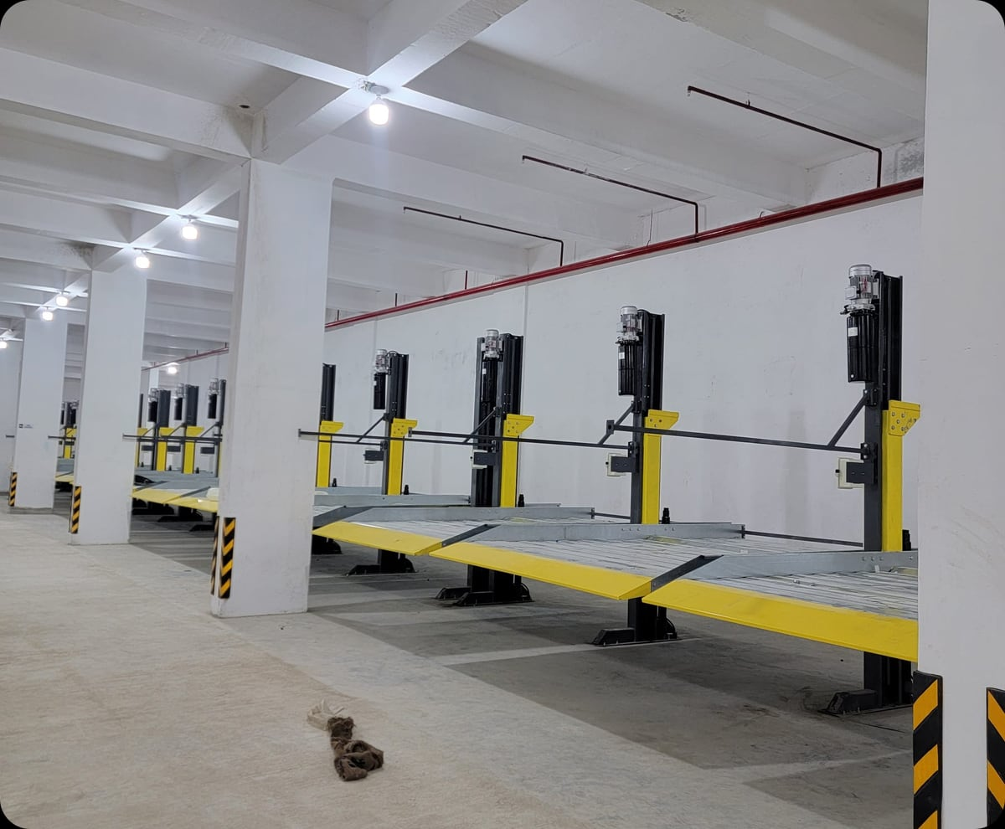
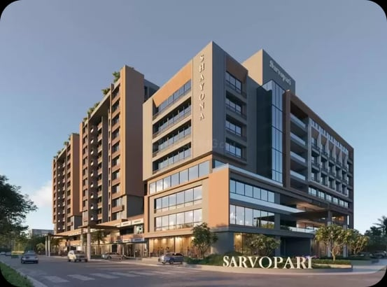
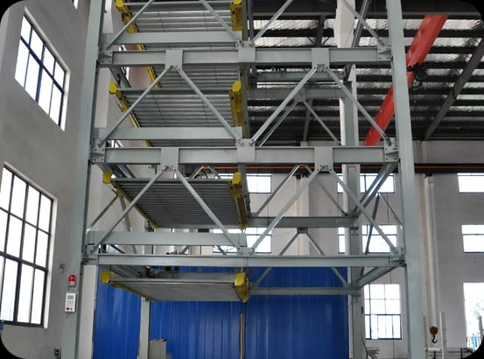
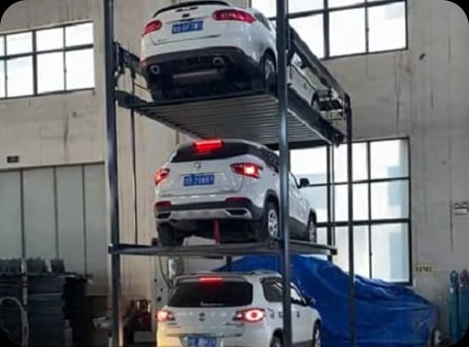
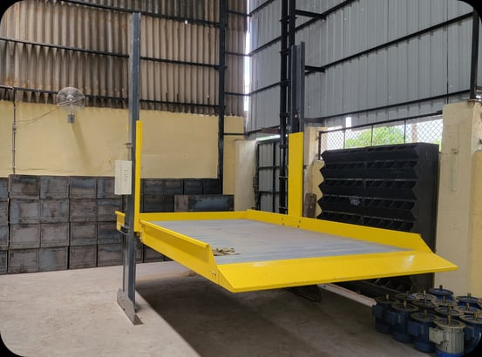
Installed across residential and commercial sites
PROJECTS
Sarvopari, Chanakyapuri — Shayona Group
Multi-level puzzle structure
Three-level TPP+ stacker
Two-post stacker
Notes:
A selection of installations. More photos at smartparx.com/projects.

Slide 16











Trusted by 70+ developers and enterprises
CLIENTS
“We chose SmartPARX again for our 1200 luxury apartments near Naranpura.”
Shri Mayur Gurjar, Partner, Gunatit Infrastructure
“Over 550 parking spaces across multiple developments. We value their honest, transparent approach.”
Shri Kanu Patel, Chairman, Avirat Group
“Used daily at The Obelisk for six years. They’ve consistently honoured the AMC.”
Shri Sunil Modi, Partner, Sanelite Group
Notes:
Testimonials are from the SmartPARX brochure. Confirm written permission from each client before external distribution.

Slide 17
One team from site survey to service
WARRANTY & SERVICES
01
Site survey & feasibility
2+5
Clear height, column spacing and driveway checked against our guidelines.
02
Customised design
Lifts from 1.8 m to 10 m, built around walls and D-walls.
years of cover
03
In-house manufacturing
2 years zero-pay warranty as standard, plus an additional 5 years with an AMC contract.
Two Ahmedabad units and indigenous hydraulics.
04
Installation & commissioning
Our own crews anchor, align, load-test and train your team.
Excludes damage from water logging, debris, theft, fire and natural events.
05
Warranty & AMC
Scheduled maintenance that keeps systems running safely.
Notes:
SmartPARX is the only company offering a 2-year zero-pay warranty plus 5 more years with an AMC.

Slide 18
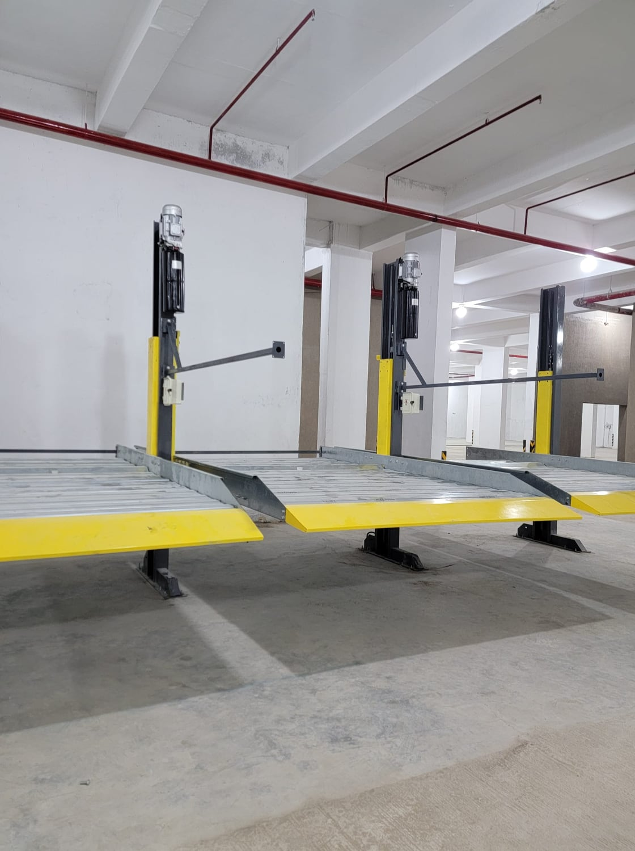
SmartPARX
Do it the smart way
Let's plan your parking
Book a free site survey and quotation with our engineering team.
CALL / WHATSAPP
+91 99250 36201 · +91 97129 37203
EMAIL
info@smartparx.com
HEAD OFFICE
302, Atlantis One, Sagar Sangeet Cross Roads, Ahmedabad 380060
FACTORY
C1/4524-2, Vatva GIDC, Phase-IV, Ahmedabad 382445
www.smartparx.com
Notes:
Close with the free site survey offer and contact details. Leave this slide up during Q&A.

