Slide 1
Configuring and Securing a Network Infrastructure
Cyber Security Minor Project
By: Ayush Kumar Sharma

Slide 2
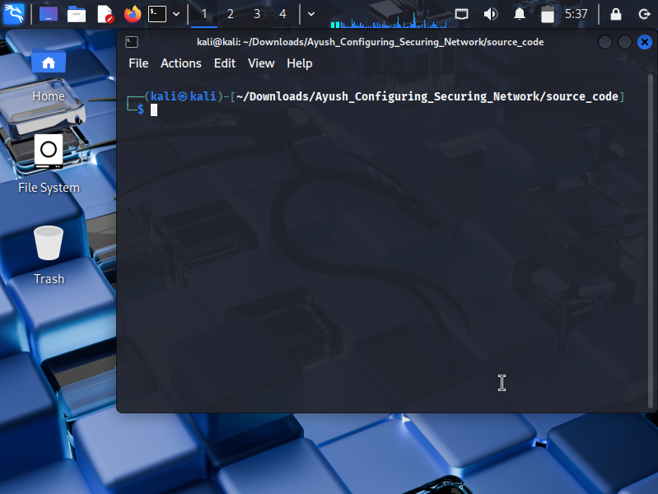
Firewall Configuration
Initial firewall setup using iptables. Rules defined for SSH, HTTP/HTTPS, DNS, and logging.

Slide 3
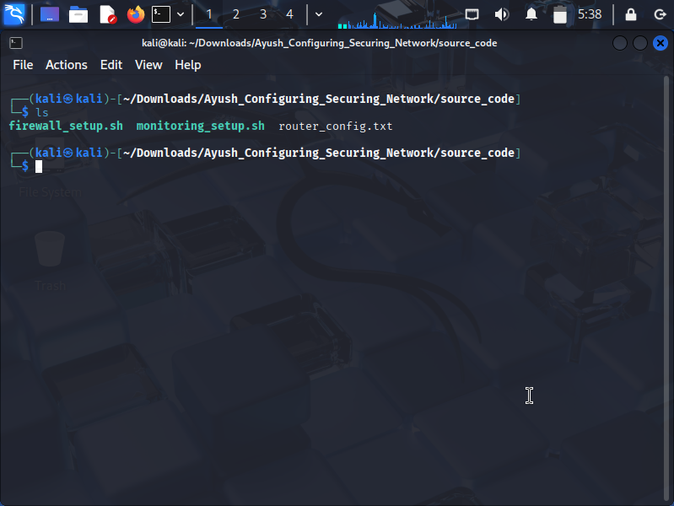
Terminal Interface – Routing/Rules
CLI output showing router and NAT configuration commands.

Slide 4
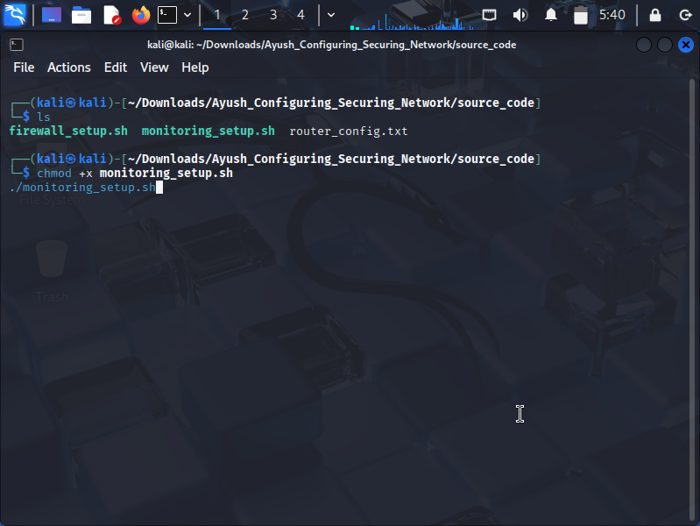
Monitoring Tools Installation
Setup of Netdata and iftop monitoring tools using Bash script.

Slide 5
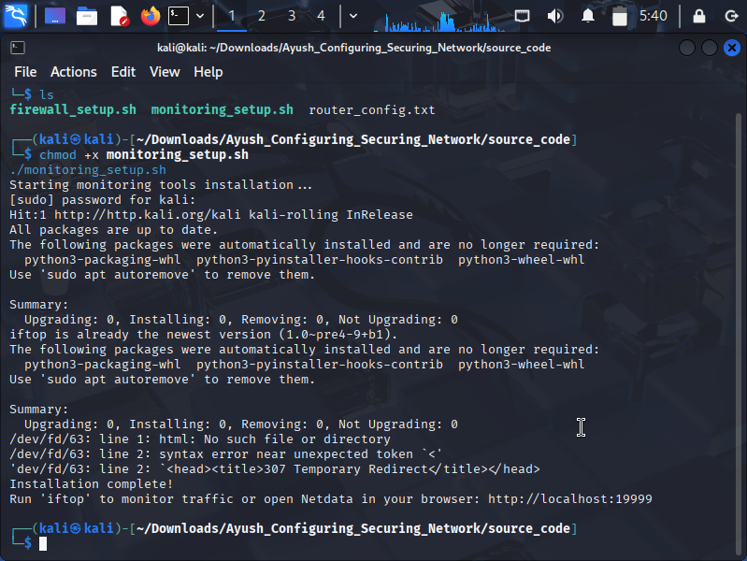
System Monitoring - Netdata
Web-based dashboard displaying real-time CPU, memory,
and traffic usage.

Slide 6
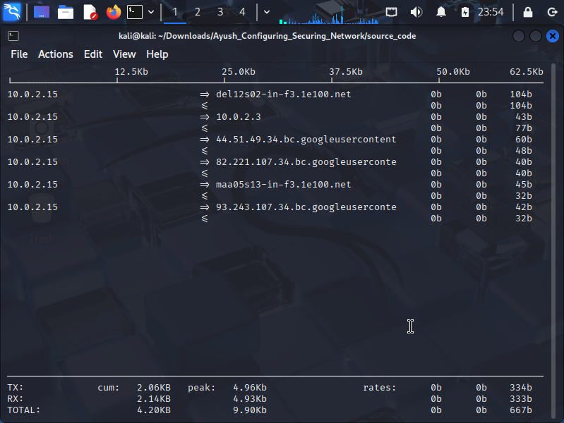
Live Network Monitoring
Terminal-based network bandwidth analysis with iftop.

Slide 7
Thankyou

