Slide 1

Test Integration Engine
Automated UI & API Testing Framework
Ayush

Slide 2
Project Objective
Automate Testing
Reduce Effort
Eliminate manual UI and API testing processes
Minimize repetitive manual testing workloads
Parallel Execution
Centralized Reporting
Run multiple test suites simultaneously
Unified reporting for all test results

Slide 3

Framework Overview
What is It?
Complete automation testing framework
Unified platform for UI and API testing
Enhanced efficiency and accuracy
Built on Spring Boot foundation

Slide 4
Core Technologies
Java & Spring Boot
Selenium WebDriver
REST-Assured
Backend framework for REST APIs and application logic
UI automation for web application testing
API testing library for RESTful services validation
MySQL Database
Chart.js & Thymeleaf
Persistent storage for test results and execution data
Dynamic reporting and interactive dashboard rendering

Slide 5
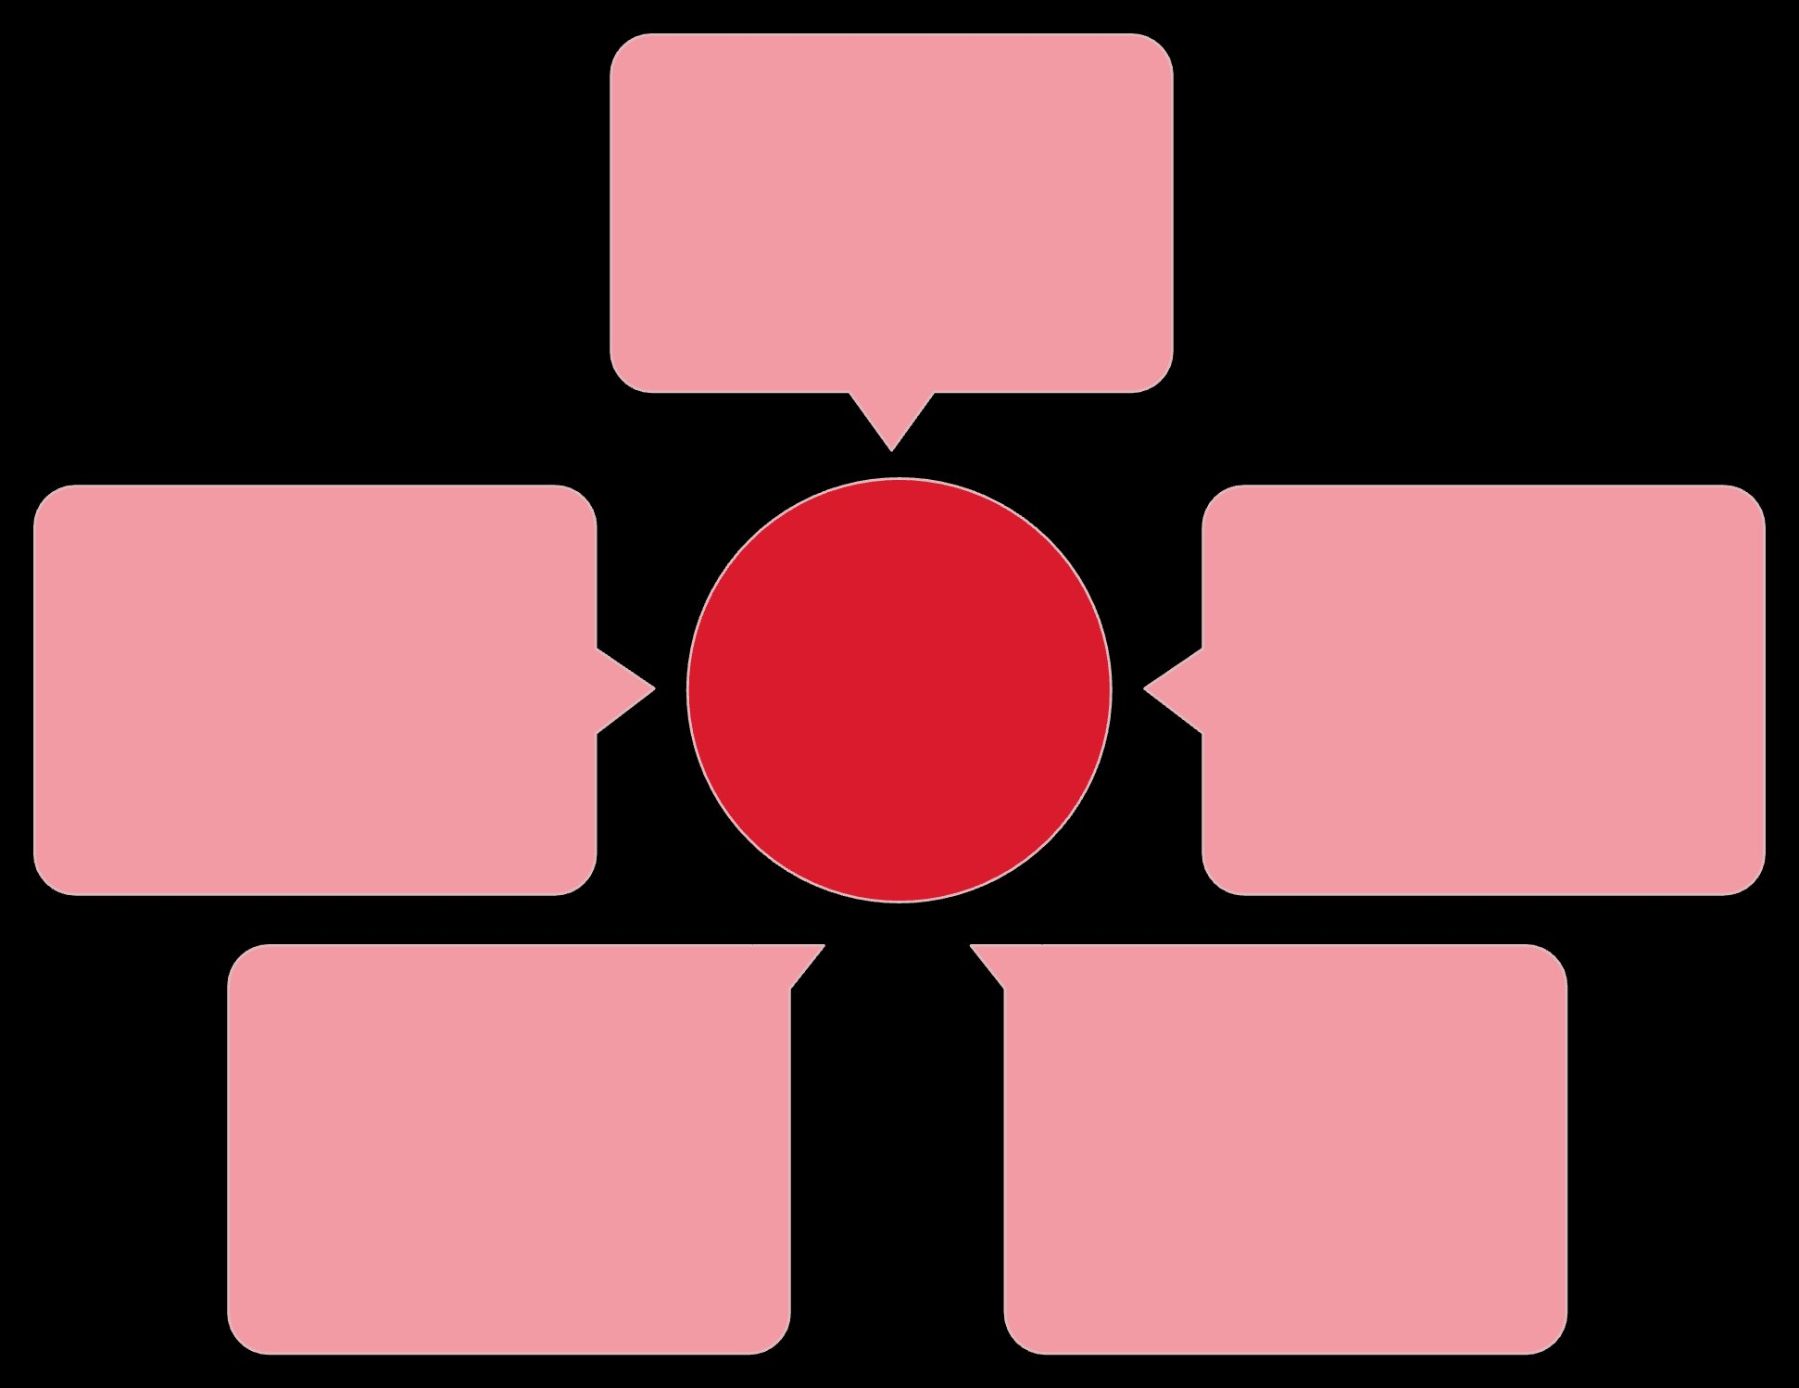
System Architecture
Frontend Dashboard
User interface for testers
Report Generation
Modular Test Architecture
Backend APIs (Spring Boot)
Aggregates results into reports
Business logic and endpoints
MySQL Database
Test Execution Engine
Persistent test results storage
Runs and manages test suites
Modular architecture enabling seamless integration between testing components and data persistence layers

Slide 6





Data Flow Process
UI Layer
Dashboard accepts test configurations
API Layer
REST endpoints process requests
Execution Engine
Runs Selenium and API tests
Database
Stores results in MySQL
Reports
Generates visual analytics

Slide 7
Key Modules
Selenium Test Runner
1
Executes automated UI tests across multiple browsers and platforms
API Test Runner
2
Validates REST endpoints with request/response verification
Test Executor
3
Manages test suite execution and result collection
Scheduler
4
Configures automated test runs with cron-based triggers
Reporting & Analytics
5
Generates HTML, CSV reports with visual dashboards

Slide 8
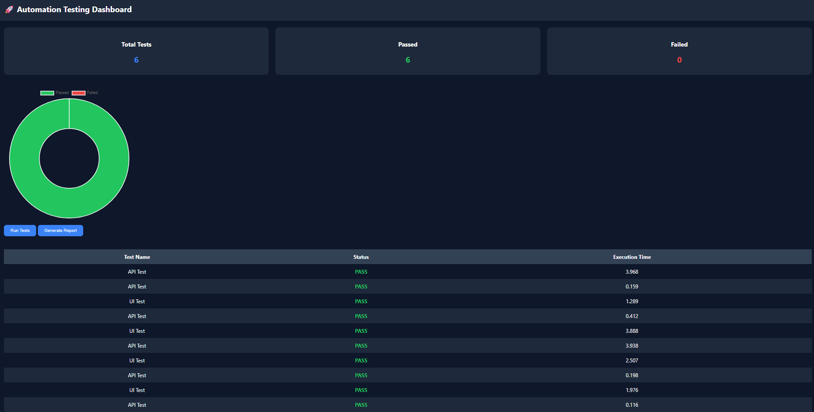
Dashboard & Results

Slide 9
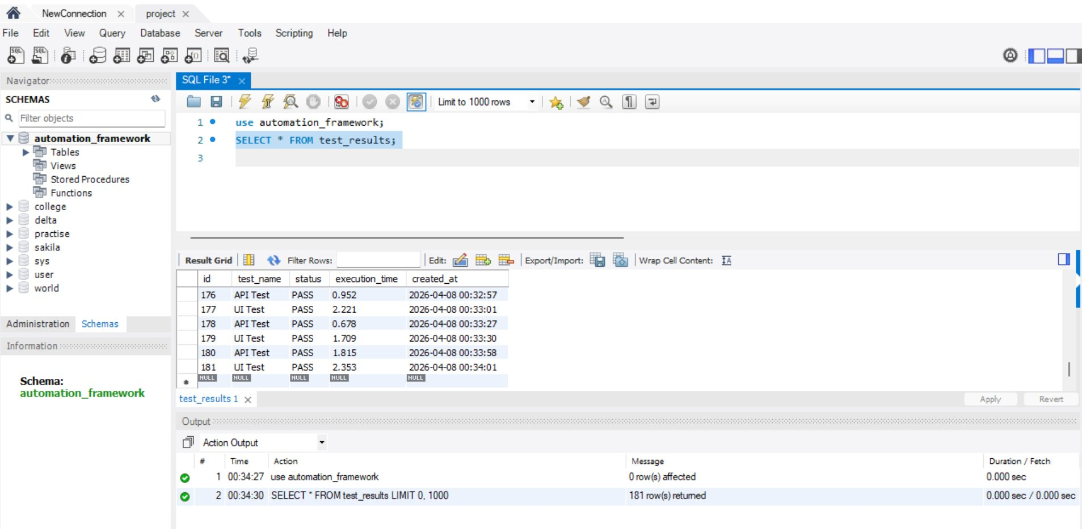
Database

Slide 10
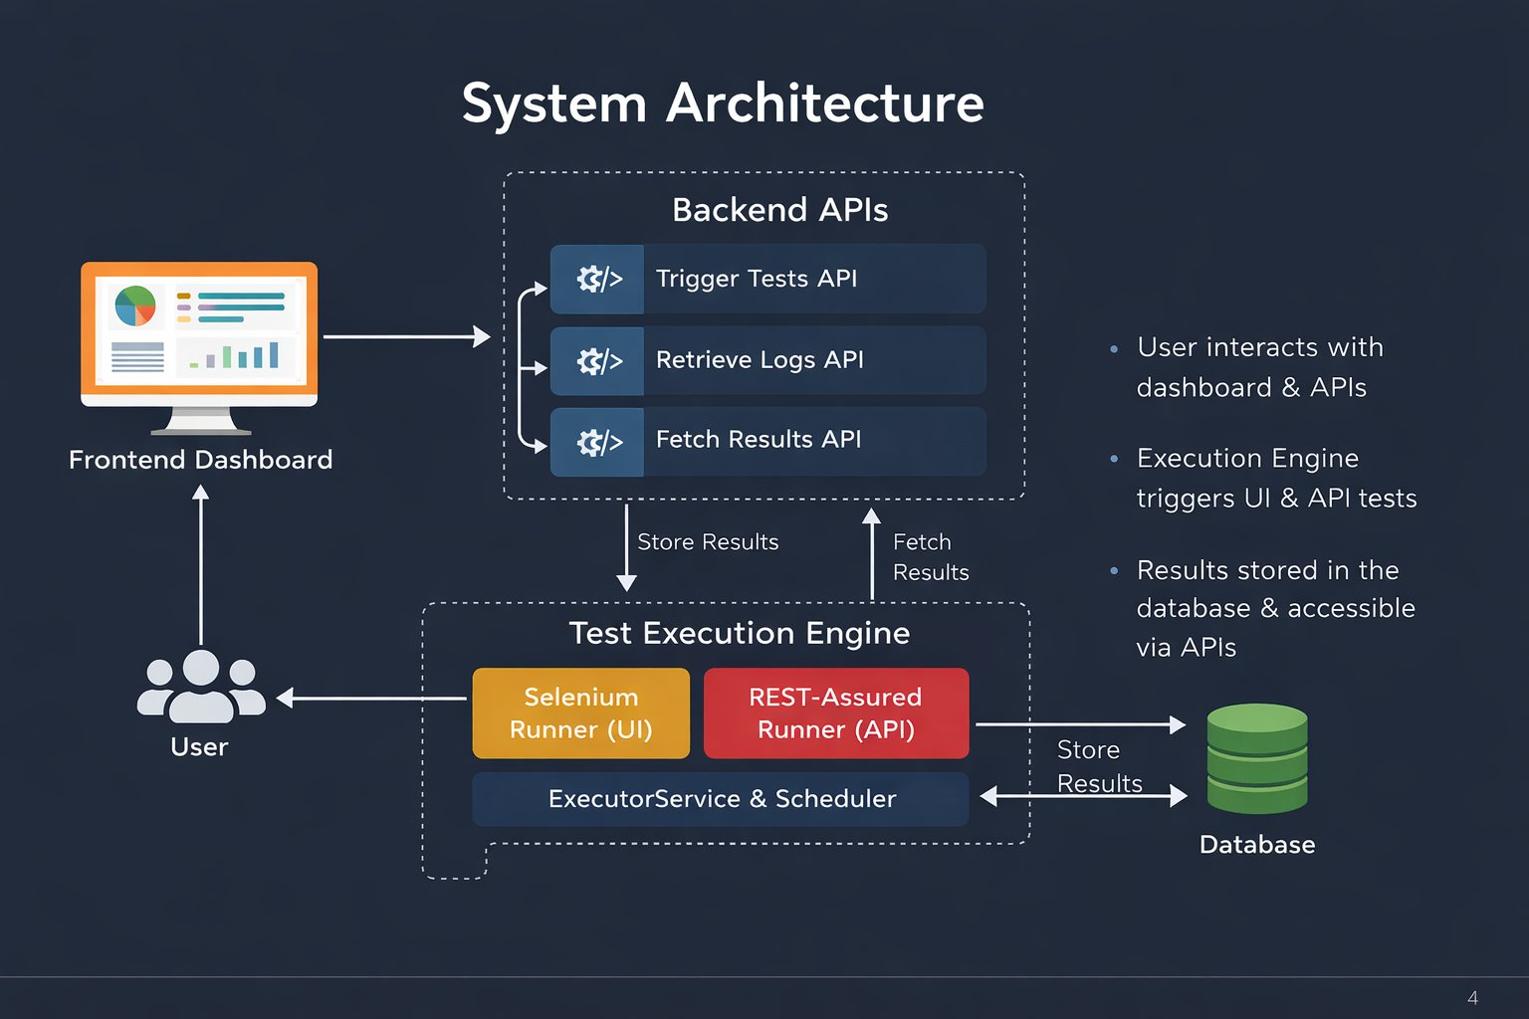
System Architecture

Slide 11
Key Achievements
01
02
Complete Framework
UI + API Integration
Built fully functional automation framework from ground up
Seamlessly combined both testing types in single platform
03
04
Enhanced Efficiency
End-to-End Testing
Significantly reduced testing time and manual effort
Achieved complete test coverage across all layers

Slide 12

Thank You
Questions?

