Slide 1
Hindi Chunking using XLM-RoBERTa
Token Classification Project Summary
By : Ayush Sharma
22075017
CSE B-Tech

Slide 2
1. Introduction
Objective: Develop a chunking model for Hindi using XLM-RoBERTa.
Chunking: Grouping tokens into syntactic units (NP, VP, etc.).
Dataset: Hindi UD Treebank (HDTB).
Categories: NP, VP, ADJP, ADVP, PP, Other.

Slide 3
2. Dataset and Preprocessing
Dataset: Hindi UD Treebank (HDTB).
Preprocessing Steps:
1. Trim CONLL-U files to retain key columns.
2. Extract tokens, UPOS, and dependency relations.
3. Generate BIO chunk labels.
Chunk Categories:
['CCP', 'NEGP', 'JJP', 'BLK', 'VGNF', 'FRAGP', 'NP', 'VGNN', 'VGF', 'RBP']

Slide 4
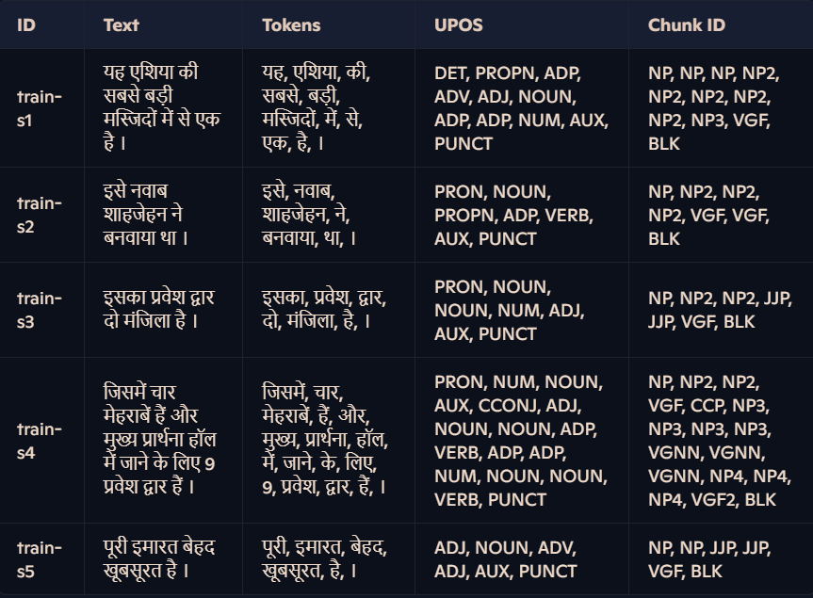
2.1 Dataset

Slide 5
2.2 UPOS TAGS AND BIO CHUNK LABELS
ID | UPOS Label
0 | PROPN
1 | ADP
2 | ADJ
3 | PUNCT
4 | PART
5 | X
6 | SCONJ
7 | AUX
8 | CCONJ
9 | DET
10 | ADV
11 | NOUN
12 | VERB
13 | NUM
14 | INTJ
15 | PRON
ID | BIO Chunk Label
0 | O
1 | B-CCP
2 | I-CCP
3 | B-NEGP
4 | I-NEGP
5 | B-JJP
6 | I-JJP
7 | B-BLK
8 | I-BLK
9 | B-VGNF
10 | I-VGNF
11 | B-FRAGP
12 | I-FRAGP
13 | B-NP
14 | I-NP
15 | B-VGNN
16 | I-VGNN
17 | B-VGF
18 | I-VGF
19 | B-RBP
20 | I-RBP

Slide 6
3. Model and Experimental Setup
Model: XLM-ROBERTA fine-tuned for token classification.
Training Configuration:
- Batch Size: 2, Learning Rate: 3e-5, Epochs: 5.
Tokenization: Subword alignment for BIO labels.
Evaluation Metrics: Precision, Recall, F1-score.

Slide 7
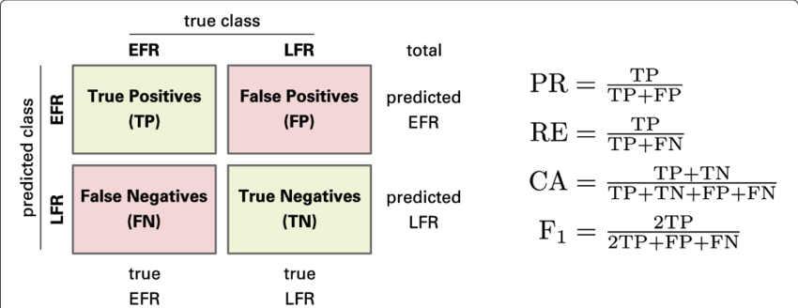
4. Results and Analysis
Metric | Validation Set (%) | Test Set (%)
Precision | 93.6658 | 94.1240
Recall | 93.6585 | 94.1078
F1-score | 93.5081 | 93.9689

Slide 8
Error Analysis
Ambiguity in short sentences with limited POS context.
Subword tokenization misalignment for compound words.
Slightly lower performance for smaller chunk categories.

Slide 9
5. Conclusion and Future Work
Conclusion: XLM-ROBERTA excels in chunking for Hindi.
Future Work:
Improve subword alignment.
Explore data augmentation methods.
Extend model to other low-resource languages.

