Slide 1

16-bit ALU: RTL to GDSII Implementation and Optimization on SKY130A
National Institute of Technology Raipur
Department of Electronics and Communication Engineering
SEMESTER PROJECT (PROJECT-I) PRESENTATION
Presented by
Ayush Tiwari (23116022)
Abeer Gupta (23116003)
Under the guidance of
Dr. Chitrakant Sahu
Professor, Dept. of ECE
7th Semester | November 2026

Slide 2
Contents
1
Introduction & Objectives
7
Design B: Area & Power Optimization
2
Literature Survey
8
Design C: Hybrid Optimization
3
How the Papers Shaped Our Designs
9
Results & Discussion
4
Baseline, Flow & Configuration
10
Conclusion & Future Scope
5
STA Analysis
11
References
6
Design A: Delay Optimization

Slide 3
Introduction
Context
Platform
Approach
The ALU is among the most exercised datapath blocks, so its speed, area and power shape processor performance and cost.
One 16-bit ALU taken from RTL to GDSII with OpenLane 2 on the SkyWater SKY130A PDK (sky130_fd_sc_hd).
The same function implemented three times (delay, area-power, hybrid) and compared with each other and with published work.
RTL-to-GDSII flow
Synthesis
Floorplan
Placement
CTS
Routing
STA
DRC / LVS / Antenna

Slide 4
Objectives & Motivation
Objectives
Motivation
Take a registered 16-bit ALU from RTL to DRC- and LVS-clean GDSII
Optimize three ways: delay, area-power and a balanced hybrid
Show the baseline, every design step and the numbers behind it
Show how published papers guided each change
Speed, area and power pull in different directions in the ALU
Textbook estimates rarely survive a real cell library and P&R flow
Open-source tools let a student team measure every choice on a real PDK

Slide 5
Literature Survey: ALU Papers
Paper | Scope and reported result | Role in our design
[1] Ravindran & Lourde, ICTRC 2015 | 4-bit adders: CLA 1.49 ns / 1.50 mW vs RCA 1.55 ns / 0.76 mW. 16-bit ALU: CMOS 2.84 ns vs mixed logic 2.75 ns (PDP −1.95%). | CLA buys speed at about twice the power: basis for A's CLA and B's compact RCA.
[3] Uniyal & Niranjan, ICCCA 2017 | 8-function 16-bit ALU, variable-stage adder + pass-transistor mux, 90 nm: −23.48% delay, −2.76% power. | Closest analogy: adder and operation select designed together (C), decode before the flops (A).
[2] Santhanam & Prasad, ICICACS 2025 | Verilog 16-bit vs 32-bit ALU on Spartan-6: 10.365 ns / 128 mW vs 17.586 ns / 237 mW. | FPGA reference for width scaling; not comparable with SKY130 area or power.
[11] Mallikarjuna, PrimeMOS tutorial | 4-bit ALU RTL-to-GDSII on SKY130 with OpenLane; not peer reviewed, no post-route benchmark. | Flow reference only (synthesis to GDSII steps).

Slide 6
Literature Survey: Adder Papers
Paper | Scope and reported result | Role in our design
[7] Nagendra, Irwin & Owens, TCAS-II 1996 | HSPICE framework across RCA, carry-skip, carry-select and CLA; area, delay and power are coupled trade-offs. | Why area-power (B) and delay (A) are separate objectives.
[6] Kim & Kim, ISCAS 2001 | 64-bit carry-select with one RCA + add-one circuit: 38% fewer transistors than dual-RCA, 3.45 ns at 2.5 V, 0.25 µm. | Idea behind C's carry-increment upper half and B's shared hardware.
[10] Ramkumar & Kittur, TVLSI 2012 | Modified SQRT-CSLA, 8 to 64 bits: less area and power than the regular one for a slight delay increase, 0.18 µm. | Supports PPA trade-off: Run 20's redundant-gating removal and C's split adder.
[9] Saini, Akhter & Chauhan, VLSI Design 2016 | RCA, CLA, carry-select, SQRT-CSLA and common-Boolean adders, 8 to 64 bits, 32/28 nm standard cells. | Adder architecture comparison behind A's CLA study; technology differs.

Slide 7
Literature Survey: Shifter & Power Papers
Paper | Scope and reported result | Role in our design
[4] Das & Khatri, TCAS-II 2008 | Timing-driven merging of barrel-shifter stages, 28 combinations: average 10.19% faster for 4.11% more area; up to 13.84% faster for 7.29% more area. | Strong timing reference for A's two-level one-hot shifter (structure not identical).
[5] Chon et al., ISOCC 2022 | 32-bit bidirectional shifter, 28 nm dynamic-logic MUX: 36% power, 19% performance, 37% area gain vs domino logic. | Shows shifter architecture matters; dynamic logic differs from our static cells.
[8] Banerjee et al., ICCD 2005 | Operand isolation for low-power datapath synthesis; warns that isolation logic itself costs area and timing. | Motivation for B's operand gating; our Runs 17 and 25 agree with the warning.
Papers use 90, 180, 250 and 28 nm CMOS or FPGA, different tools and circuit styles: their values are context, not benchmarks for our numbers.

Slide 8
Paper Influence: Design A (Delay)
Change in our design | Paper | Paper expects | We measured | Conclusion
CLA adder: grouped lookahead replaces the ripple chain | [1] Ravindran & Lourde | CLA slightly faster than RCA (1.49 vs 1.55 ns) at about twice the power | Isolated adder 8.50 to 7.16 ns; Run 8 to 9: 10.32 to 10.01 ns for +10% area; power rose | Trade-off confirmed; adder is not the main bottleneck (plain + gave 7.03 ns)
Shallower shifter: one-hot decode, two AND-OR levels | [4] Das & Khatri | About 10% faster for about 4% more area (up to 13.8% for 7.3%) | opt2 vs v1: 7.85 to 6.34 ns (−19.3%) for +2.5% area | Strongest result; biggest single win
Decode before the flops; B pre-XORed for subtract | [3] Uniyal; [7] Nagendra | [3]: −23.48% delay, −2.76% power | v1: 9.66 to 7.85 ns (mixed with the zero-flag change) | Decode sat on the critical path; gain not separable
Early zero flags: per unit, carry-free ADD, shift-zero mask | [3] (as above) | Take the post-mux zero check off the critical path | Whole chain 9.66 to 6.34 ns (−34%); power +39% (0.398 to 0.553 mW) | Delay met, power went the opposite way from [3]
Clock tightening: same RTL, shorter clock, antenna repair tuned | None (own experiment) | n/a | Passes 6.5 ns (+0.087 ns, 9 corners); fails 6.0 ns (−0.421 ns) | Proven result is 6.5 ns, only 1.3% slack

Slide 9
Paper Influence: Design B (Area & Power)
Change in our design | Paper | Paper expects | We measured | Conclusion
Compact adder: one shared RCA for add and sub (B inverted, carry-in = sub) | [1], [7] | RCA uses about half the CLA's power at similar delay (4-bit) | Whole design: area 5,514 to 4,299 µm² (−22%); power 0.398 to 0.331 mW (−17%) | Compact adder lowers area and power; cost is a slower clock
Shared shifter: one right-shifter, input and output reversed for left | [6] Kim & Kim | Sharing hardware cuts area (38% fewer transistors there) | Included in the −22% area; no separate number | Likely the second main area saving
Operand isolation: A_alu = A_reg & arithmetic_enable | [8] Banerjee | Saves power, but isolation costs area and timing | Runs 17 and 25: no reliable power saving, extra area | Agrees with the paper's warning, not its benefit
Remove redundant gating: Run 20 drops post-adder masks | [10] Ramkumar & Kittur | Less area and power for a slight delay increase | Delay proxy 9.66 to 11.32 ns (+17%); area and power fell | Direction as expected; delay penalty larger than 'slight'
B's savings come from less hardware, not from operand isolation. B was never run at a tight clock, so 11.32 ns is an upper bound.

Slide 10
Paper Influence: Design C (Hybrid)
Change in our design | Paper | Paper expects | We measured | Conclusion
Split adder: 8-bit RCA low half + 8-bit carry-increment high half | [6], [10] | Less area than a full carry-select with moderate delay | Whole-design numbers only (below) | Lands between B and A as intended
Precomputed subtract operands (B XOR SUB before the flops) | [3] Uniyal & Niranjan | Design adder and select logic together | Whole-design numbers only | Same trade as A's decode work, at lower cost
Shared rotator and shared P/G logic | [4], [6] | Shallower shifter, fewer duplicated gates | Whole-design numbers only | Keeps area down while holding delay
Hybrid at 20 ns | Area | Power | Delay proxy
C vs baseline (Run 7) | −11.5% | +19.5% | −14%
C vs B | +13.5% | +43.9% | −26.6%
C vs A | −22.5% | −13.9% | +31.1%
C is a balanced middle design: about 16% less energy per cycle than A at their fastest clocks, but not an optimum.

Slide 11
How We Use the Papers
What we can say
What we do not claim
The paper supports this technique, and our result moved in the same direction.
Speed costs area and power (A); compact hardware saves area and power but slows the clock (B); C sits between.
That we implemented a paper or reproduced its number: the structures are not identical.
That the shifter alone gave the 34% delay gain: decode and zero-flag changes were made together. The clean split is opt2 vs v1 (−19.3%).
Known weak points
A plain + beat our hand CLA, so Yosys/ABC already builds a good adder.
A's power rose 39% while [3] reported lower power (900 vs 627 cells, 68 vs 54 flops; vectorless estimate).
B was never run at a tight clock, so the three-way tight-clock comparison is incomplete.

Slide 12
Common ALU Architecture
Adder / subtractor
RCA | CLA | hybrid
8
operations, 3-bit opcode
Logic unit
AND OR XOR NOT
Inputs
A[15:0]
B[15:0]
opcode[2:0]
Input registers (+ optional pre-decode)
Result select (one-hot)
Output regs Y, Z, N, C, V
4
Shifter
SLL / SRL (B[3:0])
status flags: Z, N, C, V
Flag logic
Z N C V
2-stage
Figure 1: Common structure of the registered 16-bit ALU shared by all three designs
fixed latency, registered I/O

Slide 13
ALU Functional Specification
Opcode | Operation | Definition
000 | ADD | A + B; carry and signed overflow reported
001 | SUB | A − B (B inverted, carry-in = 1); C = no-borrow
010 | AND | Bitwise A & B
011 | OR | Bitwise A | B
100 | XOR | Bitwise A ^ B
101 | NOT A | Bitwise complement of A
110 | SLL | Logical shift left by B[3:0]; C = last bit out
111 | SRL | Logical shift right by B[3:0]; C = last bit out
Flags
Z result is zero
N result bit 15
C carry (no-borrow for SUB) or last bit shifted out
V signed overflow for ADD/SUB

Slide 14
Where We Started: The Baselines
Run | Adder | Area (µm²) | Setup slack (ns) | Est. period (ns) | Slew / fanout / antenna
Run 7 | Behavioural + / − | 5,514.04 | +10.345 | 9.66 | 7 / 4 / 0
Run 8 | Explicit 16-bit RCA | 4,835.89 | +9.678 | 10.32 | 0 / 4 / 0
Run 9 | Four 4-bit-group CLA | 5,336.37 | +9.988 | 10.01 | 10 / 4 / 1
Table: the three simulation-verified baselines, all at 20 ns with 4 ns I/O delays (same flow for every later change)
What limited every baseline
Run 7: the reference point
Opcode decode, then the big output mux, then a 16-input zero check computed on the muxed result.
5,514.04 µm², 0.3983 mW, 783 instances, 54 flops, setup +10.345 ns, hold +0.111 ns. Runs 1 to 6 were flow and setup clean-up.
Phase 1 fixes (sub select, per-unit zero, CLA): WNS −3.18 to −0.41 ns.

Slide 15
RTL-to-GDSII Flow: Step by Step
1 Synthesis
2 Floorplan
3 Power grid
4 Placement
5 Clock tree (CTS)
Yosys + ABC turn RTL into a netlist of sky130_fd_sc_hd cells; ABC may restructure hand-written logic.
Sets die and core area from the target utilization (35%), places tap cells and I/O pins.
Builds the power distribution network (VDD/VSS rails and straps) over the core.
Global then detailed placement of cells (target density 40%), with timing-driven repair.
Builds the clock network for a real clock port; sink clustering 5, max diameter 20.
6 Routing
7 Parasitics + STA
8 GDSII stream-out
9 DRC
10 LVS + antenna
Global then detailed routing of signal nets, with antenna repair after global routing.
Extracts parasitics and runs static timing at nine corners (setup and hold).
Magic and KLayout write the final layout, alu16.gds.
Magic and KLayout design-rule checks must both report 0 violations.
Netgen compares layout with netlist (unique match required); antenna rules rechecked.
OpenLane 2 runs 74 steps in total on SKY130A; the ten stages above group them.

Slide 16
Run Configuration & Constraints
Setting | 20 ns runs | Tight-clock runs (A 6.5 ns, C 8.5 ns)
Floorplan / placement | FP_CORE_UTIL 35, PL_TARGET_DENSITY_PCT 40 | same
CTS | SINK_CLUSTERING_SIZE 5, MAX_DIAMETER 20 | same
Antenna repair (global router) | defaults: margin 10, iterations 3 | margin 40, iterations 10
Clock period (config and SDC agree) | 20 ns | 6.5 ns / 8.5 ns
Input / output delay | 4 ns / 4 ns | 1.3 ns / 1.3 ns (20% of 6.5 ns; 15% of 8.5 ns)
Uncertainty / transition / load | 0.25 ns / 0.15 ns / 0.0334 pF | same
Max transition / capacitance / fanout | 0.75 ns / 0.2 pF / 10 | same
I/O delay was scaled with the clock: a fixed 4 ns made 6.0 ns look like a floor. CLOCK_PERIOD in config.json and create_clock in the SDC must agree.

Slide 17
STA Analysis: Nine Corners (Design A)
Limiting setup corner: max_ss_100C_1v60 (slow, hot, low voltage): +0.087 ns at 6.5 ns, versus +3.28 ns typical and +4.31 ns fast.
Hold: tightest at the fast corners (+0.136 to +0.143 ns); hold violations are repaired with delay cells.
Reading rule: estimated period = clock − worst setup slack; only pass/fail at a given clock is solid.

Slide 18
Design A: Delay Progress
Checkpoints
Run 7: 9.66 ns baseline.
v1: decode before flops, 7.85 ns (−19%).
opt2: one-hot shifters, 6.34 ns est. (−34%).
6.5 ns: timing really met, +0.087 ns.

Slide 19
Design A: Finding the Bottleneck
Controlled experiment (10 ns) | RCA | CLA | Plain +
Isolated 16-bit adder, est. period | 8.50 ns | 7.16 ns | 7.03 ns
Full ALU, est. period | 9.99 ns | 8.77 ns | 8.67 ns
The shifter, not the adder, was the bottleneck.
Table: CLA is about 16% shorter than RCA for the adder alone and about 12% for the full ALU, at 2 to 6% more area
This finding decided opt2: attack only the shifter paths and the final select, keep everything else from v1.
Phase 1: every baseline hit the same path: opcode decode, big output mux, 16-input zero check on the muxed result.
Phase 2: clocked ALU: early per-unit zero flags and a carry-free ADD zero check cut the period about 9%.
v1: worst paths all began at the shift-amount flop and went through mux2, mux2, mux4; the CLA was about 1.5 ns behind.

Slide 20
Design A: Baseline to v1
Baseline (Run 7 / Run 9)
Inputs
A, B, opcode
Input flops
Opcode decode + adder, 4-level shifter, logic units
7-input case mux
16-input zero check on muxed result
Output flops
v1 (decode before the flops)
Inputs
A, B, opcode
Pre-flop work: opcode decode, B XOR sub
Input flops
CLA, 4-level shifter, logic units + per-unit zero flags
Select result and zero together
Output flops
[3]
[3]
New in v1 (blue); amber chip = supporting paper
Result: 9.66 ns to 7.85 ns (−19%). Moving decode ahead of the flops is almost free because the input stage has a large time budget; the shifter now limits.

Slide 21
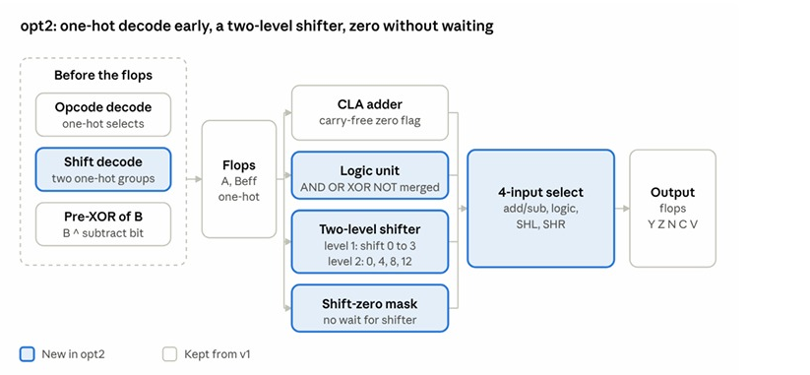
Design A: opt2, the Final Architecture
Five changes from v1
One-hot shift decode into two groups before the flops
Two-level AND-OR shifters replace four mux levels [4]
Shift-zero from a mask, no wait for the shifter
Shift carry-out from the same selects
Merged logic unit: 4-input final select
Figure: opt2 block diagram (blue = new in opt2, grey = kept from v1)
[4]
Das & Khatri: merged, shallower shifter stages

Slide 22
Design A: Delay Block by Block (6.5 ns)
Instance | Cell | Fanout | Delay (ns)
_0955_ (launch flop, clk to Q) | dfxtp_1 | 5 | 0.926
fanout115 | clkbuf_4 | 10 | 0.579
_0530_ | xnor2_2 | 6 | 0.321
_0592_ | or3_1 | 3 | 1.000
_0669_ | or3_1 | 2 | 0.941
_0746_ | a31o_1 | 3 | 0.535
_0747_ | a21oi_2 | 5 | 0.470
_0749_ | nor2_1 | 1 | 0.216
_0759_ (to result_comb[12]) | or3_1 | 1 | 0.858
Worst setup path, max_ss_100C_1v60: path delay 5.846 ns, slack +0.087 ns. Launch flop and clock buffer take 1.505 ns (26%); logic 4.341 ns (74%). Three OR3 cells alone take 2.799 ns (48%).

Slide 23
Design A: Final Result & Power
Metric (opt2 @ 6.5 ns) | Final result
Setup timing | Met in all 9 corners, +0.087 ns
Hold timing | Met
Antenna | 0 (margin 40, iterations 10)
DRC / LVS | 0 / pass
Area | 6,319.8 µm²
Cells / flops | 902 / 68
Wirelength | 21,550
Power | 1.7085 mW (max corner), 1.4621 mW (nominal)
Max slew / fanout violations | 21 / 1
Clock is 36% of total power and sequential cells 34% at both clocks; power scales with frequency.

Slide 24
Design A: Pushing to 6.0 ns (opt2 to opt5)
6.0 ns clock, slowest corner | opt2 | opt3 | opt4 | opt5
Worst setup slack | −0.421 ns | −0.331 ns | −0.246 ns | −0.150 ns
Violating paths | 11 | 37 | 6 | 9
Hold-fix buffers | 0 | 40 | 9 | 4
Area (µm²) | 6,317 | 7,420 | 6,092 | 6,357
Flops | 68 | 82 | 83 | 102
Slew warnings | not recorded | 17 | 8 | 0
opt3: pre-registered adder terms and moved shifter and zero logic ahead of the flops; the input stage became the limit and 40 hold-fix buffers appeared.
opt4 / opt5: rebalanced stages, then a shallow input stage with masks after the flops (102 flops).
Decision: none passed 6.0 ns in a real run, so opt2 at 6.5 ns was frozen as the final design.

Slide 25
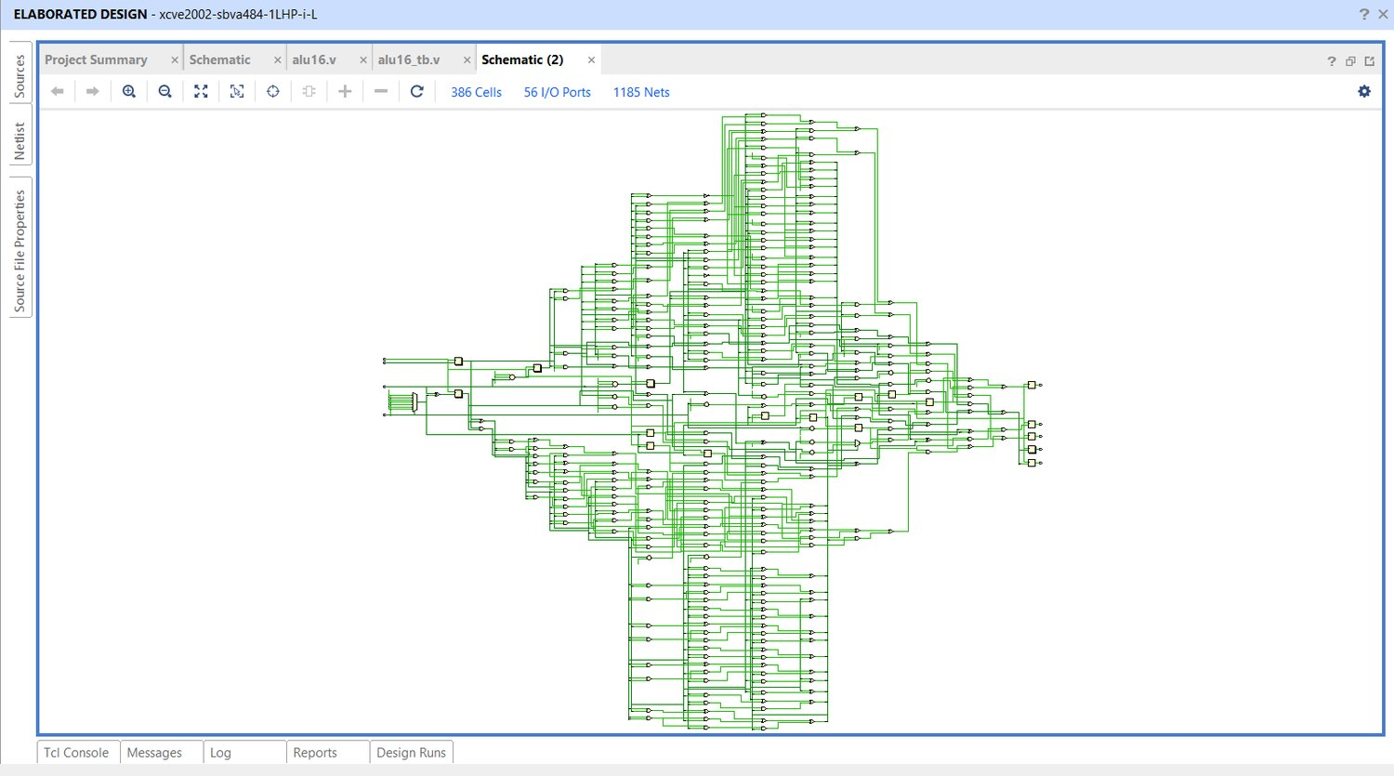
Design A: RTL Schematic
Elaborated RTL
386 cells, 1,185 nets
Largest of the three designs (B 212, C 241 cells)
Wide one-hot AND-OR shifter and per-unit zero logic are visible
Verified: 13,375 test cases, ALL TESTS PASSED
Figure: Vivado elaborated schematic of the delay design (delay_opt.v)

Slide 26
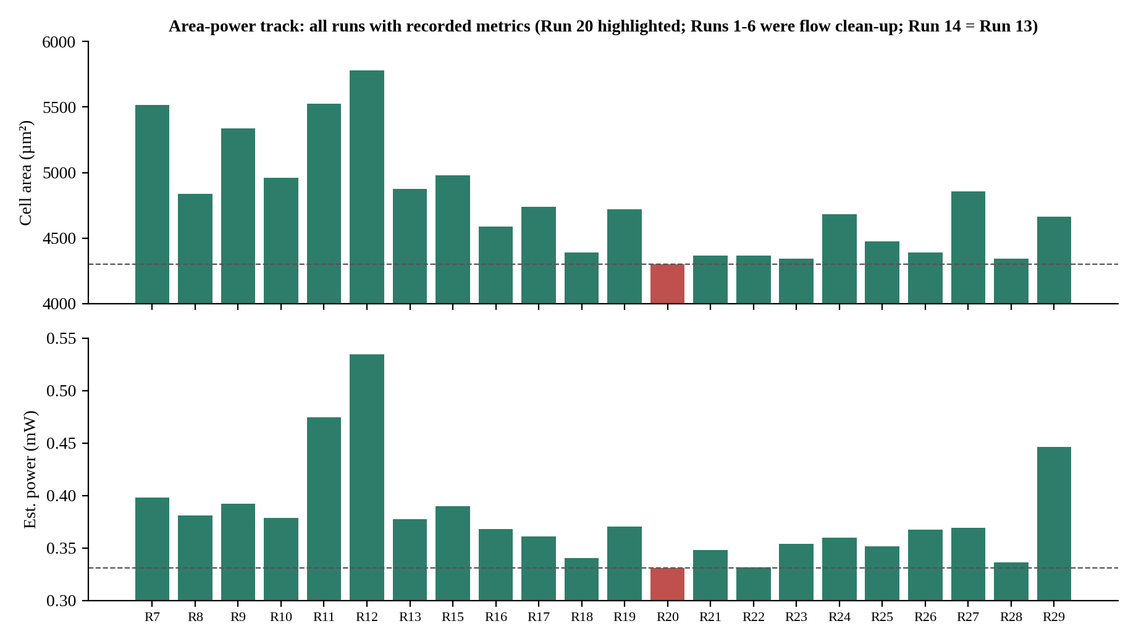
Design B: Approach
Goal: smallest area and lowest power at a fixed 20 ns clock; timing only needs to stay positive.
Start: Run 7 behavioural baseline, 5,514.04 µm², 0.3983 mW (Runs 1 to 6 were flow clean-up).
Held constant: sky130A / hd, utilization 35, density 40, CTS 5 / 20, same SDC for all 29 runs.
Step 1 (Runs 1 to 9): adder choice, + vs RCA vs CLA.
Step 2 (Runs 10 to 19): one-hot select, shared shifter.
Step 3 (Runs 20 to 29): refinements; Run 20 selected.
Fig: area and power per run; Run 20 (red) is selected, Run 14 equals Run 13.
−22.0%
−16.9%
area vs Run 7
power vs Run 7

Slide 27
Design B: Step 2 (Runs 10 to 19)
Run | Core idea | Area (µm²) | Power (mW) | Setup WNS | Decision
10 | One-hot CLA / result selection | 4,959.76 | 0.37835 | +10.358 | Useful checkpoint
11 | Registered one-hot opcode predecode | 5,527.80 | 0.47441 | +11.599 | Reject: register overhead
12 | Registered conditional B operand | 5,781.80 | 0.53449 | +10.166 | Reject: more state
13 | CLA + shared bidirectional shifter | 4,874.68 | 0.377213 | +8.577 | Retained
14 | Balanced result network | = Run 13 | = Run 13 | = Run 13 | No measured change
15 | Partial opcode predecode | 4,977.27 | 0.38982 | +8.983 | Reject
16 | RCA + one-hot + shared shifter | 4,588.15 | 0.36830 | +7.173 | Best at that point
17 | Operand isolation | 4,738.29 | 0.36073 | +7.851 | Power/area trade-off
18 | Integrated shift carry | 4,389.21 | 0.340132 | +8.376 | Best of phase
19 | Selective B-register hold | 4,718.28 | 0.37023 | +7.240 | Reject
Registering decode or derived operands (Runs 11, 12) costs flops and clock load; sharing and integrating the shifter paid off (Runs 13, 18).

Slide 28
Design B: Step 3 (Runs 20 to 29)
Run | Hypothesis | Area (µm²) | Power (mW) | vs Run 20 (area / power) | Decision
20 | Remove redundant arithmetic masks | 4,299.12 | 0.330823 | baseline | SELECTED
21 | Case-based result selection | 4,367.94 | 0.348211 | +1.6% / +5.3% | Reject
22 | Share Boolean intermediates | 4,367.94 | 0.33156 | +1.6% / +0.2% | Reject
23 | Reuse RCA P/G for Boolean ops | 4,345.42 | 0.354097 | +1.1% / +7.0% | Reject
24 | Inferred + adder | 4,684.49 | 0.359632 | +9.0% / +8.7% | Reject
25 | Bitwise input isolation | 4,473.04 | 0.351609 | +4.1% / +6.3% | Reject
26 | Flag factoring, no shift-carry mask | 4,389.21 | 0.367542 | +2.1% / +11.1% | Reject
27 | Separate left/right shifters | 4,855.91 | 0.368995 | +13.0% / +11.5% | Reject
28 | Reorder B isolation after XOR | 4,344.17 | 0.336307 | +1.0% / +1.7% | Reject (closest)
29 | Registered one-hot opcode decode | 4,663.22 | 0.446062 | +8.5% / +34.8% | Reject (59 flops)
Why Run 20 works: with operand isolation and carry-in forced to zero, extra arithmetic masks are redundant; removing them cut area 2.05% and power 2.74% versus Run 18.

Slide 29
Design B: Baseline to Run 20
Baseline (Run 7)
Inputs
A, B, opcode
Input flops
Behavioural + / − (inferred adder)
Case-based result mux; zero flag after the mux
Output flops
Barrel shifter(s)
Logic units
Run 20 (selected)
Inputs
A, B, opcode
Input flops
Operand isolation: A_alu = A_reg & arith_enable
One-hot OR merge; redundant masks removed; Z from merged result
Output flops
One shared RCA (B XOR is_sub, cin = sub)
Shared bidirectional shifter + integrated shift-carry
[8]
[1][7]
[6]
[10]
Blue = changed block; amber chips = supporting papers

Slide 30
Design B: Area & Power by Block Change
Block change | Runs | Δ Area (µm²) | Δ Power (mW)
Adder: inferred + to explicit RCA | 7 to 8 | −678.15 (−12.3%) | −0.0172 (−4.3%)
One-hot result select | 9 to 10 | −376.61 (−7.1%) | −0.0141 (−3.6%)
Shared bidirectional shifter | 10 to 13 | −85.08 (−1.7%) | −0.0011 (−0.3%)
CLA replaced by RCA | 13 to 16 | −286.53 (−5.9%) | −0.0089 (−2.4%)
Integrated shift carry | 16 to 18 | −198.94 (−4.3%) | −0.0282 (−7.6%)
Redundant masks removed | 18 to 20 | −90.09 (−2.1%) | −0.0093 (−2.7%)
Run-to-run deltas from the measured sequence; other source changes interact, so this is not an exact per-block split. Run 20: 627 instances, 54 flops, 4,299.12 µm², 0.3308 mW.
Total vs Run 7: −1,214.92 µm² (−22.0%), −0.0675 mW (−16.9%)

Slide 31
Design B: Run 20 Final Numbers
Metric | Run 20 (20 ns)
Cell area / instances | 4,299.12 µm² / 627 (54 flops)
Estimated power | 0.330823 mW (nominal 0.2834 mW)
Setup / hold WNS | +8.676 ns / +0.142 ns
Functional regression | 13,375 cases passed; 150,000-cycle stress: 0 mismatches
Max slew / fanout / cap violations | 0 / 4 / 0
Antenna / DRC / Magic / KLayout / LVS | 0 / 0 / 0 / 0 / pass
Flow errors | 0 (one warning)
−22.0%
−16.9%
area vs Run 7
power vs Run 7
Honest limits
4 max-fanout violations remain.
Z is still taken after the merge: the main reason B is slow.
Only ever run at 20 ns (+8.7 ns spare); tight-clock timing not measured.
Final RTL: area_opt_alu16_rca_run20.v

Slide 32
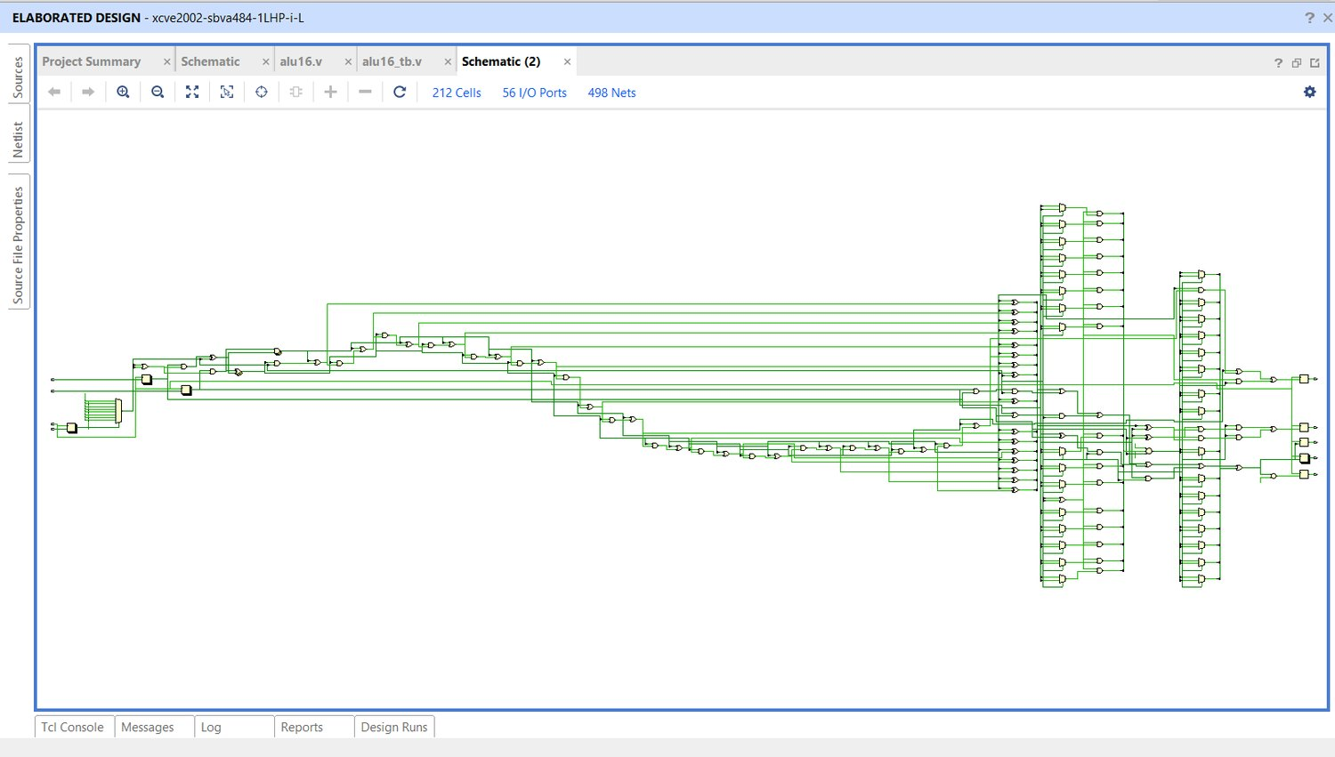
Design B: RTL Schematic
Elaborated RTL
212 cells, 498 nets
Smallest of the three designs
One shared adder and one shared shifter block
Verified: 13,375 test cases, ALL TESTS PASSED
Figure: Vivado elaborated schematic of Run 20 (area-power design)

Slide 33
Design C: Hybrid Architecture
Hybrid: split adder, shared P/G and shared rotator
[6][10]
8-bit RCA (low half)
8-bit carry-increment (high half)
Inputs A, B, opcode
Pre-flop work: B XOR SUB, rotation bits
Flops: A, Beff, op, rot
Shared P/G: p = A^B, g = A&B
Result select (one-hot)
Output flops
Logic unit (reuses P/G)
[3]
Shared rotator + thermometer mask
Flags: Z per class, N, C, V
Blue = changes from the baseline; amber chips = supporting papers
[4][6]

Slide 34
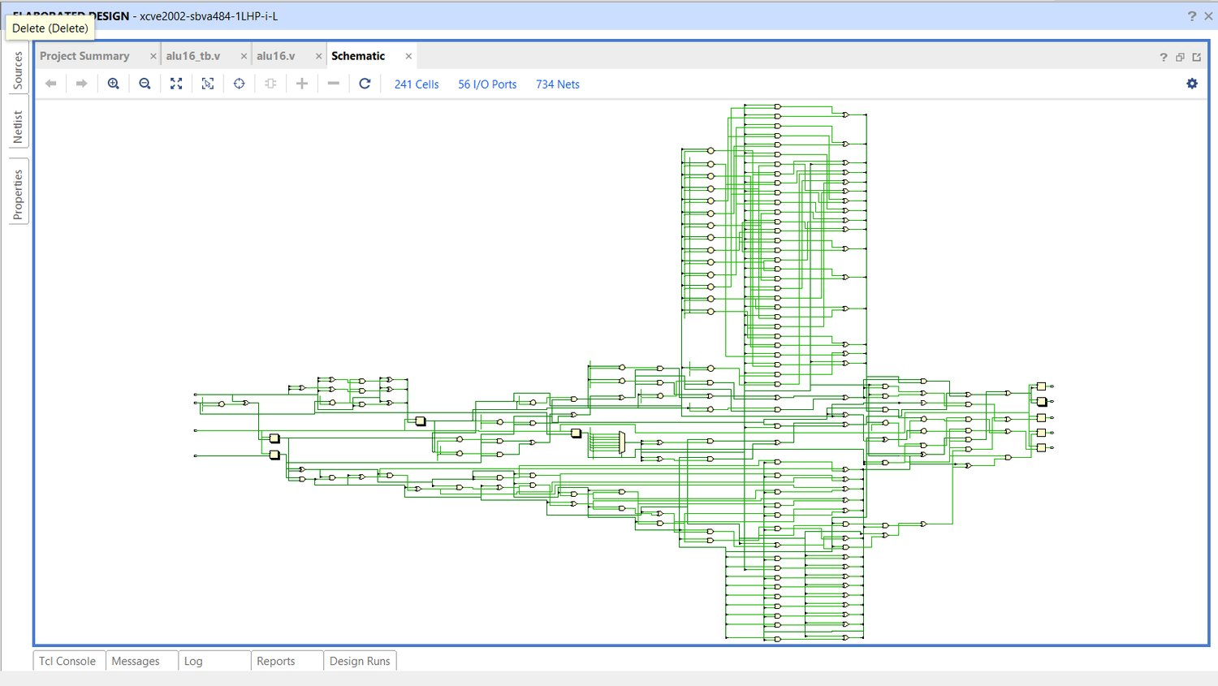
Design C: RTL Schematic
Elaborated RTL
241 cells, 734 nets
Between A (386) and B (212)
Split adder and shared rotator visible in the datapath
Verified: 13,375 test cases, ALL TESTS PASSED
Figure: Vivado elaborated schematic of the hybrid design (hybrid_opt.v)

Slide 35
Design C: Delay Block by Block (8.5 ns)
Stage (max_ss_100C_1v60) | Cell | Delay (ns)
Clock to Q of op_reg[2] | dfxtp_1 | 0.873
Opcode decode | and2b_1 | 0.572
Fanout buffer | clkbuf_4 | 0.447
Select logic | a21boi_4 | 0.565
Fanout buffer | clkbuf_4 | 0.595
Inverter | inv_2 | 0.235
Shift / logic zero terms | a2bb2o_1 + a31o_1 | 0.557 + 0.379
Zero tree, level 1 | or4_1 | 1.304
Zero tree, level 2 | or4_1 | 1.160
Zero tree, level 3 | or3_1 | 0.960
Final combine into zero_comb | o21ai_1 | 0.238
Slack +0.166 ns, arrival 8.482 ns. The three OR cells of the zero tree take 3.42 ns, about 40% of the path; the adder is not the limiter. The listed stages sum to 7.885 ns.

Slide 36
Design C: Power & Area by Block
Area and cells | 8.5 ns | 20 ns
Cell area (µm²) | 4,863.41 | 4,878.43
Core / die (µm²) | 13,190 / 17,378 | 13,190 / 17,378
Utilization | 36.87% | 36.99%
Instances | 685 | 686
Timing-repair buffers | 81 | 81
Clock buffers / inverters | 11 / 4 | 13 / 3
Routed wirelength (µm) | 14,820 | 15,307
Clock network is about 34% of power and sequential about 34% in both runs. Max-corner totals: 1.1016 mW at 8.5 ns, 0.4761 mW at 20 ns.

Slide 37
Design C: Timing & Sign-off Numbers
Timing metric | 8.5 ns | 20 ns
Worst setup slack | +0.1657 ns | +11.6927 ns
Worst hold slack | +0.1490 ns | +0.1542 ns
Setup / hold violations | 0 / 0 | 0 / 0
Worst setup corner | max_ss | max_ss
Est. minimum period | 8.3343 ns | 8.3073 ns
Check | 8.5 ns | 20 ns
Routing DRC | 0 | 0
Magic / KLayout DRC | 0 / 0 | 0 / 0
LVS | PASS | PASS
Antenna / pins / grid | 0 / 0 / 0 | 0 / 0 / 0
Max cap / fanout | 0 / 0 | 0 / 0
Max transition | 3 (max_ss) | 0
Both runs share a byte-identical Yosys netlist, so the comparison isolates the clock. The 8.5 ns run's 3 max-transition violations are about 0.7528 ns against a 0.750 ns limit: setup/hold closed, but not all electrical checks clean.

Slide 38
Architecture Comparison
Feature | A: Delay | B: Area + power | C: Hybrid
Adder | Grouped CLA (4 x 4-bit) | 16-bit RCA | 8-bit RCA + 8-bit carry-increment
Shifter | Two one-hot AND-OR shifters, 2 levels | One shared bidirectional shifter | One shared rotator + thermometer mask
Operand isolation | No | Yes | No (removed)
Logic unit | Merged AND/OR/XOR/NOT | Bitwise paths into one-hot select | Reuses adder P/G
Zero flag | Per unit, shift zero from mask | Per result path (after merge) | Per class, operand/mask based
Pre-register work | Opcode classes, B XOR SUB, one-hot shift decode | Decode after flops | B XOR SUB, shift rotation bits

Slide 39
Results: Three-Way Comparison
Metric (20 ns clock) | B: Area + power | A: Delay | C: Hybrid
Cell area (µm²) | 4,299.12 | 6,293.54 | 4,878.43
Instances / flops | 627 / 54 | 900 / 68 | 686 / 57
Estimated power (mW) | 0.3308 | 0.5532 | 0.4761
Worst setup slack (ns) | +8.676 | +13.663 | +11.693
STA path proxy (ns) | 11.32 | 6.34 | 8.31
Max-slew / max-fanout | 0 / 4 | 31 / 1 | 0 / 0
DRC / LVS errors | 0 / 0 | 0 / 0 | 0 / 0
Area × proxy (derived, µm²·ns) | about 48,700 | about 39,900 | about 40,500
STA path proxy = clock period − worst setup slack; power from the max-power corner (vectorless estimate)

Slide 40
Results: Area, Power and Timing at 20 ns
B Area + power A Delay C Hybrid
B is smallest and lowest-power but slowest; A is fastest but largest and highest-power; C sits between.

Slide 41
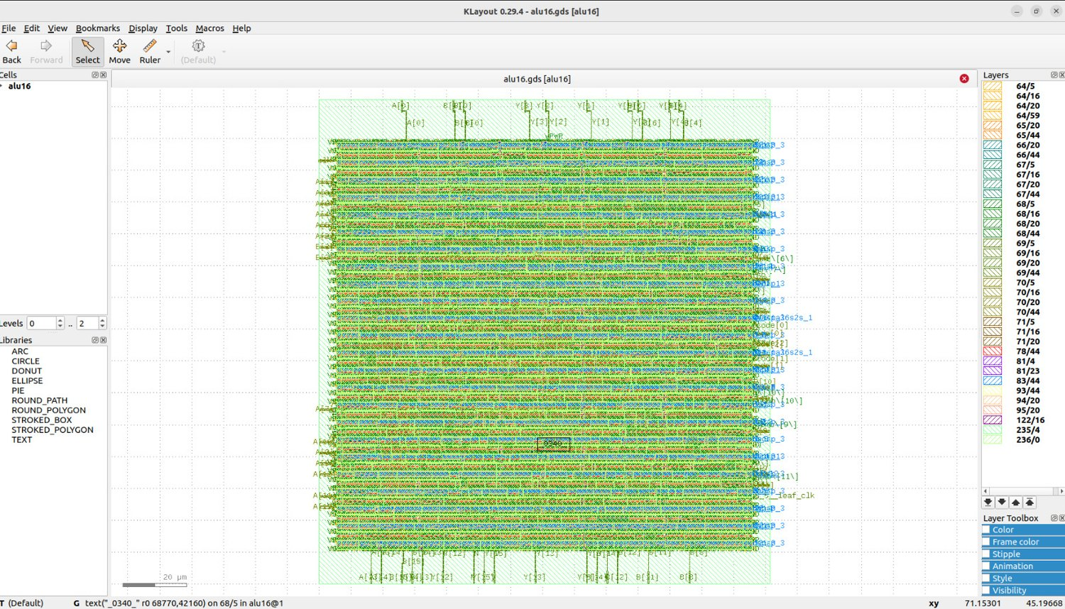
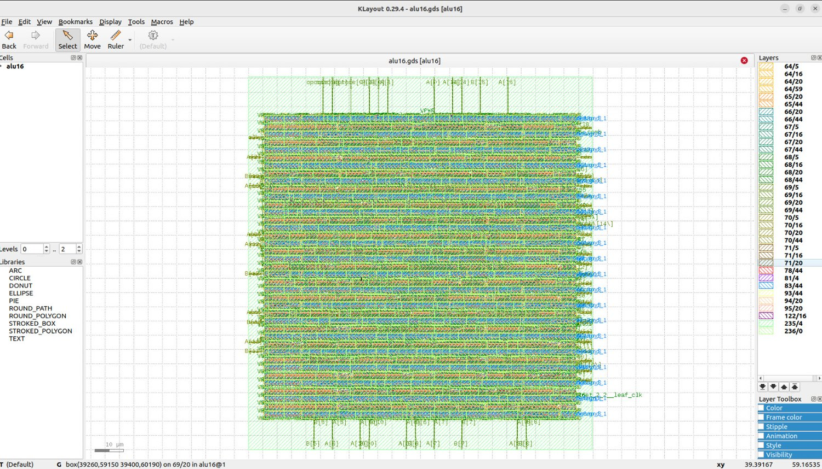
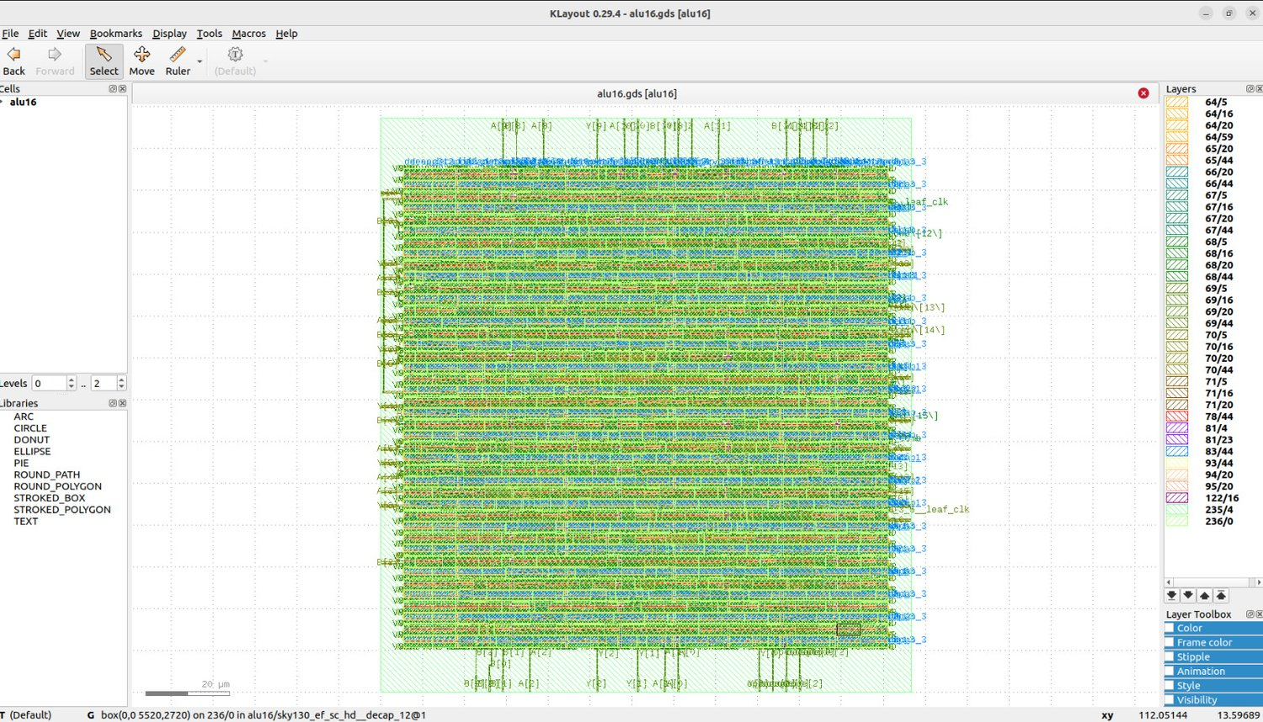
Physical Implementation (GDSII)
Design A (6.5 ns)
Design B (20 ns)
Design C (8.5 ns)
Design | Clock | Area (µm²) | Setup slack | DRC / LVS / antenna
A: Delay | 6.5 ns | 6,319.81 | +0.087 ns | Passed
B: Area + power | 20 ns | 4,299.12 | +8.676 ns | Passed
C: Hybrid | 8.5 ns | 4,863.41 | +0.166 ns | Passed
KLayout views are zoom-to-fit; die size is not comparable between views

Slide 42
Closure Demonstrated & Energy per Cycle
Design | Shortest clock passed | Margin | Area (µm²) | Power, nominal (max corner)
A: Delay | 6.5 ns (6.0 ns failed by 0.421 ns) | +0.0873 ns | 6,319.8 | 1.4621 mW (1.7085)
C: Hybrid | 8.5 ns | +0.1657 ns | 4,863.41 | 0.9429 mW (1.1016)
B: Area-power | 20 ns only (never tightened) | +8.676 ns | 4,299.12 | 0.2834 mW (0.3308)
Energy view | B | A | C | Lowest
Energy per cycle at 20 ns (pJ) | 5.67 | 9.47 | 8.15 | B
Power × STA proxy (mW·ns) | 3.21 | 3.00 | 3.38 | A
Energy at each design's fastest clock (pJ) | 5.67 (20 ns) | 9.50 (6.5 ns) | 8.01 (8.5 ns) | B; C below A
A and C ran with identical constraints (1.3 ns I/O, CTS 5/20, antenna 40/10); B's tight-clock result is not measured.

Slide 43
Results: Key Observations
No dominant design
C vs B
C vs A
Area, power and delay cannot all be won at once.
26.6% shorter proxy for +13.5% area and +43.9% power.
22.5% less area and 13.9% less power, 31.1% longer proxy.
Closure shown
Energy per cycle
Common limiter
A at 6.5 ns, C at 8.5 ns; B was run only at 20 ns.
At each fastest closed clock, C is about 16% below A (8.01 vs 9.50 pJ).
Once adder and shifter are fixed, opcode decode and zero-flag logic set the clock.

Slide 44
Real-World Applications of the Three Designs
A: Faster logic
B: Compact, low power
C: Balanced
Typical uses
Typical uses
Typical uses
High-throughput DSP pipelines
Network packet processing
High-frequency processor execution units
Real-time control loops
Battery-powered IoT sensor nodes
Wearables and medical or hearing devices
RFID tags and smart cards
Always-on, low-duty-cycle microcontrollers
General-purpose embedded microcontrollers
Motor control and industrial controllers
Audio and sensor-hub processors
Edge devices and teaching cores
Why it fits
Why it fits
Why it fits
Shortest clock: closes at 6.5 ns (about 154 MHz on SKY130A). Cost: largest area, 6,294 µm², and 0.553 mW at 20 ns.
Smallest and lowest-power: 4,299 µm² and 0.331 mW at 20 ns. Only verified at 20 ns, so suited to relaxed clocks.
Middle on every axis: closes at 8.5 ns (117.65 MHz), 4,878 µm², 0.476 mW; about 16% less energy per cycle than A at their fastest clocks.
Illustrative use cases drawn from the measured trade-offs; the designs were not tested in these applications. All numbers are SKY130A tool estimates.

Slide 45
Conclusion & Future Scope
Conclusion
Future Scope
One 16-bit, 8-operation ALU taken from RTL to DRC/LVS-clean GDSII in three variants; none dominates every metric.
A met 6.5 ns; B is 22% smaller than the baseline; C is balanced and met 8.5 ns.
Each change was guided by a paper and measured; results move in the papers' direction.
All numbers are tool estimates, not silicon measurements.
Run Design B at the tight clocks used for A and C.
Clear the remaining slew, fanout and transition violations.
Restructure opcode decode and zero-flag logic.

Slide 46
References
N. Ravindran and R. M. Lourde, “An Optimum VLSI Design of a 16-Bit ALU,” ICTRC 2015, pp. 52–55.
S. Santhanam and S. R. Prasad, “Performance Comparison of 16-Bit ALU and 32-Bit ALU Using Verilog,” ICICACS 2025.
A. Uniyal and V. Niranjan, “A new 16-bit ALU using variable stage adder and PTL mux,” ICCCA 2017, pp. 1374–1378.
S. Das and S. P. Khatri, “A Timing-Driven Approach to Synthesize Fast Barrel Shifters,” IEEE TCAS-II, vol. 55, no. 1, 2008.
D. Chon et al., “Hardware-Efficient Barrel Shifter Design Using Customized Dynamic Logic Based MUX,” ISOCC 2022.
Y. Kim and L. S. Kim, “A low power carry select adder with reduced area,” IEEE ISCAS 2001, vol. 4, pp. 218–221.
C. Nagendra, M. J. Irwin and R. M. Owens, “Area-time-power tradeoffs in parallel adders,” IEEE TCAS-II, vol. 43, no. 10, 1996.
N. Banerjee et al., “Novel Low-Overhead Operand Isolation Techniques for Low-Power Datapath Synthesis,” IEEE ICCD 2005.
V. K. Saini, S. Akhter and T. Chauhan, “Implementation, Test Pattern Generation, and Comparative Analysis of Different Adder Circuits,” VLSI Design, 2016.
B. Ramkumar and H. M. Kittur, “Low-Power and Area-Efficient Carry Select Adder,” IEEE TVLSI, vol. 20, no. 2, 2012.
P. V. S. D. D. Mallikarjuna, “Design of 4-Bit ALU Implementation Using OpenLane (RTL to GDSII),” PrimeMOS, tutorial.

Slide 47
Thank You
Ayush Tiwari (23116022) | Abeer Gupta (23116003)

