Slide 1

Summer Internship (II) Presentation
on
Smart Irrigation and Monitoring System using ESP32 and RTL/SoC Design
Department of Electronics and Communication
National Institute of Technology, Raipur
November 2026
Presented By:
Ayush Tiwari
7th Semester | Roll No: 23116022
Internship under Prof. Basant Kumar, Professor, MNNIT Allahabad | 15 June to 14 July 2026
Notes:
Introduce yourself, the project title, and that the internship project covers two phases: an ESP32 IoT prototype and its RTL / ASIC implementation.

Slide 2
Contents
1
Introduction
8
Verification & FPGA Synthesis
2
Objectives & Motivation
9
RTL-to-GDSII (OpenLane 2)
3
Organization Profile
10
Key Learnings & Skills
4
Literature Survey
11
Results & Discussion
5
Architecture & Hardware
12
Conclusion & Future Scope
6
Firmware & Cloud Dashboard
13
References
7
RTL Design & FSM
Notes:
Outline of the talk: motivation first, then the IoT phase, the RTL phase, physical design, and the results.

Slide 3
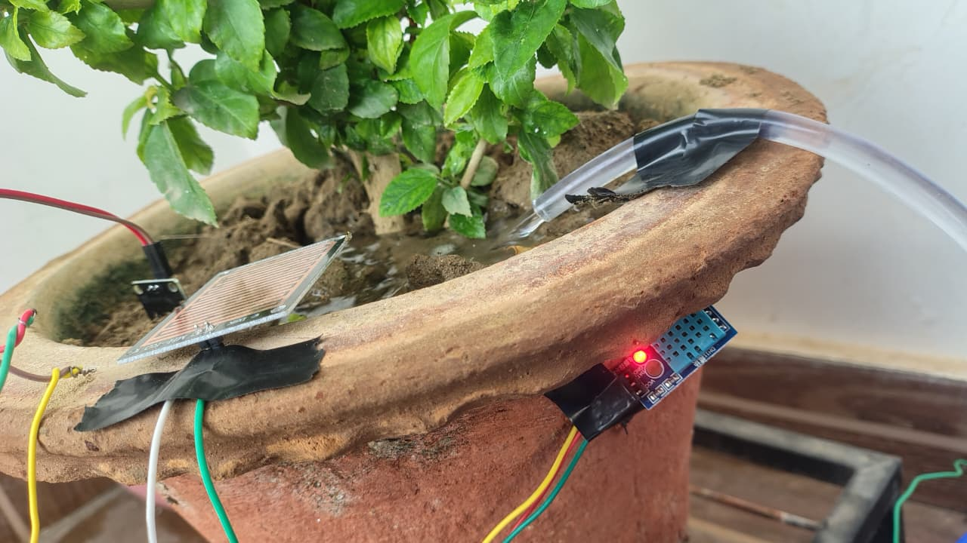
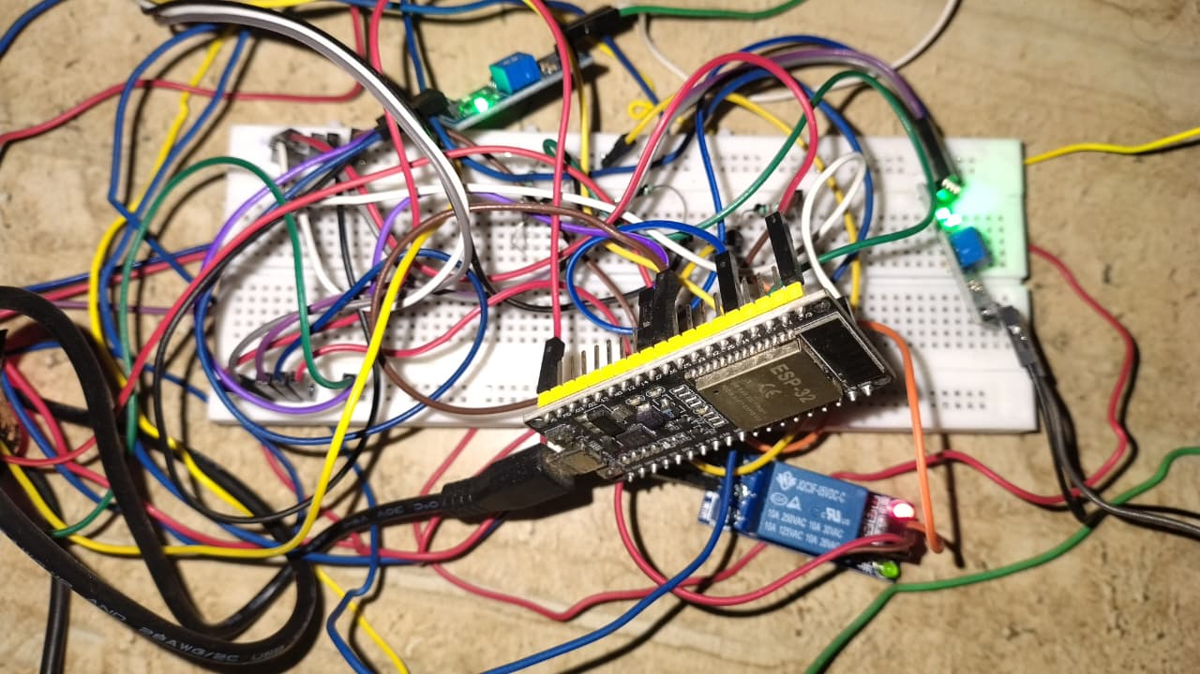
Introduction
Manual or fixed-schedule irrigation wastes water and stresses crops.
Another common problem arises when people travel out of town for a few days, as ensuring that their plants receive adequate water during their absence becomes a challenge.
Project: a low-cost smart irrigation controller built in two phases
Phase I: ESP32 IoT prototype with soil, weather and tank sensing, a relay-driven pump and a Blynk cloud dashboard
Phase II: the same algorithm as Verilog RTL, verified, synthesized and implemented as a GDSII layout with OpenLane 2
Figure 1: Plant pot, rain sensor and irrigation tube
Figure 2: ESP32 prototype wiring
Notes:
Fixed-schedule or manual watering wastes water. The project builds a sensor-driven controller twice: first as ESP32 firmware, then as hardware (RTL) taken all the way to a layout.

Slide 4


Objectives & Motivation
Objectives
Motivation
Automatic irrigation controller on the ESP32
Cloud monitoring and manual override through Blynk
Modular Verilog RTL of the same algorithm
Verify, synthesize and implement it from RTL to GDSII
Agriculture & Plantation is a major consumer of fresh water
Sensor-driven control applies water only when needed
Re-targeting the algorithm to hardware shows a path from an IoT prototype to a dedicated chip
Notes:
Objectives are the deliverables; motivation is why a hardware re-implementation is interesting beyond the IoT prototype.

Slide 5
Organization Profile
Organization
Innovation and Incubation Hub MNNIT Foundation (IIHMF)
Location
MNNIT Allahabad, Prayagraj, Uttar Pradesh
About
Official incubator of MNNIT Allahabad; central innovation platform of the institute [1]
Functions
Incubation, mentoring and funding access for student and faculty-led ventures [1]
Internship
15 June to 14 July 2026 (4 weeks), under Prof. Basant Kumar, Professor, Department of ECE, MNNIT Allahabad
Relevance
Prototype-to-product setting for the IoT and VLSI work in this project
Notes:
Internship at IIHMF, the official incubator of MNNIT Allahabad, under Prof. Basant Kumar, Professor, Department of ECE, MNNIT Allahabad, from 15 June to 14 July 2026.

Slide 6



Literature Survey
Conventional irrigation
IoT-based irrigation
Gap and proposal
Fixed timers or manual watering
No response to soil moisture or rain
Over- and under-watering
Low-cost Wi-Fi microcontroller (ESP32 [2])
Soil sensor and relay-driven pump
Cloud dashboards (Blynk [3])
Most work stops at firmware
Here: same logic re-implemented as verified Verilog RTL [4]
Carried on to an ASIC layout
Notes:
Conventional timers ignore conditions; IoT systems fix that but mostly stay in firmware. The gap addressed here is verifying and implementing the same logic as hardware.

Slide 7
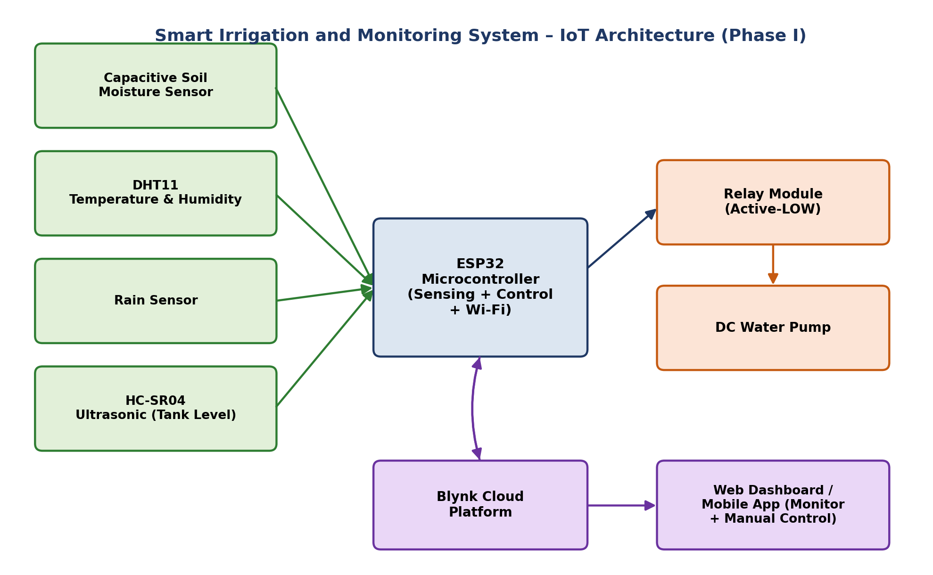
System Architecture
Inputs: soil moisture, DHT11, rain, HC-SR04 tank level
Control: ESP32 thresholds and priorities
Output: relay-driven DC pump
Cloud: Blynk web and mobile, 8 virtual pins
Safety: tank-empty cut-off in every mode
Figure 3: IoT system block diagram
Notes:
Four sensors feed the ESP32; it drives the relay and pump locally, and mirrors data to Blynk for monitoring and manual control.

Slide 8
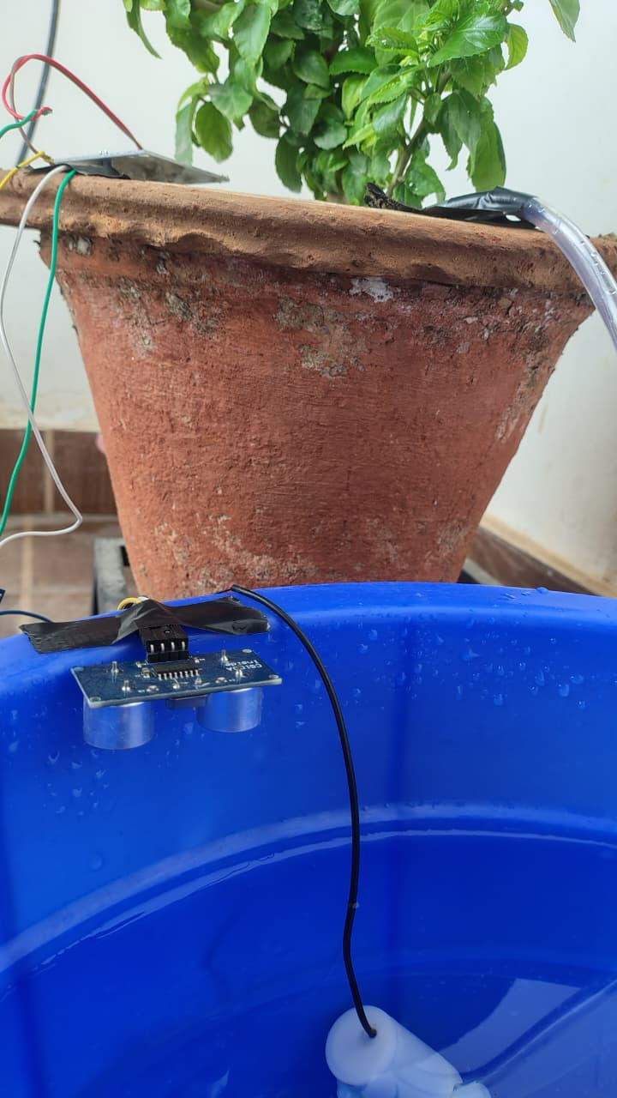
Hardware Prototype
ESP32 pin | Connected to
GPIO 34 | Soil moisture (ADC)
GPIO 4 | DHT11
GPIO 27 | Rain sensor
GPIO 26 | Relay (pump)
GPIO 18 / 19 | HC-SR04 trig / echo
ESP32, relay and wiring
Tank with HC-SR04
Plant pot with rain sensor
Notes:
Show the real setup: breadboard with ESP32 and relay, rain sensor on the pot, and the ultrasonic sensor on the water tank. Pin map on the right.

Slide 9
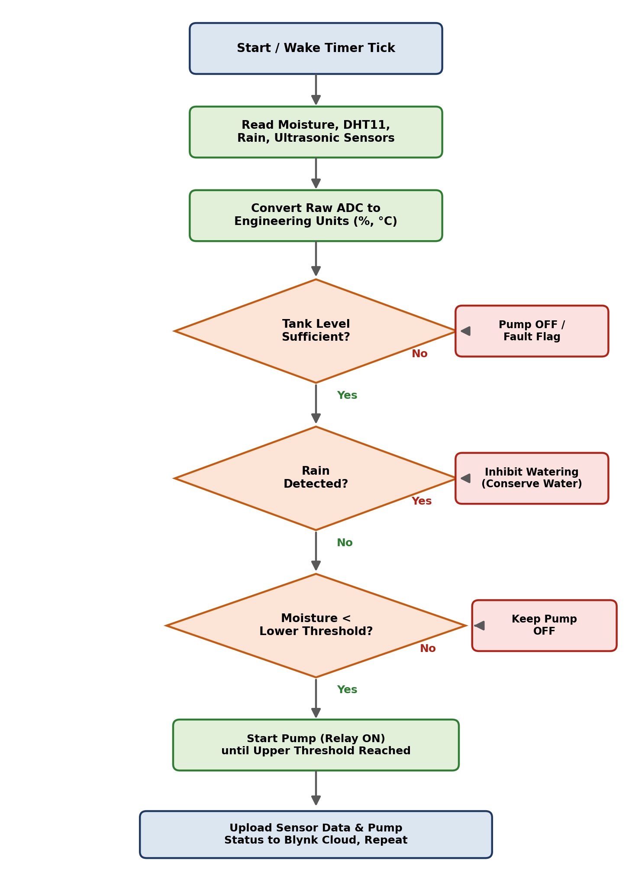
Firmware & Algorithm
Task: runs on a 2 s timer; moisture averaged over 10 ADC samples
Auto mode: pump ON below 20% moisture, OFF above 60%
Rain: watering inhibited while rain is detected
Tank: pump forced OFF at 10% level or below, with an alert
Manual mode: dashboard switch drives the relay; tank cut-off still applies
Cloud: data to Blynk virtual pins V0 to V7 [3]
Figure 4: Firmware flowchart
Notes:
Every two seconds the task averages the moisture reading, checks tank and rain, then starts or stops the pump with hysteresis between the low and high thresholds.

Slide 10
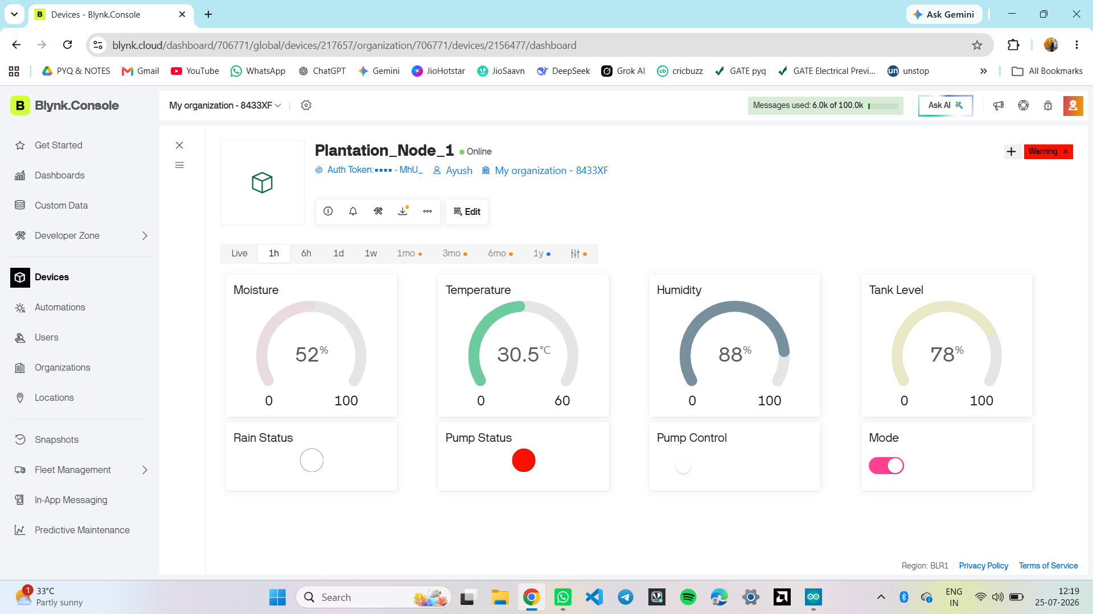
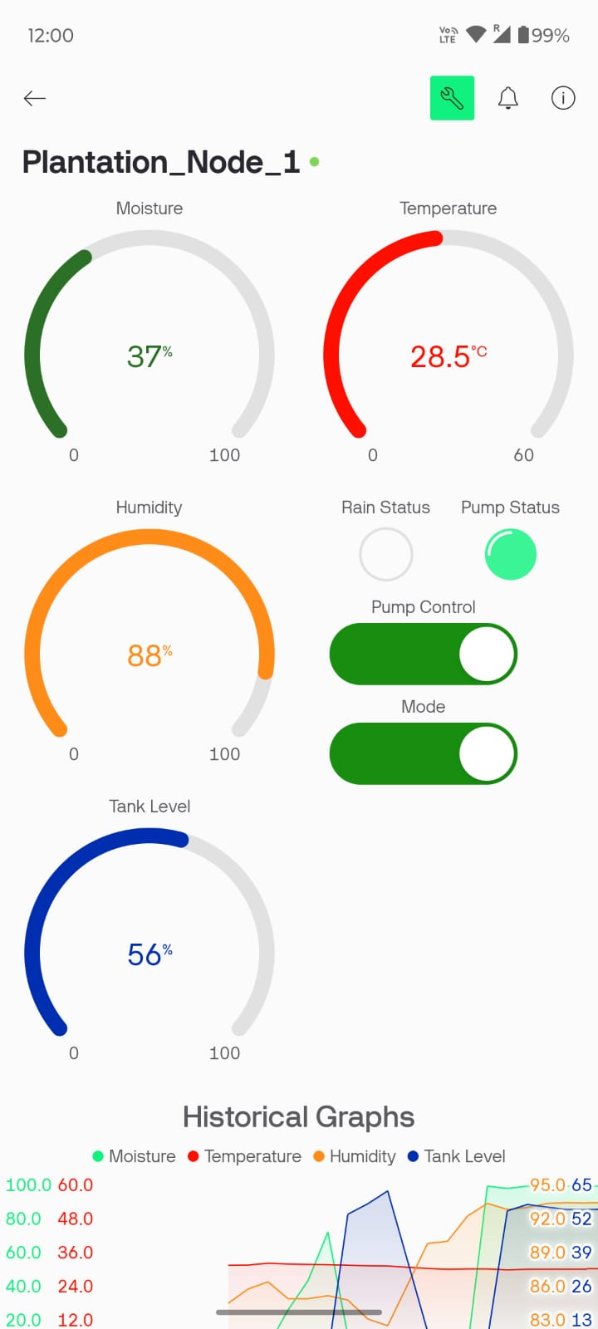
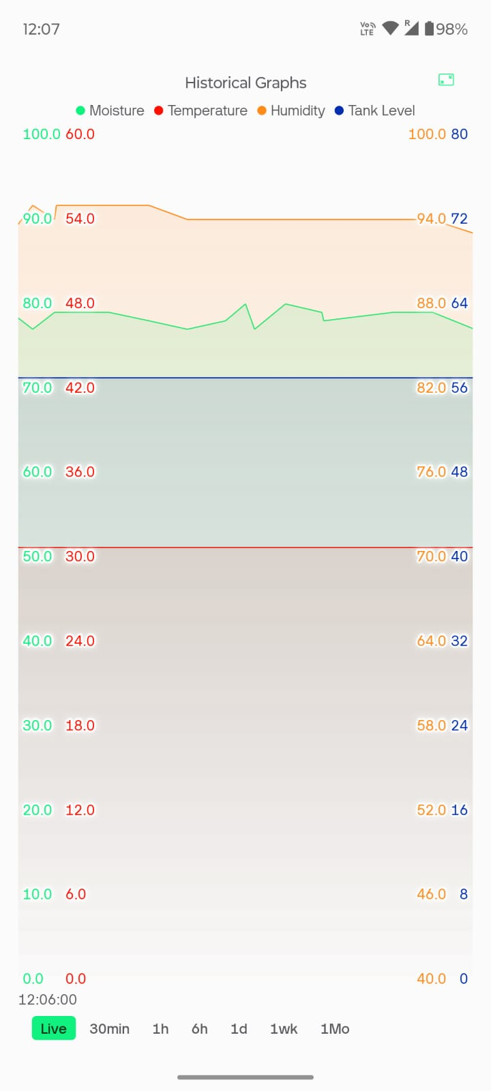
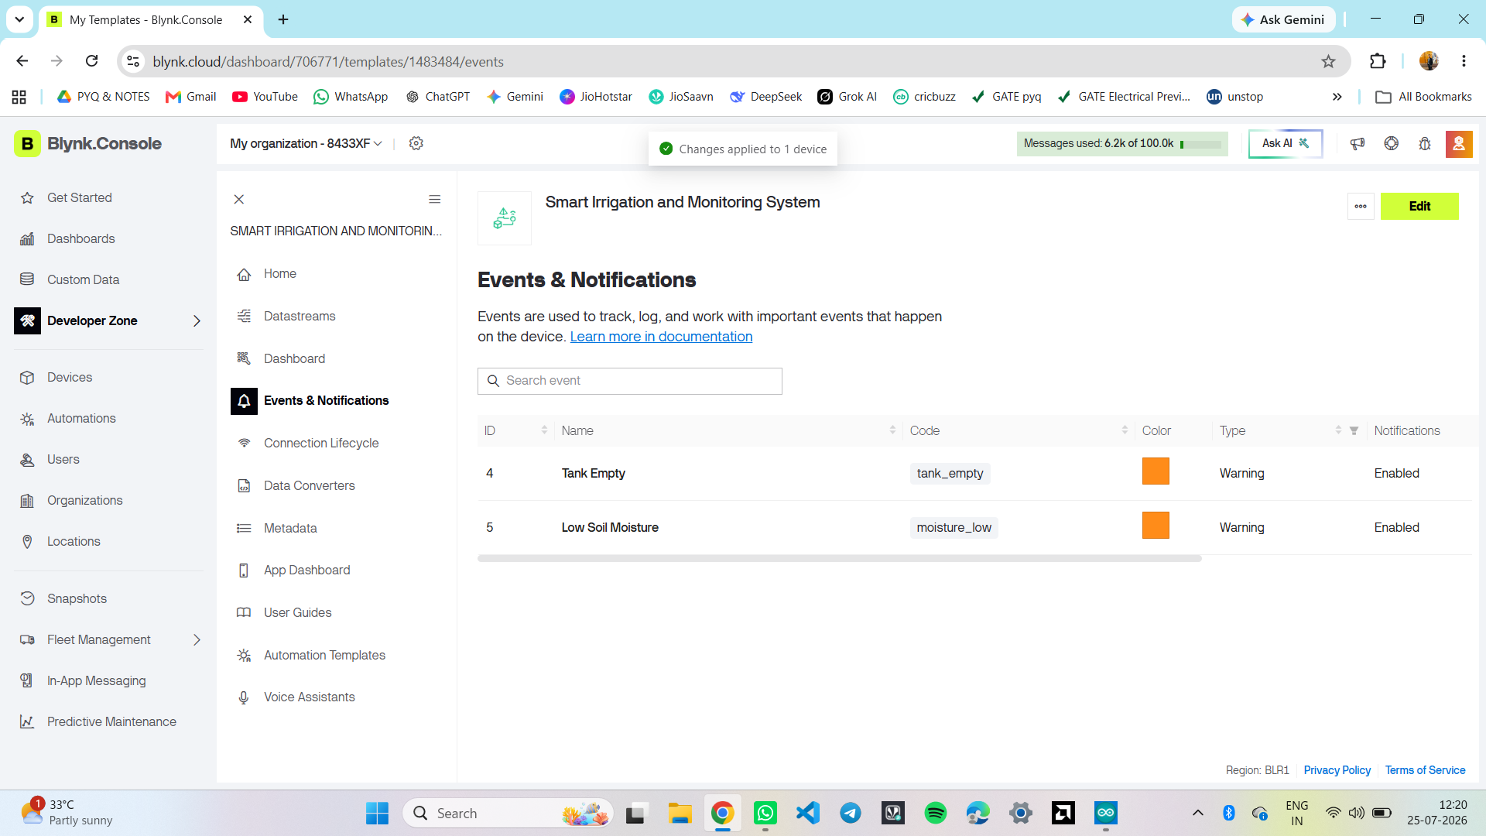
Cloud Monitoring (Blynk)
Web dashboard (manual mode, pump on)
Mobile dashboard
History graph
Tank-empty and low-moisture events
Notes:
The web dashboard and mobile app show live moisture, temperature, humidity, tank level, rain and pump state, with manual controls and warning events.

Slide 11
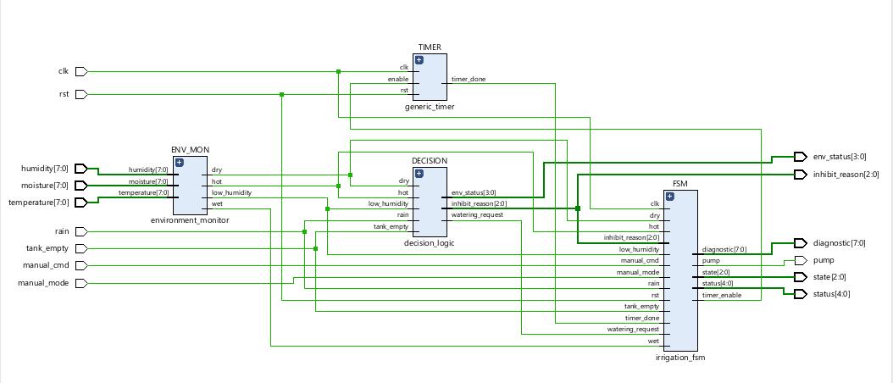
RTL Design of the Controller
Figure 5: Elaborated RTL schematic of smart_irrigation_top
Environment Monitor
Decision Logic
Generic Timer
Irrigation FSM
8-bit sensor values to dry, wet, hot, low-humidity flags
Priority rules give a watering request and inhibit reason
Parameterized counter sets the watering duration
RESET, IDLE, WATER, FAULT states drive the pump
Notes:
The algorithm is split into four modules with narrow interfaces, integrated in a top module. This is the elaborated schematic from Vivado.

Slide 12
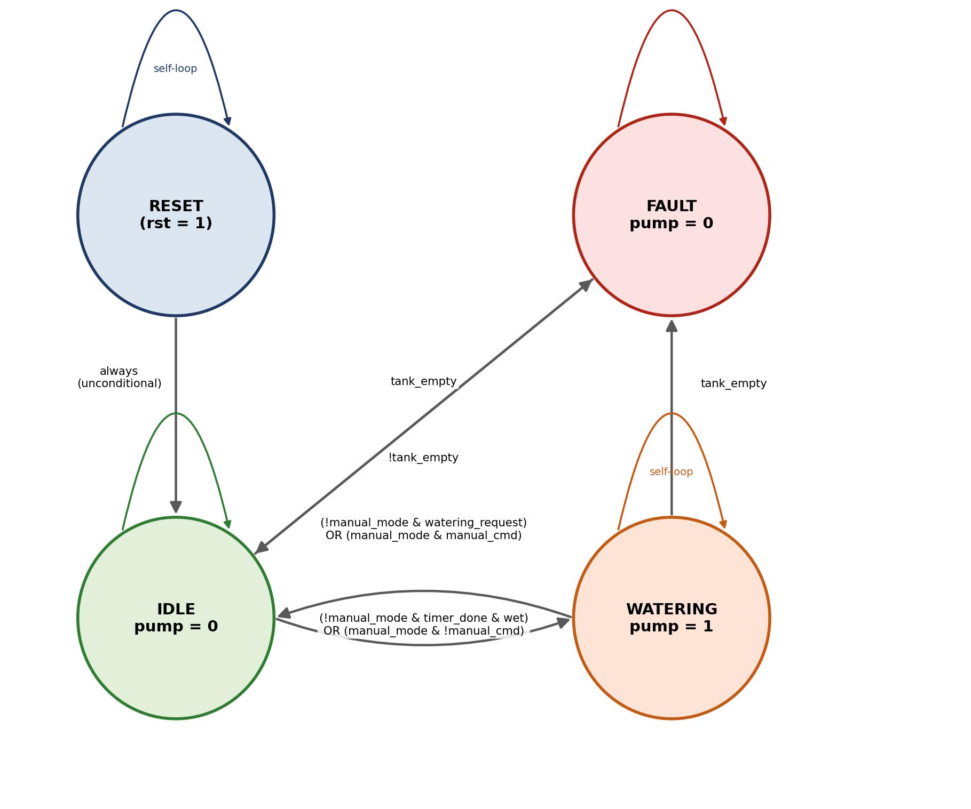
Irrigation FSM
Decision priority
Tank empty > Rain > Temperature >
Humidity > Soil not dry
Tank empty sends IDLE or WATER to FAULT; FAULT returns to IDLE once refilled
Timer sets the watering duration; moisture above threshold ends it
Manual mode overrides automation but never the tank-empty cut-off
(!manual_mode & timer_done & wet) OR (manual_mode & !manual_cmd)
(!manual_mode & watering_request) OR (manual_mode & manual_cmd)
Figure 6: FSM state diagram
Notes:
A Moore machine: outputs depend on state only. Tank-empty always wins, in both automatic and manual modes.

Slide 13
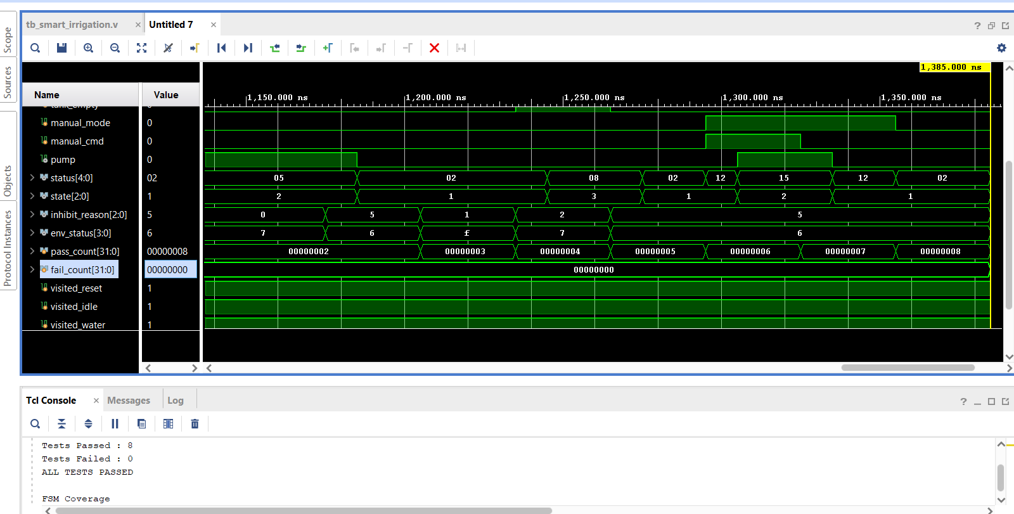
Functional Verification
# | Scenario | Expected
1 | Reset | IDLE, pump off
2 | Dry soil | WATER, pump on
3 | Timer expiry | IDLE, pump off
4 | Rain | Inhibited
5 | Tank empty | FAULT, pump off
6 | Recovery | IDLE
7a | Manual on | WATER, pump on
7b | Manual off | IDLE, pump off
Figure 7: Simulation result
8 / 8
100%
tests passed
FSM state coverage
Notes:
A self-checking testbench applies eight scenarios and compares pump and state automatically; coverage flags confirm every FSM state was reached.

Slide 14
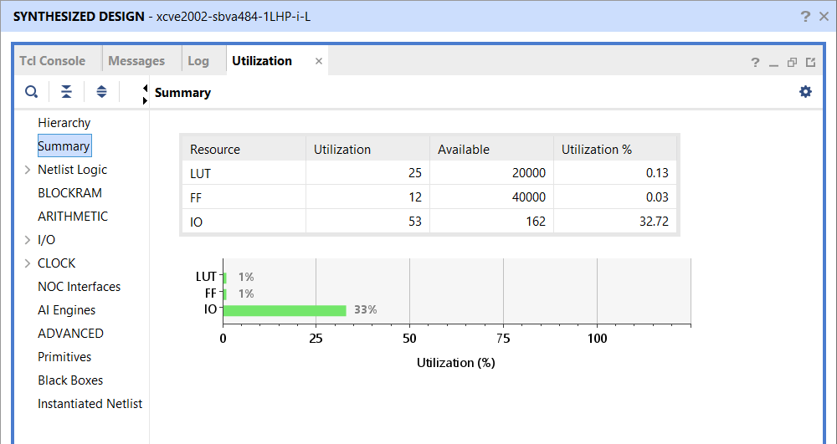
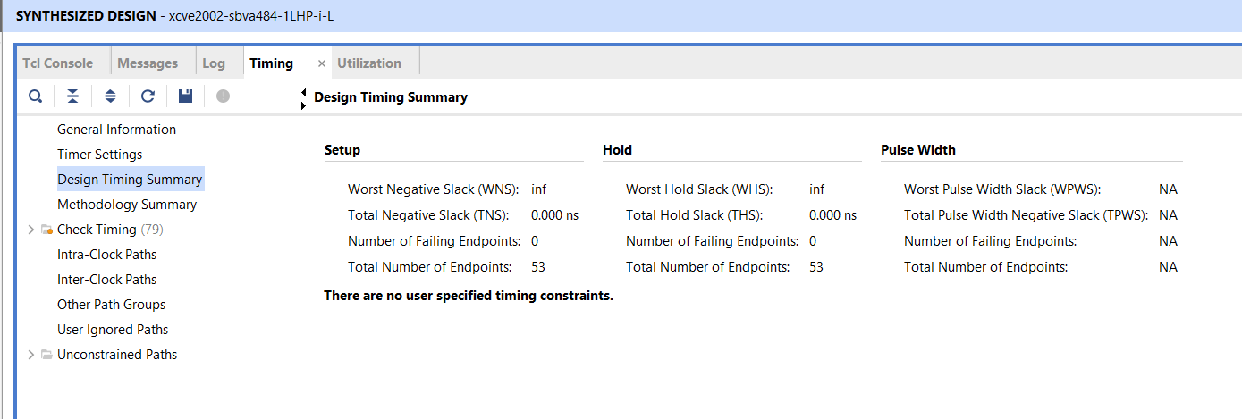
Synthesis in Vivado
25
12
53
LUTs (0.13%)
Flip-flops (0.03%)
I/O pins (32.7%)
Figure 9: Timing summary (unconstrained)
Figure 8: Utilization summary
Target: Versal xcve2002 reference part, AMD Vivado 2025.2 [5]
Notes:
Vivado synthesis shows a very small design. The run had no timing constraints, so it reports no violations but does not claim timing closure.

Slide 15
RTL-to-GDSII with OpenLane 2
1 Synthesis
2 Floorplan & PDN
3 Placement
4 Clock tree
5 Routing
6 STA, 9 corners
7 DRC, LVS, antenna
8 GDSII
Setup
Finding: synthesis strategy
SKY130A, sky130_fd_sc_hd cells [6][7]
Yosys / ABC synthesis, OpenROAD place and route [8][9]
120 x 120 um die, 5 ns clock
Generic SDC, 20% I/O delays
Default AREA 0 left a weak 5-input AOI gate: 3 max-slew violations at the slow corner
DELAY 0 re-mapped the logic: 0 violations
Cost: about 5% more area
Notes:
The same RTL goes through the open-source flow on SKY130. Interesting finding: switching the synthesis strategy removed a slew violation.

Slide 16
Clock Sweep & Signoff
Final run (5 ns) | Result
Setup slack | +0.18 ns
Hold slack | +0.119 ns
DRC / LVS | 0 / 0
Antenna | 0
Slew violations | 0
Power | 391 uW
Std-cell area | 1,378 um2
Notes:
Worst setup slack across nine corners for each run. DELAY 0 closes timing at 5 ns; the default strategy fails at 5 ns by 0.059 ns. Signoff checks are all clean.

Slide 17
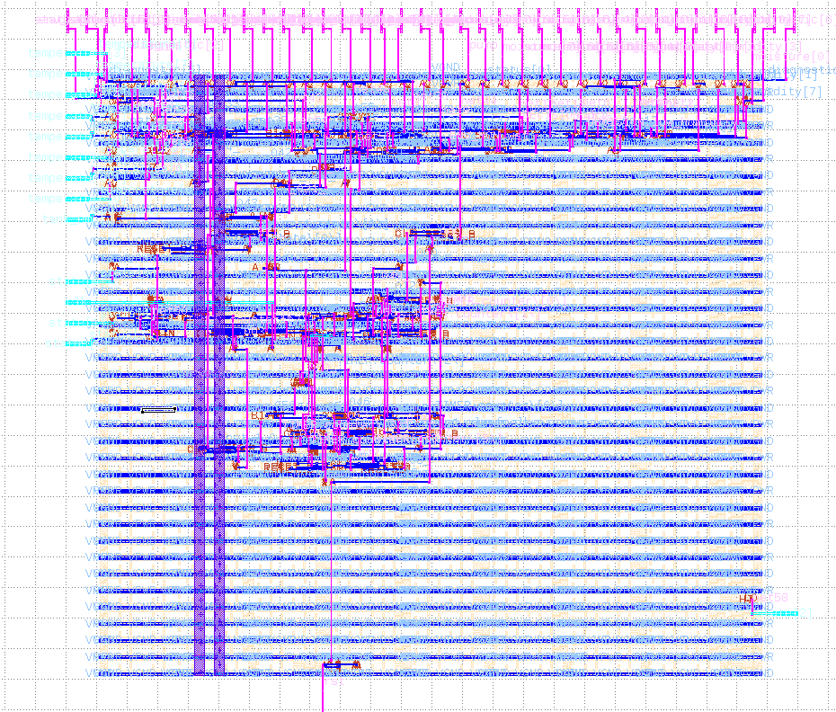
Final Layout & Gate-Level Check
8 / 8
gate-level tests pass on the post-layout netlist
0
DRC, LVS and antenna violations
Race found
reset released on a clock edge; fixed with a 1 ns offset
Figure 10: Final routed layout (120 x 120 um)
Notes:
Left: the final routed layout. Right: gate-level simulation passed 8 of 8; it also exposed a clock-edge race in the original testbench, which was fixed.

Slide 18

Key Learnings & Skills
Technical Knowledge
Practical & Analytical
Professional
ESP32 firmware, sensors and Blynk
Verilog RTL and FSM design
Self-checking verification
Vivado and OpenLane 2 flows
Comparing options with data (clock sweep, strategies)
Reading STA and tool reports
Debugging a race and a slew violation
Technical documentation
Treating warnings and failures as feedback
Stating assumptions and limits of results
Notes:
Technical knowledge, practical and analytical skills, and professional habits developed during the internship.

Slide 19
Results & Discussion
Aspect | ESP32 IoT (Phase I) | Verilog RTL (Phase II)
Execution | Sequential software | Parallel synchronous hardware
Monitoring | Blynk cloud, web and mobile | Diagnostic output buses
Verification | Live testing on plant and tank | 8 self-checking tests, 100% coverage, gate-level sim
Implementation | ESP32 board | 25 LUTs, 12 FFs; SKY130 layout, 1,378 um2
Next step | Standalone product | Reusable SoC IP block
The prototype fixed the thresholds; the RTL flow turned them into verified, implementable hardware.
Notes:
Same algorithm in two domains. The software prototype validated thresholds on real hardware; the RTL version is testable, synthesizable and now has a layout.

Slide 20


Conclusion & Future Scope
Conclusion
Future Scope
ESP32 prototype validated with automatic and manual irrigation
RTL passes 8 of 8 tests with full state coverage
RTL-to-GDSII at 5 ns: clean DRC, LVS, antenna
Gate-level simulation matches the RTL
AXI-style interface for SoC integration
Digital I2C/SPI sensors, ML-based irrigation prediction
Solar-powered field deployment
FPGA board test, custom SDC and SDF timing simulation
Notes:
Summarize what was delivered, then the next steps: SoC integration, better sensors, prediction, field deployment, and a real FPGA or tape-out path.

Slide 21
References
[1] “MNNIT Incubator Ties Up With Wadhwani Foundation To Start Liftoff Acceleration Program,” Wadhwani Foundation. [Online]. Available: https://wadhwanifoundation.org/?p=43622
[2] Espressif Systems, “ESP32 Series Datasheet,” Shanghai, China. [Online]. Available: espressif.com
[3] Blynk Inc., “Blynk IoT Platform Documentation.” [Online]. Available: https://docs.blynk.io
[4] IEEE Standard for Verilog Hardware Description Language, IEEE Std 1364-2005, 2006.
[5] AMD, “Vivado Design Suite User Guide: Synthesis (UG901),” 2025.
[6] “OpenLane 2 Documentation.” [Online]. Available: https://openlane2.readthedocs.io
[7] SkyWater Technology, “SkyWater Open Source PDK (SKY130) Documentation.” [Online]. Available: https://skywater-pdk.readthedocs.io
[8] C. Wolf, “Yosys Open SYnthesis Suite.” [Online]. Available: https://yosyshq.net/yosys/
[9] T. Ajayi et al., “Toward an open-source digital flow: First learnings from the OpenROAD project,” in Proc. 56th ACM/IEEE DAC, Las Vegas, NV, USA, Jun. 2019.

Slide 22
Thank You
Ayush Tiwari | Roll No: 23116022
Department of Electronics and Communication, NIT Raipur
Notes:
Thank the audience and invite questions.

