Slide 1

Project Title -Car Market Trends Analysis
AICTE STU ID : STU69df439a37b6a1776239514
NAME: AYUSH SINHA

Slide 2

PROBLEM STATEMENT
* The used-car market contains vehicles with different prices, fuel types, transmission types, and usage levels.
* It is difficult for everyday consumers to understand which specific factors have the greatest impact on a car's resale selling price.
* Both buyers and sellers lack accessible, data-driven frameworks to evaluate a vehicle's fair market value.
* This project analyzes historical Car Dekho data to uncover critical market trends and pricing patterns, supporting optimal purchasing and pricing decisions.

Slide 3
Project Description
* This project centers on exploratory data analysis (EDA) of automobile data using Python libraries (Pandas, NumPy, Matplotlib, and Seaborn).
* The dataset evaluates core attributes: car name, manufacturing year, selling price, present showroom price, kilometers driven, fuel type, seller type, transmission type, and previous owner history.
* By analyzing correlations and distributions between these attributes, the project highlights the primary macroeconomic and physical drivers behind used-car depreciation and valuation.

Slide 4

WHO ARE THE END USERS?
* Car Buyers: To cross-compare vehicle options, evaluate depreciation rates, and identify reasonable market purchase prices.
* Car Sellers: To benchmark vehicle specifications against historical trends and estimate competitive selling prices.
* Car Dealers: To understand localized consumer demand patterns and optimize vehicle inventory valuation.
* Used-Car Businesses: To drive profitable pricing strategies and risk assessment models.

Slide 5

Technology Used
  * Programming Language: Python (executed via Google Colab)
  * Data Manipulation & Processing: Pandas and NumPy
  * Data Visualization: Matplotlib and Seaborn
  * Version Control & Collaboration: GitHub

Slide 6
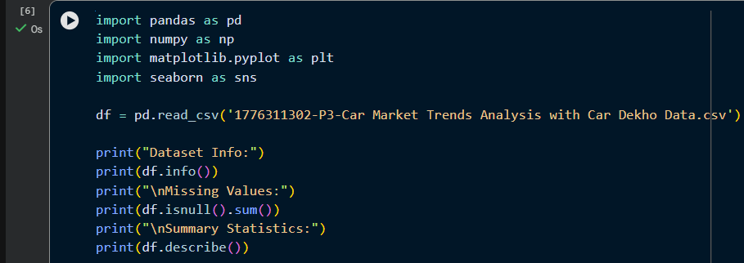
RESULTS
Demo Link

Slide 7
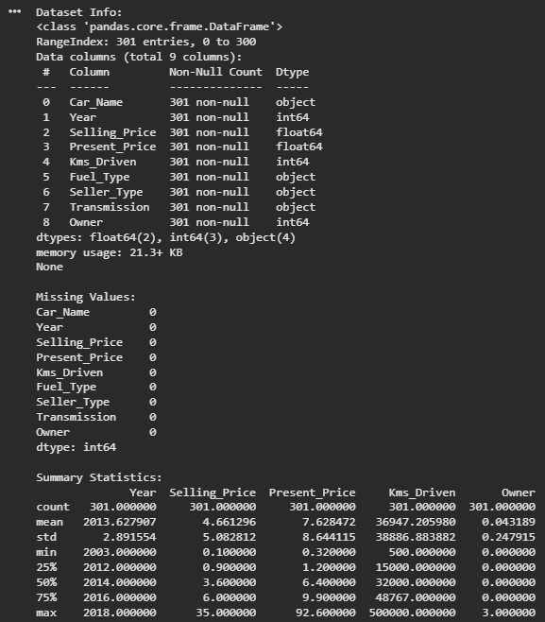
RESULTS

Slide 8
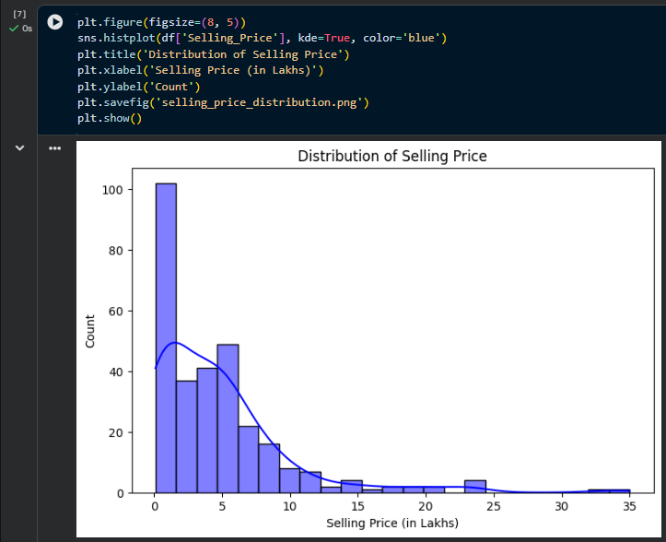
RESULTS

Slide 9
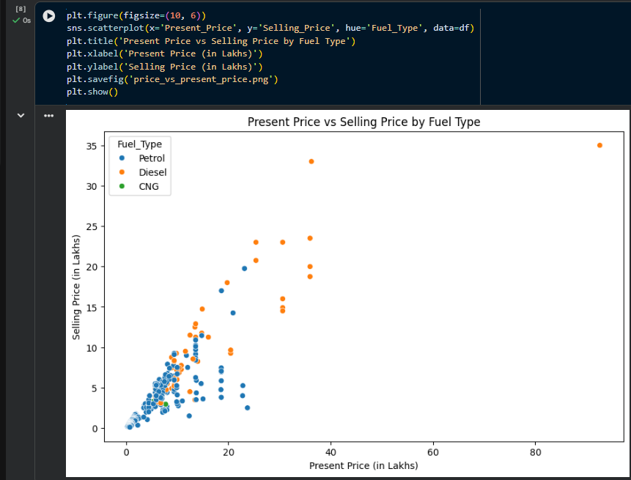
RESULTS

Slide 10
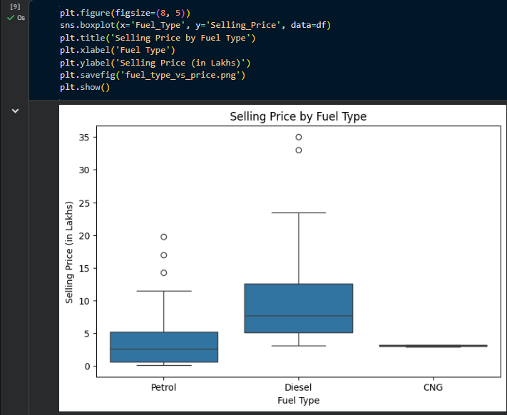
RESULTS

Slide 11
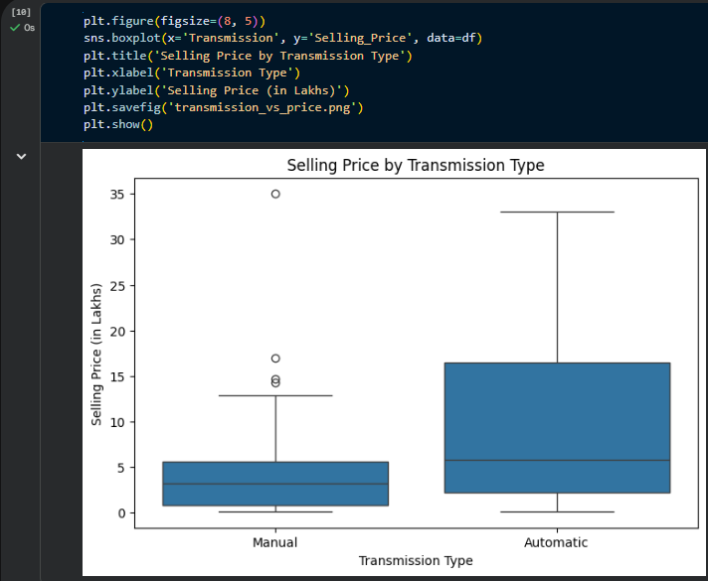
RESULTS

Slide 12
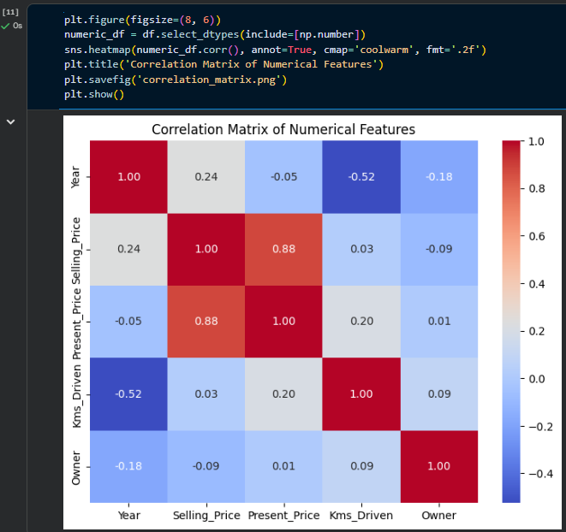
RESULTS

Slide 13

RESULTS
GITHUB link: https://github.com/ayush-614/Car-Market-Analysis.git

Slide 14

Thank you
.
.

