Slide 1
Google Play Store Data Analysis
Presented By:
Hirak Jyoti Dutta
188920_IN

Slide 2

Contents
Requirements
Understanding the dataset
Inspiration
Workflow
Master Job
Data Cleaning
Creating Data Models : Dimension tables and Fact tables
Loading data into HDFS
Loading data into hive
Back Up data into a RDB
Analysis

Slide 3
Requirements
DataSet
HDFS environment
Talend Open Studio

Slide 4
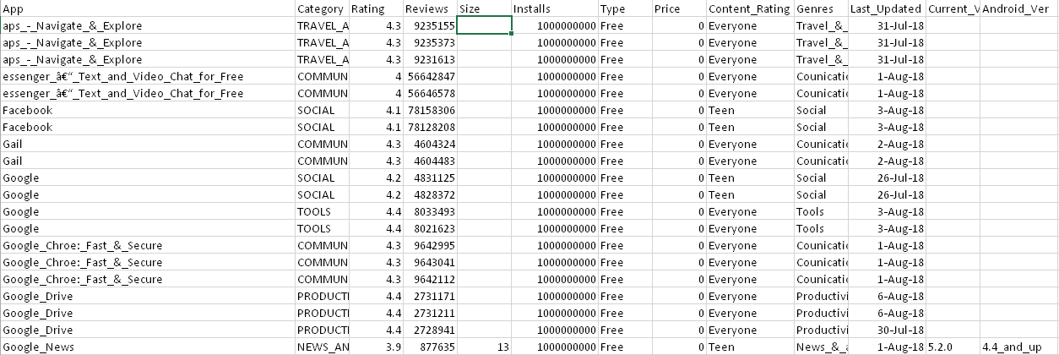
Understanding the dataset
Details of applications available on Google Play Store.
There are 13 features in the available dataset.

Slide 5
Inspiration
The Play Store apps data has enormous potential to drive app-making businesses to success.
Actionable insights can be drawn for developers to work on and capture the Android market.

Slide 6
Workflow
Start
NO
If there are duplicates and null values
Understanding the data
Data cleaning using talend
Decision for dimension table
Make fact tables by logically using Dimension tables and the cleaned dataset together
Yes
Back up data into MySql using Sqoop
Load data into hive
Create hive tables
Load data into hdfs
Data ready for analysis

Slide 7
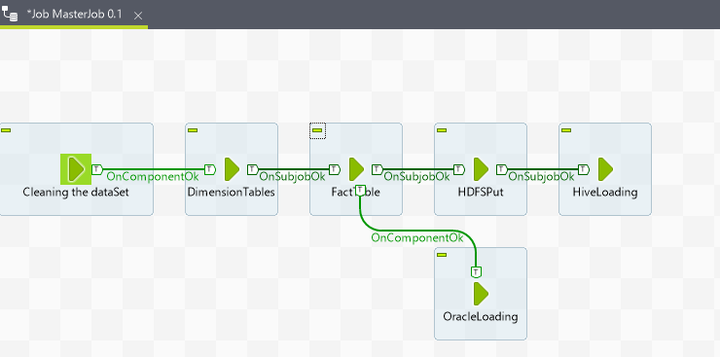
Master Job

Slide 8
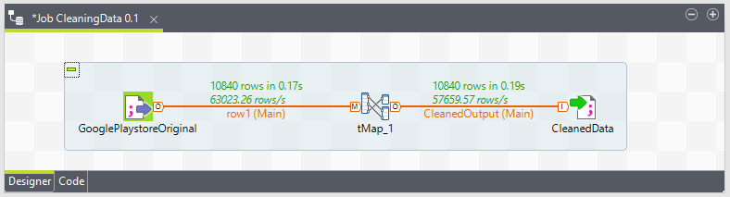
Cleaning The Dataset With Talend
Content: Each row has values for app name, category, rating, reviews, size, version, and more.
Columns: 14
Rows: 10,842

Slide 9
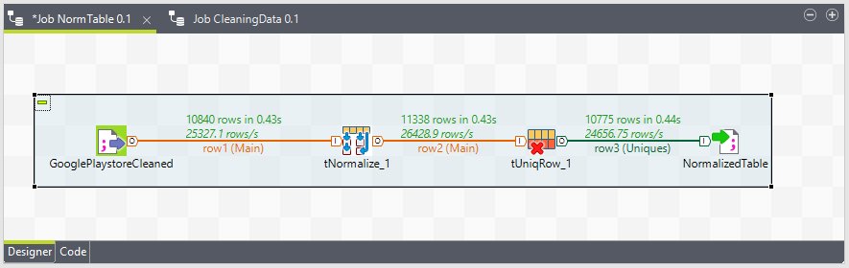
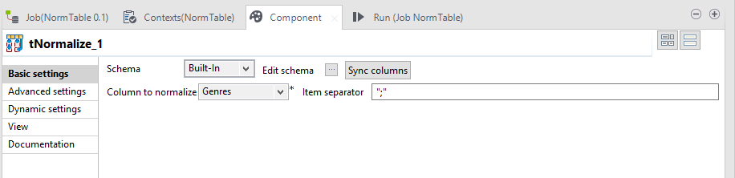
Normalizing Data Using Talend

Slide 10
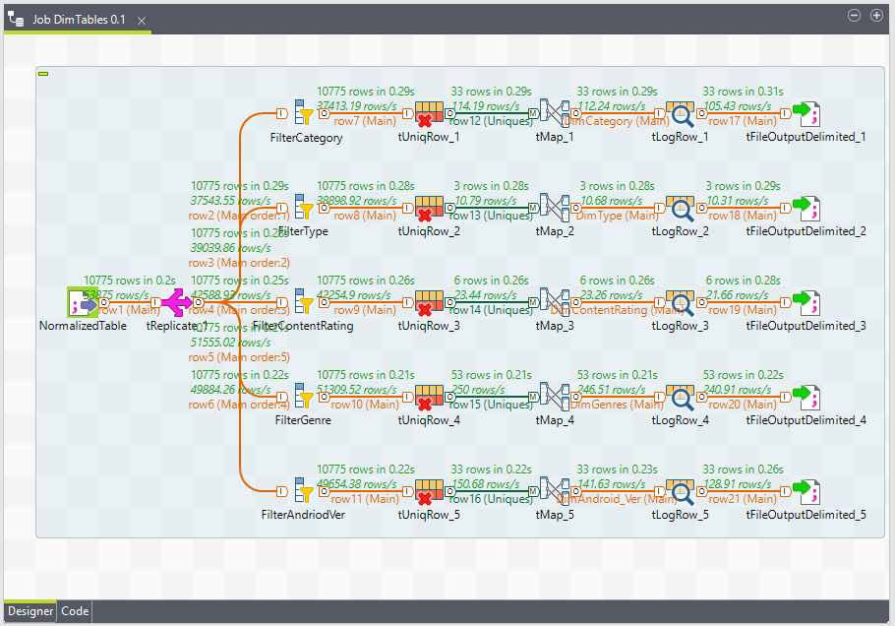
Creating Dimension Tables Using Talend

Slide 11
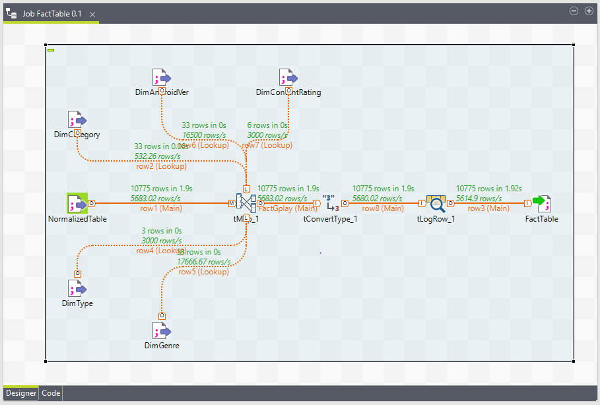
Creating Fact Table Using Talend

Slide 12
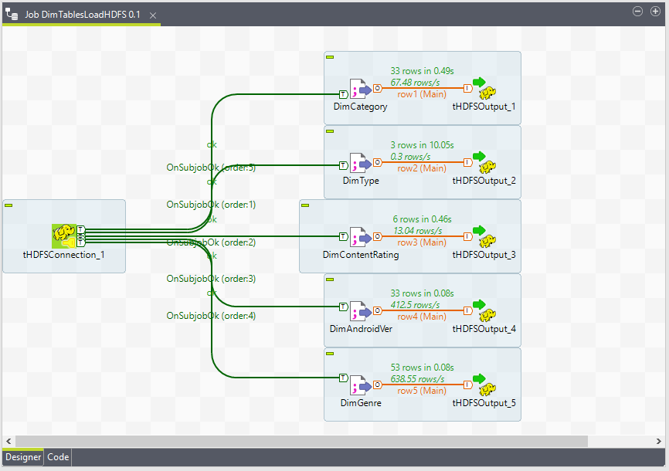
Loading Dimension Tables Into HDFS Using Talend

Slide 13
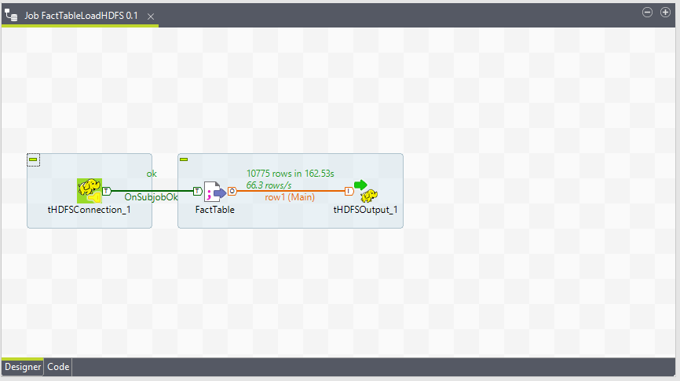
Loading Fact Table Into HDFS Using Talend

Slide 14
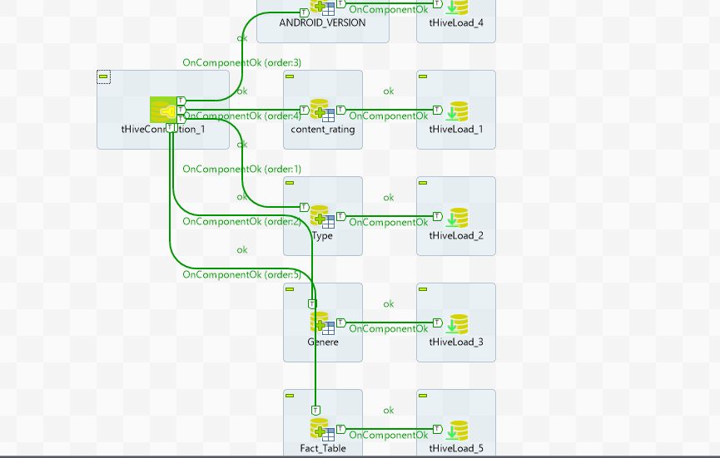
Loading Fact Table Into Hive Using Talend

Slide 15

ANALYSIS

Slide 16
Type of Apps
Free or Paid
Free | 9941
Paid | 833

Slide 17
Top 20 Paid Apps Based on Installs
TYPE | APP
Paid | Minecraft
Paid | Hitman_Sniper
Paid | Facetune_-_For_Free
Paid | HD_Widgets
Paid | Beautiful_Widgets_Pro
Paid | Zombie_Avengers:(Dreamsky)Stickman_War_Z
Paid | League_of_Stickman_2018-_Ninja_Arena_PVP(Dreamsky)
Paid | Stickman_Legends:_Shadow_Wars
Paid | Tasker
Paid | Cut_the_Rope_GOLD
Paid | Bloons_TD_5
Paid | Where's_My_Water?
Paid | True_Skate
Paid | Lost_Journey_(Dreamsky)
Paid | Grand_Theft_Auto:_San_Andreas
Paid | Fruit_Ninja_Classic
Paid | Card_Wars_-_Adventure_Time
Paid | Sleep_as_Android_Unlock
Paid | Infinity_Dungeon_VIP
Paid | Five_Nights_at_Freddy's

Slide 18
Top 20 Free Apps Based on Installs
TYPE | APP
Free | WhatsApp_Messenger
Free | Google_News
Free | Google_Chrome:_Fast_&_Secure
Free | YouTube
Free | Google_Play_Books
Free | Maps_-_Navigate_&_Explore
Free | Subway_Surfers
Free | Google_Play_Games
Free | Gmail
Free | Google_Street_View
Free | Messenger_?_Text_and_Video_Chat_for_Free
Free | Google_Play_Movies_&_TV
Free | Google_Photos
Free | Instagram
Free | Google
Free | Hangouts
Free | Google_Drive
Free | Facebook
Free | Google+
Free | WhatsApp_Messenger

Slide 19
App Count of Categories
10,775 Apps are divided across 33 Categories

Slide 20
Most Popular Categories Based On Installs

Slide 21
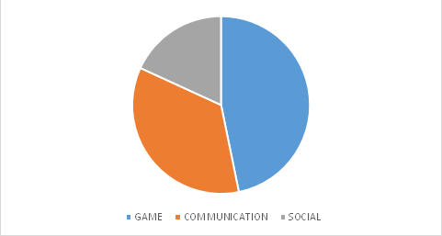
Top 3 Categories Based On Installs
CATEGORY | INSTALLS
GAME | 32,249,124,415
COMMUNICATION | 24,152,276,251
SOCIAL | 12,513,867,902

Slide 22
Top 20 Apps of GAME Category
CATEGORY | APP
GAME | Subway_Surfers
GAME | Pou
GAME | Temple_Run_2
GAME | Candy_Crush_Saga
GAME | My_Talking_Tom
GAME | Plants_vs._Zombies_FREE
GAME | Pokemon_GO
GAME | Talking_Tom_Gold_Run
GAME | ROBLOX
GAME | Banana_Kong
GAME | Roll_the_Ball_-_slide_puzzle
GAME | Super_Mario_Run
GAME | Score!_Hero
GAME | Shadow_Fight_2
GAME | Zombie_Tsunami
GAME | Skater_Boy
GAME | Smash_Hit
GAME | Sniper_3D_Gun_Shooter:_Free_Shooting_Games_-_FPS
GAME | Sonic_Dash
GAME | Dr._Driving

Slide 23
Top 20 Apps of SOCIAL Category
CATEGORY | APP
SOCIAL | Facebook
SOCIAL | Instagram
SOCIAL | Google+
SOCIAL | Snapchat
SOCIAL | Facebook_Lite
SOCIAL | Tango_-_Live_Video_Broadcast
SOCIAL | LinkedIn
SOCIAL | BIGO_LIVE_-_Live_Stream
SOCIAL | VK
SOCIAL | Badoo_-_Free_Chat_&_Dating_App
SOCIAL | Tumblr
SOCIAL | Tik_Tok_-_including_musical.ly
SOCIAL | Pinterest
SOCIAL | ooVoo_Video_Calls_Messaging_&_Stories
SOCIAL | SKOUT_-_Meet_Chat_Go_Live
SOCIAL | Zello_PTT_Walkie_Talkie
SOCIAL | MeetMe:_Chat_&_Meet_New_People
SOCIAL | POF_Free_Dating_App
SOCIAL | Amino:_Communities_and_Chats
SOCIAL | Path

Slide 24
Number of Apps based on Android Version
Out of 10,775 Apps, Android Version for 1247 apps are not available.
Rest are divided across 29 different Android Versions.

Slide 25
Installed Apps According to Rating

Slide 26
Apps with Maximum Rating and Installs
APP | RATING | INSTALLS
Ek_Bander_Ne_Kholi_Dukan | 5 | 10000
CL_Keyboard_-_Myanmar_Keyboard_(No_Ads) | 5 | 5000
Superheroes_Marvel_DC_Comics_TV_Movies_News | 5 | 5000
Oracion_CX | 5 | 5000
GKPB_FP_Online_Church | 5 | 1000
Dr_Bk_Sachin_bhai | 5 | 1000
Master_E.K | 5 | 1000
APP_Guide | 5 | 1000
Jobs_in_Canada_-_Emplois_au_Canada | 5 | 1000
BM_SPM_Practice | 5 | 1000
ReactNative_BG_Geolocation | 5 | 1000
The_Divine_Feminine_App:_the_DF_App | 5 | 1000
South_Florida_AA_Meetings | 5 | 1000
Fr._Daoud_Lamei | 5 | 1000
R_Programing_Offline_Tutorial | 5 | 1000
Bk_Usha_behn | 5 | 1000
BP_Journal_-_Blood_Pressure_Diary | 5 | 1000
Hojiboy_Tojiboyev_Life_Hacks | 5 | 1000
Rios_de_Fe | 5 | 1000

Slide 27
Thank You

