Slide 1
Title of the presentation 2 lines
Bangalore, 25th September 2019, Ayush Pandey

Slide 2
About
Kickstarter exists to help bring creative projects to life. A home for film, music, art, theater, games, comics, design, photography, and more. Here, enthusiasts upload a project and fix a deadline. During the lifetime of the uploaded project, uploader attracts thousands of generous backers from the crowd for funding and accomplishing the set goal.

Slide 3
Inspiration
Best strategy to decide the day of launch for a successful fund raising.
How much to set as goal.
Exploiting opportunities in growing categories.
Expecting the right number of backers.

Slide 4
Understanding the DataSet

Slide 5
Our Analysis
Best strategy to decide the day of launch for a successful fund raising.
How much to set as goal.
Exploiting opportunities in growing categories.
Expecting the right number of backers.

Slide 6
Workflow
Start
NO
If there are duplicates and invalid values
Understanding the data
Data cleaning using talend
Decision for dimension table
Make fact tables by logically using Dimension tables and the cleaned dataset together
Yes
Back up data into MySql using Sqoop
Load data into hive
Create hive tables
Load data into hdfs
Data ready for analysis

Slide 7
Analysis based on:
Time
Category
Country
Year vs Main category
Month influence
Weekday influence
Day of month influence
Duration influence
Subcategory
Trendy fundraisers
For successful campaigns,
Average number of backers
Average amount pledged

Slide 8
STEPS
01
Cleaning
02
Modelling
Requirements
DataSet
HDFS environment
Talend Open Studio
03
Analyzing

Slide 9
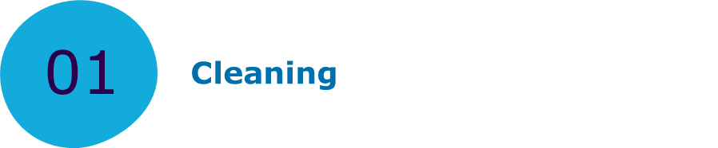
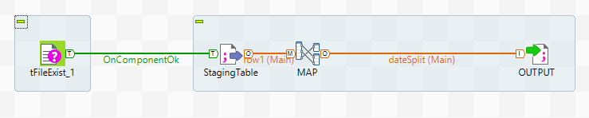
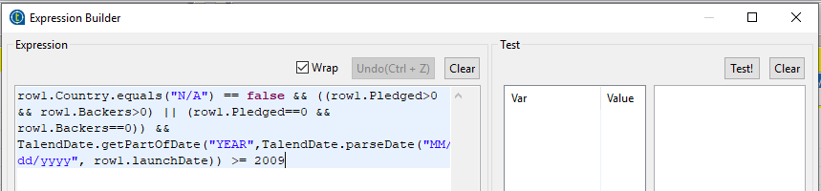
File exists?
All data latest? (>2009)
Invalid data?
(n/a country or positive amount pledged by zero backers)

Slide 10
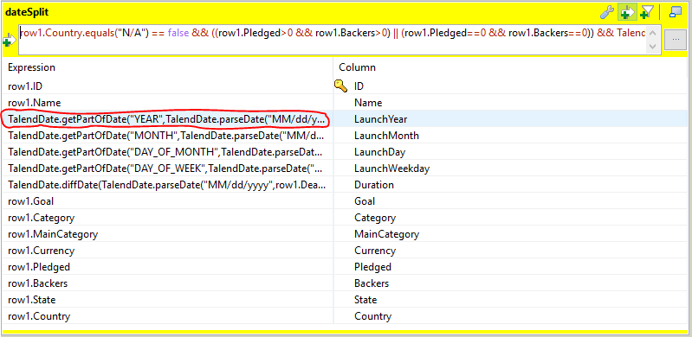
Date splitting:
Day of month, weekday, month, year

Slide 11
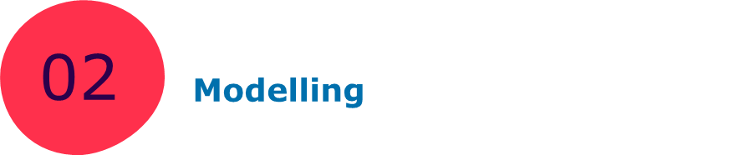
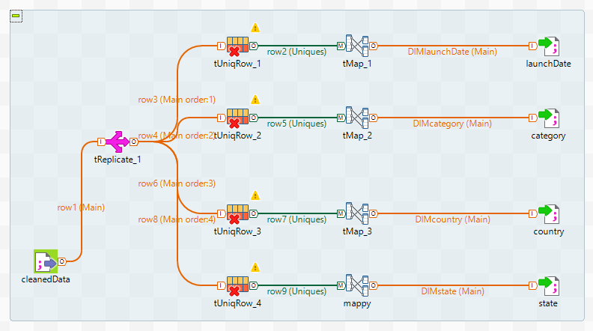

Slide 12
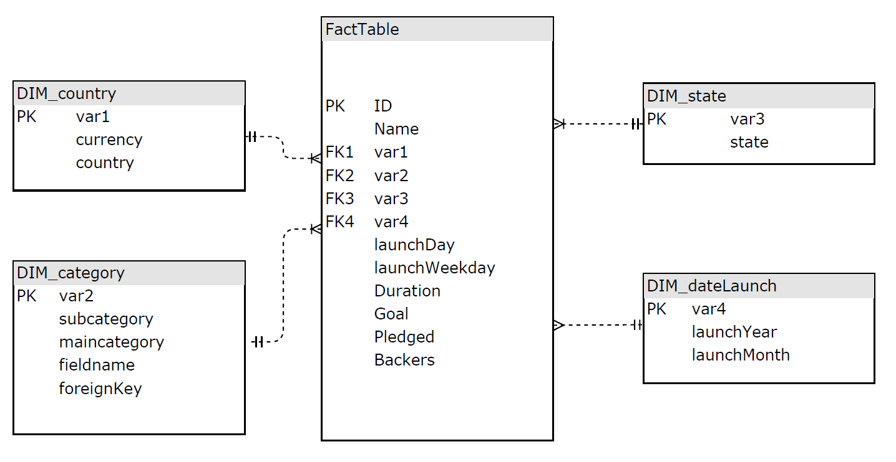
Dimension Tables

Slide 13
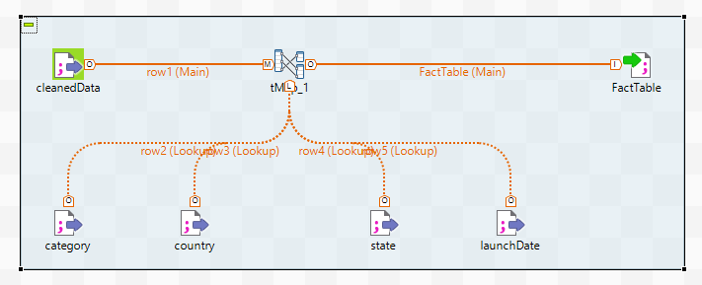
Fact Table

Slide 14

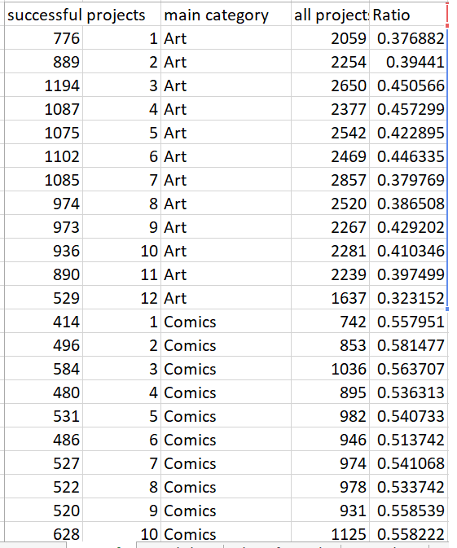
select count(c.maincategory),y.launchmonth,c.maincategory from facttable f
join dim_category c on f.dim_category=c.var1
join dim_launchDate y on f.dim_launchdate=y.var1
Where dim_state=3
group by y.launchmonth,c.maincategory
order by c.maincategory,y.launchmonth;
Ratio = successful_projects/all_projects

Slide 15
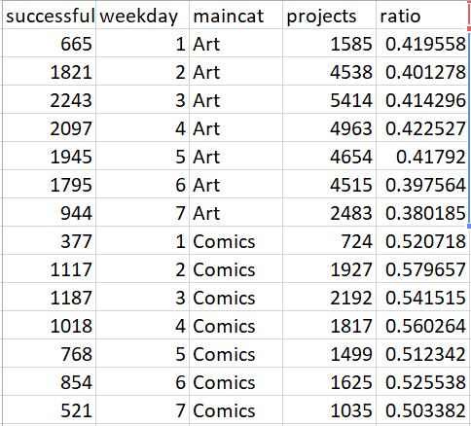
select count(c.maincategory),f.launchweekday,c.maincategory from facttable f
join dim_category c on f.dim_category=c.var1
join dim_launchDate y on f.dim_launchdate=y.var1
Where dim_state=3
group by f.launchweekday,c.maincategory
order by c.maincategory,f.launchweekday;
Ratio = successful_projects/all_projects

Slide 16
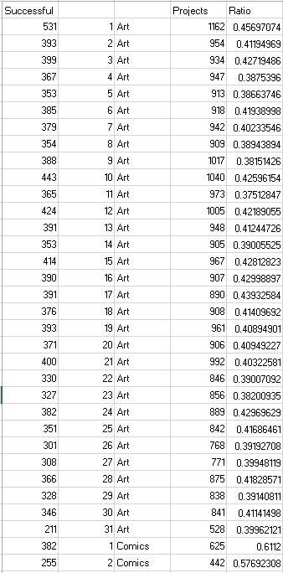
select count(c.maincategory),f.launchday,c.maincategory from facttable f
join dim_category c on f.dim_category=c.var1
join dim_launchDate y on f.dim_launchdate=y.var1
Where dim_state=3
group by f.launchday,c.maincategory
order by c.maincategory,f.launchday;
Ratio = successful_projects/all_projects

Slide 17

Analysis

Slide 18
Number of Projects Influence of launch month
In almost all categories,
July turns out to be most productive (most launches).
December turns out to be least productive.
However, Feb, Mar, Apr are the most successful.
July and Dec are poor performers.

Slide 19
Number of Projects Influence of launch weekday
In almost all categories,
Tuesday turns out to be most productive.
Monday, Saturday turns out to be least productive.
Also, Tuesday is the most successful.
Saturday is poorest in getting success.

Slide 20
Number of Projects Influence of launch day of month
Most projects get launched on the 1st day of a month. Beyond the 21st day, launch numbers keep falling with 31st day with least numbers.

Slide 21
Number of Projects Influence of launch day of month
First three days have the highest success ratio.
The First Day itself has a very high ratio, greater than 0.4 .

Slide 22
Number of Projects Influence of duration
Number of projects by Duration
Clearly seen, most campaigns are around 30 days longs.

Slide 23
Number of Projects Influence of duration
Campaign duration with
Success rate > 50% listed
DURATION |  | goal | pledged |  | goal | pleadged
22 |  | 6715.5 | 17514.29 |  | 42931.11 | 1456.171
16 |  | 3889.933 | 10430.14 |  | 17875.16 | 878.0634
11 |  | 3109.951 | 6020.047 |  | 167075.4 | 444.3689
17 |  | 4202.513 | 11467.48 |  | 10196.38 | 593.4077
23 |  | 6691.106 | 22082.05 |  | 41809.46 | 1473.902
19 |  | 4641.109 | 14104.17 |  | 14041.37 | 1314.563
18 |  | 5635.213 | 10624.77 |  | 18462.12 | 1044.947
9 |  | 1703.857 | 3135.513 |  | 120806 | 303.8873
21 |  | 5662.076 | 14329.74 |  | 51586.47 | 1169.599
13 |  | 2631.281 | 5123.656 |  | 272042.6 | 426.8547
24 |  | 7113.393 | 16503.21 |  | 99888.66 | 1519.788
8 |  | 1898.549 | 7226.98 |  | 348190 | 305.0274
12 |  | 2608.251 | 5126.95 |  | 184477.6 | 734.6729
26 |  | 6816.254 | 18150.71 |  | 29365.1 | 1743.049
32 |  | 15819.73 | 39386.05 |  | 39373.82 | 3096.929
14 |  | 2879.36 | 5979.304 |  | 30210.1 | 468.1843
MEDIAN 17.5 |  | MEDIAN 4421.811 | MEDIAN 11046.12 |  | MEDIAN 42370.28 | MEDIAN 961.505

Slide 24
Number of Projects Influence of duration
DURATION |  | goal | pledged |  | goal | pleadged
22 |  | 6715.5 | 17514.29 |  | 42931.11 | 1456.171
16 |  | 3889.933 | 10430.14 |  | 17875.16 | 878.0634
11 |  | 3109.951 | 6020.047 |  | 167075.4 | 444.3689
17 |  | 4202.513 | 11467.48 |  | 10196.38 | 593.4077
23 |  | 6691.106 | 22082.05 |  | 41809.46 | 1473.902
19 |  | 4641.109 | 14104.17 |  | 14041.37 | 1314.563
18 |  | 5635.213 | 10624.77 |  | 18462.12 | 1044.947
9 |  | 1703.857 | 3135.513 |  | 120806 | 303.8873
21 |  | 5662.076 | 14329.74 |  | 51586.47 | 1169.599
13 |  | 2631.281 | 5123.656 |  | 272042.6 | 426.8547
24 |  | 7113.393 | 16503.21 |  | 99888.66 | 1519.788
8 |  | 1898.549 | 7226.98 |  | 348190 | 305.0274
12 |  | 2608.251 | 5126.95 |  | 184477.6 | 734.6729
26 |  | 6816.254 | 18150.71 |  | 29365.1 | 1743.049
32 |  | 15819.73 | 39386.05 |  | 39373.82 | 3096.929
14 |  | 2879.36 | 5979.304 |  | 30210.1 | 468.1843
MEDIAN 17.5 |  | MEDIAN 4421.811 | MEDIAN 11046.12 |  | MEDIAN 42370.28 | MEDIAN 961.505
Highly successful campaigns are run for around
15 days to 20 days.
Ask less, get more can be a strategy!

Slide 25
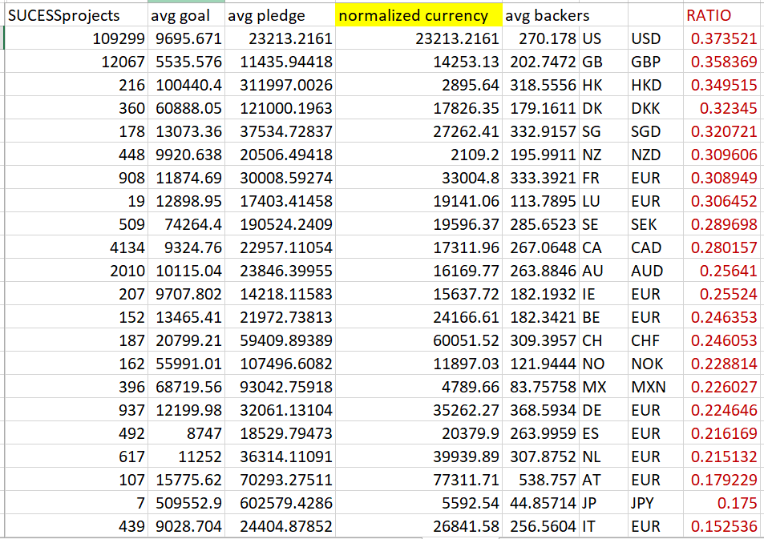
Successful Projects
In countries
Select
count(f.id),avg(f.goal),
avg(f.pledged),avg(f.backers),
avg(f.duration),c.country,
c.currency from facttable f
join dim_country c on f.dim_country=c.var1
where f.dim_state=3
group by c.country,c.currency;

Slide 26
Successful Projects
In countries
Austria,
China,
New Zealand,
Germany, France
are the best places for crowd funding.

Slide 27
Successful Projects
In countries
Japan,
Hong Kong
Have disproportionately
High number of backers.
Japan has 0.175 success ratio.
Hong Kong has 0.349 success ratio.

Slide 28
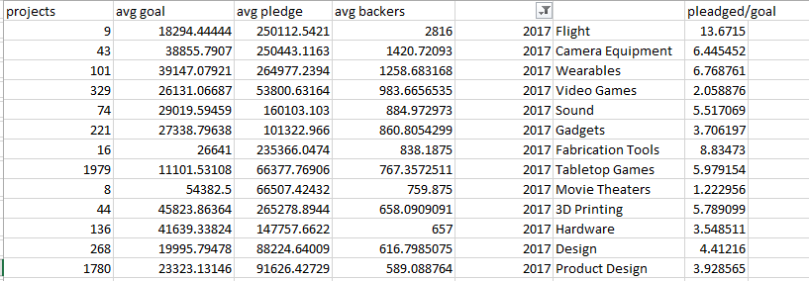
Successful Projects
By subcategories
select count(f.id),avg(f.goal),avg(f.pledged),avg(f.backers),y.launchyear,c.subcategory from facttable f
join dim_category c on f.dim_category=c.var1 join dim_launchDate y on f.dim_launchdate=y.var1
where f.dim_state=3 group by c.subcategory,y.launchyear;
sorted

Slide 29
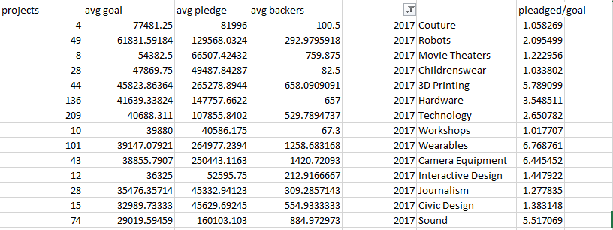
Successful Projects
By subcategories
select count(f.id),avg(f.goal),avg(f.pledged),avg(f.backers),y.launchyear,c.subcategory from facttable f
join dim_category c on f.dim_category=c.var1 join dim_launchDate y on f.dim_launchdate=y.var1
where f.dim_state=3 group by c.subcategory,y.launchyear;
sorted

Slide 30
Successful Projects
By subcategories
Tabletop Games
Product Design
Robots
3D Printing
Hardware
Technology
Wearables
Camera Equipment
Sound
>2x of goal achieved
>10k $ goal
>250 backers

Slide 31
Summary

