Slide 1
PROBLEM STATEMENT NO. 22
Interview Trainer Agent
A RAG-powered AI assistant that generates personalized technical and
behavioral interview questions, model answers, and improvement tips.
Built with IBM Cloud Lite Services · watsonx.ai · RAG (Chroma)
Ayush Sharma

Slide 2
THE PROBLEM
The Challenge
Preparing for job interviews is stressful and inconsistent. Candidates often don't know what to expect for a specific role, experience level, or industry. Interview questions, behavioral scenarios, and HR expectations are scattered across job portals, professional networks, and company-specific interview experiences — making structured preparation difficult.
Scattered information
!
Questions and HR guidance spread across many unreliable sources
!
No personalization
Generic prep that ignores role, experience level, and background
Without personalized, role-specific guidance, many candidates walk into interviews underprepared — unsure of both the technical questions they'll face and how to present their soft skills convincingly.
!
Inconsistent readiness
No structured way to assess both technical and behavioral skills
Interview Trainer Agent
02

Slide 3
THE SOLUTION GOAL
The Objective
Build an AI-powered Interview Trainer Agent that delivers personalized interview preparation for job seekers across experience levels and industries.
1
Personalized question sets
Tailored interview questions based on profile name, experience level, and job role
2
Interview data RAG retrieval
Fetches and summarizes role-specific questions, scenarios, and HR guidelines from a structured knowledge base
3
Resume-based prep & feedback
Users input a resume or job title and instantly receive targeted questions, model answers, and improvement tips
4
Comprehensive skill assessment
Covers both technical and soft-skill/behavioral preparation for well-rounded readiness
5
Visualization dashboard
Shows a readiness score, technical vs. behavioral breakdown, and progress across sessions
Interview Trainer Agent
03

Slide 4
OVERVIEW
Proposed Solution
The proposed solution is a multi-agent AI-powered Interview Trainer Agent built using IBM Bob, IBM watsonx.ai, and an IBM-hosted foundation model to provide personalized, role-specific interview preparation.
At its core, the solution uses a Retrieval-Augmented Generation (RAG) pipeline to fetch relevant interview data — role-specific questions, industry expectations, behavioral scenarios, and HR guidelines — from a structured local knowledge base. This data is embedded and stored in a vector database (Chroma), enabling the system to retrieve and generate tailored questions, model answers, and improvement tips.
The system is composed of four collaborating agents:
Interview Knowledge Agent
Question Recommendation Agent
Improvement Advisory Agent
Resume & Profile Analysis Agent
A user-friendly React dashboard visualizes readiness scores, category breakdowns, and progress across practice sessions. IBM Bob builds and structures the codebase, while watsonx.ai handles model access and inference — within IBM Cloud Lite services.
Interview Trainer Agent
04

Slide 5
SYSTEM DESIGN
Multi-Agent Architecture
1
Interview Knowledge Agent
2
Question Recommendation Agent
Retrieves and summarizes role-specific interview questions, industry expectations, and HR guidelines using RAG.
Generates personalized question sets and model answers based on profile, experience level, and job role.
3
Improvement Advisory Agent
4
Resume & Profile Analysis Agent
Delivers targeted feedback and improvement tips across technical depth and behavioral communication.
Parses uploaded resumes or job titles to extract skills and experience that enrich personalization.
Interview Trainer Agent
05

Slide 6
HOW IT'S BUILT
Technology Stack
IBM Cloud
Provides the infrastructure to build, deploy, and scale the Interview Trainer Agent efficiently — a reliable, secure, and scalable environment for deployment.
RAG (Retrieval-Augmented Generation)
Fetches real interview and role-specific data first, then generates intelligent, tailored responses — making the agent more trustworthy and effective.
Vector Database (Chroma)
Powers RAG-based interview question and scenario retrieval, storing embedded corpus chunks for fast similarity search.
Interview Trainer Agent
06

Slide 7
WHY AGENTIC AI
Role of Agentic AI in the Interview Trainer Agent
Agentic AI enables the Interview Trainer Agent to function as an intelligent, adaptive system rather than a simple chatbot. Using IBM watsonx.ai, it coordinates multiple specialized agents — retrieving interview data, generating question sets, providing improvement advice, and analyzing resume input — while working collaboratively for efficient, accurate results.
Context awareness
Real-time adaptation
Understands experience level, job role, and resume content to tailor output
Refines question sets and feedback as resumes or roles are updated
Agent collaboration
Proactive coaching
Agents communicate for more coherent, well-rounded preparation
Acts like a digital interview coach, not a static question bank
Interview Trainer Agent
07

Slide 8
WHAT SETS IT APART
Novelty and Uniqueness
Multi-agent intelligence
RAG-based accuracy
1
Specialized agents collaborate instead of one generic chatbot
2
Retrieval + generation reduces irrelevant or generic advice
Hyper-personalization
Real-time feedback loop
3
Tailors questions and answers to role, level, and resume
4
Adapts as users update their resume or job role
Flexible input options
Confidence & readiness focus
5
Supports resume upload or manual job title entry
6
Behavioral coaching, not just a question list
Scalable & enterprise-ready
7
Built on watsonx.ai within IBM Cloud Lite services
This makes the solution a smart, adaptive, and proactive digital interview coach — not just a static question-bank tool.
Interview Trainer Agent
08

Slide 9
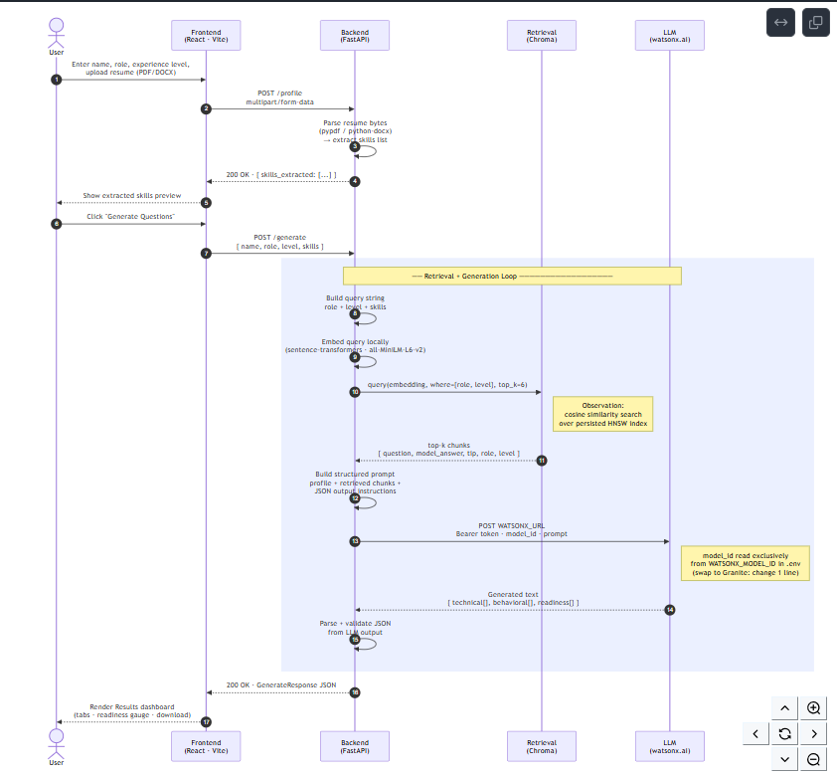
SYSTEM FLOW
Architecture Blueprint
[ Insert sequence diagram screenshot here ]
From ARCHITECTURE.md — User → Frontend → Backend → Retrieval (Chroma) ↔ LLM (watsonx.ai) → Response
Interview Trainer Agent
09

Slide 10
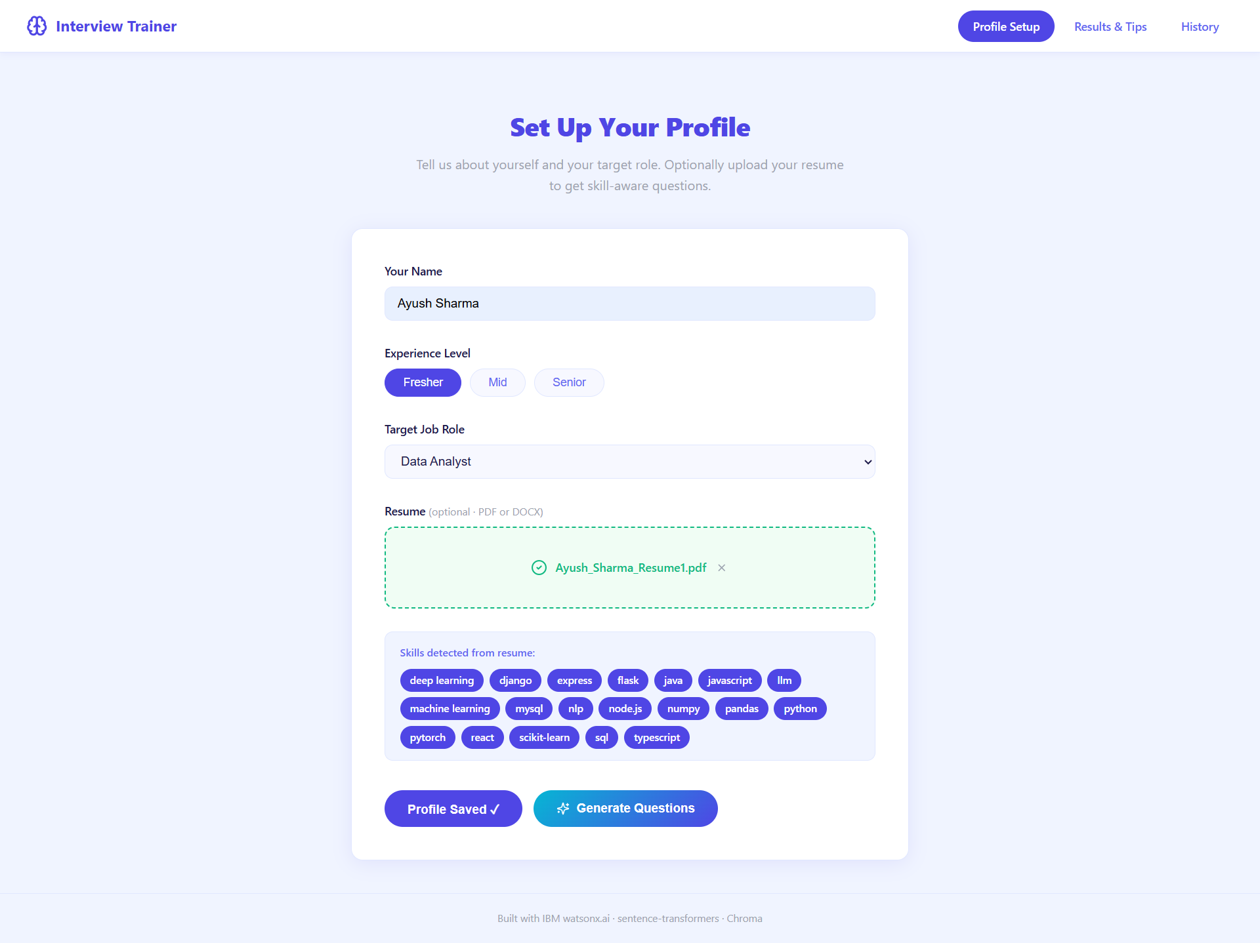
USER INTERFACE
Dashboard Preview
[ Insert dashboard screenshot here ]
Profile setup · practice/results view · readiness score · technical vs. behavioral breakdown
Interview Trainer Agent
10

Slide 11
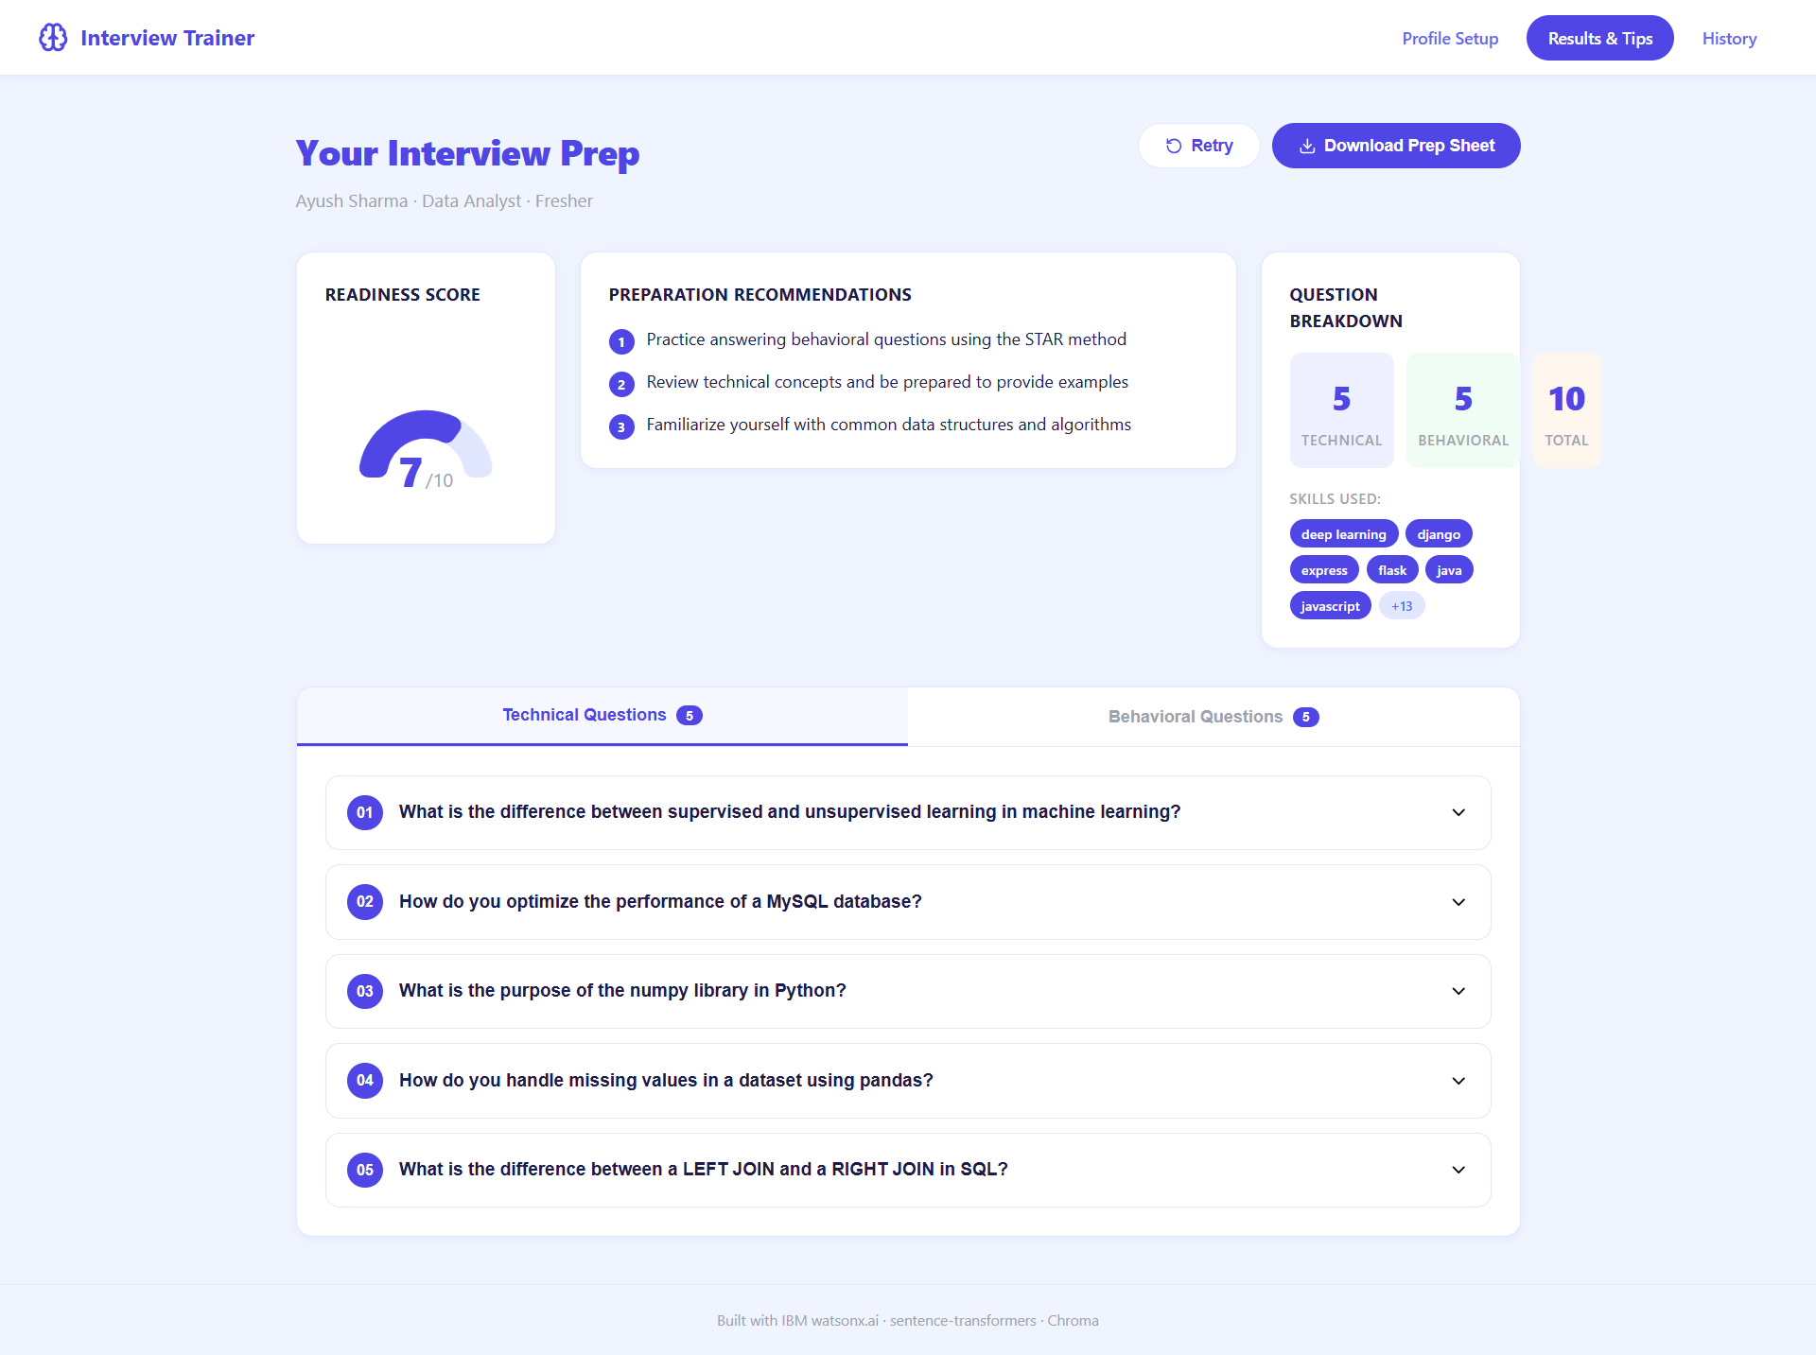
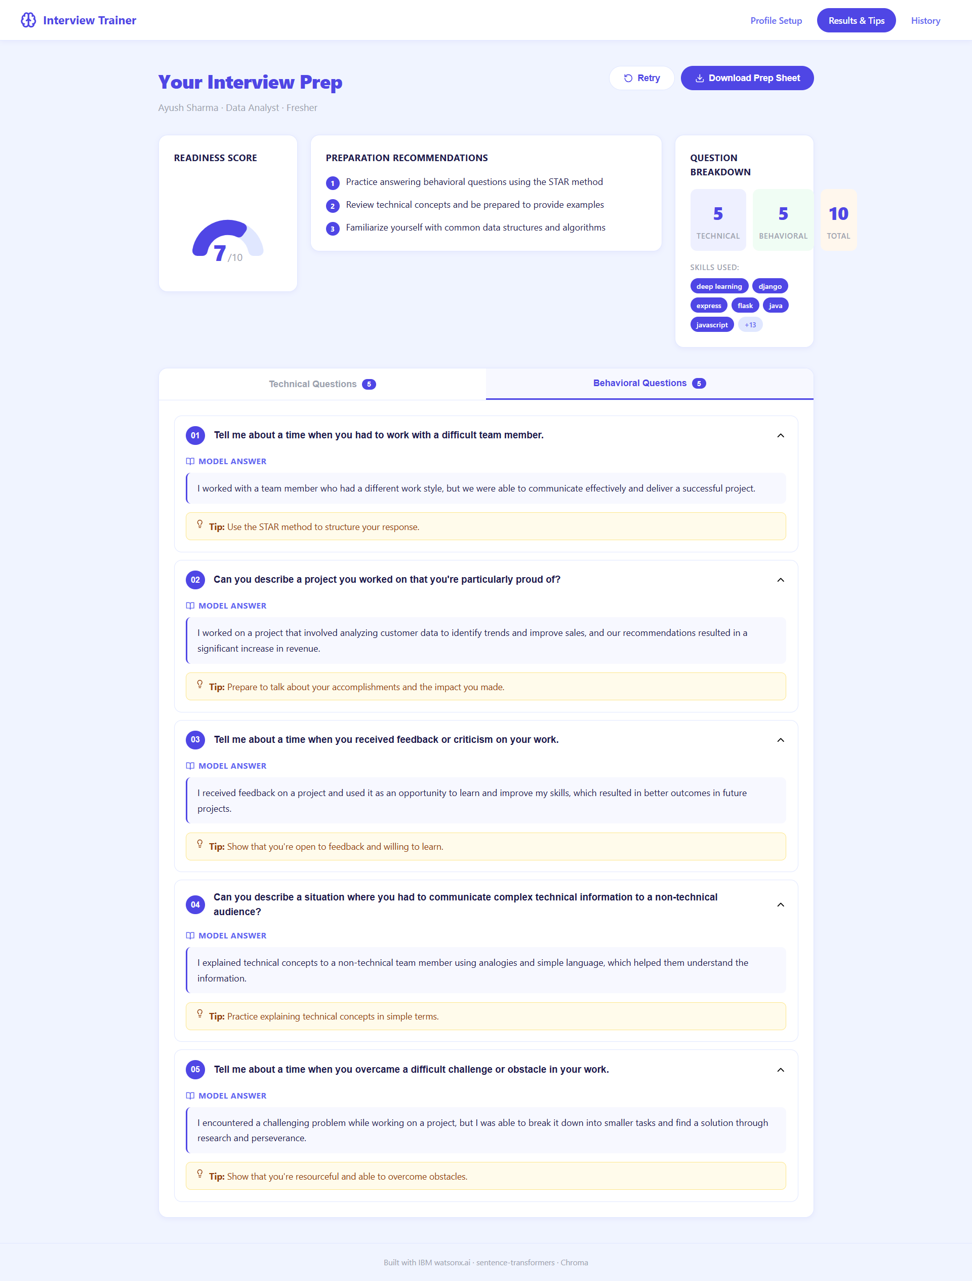
MODEL IN ACTION
Demonstration
[ Insert Prompt Lab
screenshot 1 here ]
[ Insert Prompt Lab
screenshot 2 here ]
Interview Trainer Agent
11

Slide 12
Thank You
Interview Trainer Agent — Problem Statement No. 22
GitHub: github.com/ayush-cyber1/interview-trainer-agent

