Slide 1



Blockchain-Based Secure File Verification and Sharing System
Group No 10

Slide 2

Contents
Content
01
02
03
Introduction
Objective
Literature Review
04
05
Research gaps
Tech Stack

Slide 3

Introduction
Blockchain + IPFS helps us create a decentralized system where no single authority controls the files, ensuring trust and integrity.
01
Increasing need for secure file storage & sharing
Traditional cloud storage → centralized, risk of tampering
02
03
Blockchain + IPFS → decentralized, tamper-proof solution
Goal: File Integrity, Ownership, and Secure Sharing
04

Slide 4

OBJECTIVES
Objective 01
Objective 04
Ensure File Integrity
  Verify that uploaded files remain untampered using cryptographic hash values stored on blockchain.
Enhance Data Ownership & Privacy
  Allow users to fully control their files and manage access without third-party dependence.
Objective 02
Objective 05
Enable Secure File Sharing
  Provide controlled and permission-based file access using smart contracts.
Maintain Transparent Access Logs
  Record immutable history of file uploads, access requests, and permissions on blockchain.
Objective 03
Objective 06
Decentralize File Storage
  Use IPFS to store files across distributed nodes instead of centralized servers.
Support File Encryption
  Add AES encryption before upload so that even if IPFS link leaks, files remain confidential.

Slide 5


LITERATURE SURVEY

Slide 6


LITERATURE SURVEY

Slide 7
Research Gaps
  Large Files Issues
Blockchain networks have limited storage system when dealing with large.
  Efficient File Versioning
Limited work on handling multiple versions of files with blockchain audit trails.
  Security Enhancements
No encryption before IPFS upload for stronger confidentiality.
  Integration with Wallet-Based Authentication
Research has focused on integrity, but secure user authentication (e.g., MetaMask/WalletConnect) is underexplored.

Slide 8
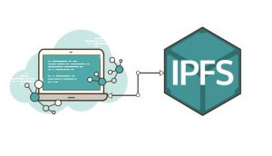
What Is IPFS?
InterPlanetary File System
Peer-to-Peer (P2P) distributed file system
Uses content-based addressing (via unique hash called CID)
Decentralized – no central server, data fetched from nearest peers
Tamper-proof – hash ensures data integrity
Faster & efficient – retrieves files from multiple sources

Slide 9
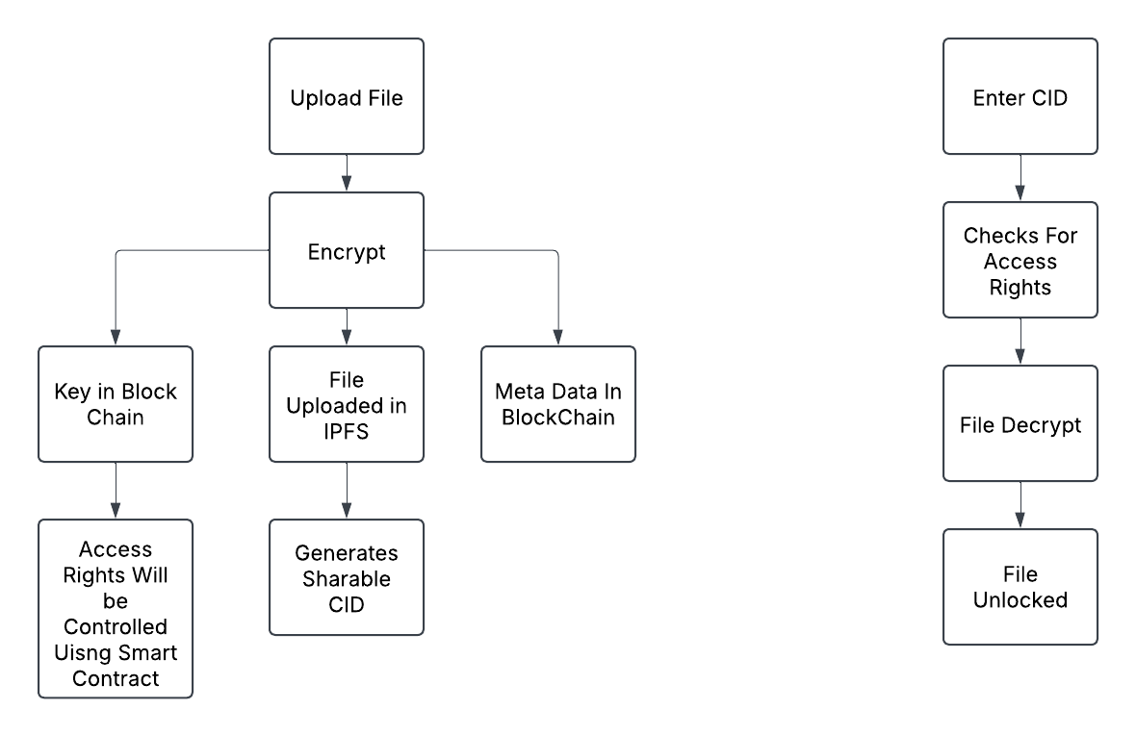
Sender’s Side
Receiver’s Side

Slide 10

TECH STACK
  Ethereum + Solidity → Smart Contracts
  IPFS (InterPlanetary File System) → Decentralized File Storage
  Web3.js + MetaMask → Blockchain interaction & authentication
  React.js / HTML & CSS → User Interface

Slide 11

Thank You!!!

