Slide 1
The Impact of Quick Commerce and Inflation on Premium FMCG Sales in Tier-1 Indian Cities
Prepared by: Ayush Gangwar
MNNIT Allahabad

Slide 2
Agenda
• Background & Market Context
• Key Trends: Quick Commerce & Inflation
• Urban vs Rural FMCG Growth
• Consumer Behavior Insights
• Strategic Recommendations
• Conclusion & Next Steps

Slide 3
Executive Summary
• Quick commerce drives convenience-led premium
purchases but also discounts.
• Inflation is shifting urban consumers towards
value-driven choices.
• Rural FMCG markets are growing faster, creating new
opportunities.
• Tier-1 cities must balance premiumization with
affordability.

Slide 4
Background: Indian FMCG Market
• Indian FMCG market valued at ₹4.3 lakh crore (2023)
• Rapid urbanization and digital adoption
• Quick commerce reshaping retail landscape
• Inflation pressuring urban disposable incomes

Slide 5
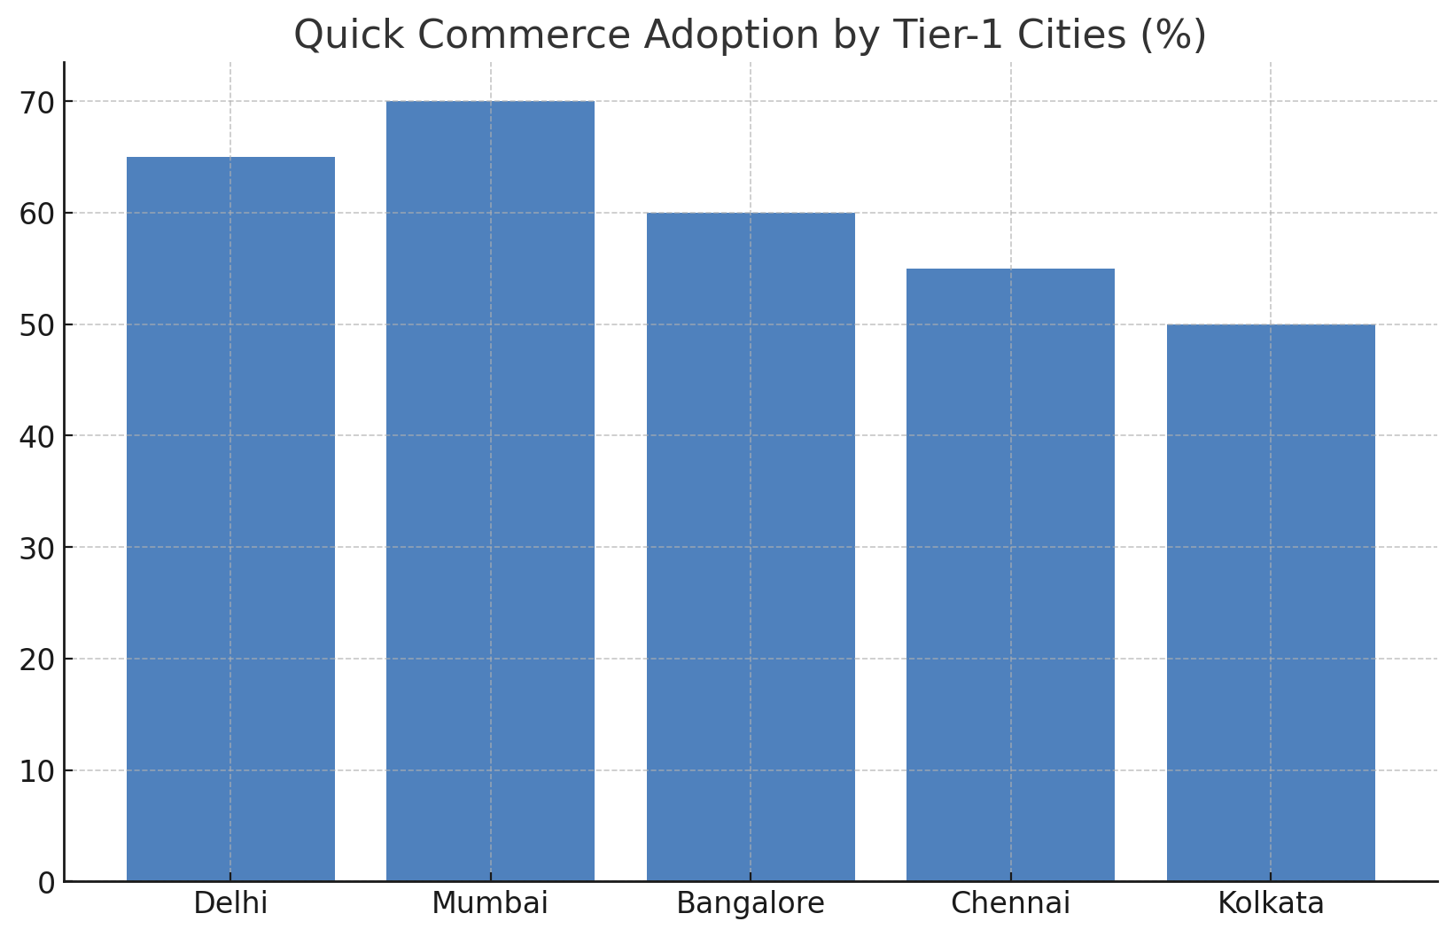
Trend: Quick Commerce Growth

Slide 6
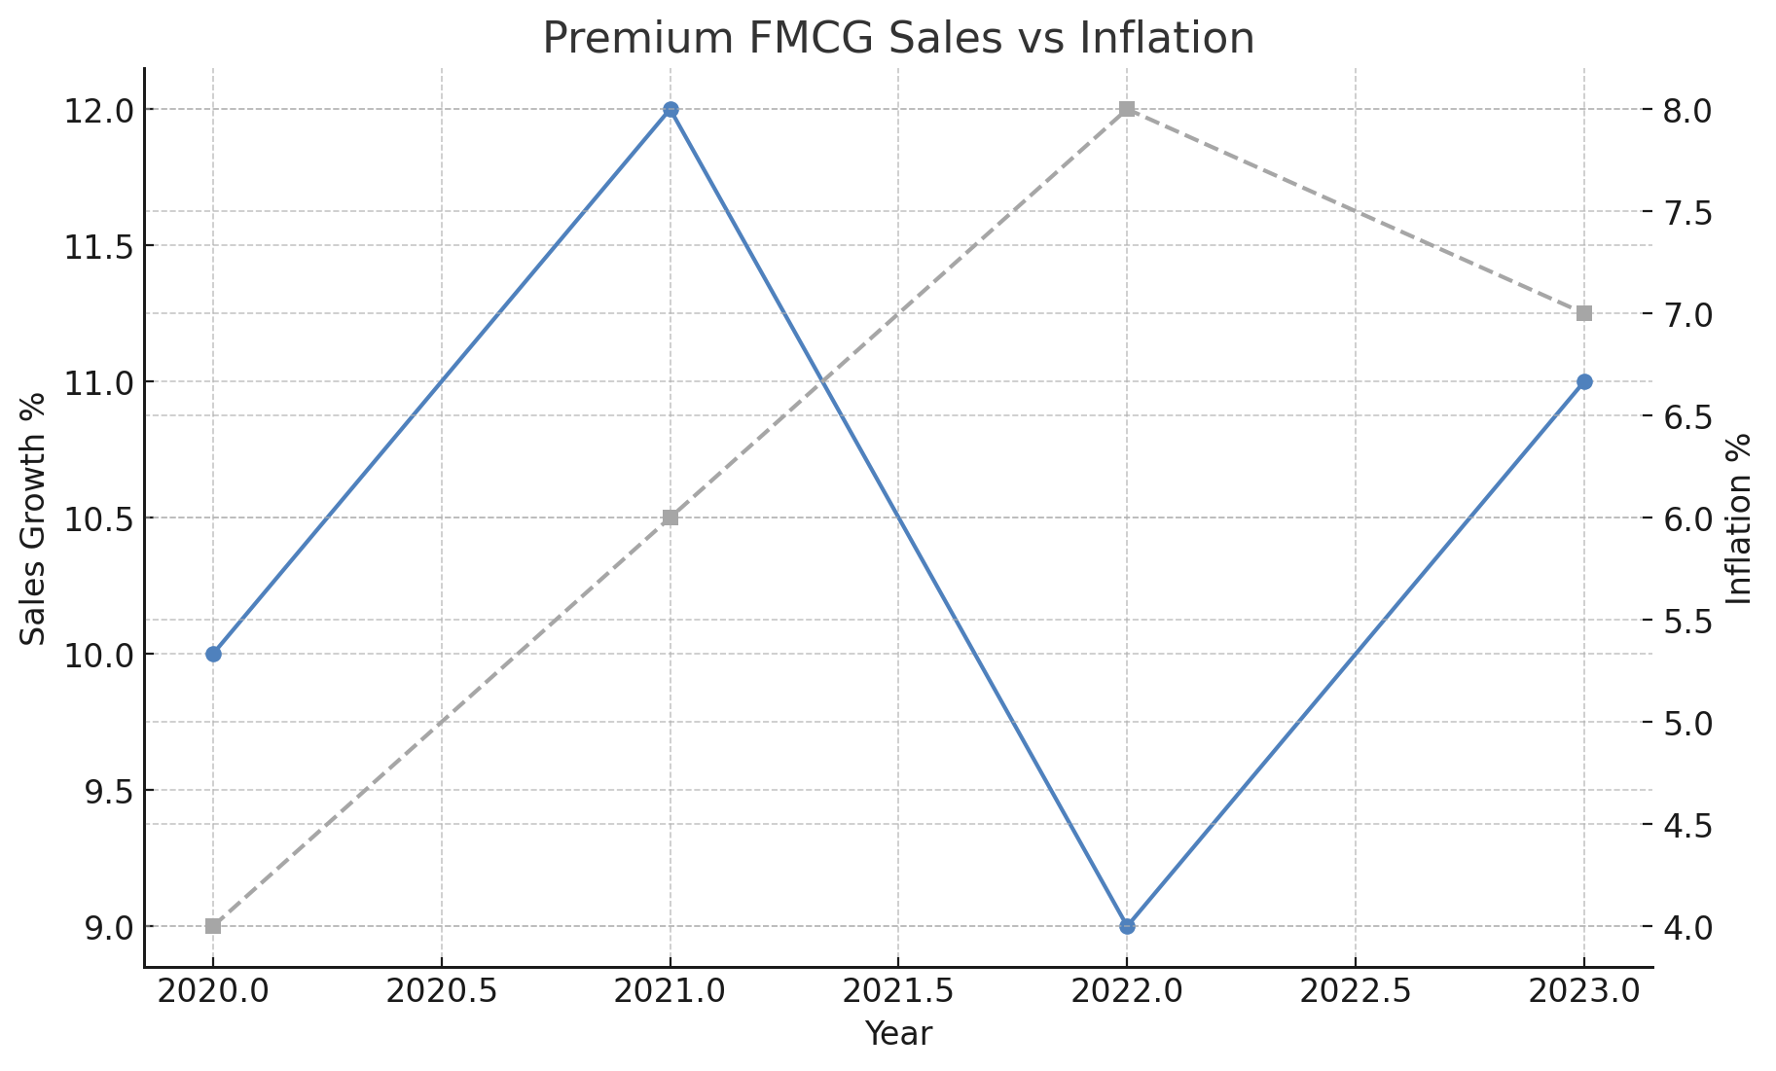
Trend: Inflationary Pressures

Slide 7
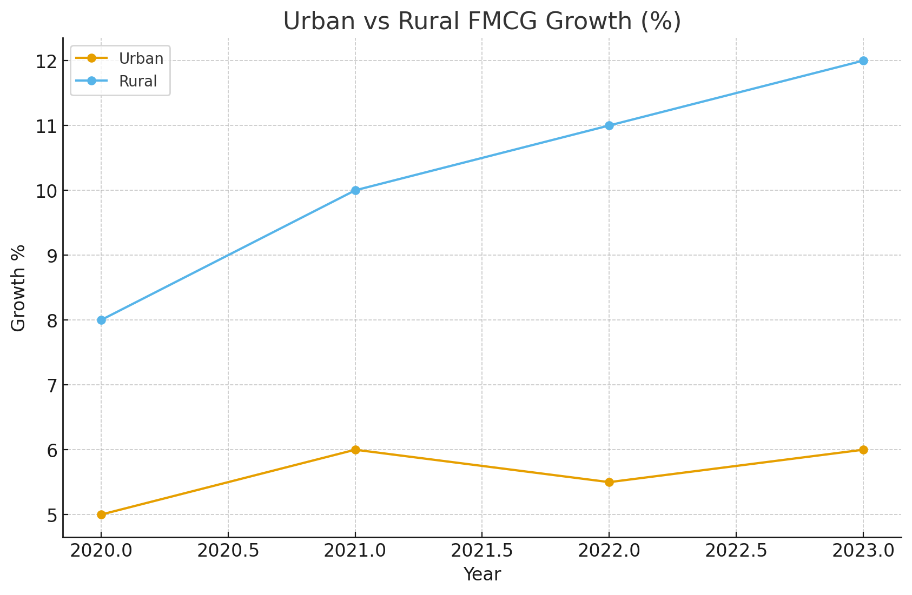
Urban vs Rural FMCG Growth

Slide 8
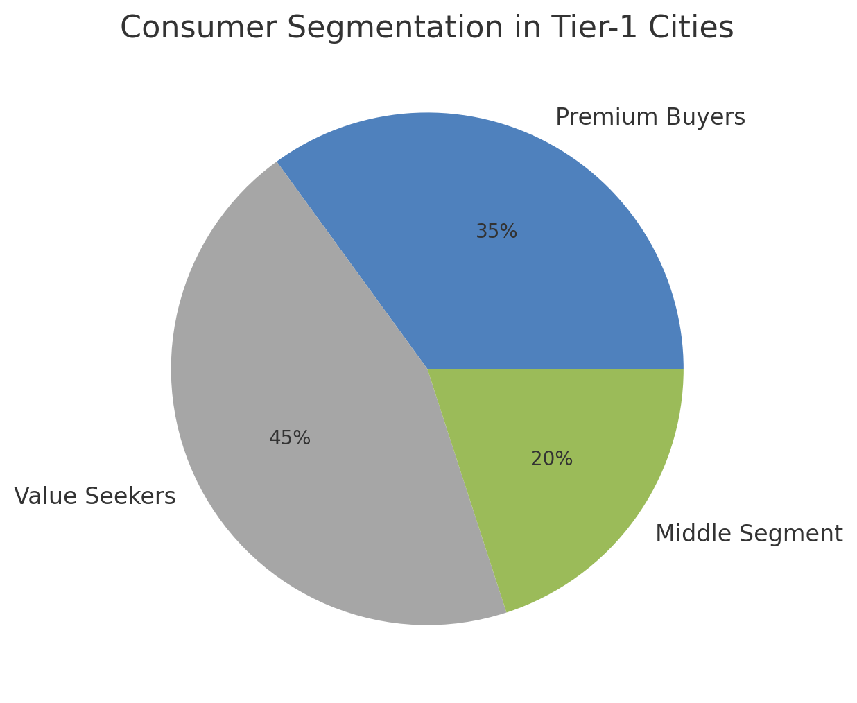
Consumer Segmentation in Tier-1 Cities

Slide 9
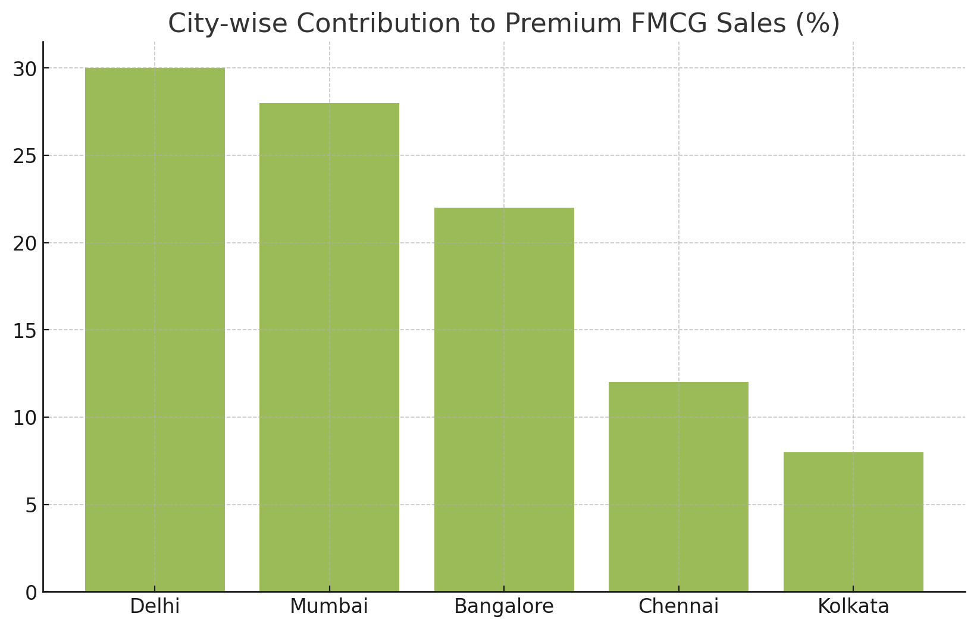
City-wise Premium FMCG Contribution

Slide 10
Key Insights: Urban vs Rural
• Rural FMCG growth > 2x urban growth
• Premium products gaining traction in rural areas
• Urban demand constrained by inflation
• Quick commerce boosts convenience-driven
purchases

Slide 11
Strategic Recommendations
• Targeted premium offerings with value-based
packaging
• Leverage quick commerce for impulse-driven
premium sales
• Localized marketing in Tier-1 cities
• Expand premium product availability in
rural regions

Slide 12
Conclusion & Next Steps
• Quick commerce reshaping consumer
behavior
• Inflation shifting priorities toward
affordability
• Premium FMCG growth requires balancing
aspiration and value
• Actionable strategies can sustain urban and
rural premium growth

Slide 13
Thank You
Prepared by: Ayush Gangwar
MNNIT Allahabad
Winter Consulting 2024

