Slide 1
Sales Insights — EcomVista
BY AYUSH GANGWAR

Slide 2
Key KPIs
Total Net Sales: $19,842,234.85
Total Gross Profit: $7,897,594.85
Profit Margin: 39.80%

Slide 3
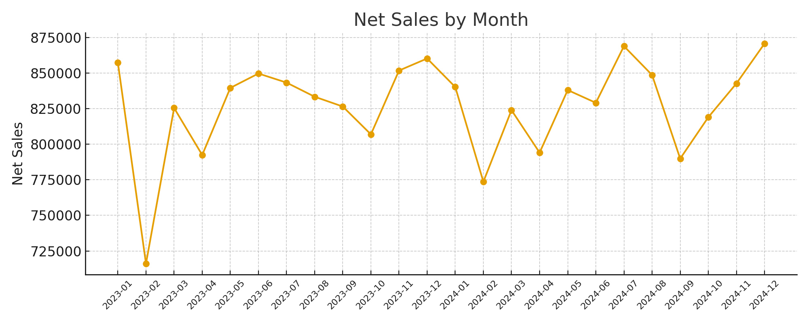
Sales Trend by Month

Slide 4
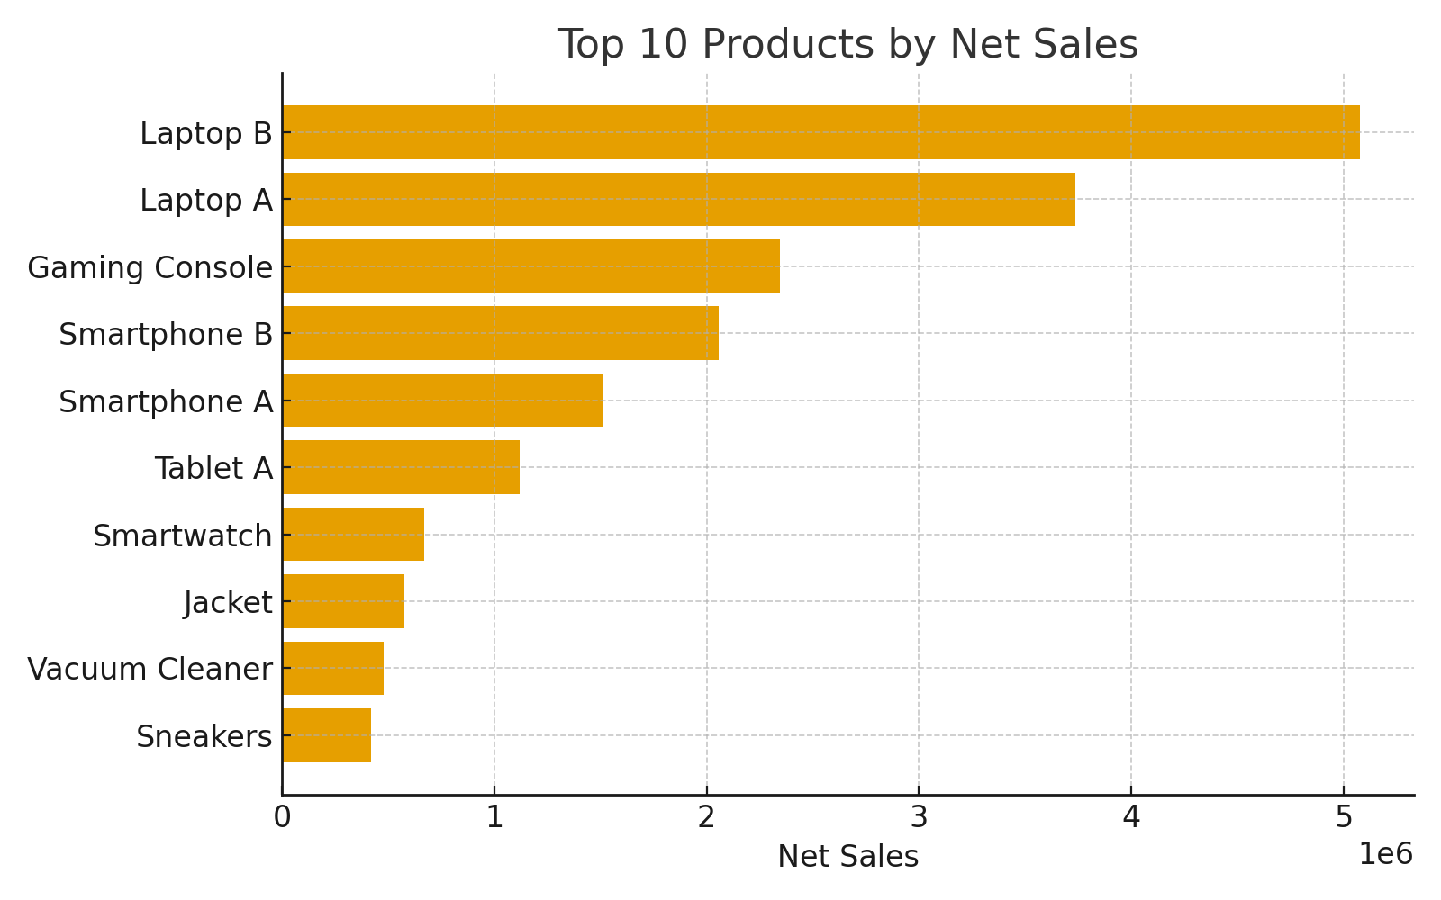
Top 10 Products

Slide 5
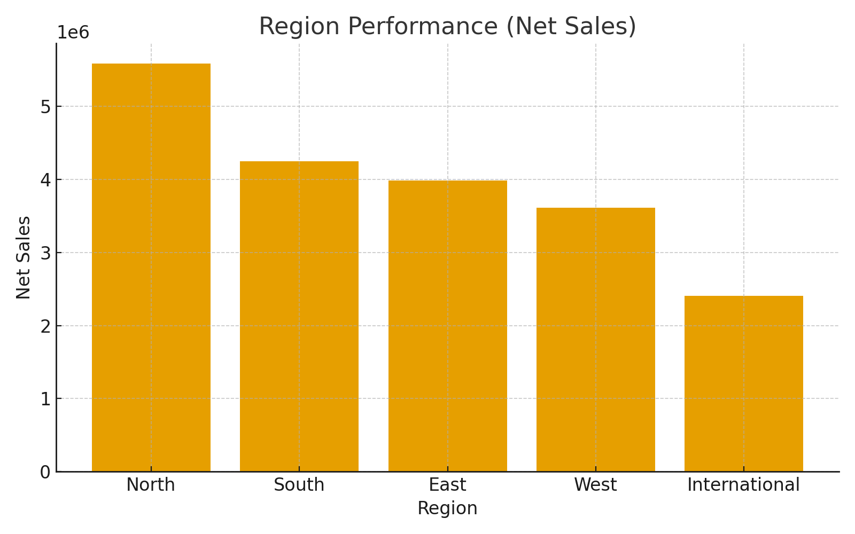
Region Performance

Slide 6
Conclusions & Next Steps
- Focus promotions on top products during peak months.
- Investigate underperforming regions for local strategies.
- Add forecasting & RFM analyses as next steps.

