Slide 1
Software Requirement Analysis
and Specification/Requirement Engineering

Slide 2
Software Requirement Analysis and Specification/Requirement Engineering:-
The goal of this phase is to clearly understand the customer requirement's and to systematically
Organize the requirement's into a specification document.
The engineers who gather and analyse customer requirement's and write the SRS are known as system analysts.
Requirement Engineering.
The Process to gather the software requirement's from client, analyse and document them is known as requirement engineering.

Slide 3
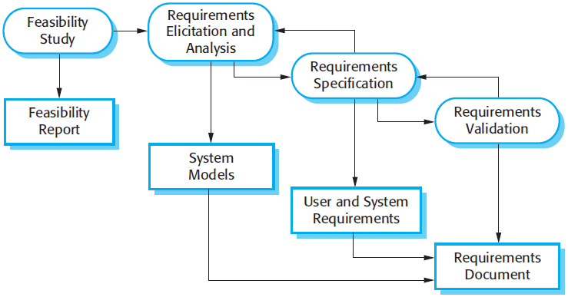

Slide 4
Management oriented activity:-
Objective :-Find out if an project can be done and if so how.
It tell management
Whether the project can be done.
What are alternative solutions
System can be engineered using current technology and within budget
Is there a preferred alternative
After a feasibility study, management makes a go/no go decision.

Slide 5
Definition:-
A document use to describe the behaviour of the software syste,Functional,Non-Functional requirements of the software system.
Users of the SRS
Development Team
Maintenance Team
Client
Technical writers.

Slide 6
Contents of SRS:-
1.Category:-What kind of your software is
E.g.:-Destktop application,system application, android app
2.Purpose:-Describe what is the purpose of making this system(as nothing without any reason)
3.Scope:-What is the area it covering, what is the range, to what limits it will help you.
4.Introduction:-Define the exiting system and proposed system (how proposed one is better than exiting)
5.Advantages:-Define the advantages of the system.(in every perspective)
6.Function requirement of the system.
7.Non functional requirements of the system.
8.Software tools:-Mention the software tools which will involve in all this development process
9.Deployment:-What kind of environment will be needed to deploy the software.
e.g. OS,RAM,Processor etc.
10.Hardware specification:-The hardware required to developed the system.

Slide 7
Thank you

