Slide 1
Software Requirements Specification
SRS

Slide 2
Software Requirements Specification(SRS)
Software Requirement Specification (SRS)
Format as name suggests, is complete specification and description of requirements of software that needs to be fulfilled for successful development of software system.
These requirements can be functional as well as non-requirements depending upon type of requirement.
The interaction between different customers and contractor is done because its necessary to fully understand needs of customers.
SRS:-It is the way to represent the requirement's in a consistent format.

Slide 3
Process steps to be followed while making SRS:-
1.Requirments Elicitation(gathering)
It is also known as gathering of requirement's
Requirement's Elicitation is the process to find out the requirement's for an intended software system by communicating with client end users, system users and others who have a stake in the software system development.

Slide 4
2.Requirement Analysis:-
Requirement's are analysed in order to identify inconsistencies, defects, omissions,anamoly incompleteness.
Anomaly:-Ambiguity in the interpretation of requirement's.
Inconsistency:-If one of the requirement's contradicts another.
Incompleteness:-Some of the requirement's have been overlooked.
After determining/Detecting these problems the analysts has to conduct further discussions and resolve the issues with the customer.

Slide 5
3.Requirement Documentation:-
All functional,non functional, formal and informal requirement's are documented and made available for next phase processing.
This documentation is known as SRS.
4.Requirments Review/Requirement verification
It is a process to improve the quality of SRS.
The SRS documentation servers as a legal contract between customers and developers.

Slide 6
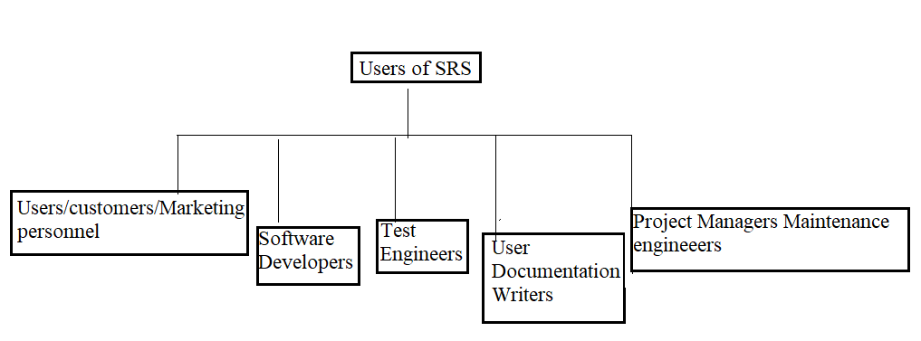
Different categories of users of SRS.

Slide 7
Software Developers:-
Ensure that they develop exactly what is required by the customer.
Test Engineers:-Ensure that the requirements are understand from a functionality point of view.
User Documentation writers:-
Understand the document well enough to be able to write user’s manual.
Project Managers:-Ensure they can plan the project in terms of cost, manpower and time.
Maintenance Engineers:-Understand the functionality so that they can plan modifications and enhancements.

Slide 8
Contents of the SRS document:-
1.Functional requirements.
2.Non Functional Requirement's
3.Goals of Implementation.
Goals of Implementation
It include revision to the system functions that may be required in the future, new devices to be supported in the future reusability issues here the qualitative issues are documented.

Slide 9
Characteristics of a good SRS document:-
1.It should be concise:-
complete, consistent and unambiguous.
2.It should be structured
Easy to understand and modify
3.Black box view:-
Specify the external behaviour of the system but not the implementation issue.
4.Conceptual Integrity:-
Easily understandable contents.
5.Response to undesired events:-
Systems response to exceptional conditions.
6.verifiable:-
All requirement's should be verifiable.

Slide 10
Thank you

