Slide 1
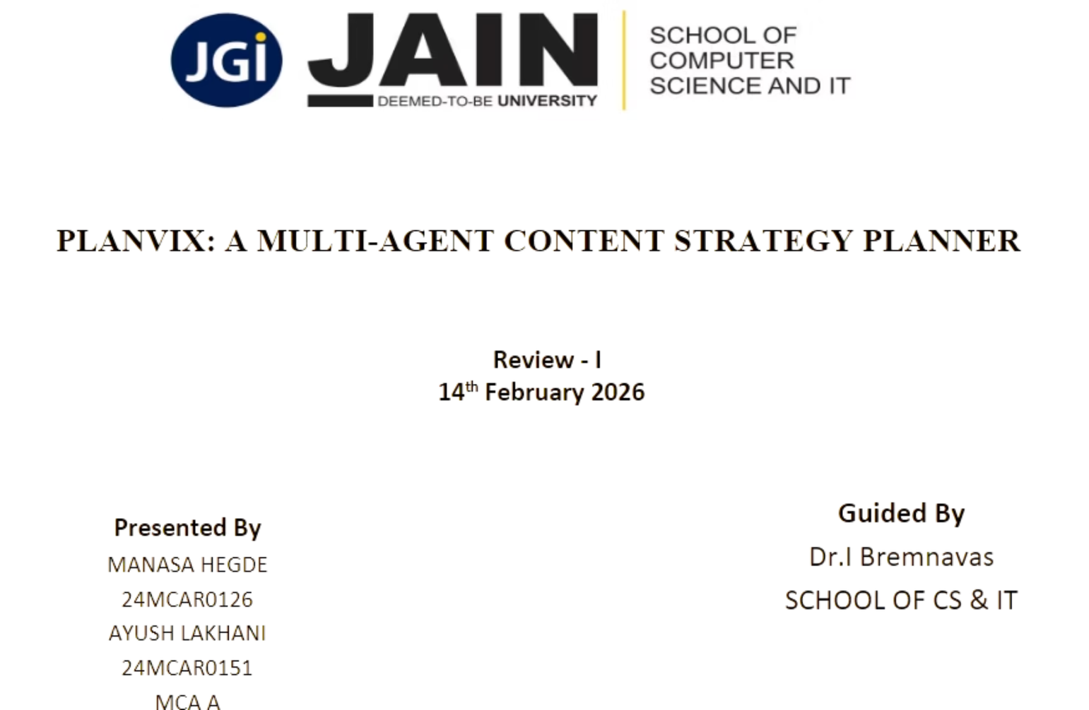
Notes:
1

Slide 2
Introduction
Digital platforms have transformed content into a strategic asset
Organizations require structured and aligned content planning
Traditional planning methods are manual and inefficient
Existing AI tools focus mainly on content generation
Planvix emphasizes strategic reasoning over content creation
PLANVIX is a dedicated SaaS platform that automates the entire role of a Chief Marketing Officer with five specialized AI agents working in coordinated sequence, delivering professional-grade content strategy in seconds instead of days
Notes:
2

Slide 3

Problem Statement
Existing AI tools focus mainly on content generation, not strategic planning
Outputs are often generic and lack audience-specific customization
Monolithic architectures lack collaborative reasoning and validation
Limited personalization based on user expertise level
No unified framework integrating multi-agent intelligence and knowledge grounding
Notes:
3

Slide 4
Proposed System (Planvix)
Multi-agent decision-support system
Experience-aware personalization
Retrieval-Augmented Generation (RAG)
Structured validation and optimization
Focus on strategic planning (not publishing)
Notes:
4

Slide 5
Scope of the Project
1
2
3
Intelligent content strategy planning system
Identifies relevant content themes
Analyzes and segments target audience
4
5
Recommends formats and distribution channels
Organizes structured planning calendars
Notes:
5

Slide 6
Multi-Agent Architecture
Agents in Planvix:
Advantages:
The Thinker - Customer insights
The Trend Hunter - Content gaps
The SEO Expert - Keyword discovery
The Planner - Strategy & calendar
The Fortune Teller - Performance prediction
Task distribution
Structured reasoning
Improved consistency
Strategic coherence
Notes:
6

Slide 7
Literature Review
Multi-agent systems distribute tasks among specialized agents, enabling collaborative reasoning and improved scalability
LLMs have limitations: static training data, outdated responses, hallucinations, and inconsistency in multi-step reasoning
Retrieval-Augmented Generation (RAG) solves LLM limitations by integrating external knowledge retrieval with text generation
RAG improves factual accuracy, contextual relevance, and reduces hallucination risks
Multi-agent + RAG integration enables intelligent, adaptive planning with dynamic personalization
Existing tools lack unified framework combining multi-agent collaboration, RAG, and personalization
Planvix fills this gap by integrating multi-agent orchestration with retrieval-augmented intelligence for strategic content planning
Notes:
7

Slide 8
System Requirements
Hardware:
Software:
Minimum Requirements:
Operating System:
Processor: Dual-core CPU (2.0 GHz or higher)
RAM: 4 GB
Storage: 2 GB free disk space
Internet: Stable broadband connection (5 Mbps+)
Windows 10/11
macOS 10.15 (Catalina) or later
Linux (Ubuntu 20.04+, Debian, Fedora, etc.)
Notes:
8

Slide 9
Functional Requirements
Accept user goals & experience level
Coordinate multiple autonomous agents
Generate structured strategy
Validate contextual consistency
Support retrieval-based knowledge grounding
Notes:
9

Slide 10
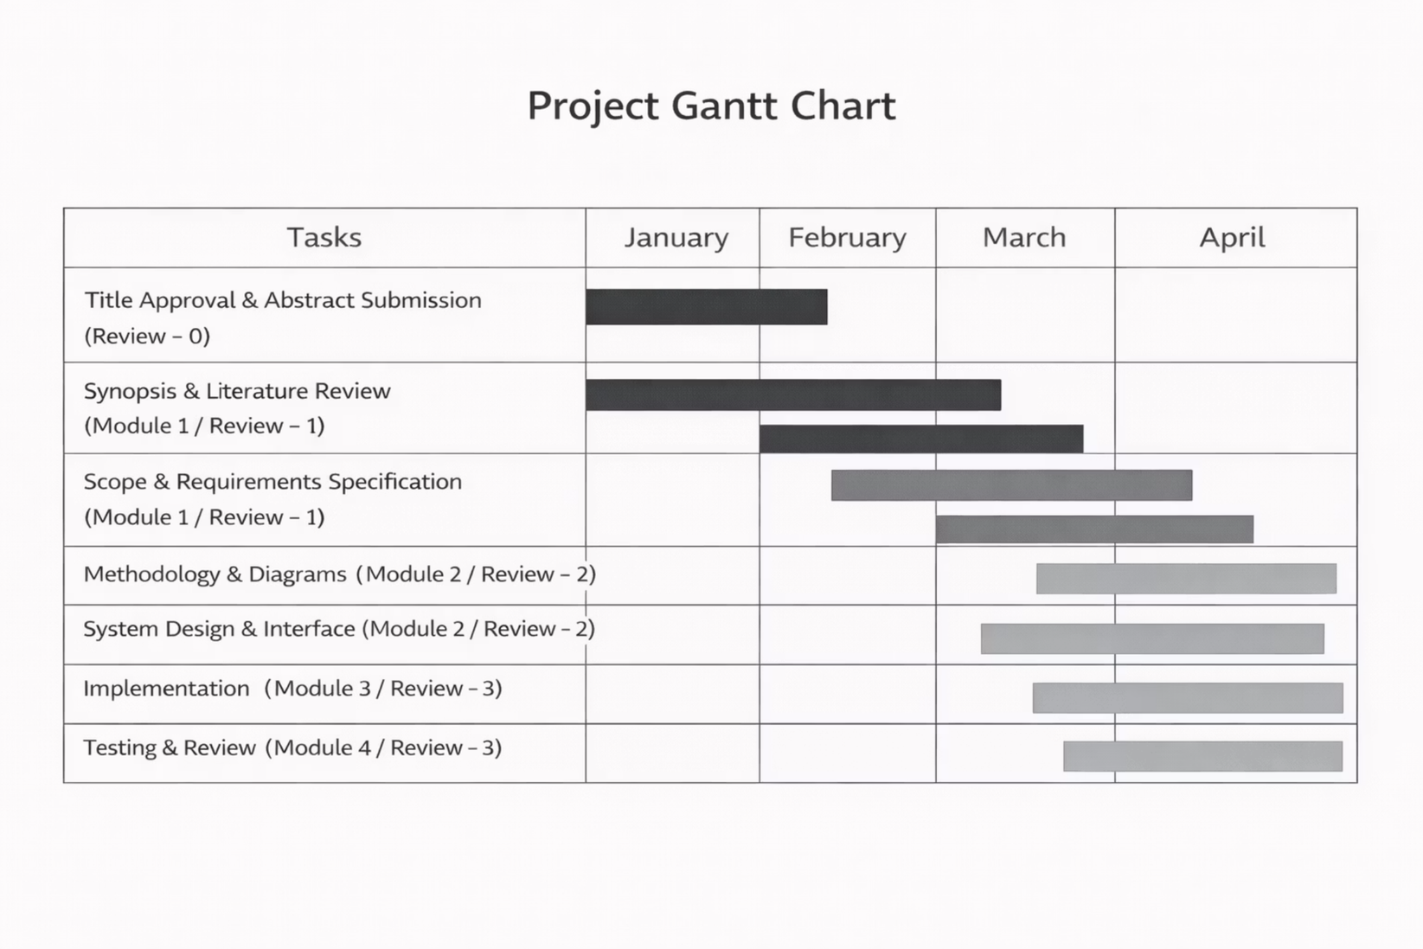
Gantt Chart
Notes:
10

