Slide 1
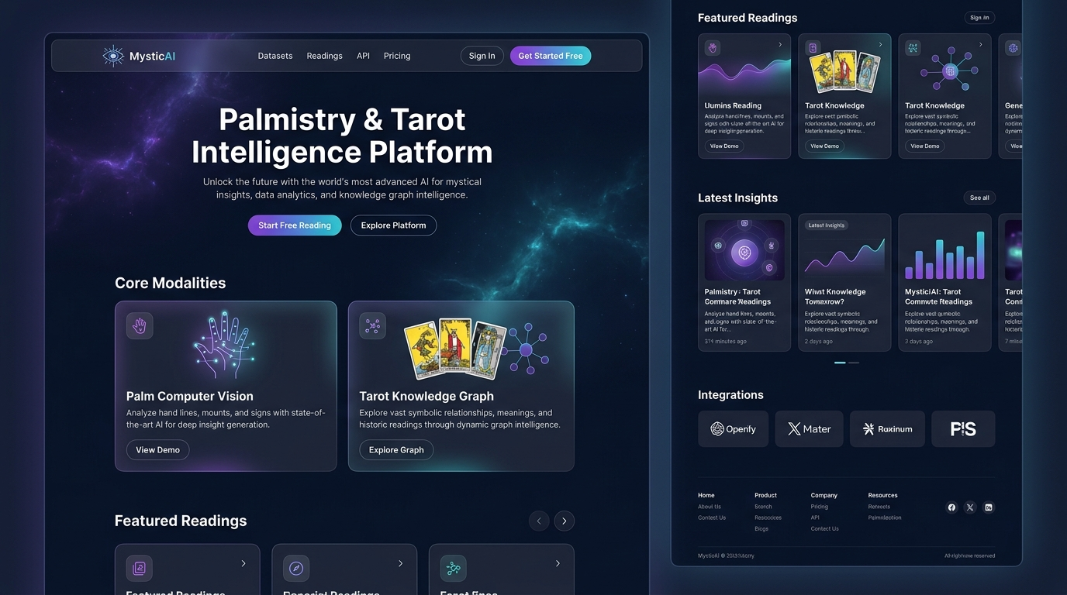
CAPSTONE PROJECT • MILESTONE 1 REVIEW
Palmistry & Tarot
Intelligence Platform
A Multimodal AI Platform for Computer Vision & Knowledge Graph-Driven Analysis
⚡ High-Performance Async Backend
FastAPI (Python 3.11) with Pydantic schemas
🌐 Modern Glassmorphic Frontend
Next.js 14 App Router + TailwindCSS
🛡️ Enterprise Auth & 4-Tier RBAC
Bcrypt password hashing & JWT token lifecycle
📚 Digitized Core Knowledge Bases
Complete 78-Card Tarot + 7-Line Palmistry Datasets
📷 Live Website Landing Page (Next.js 14)
Notes:
Good morning/afternoon professors. For Milestone 1 of our project, we have established the full-stack architecture, polyglot database, secure authentication, and interactive knowledge bases for our Palmistry & Tarot Intelligence Platform.

Slide 2
DOMAIN FORMALIZATION
Problem Statement & Computational Domain Modeling
📌 Problem & Motivation
Transforming subjective symbols into structured computation.
• Unstandardized Data: Traditional practices lack structured schemas and algorithmic consistency.
• Multimodal AI Solution: Formalizes visual morphology and symbolic knowledge graphs into unified reflection metrics.
• Milestone 1 Scope: Establishing clean API contracts, secure identity, and core reference knowledge bases.
🃏 Tarot: Knowledge Graph
78 Discrete Semantic Nodes & Spreads
• 78 Discrete Nodes: 22 Major Arcana (life archetypes) + 56 Minor Arcana (4 elemental domains).
• Binary Orientation State: Upright (direct expression) vs. Reversed (internalized block).
• Positional Spreads: Multi-node directed graph (e.g. Node 1=Past, Node 2=Present, Node 3=Future).
✋ Palmistry: Computer Vision
Geometric Landmarks & Ridge Features
• 21 Hand Landmarks: 3D coordinates extracted using Google MediaPipe framework.
• ROI Segmentation: Isolates palm plane for perspective-corrected analysis.
• Ridge Feature Vectors: Measures length, curvature, and continuity of major crease lines (Heart, Head, Life, Fate).
Notes:
We explain the domain in strict computer science terms: Tarot as a finite semantic knowledge graph with 78 nodes, and Palmistry as an anatomical computer vision problem with 21 landmark coordinates and crease ridge extraction.

Slide 3
FULL-STACK ARCHITECTURE
System Architecture & Polyglot Data Strategy
🌐 Frontend Client
Next.js 14 • React • Tailwind
✔ Next.js 14 App Router for rapid SSR & client interactivity.
✔ Cosmic dark glassmorphism theme with responsive UI.
✔ Client-side JWT session handling & state synchronization.
⚡ Async Backend
FastAPI • Python 3.11 • Pydantic
✔ Asynchronous ASGI non-blocking event loop.
✔ Strict Pydantic request/response schema validation.
✔ Auto-generated OpenAPI / Swagger live testing interface.
🗄️ Polyglot Database
PostgreSQL / SQLite • MongoDB • Redis
✔ Relational SQL: ACID compliance for User Auth & RBAC.
✔ MongoDB: Schema-less store for 21-point hand coordinates & AI logs.
✔ Redis: Sub-millisecond JWT blacklist token checking & caching.
💡 Polyglot Strategy: Relational SQL guarantees ACID transactions for users/roles, while MongoDB stores high-dimensional AI & CV telemetry without rigid schema migration overhead.
Notes:
Our architecture uses an async microservices pattern with FastAPI, Next.js 14, and a polyglot database strategy separating relational auth data from flexible document payloads.

Slide 4
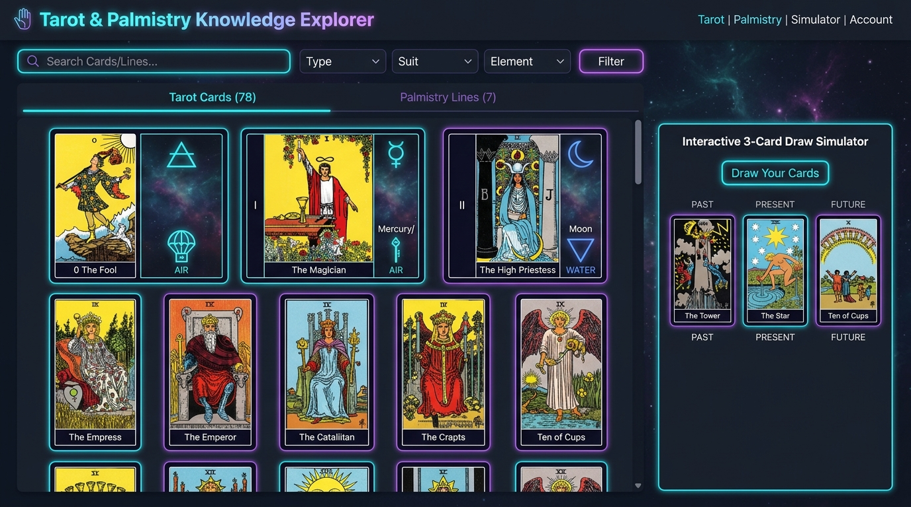
CORE DATASETS & SIMULATOR
Digitized Knowledge Bases & Draw Simulator
📚 78-Card Tarot Dataset
Complete 22 Major Arcana + 56 Minor Arcana (Wands, Cups, Swords, Pentacles) with keywords and upright/reversed definitions.
✋ 7-Line Palmistry Reference
Heart, Head, Life, Fate, Sun, Mercury, and Girdle lines mapped with morphological variation rules.
🎲 Interactive Draw Simulator
Real-time pseudo-random sampling of 1-card, 3-card (Past/Present/Future), and 5-card spreads with dynamic orientation.
🔍 Live Search & Filter APIs
Instant in-memory filtering by suit, arcana type, element, and keyword via `/api/v1/datasets/tarot/cards`.
📷 Interactive Tarot & Palmistry Explorer (/datasets)
Notes:
Here is the interactive dataset explorer interface. We digitized all 78 Tarot cards and 7 palm lines. Users can filter cards in real-time and simulate live 3-card spread draws.

Slide 5
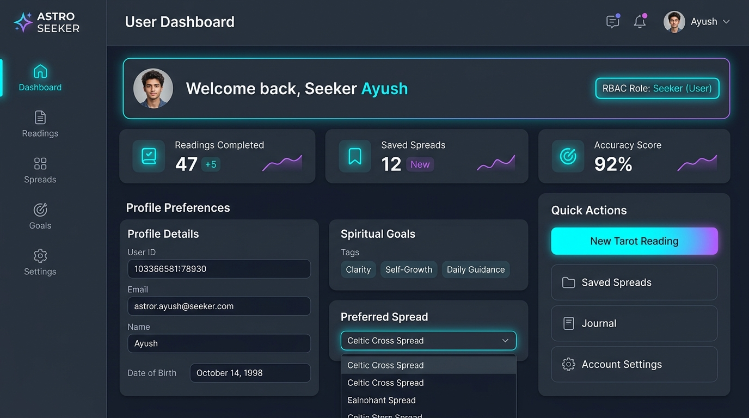
SECURITY & USER INTERFACE
User Authentication, 4-Tier RBAC & Dashboard
🔐 Salted Bcrypt Password Hashing
Zero plaintext passwords. Evaluated with one-way cost factor 12 hashing.
🎫 Dual JWT Stateless Authentication
15-minute Access Tokens + 7-day Refresh Tokens with instant Redis token blacklisting on logout.
🛡️ 4-Tier Granular RBAC Roles
Enforces access across `guest`, `user`, `tarot_reader`, and `admin` via FastAPI dependency injection.
👤 Seeker Dashboard & Profiles
Personalized user preferences, date of birth, spiritual goals, and preferred card spreads.
📷 Authenticated Seeker Dashboard & Profile Preferences (/dashboard)
Notes:
This slide showcases the user authentication, RBAC permission system, and seeker dashboard. Passwords are encrypted with bcrypt, sessions are managed with JWT, and users can customize their spiritual goals.

Slide 6
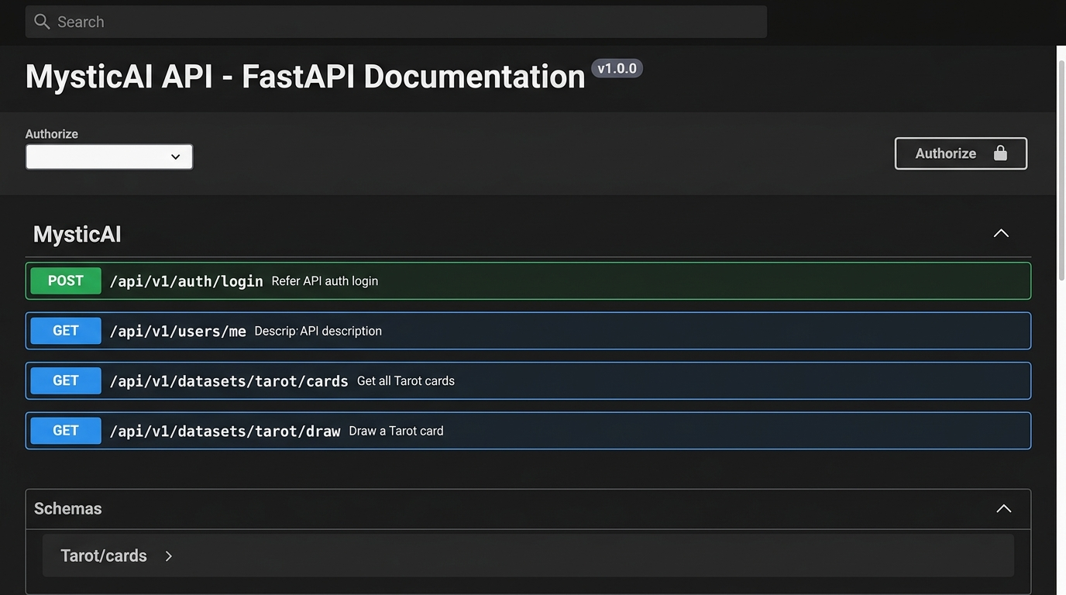
API ECOSYSTEM & VALIDATION
Verified REST API & Interactive Swagger Specs
🔌 100% Typed REST Endpoints
Built using FastAPI routers: `/auth`, `/users`, `/profiles`, and `/datasets`.
🛡️ Automatic Pydantic Validation
Incoming request bodies and outgoing responses are strictly validated against schema models.
📖 Interactive Swagger UI (/docs)
Built-in OpenAPI interface allowing examiners to authenticate with JWT and test live queries directly in the browser.
✅ Zero-Config Fallback Mode
Runs out-of-the-box with SQLite and in-memory caches, plus Docker Compose support for production.
📷 FastAPI Interactive Swagger Workbench (/docs)
Notes:
All backend endpoints are strongly typed, validated with Pydantic, and self-documented via Swagger UI at /docs, enabling direct in-browser testing during viva defense.

Slide 7
PROJECT STATUS & FUTURE SCOPE
Milestone 1 Summary & Phase 2 Roadmap
✅ Milestone 1: Delivered Foundations
✔ Async Microservices Architecture (FastAPI + Next.js 14)
✔ Polyglot Persistence (SQL + MongoDB Document + Redis)
✔ Bcrypt Password Hashing & Stateless JWT Auth
✔ 4-Tier RBAC Permission Hierarchy
✔ Complete 78-Card Tarot & 7-Line Palmistry Datasets
✔ Interactive Card Draw Simulator & Search Filters
✔ Seeker Dashboard & Profile Customization
✔ Live OpenAPI / Swagger API Workbench
🚀 Phase 2: Future Development Roadmap
➔ MediaPipe 21-Point Palm Detection: Live 3D hand landmark coordinate mapping.
➔ OpenCV Line Crease Segmentation: Adaptive CLAHE & Canny edge ridge extraction.
➔ Generative AI / LLM Narrative Synthesis: Dynamic multi-turn prompt pipeline for custom readings.
➔ Celery Background Task Queue: Asynchronous image processing and report rendering.
➔ PDF Report Generator: Downloadable reflection summaries stored in MongoDB.
➔ Live Reader WebSocket Chat: Real-time consultation with certified readers.
Notes:
To conclude: In Milestone 1, we established all architectural, security, database, and knowledge foundations. In Milestone 2, we will integrate Google MediaPipe and OpenCV for computer vision, and connect generative AI for narrative report generation. Thank you! We are now open for questions.

