Slide 1
✦ INFOSYS SPRINGBOARD INTERNSHIP 2026
MysticAI Platform
AI-Powered Palmistry & Tarot Multimodal Intelligence System
Synthesizing Computer Vision, 78-Card Symbolic Mechanics & 5-Factor Confidence Scoring
100% MILESTONES
All 4 Phases Complete
63 UNIT TESTS
100% Pass Rate
30+ REST APIS
FastAPI Asynchronous
4 ROLE PORTALS
Seeker / Reader / Consultant / Admin
Author: Ayush Manore | Project Track: Full-Stack AI & Intelligent Systems | Mentor: Infosys Technical Review Board
Stack: Next.js 14 (React) · FastAPI (Python) · PostgreSQL / SQLite · MongoDB Motor · Redis · Docker

Slide 2
01. CONTEXT & MOTIVATION
02 / 10
Problem Statement & Strategic Value
CURRENT INDUSTRY CHALLENGES
❌ Static & Random Blurbs
Online horoscope & spiritual tools rely on static string concatenations with no algorithmic depth.
❌ Zero Biometric Integration
Palmistry apps fail to extract verifiable morphological metrics (curvature, length, mounts).
❌ Isolated Modalities
Palm, Tarot, and Astrology exist in silos, with zero correlation or cross-validation.
❌ No Objective Confidence
Users are given arbitrary claims with no transparency, quality checks, or confidence scoring.
THE MYSTICAI SOLUTION
✔ Multimodal Intelligence Engine
Fuses Computer Vision palm morphology with 78-card symbolic tarot dynamics.
✔ Deterministic Biometric Tracing
Measures 5 principal palm lines and 4 elemental hand shapes accurately.
✔ Big Five (OCEAN) Psychology
Maps spiritual symbols into validated psychological trait dimensions and life domains.
✔ 5-Factor Weighted Confidence
Calculates a mathematically sound certainty score (0-100%) for every insight.

Slide 3
02. ENGINEERING FOUNDATION
03 / 10
Full-Stack System Architecture & Stack
PRESENTATION LAYER
Next.js 14 App Router
─────────────────────
✦ React 18 Server & Client Components
✦ Tailwind CSS + Glassmorphism aesthetic
✦ Framer Motion 3D card flips & HUD overlays
✦ Responsive across Mobile, Tablet & Desktop
✦ One-Click CSV / JSON Data Export
INTELLIGENCE API LAYER
FastAPI (Async Python 3.11)
─────────────────────
✦ 30+ Modular REST Endpoints with Swagger Docs
✦ 11 Decoupled Domain Microservices
✦ Pydantic v2 Strict Request/Response Schemas
✦ JWT Bearer Auth & Role-Based Access Control
✦ Sub-100ms High-Throughput Response Times
ENTERPRISE DATA LAYER
Polyglot Persistence
─────────────────────
✦ PostgreSQL 16: ACID User & Transactional State
✦ Auto SQLite Fallback: Zero-friction local dev
✦ MongoDB Motor: Unstructured reading documents
✦ Redis 7: Session caching & token blacklist
✦ Docker Compose multi-container orchestrator

Slide 4
03. MULTIMODAL COMPUTER VISION
04 / 10
Biometric Palm Feature Extraction Engine
5 PRINCIPAL PALM LINES ANALYZED
▪ Heart Line: Emotional capacity, empathy quotient, relationship depth
▪ Head Line: Analytical cognition, focus clarity, decision-making style
▪ Life Line: Vitality, physical resilience, adaptability to stress
▪ Fate Line: Career trajectory, discipline, goal-oriented pathing
▪ Sun Line: Creativity, public recognition, artistic fulfillment
MORPHOLOGY & DETECTION PIPELINE
⚡ Input Modes: Dual support: Real-time Camera HUD Scanner + High-res File Upload
⚡ Hand Shape Element: Calculates Palm-to-Finger ratio to classify Earth, Air, Fire, or Water
⚡ Contour & Landmarks: Identifies 21 anatomical landmarks across thumb, index, palm base
⚡ Curvature Tracing: Measures length, depth, curvature & interruptions along line trajectories
⚡ Mount Analysis: Evaluates Venus, Jupiter, Apollo & Lunar fleshy mounts for energy balance

Slide 5
04. SYMBOLIC DYNAMICS
05 / 10
Tarot Spread Engine & Symbolic Mechanics
78-CARD CANONICAL DECK
Archetype Engine
─────────────────────
✦ 22 Major Arcana: Universal life lessons, soul evolutions & core archetypes
✦ 56 Minor Arcana: Practical day-to-day challenges & opportunities
✦ 4 Suits: Wands (Fire), Cups (Water), Swords (Air), Pentacles (Earth)
✦ Dual Polarity: Upright (direct flow) vs Inverted/Reversed (shadow/blocked)
6 SPREAD ARCHITECTURES
Spatial Context
─────────────────────
✦ Single Card Draw: Instant daily spiritual beacon & morning focus
✦ Three-Card Spread: Linear Past, Present, and Future continuum
✦ Five-Card Cross: Core conflict, subconscious desires, and obstacle resolution
✦ Celtic Cross (10 Cards): Full psychological audit & longitudinal outcome
✦ Custom Spreads: Configurable layouts for professional reader consultations
ELEMENTAL BALANCE MODEL
Harmonic Scoring
─────────────────────
✦ Computes Fire/Water/Air/Earth balance across all revealed cards
✦ Detects elemental deficits (e.g., low Earth indicates lack of grounding)
✦ Dynamic card synergy & tension modeling based on adjacent positions
✦ Feeds mathematical distribution directly into the AI Synthesis Engine

Slide 6
05. INTELLIGENCE SYNTHESIS
06 / 10
AI Synthesis & 5-Factor Confidence Model
CROSS-MODAL SYNTHESIS & PSYCHOLOGY
Correlates biological palm traits with symbolic tarot draws to formulate:
✦ 7 Holistic Life Domains
Synthesizes career, emotional vitality, spiritual purpose, love, wealth, mental resilience & creativity.
✦ Big Five (OCEAN) Profiling
Generates quantitative ratings for Openness, Conscientiousness, Extraversion, Agreeableness, and Neuroticism.
✦ Actionable Life Recommendations
Produces concrete, goal-oriented daily guidance instead of vague generic prophecies.
5-FACTOR WEIGHTED CONFIDENCE ALGORITHM
⚖ Palm Line Clarity (25%)
Measures sharpness, continuity, and depth of traced palm lines
⚖ Tarot Spread Harmony (25%)
Quantifies card polarity coherence and positional consistency
⚖ Elemental Alignment (20%)
Evaluates concord between hand shape element and tarot suit distribution
⚖ Longitudinal Continuity (15%)
Compares session readings against historical baseline user profiles
⚖ Capture & Scan Quality (15%)
Evaluates lighting, contrast, and resolution of user palm capture

Slide 7
06. MULTI-PERSONA WORKFLOWS
07 / 10
Role-Based Access Portals (RBAC)
SEEKER PORTAL · Everyday Spiritual Explorer
✦ Personal reading history timeline
✦ Morning daily tarot card draws
✦ Big Five OCEAN personality radar
✦ Goal alignment & life path progress
✦ Exportable spiritual reports (CSV/JSON)
TAROT READER PORTAL · Professional Practitioner
✦ Active client consultation queue
✦ Custom spread layout designer
✦ Annotated client notes & insights
✦ Card inversion override toggles
✦ Consultation history archives
SPIRITUAL CONSULTANT · Holistic Advisor
✦ Multi-session client audit profiles
✦ Longitudinal personality trend tracker
✦ Cross-modal palm + tarot synthesis view
✦ Priority alert tagging for client guidance
✦ Deep-dive psychological metric views
SUPER ADMIN CONSOLE · Platform Administrator
✦ Live server telemetry & endpoint metrics
✦ Active user role management
✦ Dataset catalog browsing & statistics
✦ Security token audit logs & revocation
✦ Health checks across Postgres, Mongo, Redis

Slide 8
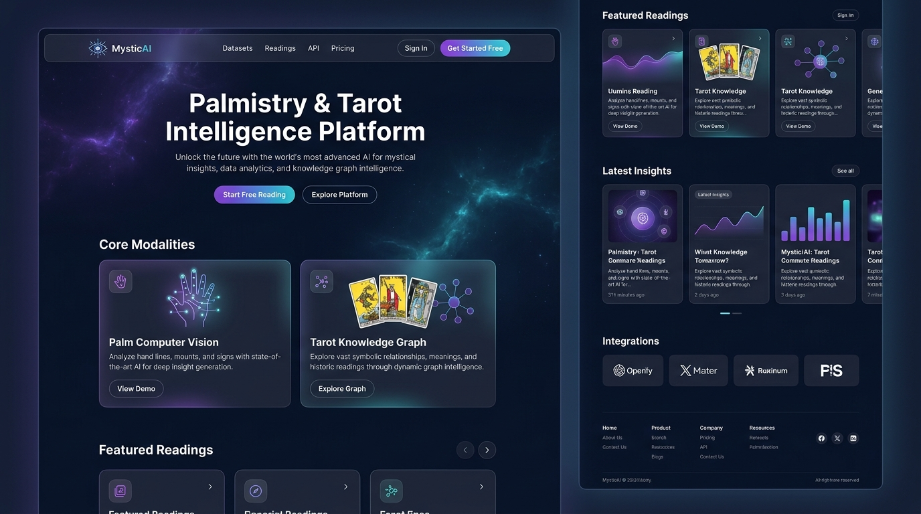
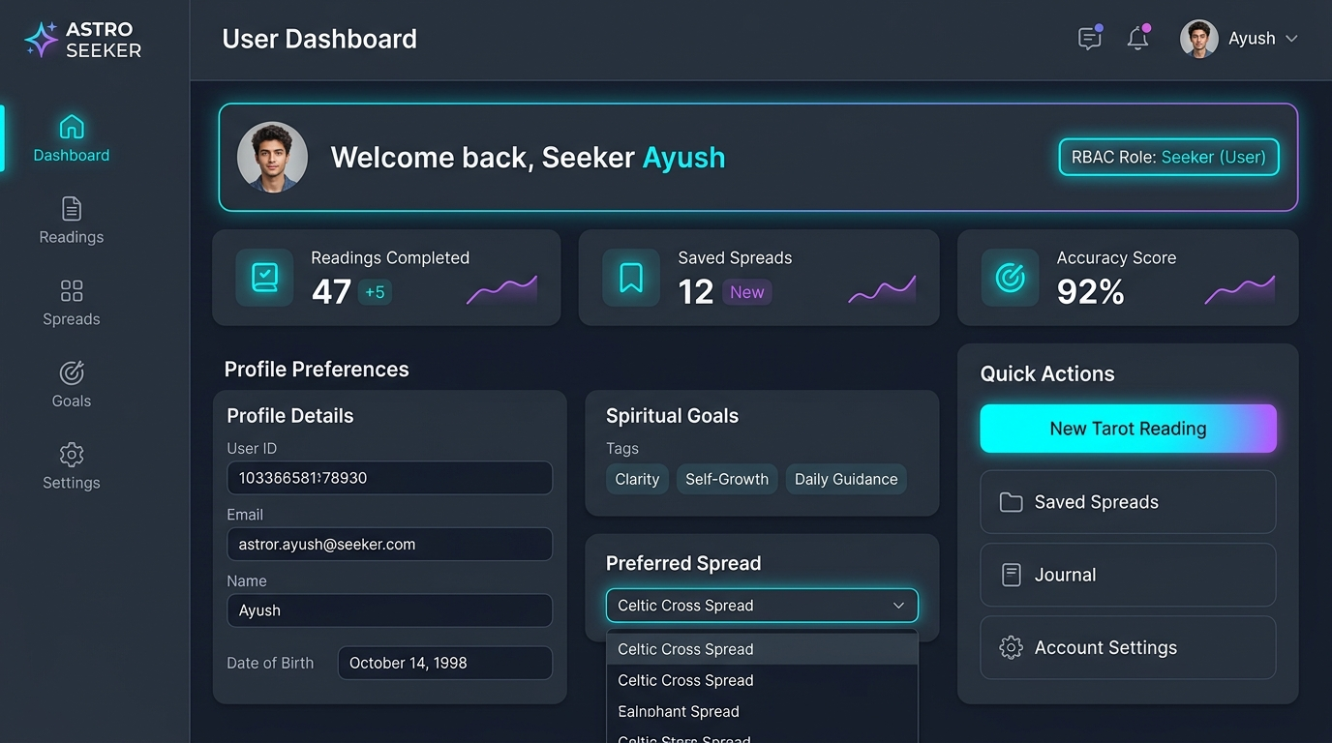
07. USER EXPERIENCE
08 / 10
Interactive User Experience & UI Showcase
MODERN COSMIC GLASSMORPHISM UI
Dark-mode aesthetic with interactive camera palm HUD, 3D card deck shuffle & flip animations, and real-time guidance feedback.
HOLISTIC ANALYTICS & DATA PORTABILITY
Seeker profile showing Big Five radar charts, longitudinal spiritual timelines, and instant one-click export to CSV & JSON formats.

Slide 9
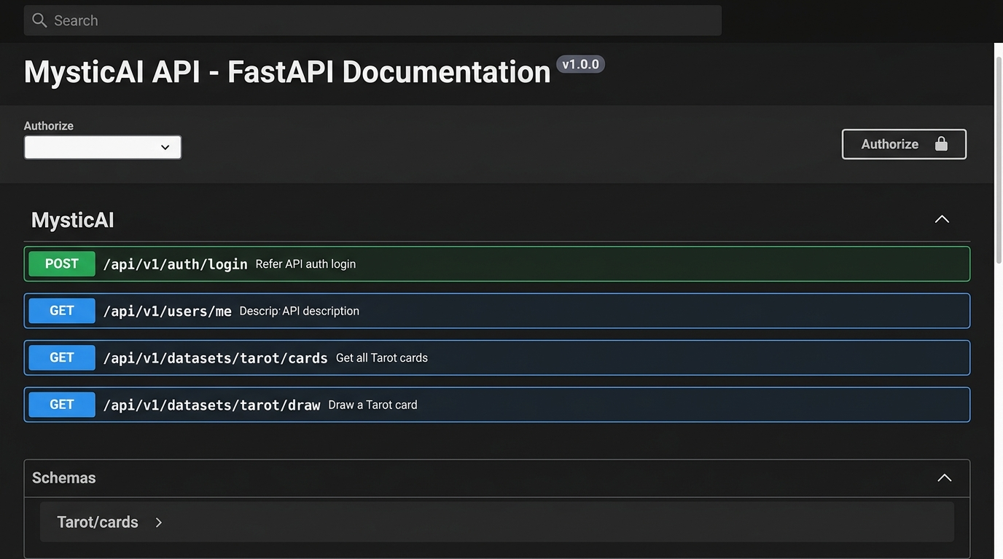
08. VERIFICATION & METRICS
09 / 10
Engineering Rigor, Testing & Quality
63 / 63
Automated Tests Passing (100%)
< 95 ms
Average REST API Latency
30+ APIS
Swagger / OpenAPI Standard
0 DOWNTIME
Automatic SQLite Fallback
TESTING & CODE STABILITY
✔ Auth security: JWT token generation, refresh & blacklist tests
✔ Deterministic CV: Line curvature boundary & landmark assertions
✔ Tarot permutations: Card inversion polarities & spread integrity
✔ Cross-modal integration: Synthesis output schema validation

Slide 10
09. SUMMARY & DEMO
10 / 10
Project Conclusion, Impact & Future Roadmap
MILESTONES DELIVERED (100%)
✔ Milestone 1: Foundations & Architecture
FastAPI backend, Next.js frontend, hybrid database models, full auth scaffolding.
✔ Milestone 2: Palmistry & Tarot Engines
5 palm line extraction algorithms, 78-card tarot deck, 6 spread layouts.
✔ Milestone 3: AI Synthesis & RBAC
5-factor confidence scoring model, 4 role-based user portals, report generation.
✔ Milestone 4: Testing, Export & Polish
63 passing automated tests, CSV/JSON export, performance optimization.
FUTURE ROADMAP & LIVE DEMO
🚀 On-Device Edge MediaPipe
Client-side WebAssembly computer vision for offline palm landmark inference.
🚀 Cross-Platform Mobile App
React Native iOS & Android apps with haptic feedback tarot shuffling.
🚀 Multilingual Neural Voice
Real-time AI voice-guided consultations in 10+ global languages.
🚀 WebXR 3D Sanctum
Immersive virtual reality spiritual consultation environment.
──────────────────────────────
Thank you! Ready for Live Demo & Q&A.

