Slide 1
NEW ECONOMIC POLICIES: Liberalization Privatization Globalization
By
Dr. Mahendra Parihar
Associate Professor,
MPSTME, NMIMS Mumbai

Slide 2

LPG
Indian economy had experienced major policy changes in early 1990s. The new economic reform, popularly known as, Liberalization, Privatization and Globalization (LPG model)
It was aimed at making the Indian economy as fastest growing economy and globally competitive. The series of reforms undertaken with respect to industrial sector, trade as well as financial sector aimed at making the economy more efficient.

Slide 3

REASONS FOR IMPLEMENTING LPG
Large and growing fiscal imbalances.(Gross fiscal deficit rose to 12.1% of GDP in 1991).
Growing inefficiency in the use of resources.
Low foreign exchange reserves.($1.2 billion in January 1991)
High inflation rate.(13.87% in year 1990-91)
The low annual growth rate of Indian economy stagnated around 3.5% from 1950s to 1980s, while per capita income averaged 1.3%.

Slide 4
Impact on India
India opened up the economy in the early nineties following a major crisis that led by a foreign exchange crunch that dragged the economy close to defaulting on loans.
The response was a number of Domestic and external sector policy measures partly prompted by the immediate needs and partly by the demand of the multilateral organizations.
The new policy regime radically pushed forward in favor of a more open and market oriented economy.

Slide 5


Slide 6
LIBERALIZATION
It means the process of opening up of the Indian economy to trade and investment with the rest of the world.
It means that opening the Door for doing Business to all over the world.
Till 1991 India had a import protection policy wherein trade with the rest of the world was limited to exports.
Foreign investment was very difficult to come into India due to a bureaucratic framework.
After the start of the economic liberalization, India started getting huge capital inflows and it has emerged as the 2nd fastest growing country in the world.

Slide 7
MEASURES TAKEN FOR LIBERLIZATION
Freedom for expansion and production to industries.
Increase in the investment limit of the small industries.
Freedom to import the capital goods and raw materials.
Freedom to import technology.
Liberalization of export and import transactions.
Liberalization in taxation policy.
Liberalization in capital markets.
Liberalization in banking sector.
Increase the foreign investment.
Increase the foreign exchange reserve.
Increase in consumption.
Control over price.
Check on corruption.
Reduction in dependence on external commercial borrowings.

Slide 8
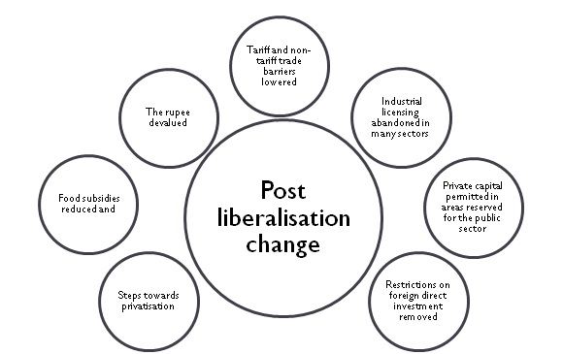

Slide 9

BENEFITS OF LIBERLIZATION
Increase the foreign investment.
Increase the foreign exchange reserve.
Increase in consumption.
Control over price.
Check on corruption.
Reduction in dependence on external commercial borrowings.

Slide 10
LIMITATIONS OF LIBERLIZATION
Increase in unemployment.
Loss to domestic units
Increase dependence on foreign nations.
Unbalanced development.
Increase the imbalances.

Slide 11


Slide 12
PRIVATIZATION
Privatization means transfer of ownership and/or management of an enterprise from the public sector to the private sector .
Privatization is opening up of an industry that has been reserved for public sector to the private sector.
Privatization means replacing government monopolies with the competitive pressures of the marketplace to encourage efficiency, quality and innovation in the delivery of goods and services.

Slide 13
Disinvestment
Privatization of PSUs by selling off part of the equity (share) to the public is known as disinvestment.
The purpose of Disinvestment is to improve financial discipline and to facilitate modernization. Private capital and managerial capabilities would improve the efficiency of PSUs.
Government adopted following two main methods for disinvestment:
Minority Sale: Equity is offered to investors through domestic public issue. The govt transfers minority share to private persons. The management control is not transferred.
Strategic Sale: Govt sells majority share above 51% to the private sector. It is called strategic as management is transferred to the private sector as a matter of strategy.

Slide 14
MEASURES ADOPT FOR PRIVATIZATION
Contractions of public sectors.
Sales shares of public sectors to the private sector.
Sick public sector industries.
Memorandum of understanding.
National renewal fund.

Slide 15
ADVANTAGES OF PRIVATIZATION
Increase in efficiency.
Professional management.
Increase in competition.
In line with international trends.
Reduction in political interference.
Encourage to new innovations.
Increase the industrial growth.
Increase the foreign investment.
Reduction in public sector.

Slide 16
LIMITATIONS OF PRIVATIZATION
Industrial sickness.
Lack of welfare.
Class struggle.
Increase in inequality.
Opposition by employees.
Political pressure.
Increase in unemployment.
Ignores the weaker sections.

Slide 17
Successful Privatizations in India
Lagan jute machinery company limited (LJMC)
{Gross turnover: pre-privatization= Rs. 6 million (april-june 2000),
post-privatization= Rs. 24 million (july-september 2000)}
Modern food industries limited (MFIL)
{Share value went up from Rs. 2138 on 30th Dec.(prior to sale) to
Rs. 3247 on 25th Feb.(post sale).}
Paradeep Phosphates Limited (PPL)
{Net profit: pre sale= Rs. -57.95 Cr., post sale= Rs. 23.96 Cr.}
Bharat aluminum company limited (BALCO)
Hotel Corporation of India limited (HCI)
Hindustan Zinc limited (HZL)

Slide 18


Slide 19
GLOBALIZATION
It means that opening up of the economy for foreign direct investment by liberalizing the rules and regulations and by creating favorable socio-economic and political climate for global business.
Opening and planning to expand business throughout the world.
Buying and selling goods and services from/to any countries in the world.

Slide 20
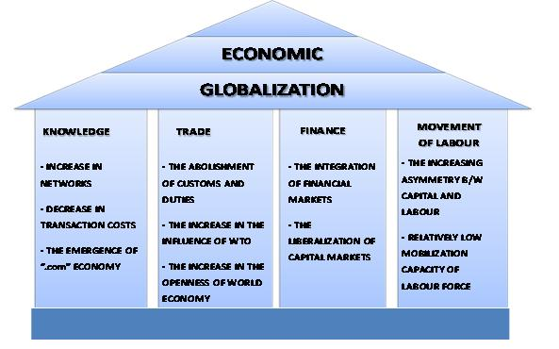

Slide 21
MEASURES ADOPTED FOR GLOBALIZATION
Increase the foreign investment.
Partial convertibility of Indian Rupee.
Foreign trade policy.
Reduction of tariffs.
Export promotion.
Freedom of repatriate.

Slide 22
POSITIVE EFFECT OF GLOBALIZATION
Increase in foreign trade.
Increase in foreign investment.
Foreign direct investment.
Increase in foreign collaboration.
Increase in foreign exchange reserves.
Expansion of market.
Technological development.
Brand development.
Development of service sectors.
Development of capital market.
Increase in employment.
Improvement in standard of living.

Slide 23
NEGATIVE EFFECTS OF GLOBALIZATION
Loss of domestic industries.
Unemployment.
Exploitation of labour.
Demonstration effect.
Increase in inequalities.
Dominance of foreign institutions.

Slide 24
Main organizations facilitating Globalization
Some of the international organizations which facilitate the process of globalization:
International Monetary Fund (IMF)
World Bank
World Trade Organization (WTO)

Slide 25
CONCLUSION
On the whole it can be concluded that changes across Euro, USA and other countries have significantly changed the Indian economy. India has realized that its business can’t survive without focusing on changes in other countries. Indian economy has become a major economy of the world and a significant trading partner. In the new era, India is looking at the potentials of the new products.

Slide 26
C o n c l u s i o n
Indian economy has made rapid strides in the process of globalisation.
Globalisation is increasing the integration of national markets and the interdependence of countries world wide for a wide range of goods, services, and commodities.
The most important lesson that we must learn from the crisis is that we must be self-reliant.
India’s trade reform programme resulted in strong economic growth in the globalization age.
In particular, difficult decisions are to redress the fiscal imbalance, by reducing subsidies, completing the process of tariff and tax reform, and stepping-up privatization of state-owned enterprises.
The efforts are needed to balance the trade and consider expansion of trade in other countries of the world.

