Slide 1

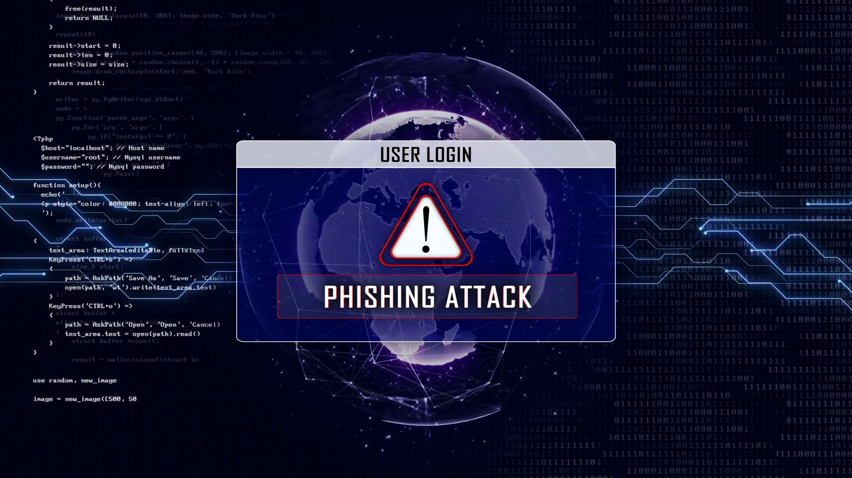
Phishing Awareness Training

Slide 2
Introduction
Phishing remains a significant cybersecurity threat, targeting individuals and organizations through deceptive tactics. This training will equip you with the knowledge and skills necessary to identify and avoid phishing attempts. We'll explore common phishing techniques, learn how to recognize suspicious communications, and establish proactive measures to protect sensitive information, ultimately fostering a more secure digital environment for everyone.

Slide 3
Understanding Phishing Attacks
Phishing attacks aim to trick individuals into revealing personal information like logins, passwords, or financial details.
Attackers often impersonate legitimate organizations or individuals to create a sense of trust and urgency.
These attacks typically utilize email, text messages, or social media platforms to deliver malicious links or attachments.
A variety of social engineering tactics are employed, such as creating fear or offering enticing rewards, to manipulate victims.

Slide 4
Recognizing Phishing Emails
Be suspicious of emails with a generic greeting like "Dear Customer" or "Valued User" instead of using your name.
Look for poor grammar and spelling errors; these are often indicators of phishing attempts from non-native English speakers.
Verify the sender’s email address, not just the display name, as it may be spoofed to look legitimate.
Pay careful attention to any sense of urgency or pressure to act immediately, which is commonly used by phishers.

Slide 5
Identifying Malicious Links
Hover your mouse over the link (without clicking) to preview the actual URL and ensure it matches the supposed destination.
Beware of URL shortening services that hide the true destination which could lead to malicious websites.
Check for the "https" and padlock icon in the address bar, indicating a secure connection, but know that this is not a foolproof guarantee.
Avoid clicking links received from unverified or unknown sources and utilize safe browsing tools or plugins.

Slide 6
Recognizing Phishing Websites
Verify the website address in the address bar, comparing it against known legitimate URLs of the site.
Look for consistency in branding, logos, and design as many phishing sites use altered or copied legitimate website elements.
Be skeptical of websites requesting your personal information without a secure connection, especially sensitive details like passwords or financial data.
If a website appears suspicious, cross check it with another independent resource to confirm its legitimacy before entering any information.

Slide 7
Common Phishing Scenarios
Fake requests from IT departments asking for password resets using deceptive emails or text messages.
Phishing attempts via fake shipping notifications claiming missed deliveries and requesting payment to be re-delivered.
Fraudulent emails masquerading as your bank or credit card provider requesting account login information.
Social media campaigns offering fake contests or gifts aiming to harvest user information and spread malware.

Slide 8
Spear Phishing: A Targeted Attack
Spear phishing attacks are targeted at specific individuals or organizations with customized and well-researched campaigns.
Attackers often gather information from public sources or social media to create personalized and compelling narratives.
These attacks are harder to detect because they look more legitimate due to their carefully crafted details.
Be extra cautious and skeptical of unsolicited communications, particularly those referencing personal details or specific work related topics.

Slide 9
Protecting Your Information
Implement strong, unique passwords for all your online accounts, or consider using a password manager.
Enable two-factor authentication (2FA) on your accounts for an extra layer of security against unauthorized access.
Be mindful of the information you share online on social media, as attackers can use this to gain information for targeted attacks.
Regularly update your browser and applications to patch any known security vulnerabilities that are often exploited.

Slide 10
Reporting Suspicious Activity
Immediately report any suspected phishing attempts to your organization's IT department or security team.
Never reply to suspicious emails or text messages directly, as this confirms your email is active.
Report phishing attempts to the relevant authorities – if appropriate – and also to the service provider where the phishing was attempted.
Encourage colleagues to follow best practices and support a culture of shared responsibility for reporting potential security threats.

Slide 11
Social Engineering Tactics
Be aware of the use of urgency and pressure tactics to rush your decision-making and bypass sound judgement.
Be vigilant against emails asking for personal information, such as passwords or financial details without proper verification.
Learn to spot emotional manipulation tactics like promises of rewards, threats and requests for urgent solutions.
The goal is to increase awareness of how phishers manipulate users into succumbing to these attacks.

Slide 12
Link Analysis Techniques
Understand how URL shortening services can disguise malicious links by hiding the true destination.
Analyze website addresses and inspect them for common misspellings designed to mimic legitimate sites.
Use browser plug-ins and extensions that can scan URLs and identify potential threats in real-time.
Practice careful observation and inspection techniques and avoid clicking unverified links.

Slide 13
Password Protection Best Practices
Utilize strong, unique passwords that combine upper and lowercase letters, numbers, and symbols.
Avoid using personal information (like names or birthdates) as parts of passwords making them vulnerable to cracking.
Consider using a reputable password manager application to securely generate and store unique passwords.
Exercise regular password updates and limit re-use of passwords across different web applications or online accounts.

Slide 14
Incident Response Protocols
If you suspect you have fallen victim to a phishing attack immediately change passwords and report the incident.
Take immediate steps to alert your IT or security team about the incident so they can take necessary mitigations steps.
Monitor your accounts for unusual activity following a suspected incident and report any discrepancies promptly.
Take any advised preventative action to recover and secure any impacted data and systems.

Slide 15
Awareness
Phishing awareness is an ongoing process, not a one-time event. By understanding phishing techniques, practicing vigilance, and consistently applying the best practices discussed, we can significantly reduce our susceptibility to these attacks. Remember, a proactive approach combined with knowledge and skepticism are the most effective tools in combating phishing and safeguarding sensitive information. Let's work together to build a more secure digital environment for everyone.

Slide 16
THANKYOU

