Slide 1



From Specification to Implementation: Assume-Guarantee Contracts for Synthetic Biology
Ayush Pandey¹, Inigo Incer^{1,2}, Alberto Sangiovanni Vincentelli², Richard M Murray¹,
¹California Institute of Technology and ²University of California, Berkeley

Slide 2


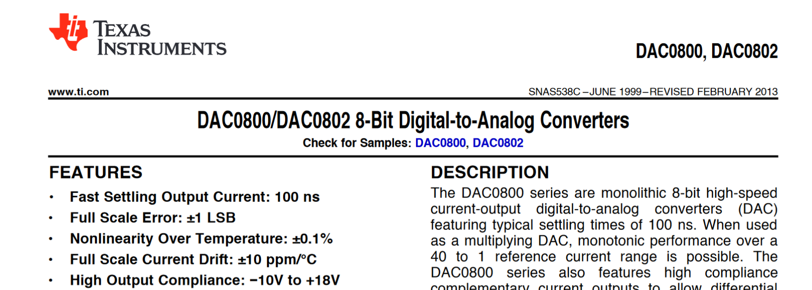
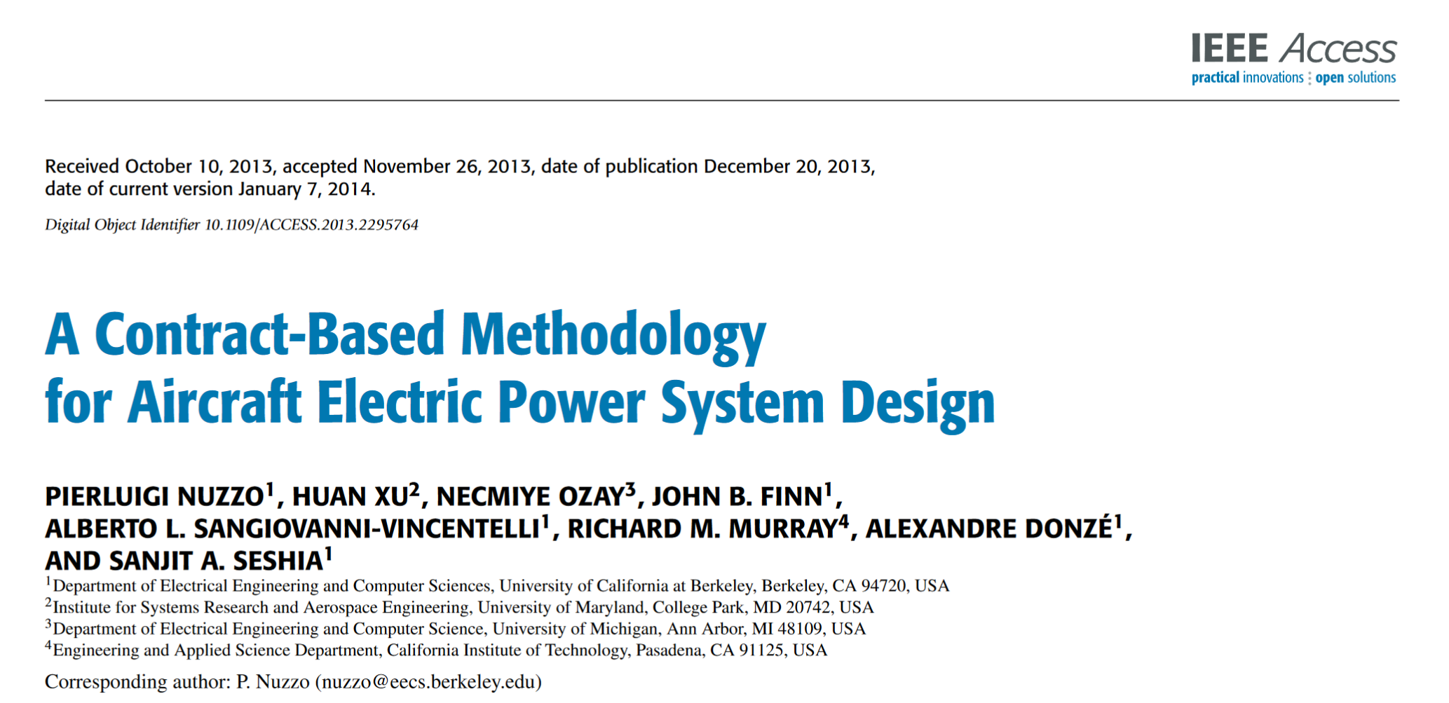
Engineering design
Vast library of well-characterized parts
Formal design frameworks
Biological context is largely unknown whereas mechanical/electrical context can be quantified when characterizing each part.
Design frameworks that consider compositionality, context effects, and that can be used to synthesize system designs.
Ayush Pandey, California Institute of Technology

Slide 3
Key ideas towards formal design of bio-circuits
Decoupling the details of a system model and its implementations from its specifications.
A framework that integrates system components agnostic of their implementation choices.
A design tool that proposes new experiments on characterization of components.

Slide 4
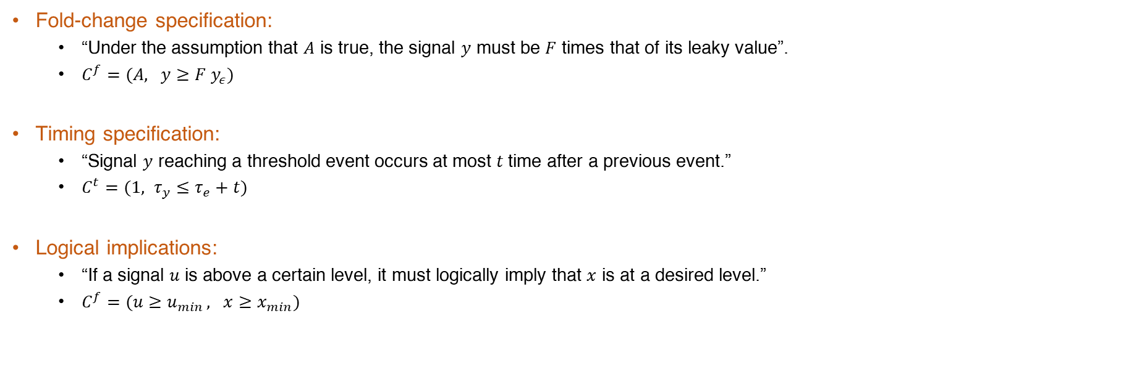
From English language specifications to mathematical formalism
Common synthetic biology specifications: Fold-change, Timing, Logic implications.
Fold-change specification:
“Under the assumption that $A$ is true, the signal $y$ must be $F$ times that of its leaky value”.
$C^{f}=(A, y≥F y_{ε})$
Timing specification:
“Signal $y$ reaching a threshold event occurs at most $t$time after a previous event.”
$C^{t}=(1, τ_{y}≤τ_{e}+t)$
Logical implications:
“If a signal $u$ is above a certain level, it must logically imply that $x$ is at a desired level.”
$C^{f}=(u≥u_{min }, x≥x_{min})$
2/28/2023

Slide 5
Contract-based design
Problem 1: Verification
Verify whether the given specifications of the subsystems satisfy the desired top-level system specification.
Assume-Guarantee Contracts
First-order models
Biological mechanism models
Subsystem spec implementation
Subsystem model implementation
Subsystem Specifications
First-order subsystem models
Phenomenological subsystem models
Contract
composition
Model composition
Model composition
System spec implementation
System model implementation
System specification
First-order system model
Phenomenological system model

Slide 6
Contract-based design
Problem 1: Verification
Problem 2: Synthesis
Verify whether the given specifications of the subsystems satisfy the desired top-level system specification.
Synthesize the specifications of a missing subsystem that completes the existing library of parts such that the top-level system specification can be met.
Assume-Guarantee Contracts
Top-level and available subsystem specifications
Contract
synthesis
First-order model
Biological mechanism model
Synthesized spec implementation
Synthesized subsystem model implementation
Synthesized subsystem contract
First-order synthesized model
Phenomenological synthesis

Slide 7
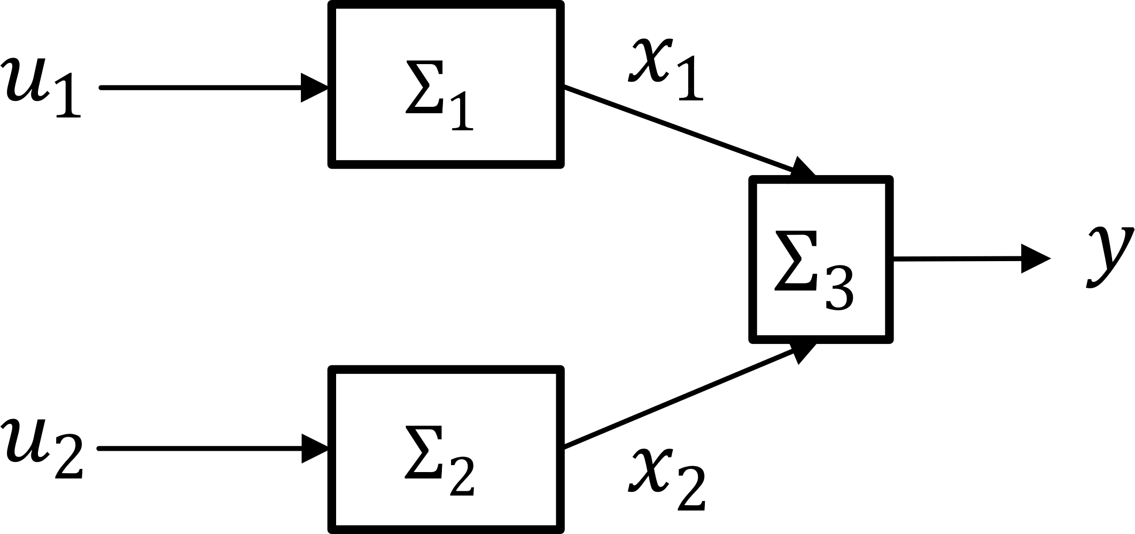
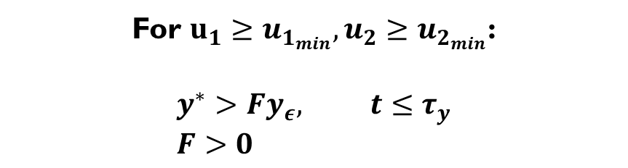
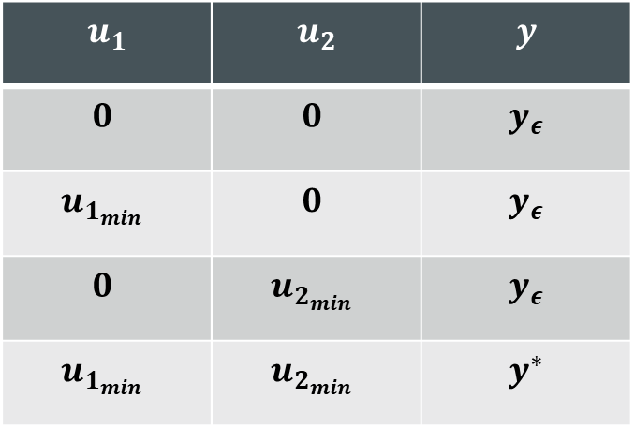
A toy example: AND gate and its top-level specification
Static specifications
$$u_{1}$$ | $$u_{2}$$ | $$y$$
$$0$$ | $$0$$ | $$y_{ε}$$
$$u_{1_{min}}$$ | $$0$$ | $$y_{ε}$$
$$0$$ | $$u_{2_{min}}$$ | $$y_{ε}$$
$$u_{1_{min}}$$ | $$u_{2_{min}}$$ | $$y^{∗}$$
Dynamic specifications
For $u_{1}≥u_{1_{min}}, u_{2}≥u_{2_{min}}$:
$$y^{∗}>Fy_{ε}, t≤τ_{y} \\ F>0$$
2/28/2023

Slide 8
Formal system design: Verification Given specifications of - the top-level system and - all subsystems verify whether the composition of subsystems satisfies the top-level specification

Slide 9

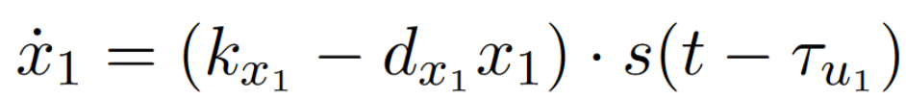
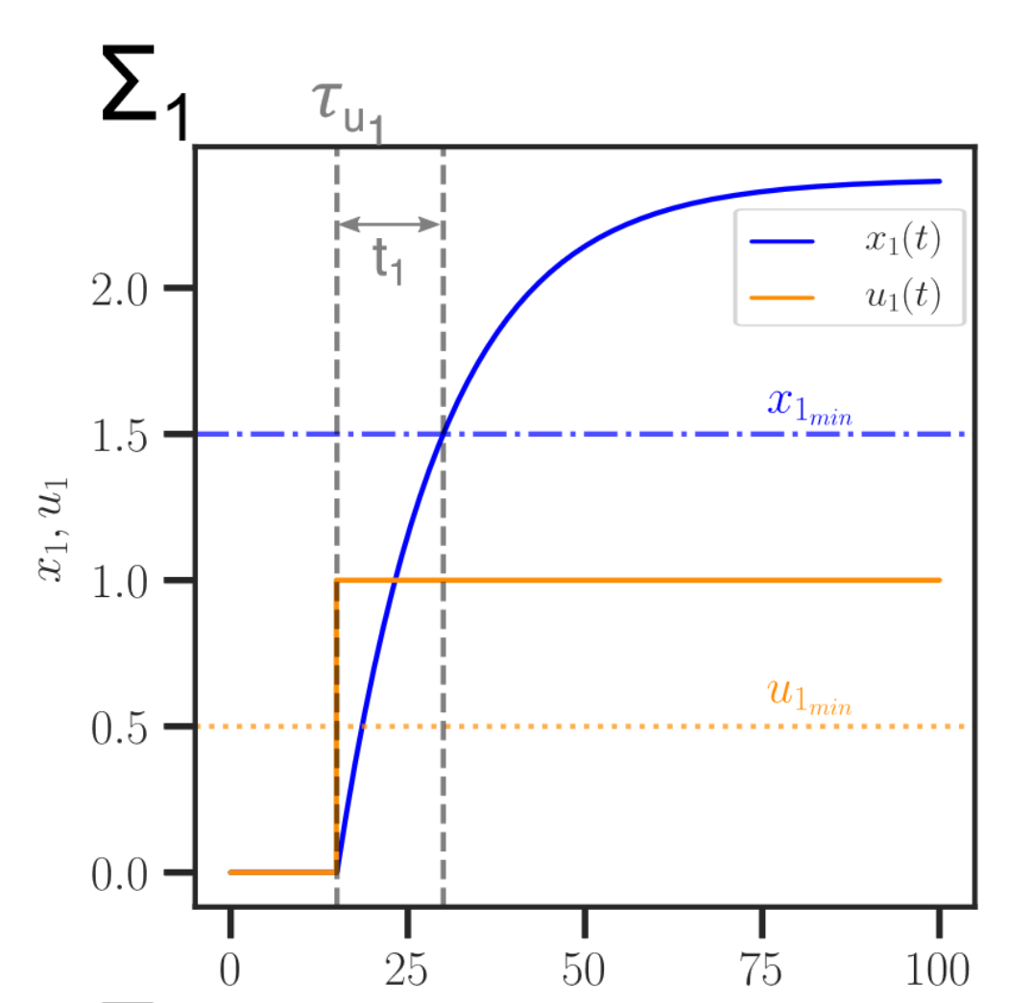
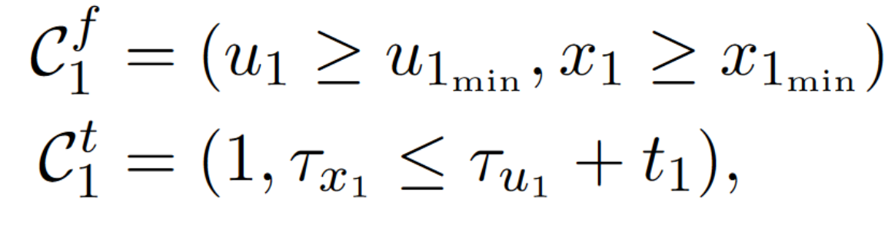
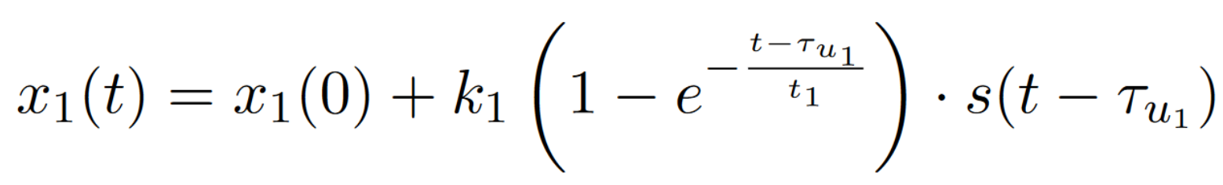
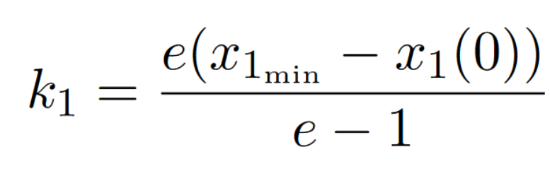
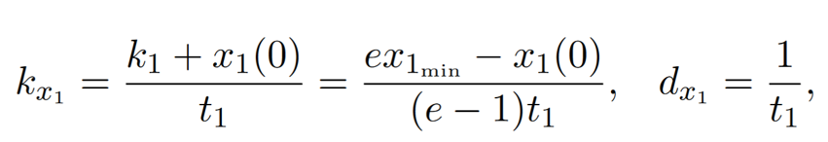

Design of $Σ_{1}$:
Specifications
First-order model
ODE

Slide 10
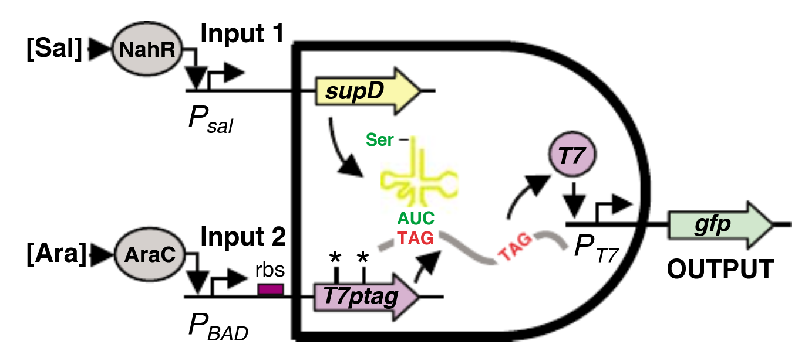
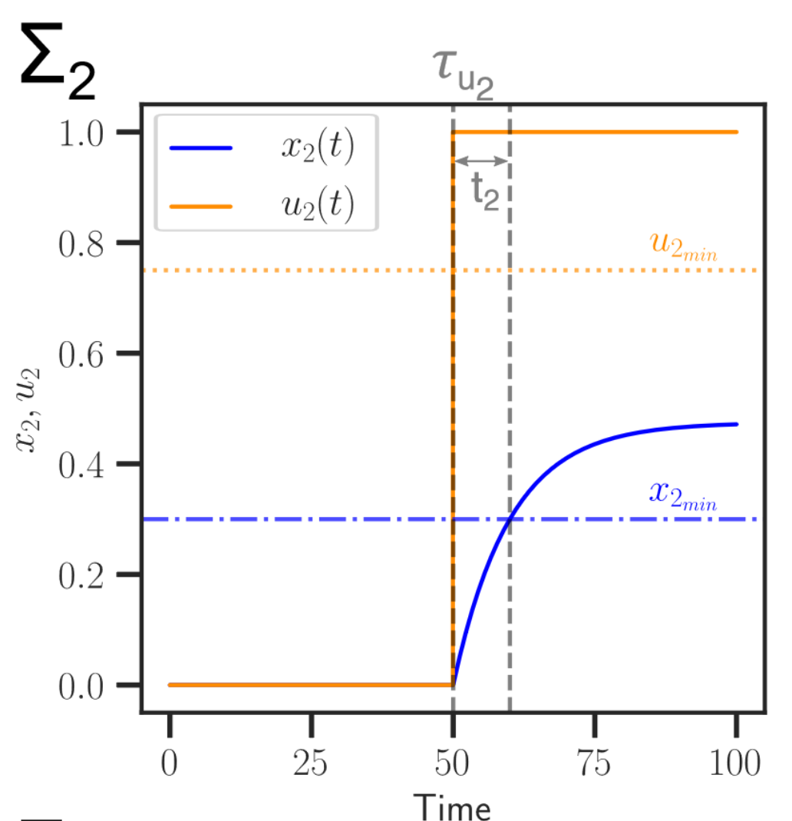

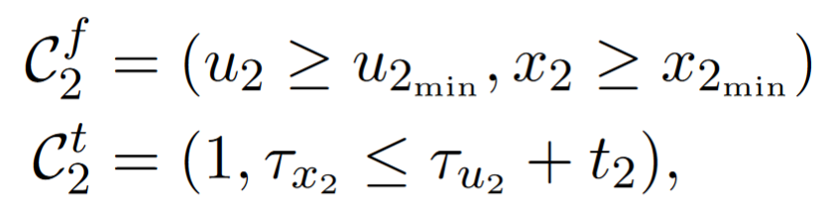

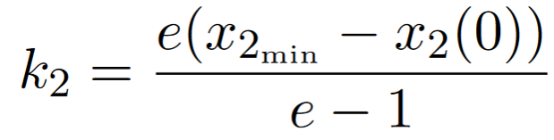
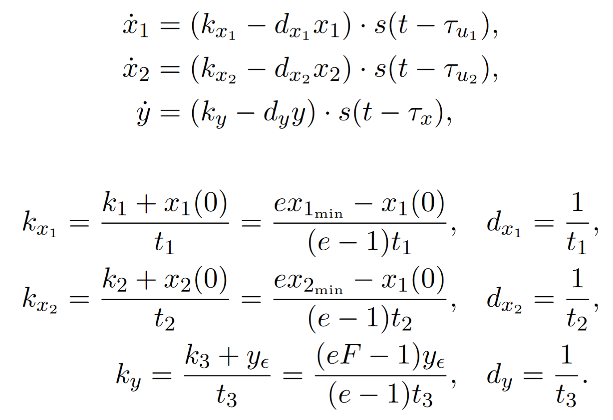


Design of $Σ_{2}$:
$u_{2}:$Ara $x_{2}:$T7ptag
Specifications
First-order model
ODE

Slide 11
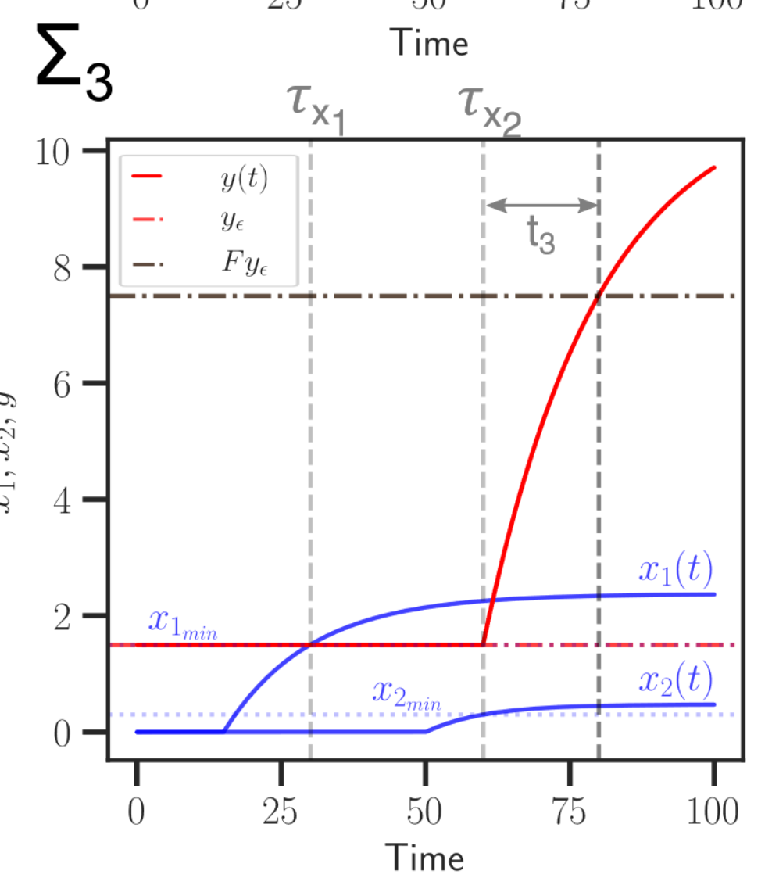

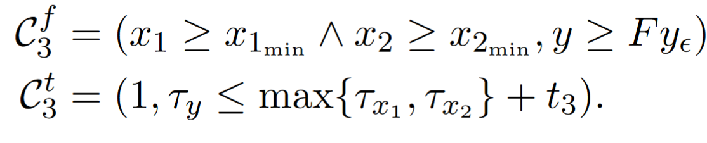
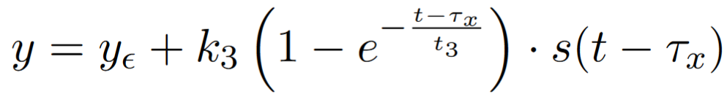

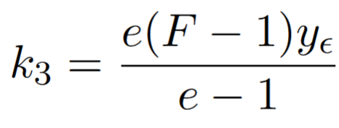


Design of $Σ_{3}$:
$y :$GFP
Specifications
First-order model
ODE

Slide 12

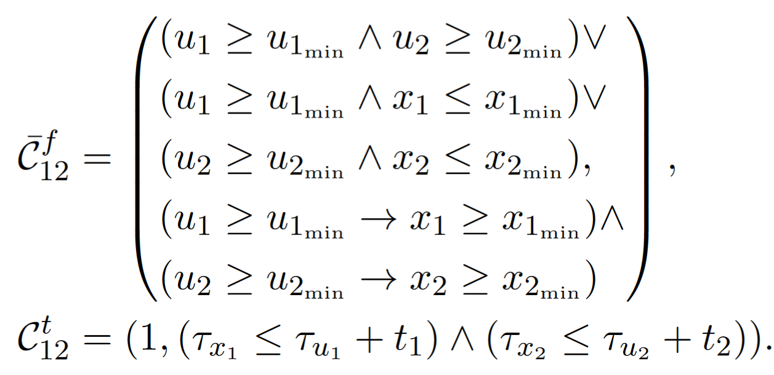
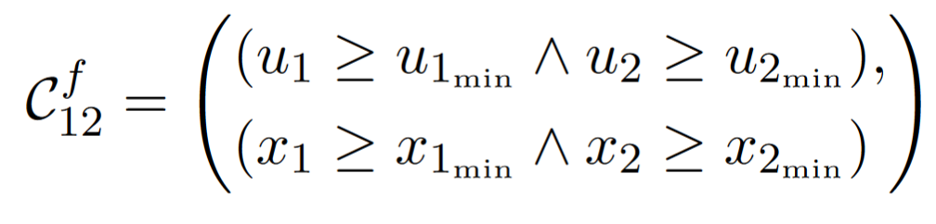
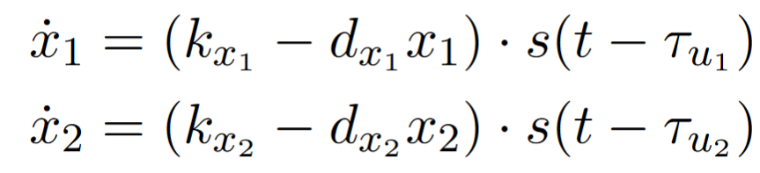

Composition
Composition of contracts:
$y :$GFP
Specification
Abstraction
First-order model
Ayush Pandey, California Institute of Technology
Benveniste, Albert, et al. Contracts for system design. Diss. Inria, 2012.
Notes:
Composition yields the smallest specification that the system obeys. This means that the system satisfies any specification which is more abstract than that obtained from the composition operation.

Slide 13
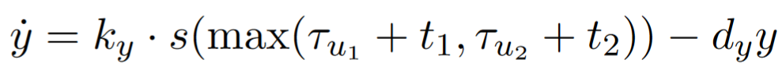
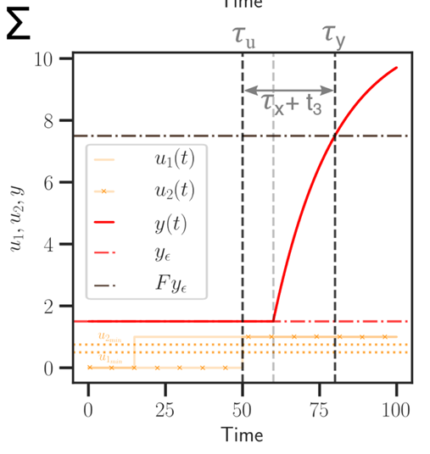
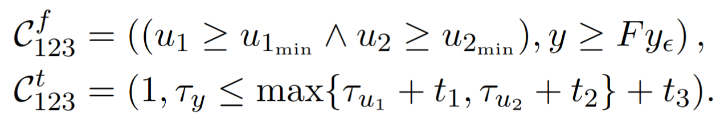

Composition
$y :$GFP
Specification
First-order model
Ayush Pandey, California Institute of Technology

Slide 14

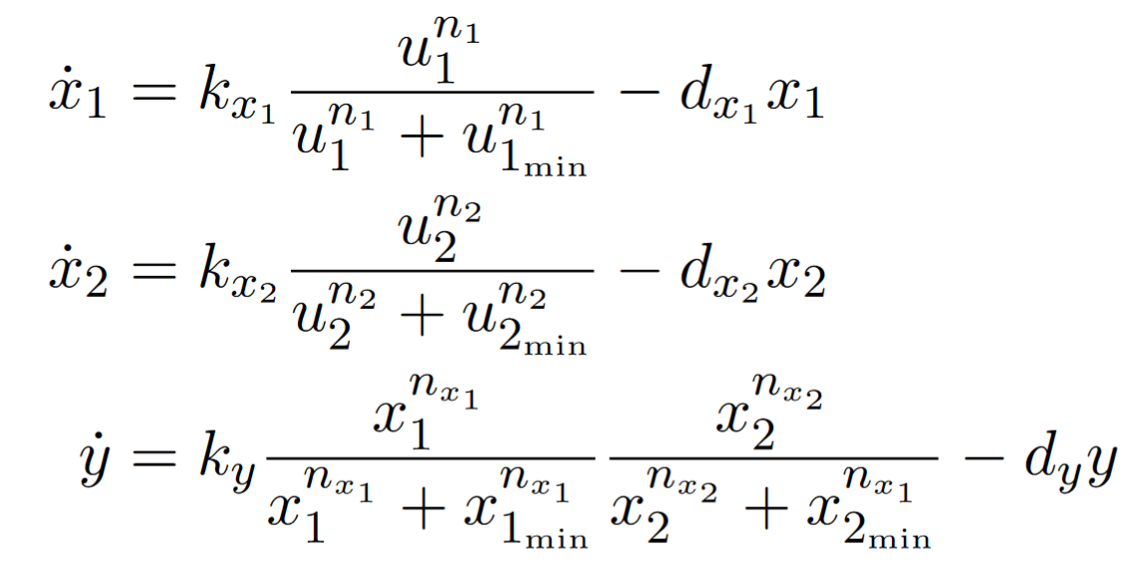
Towards detailed implementation models
Specifications
Phenomenological models
Phenomenological models
Implementation models
Interaction based specifications.
First-order models.
Mechanism level models.
Huge CRNs that represent circuit implementation.
Future Work

Slide 15
Formal system design: synthesis Given specifications of the top-level system and two subsystems, synthesize the missing subsystem that satisfies top-level specification

Slide 16
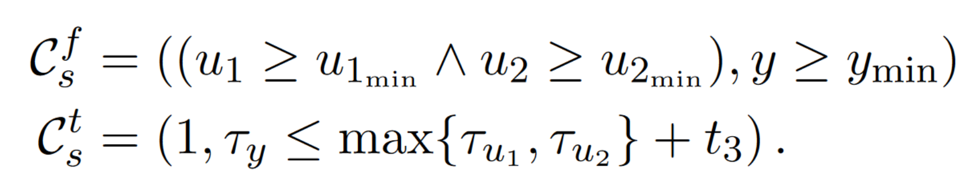

Find specification of missing component
$$??$$
Top-level system specification:
Composition of two subsystems:
2/28/2023

Slide 17

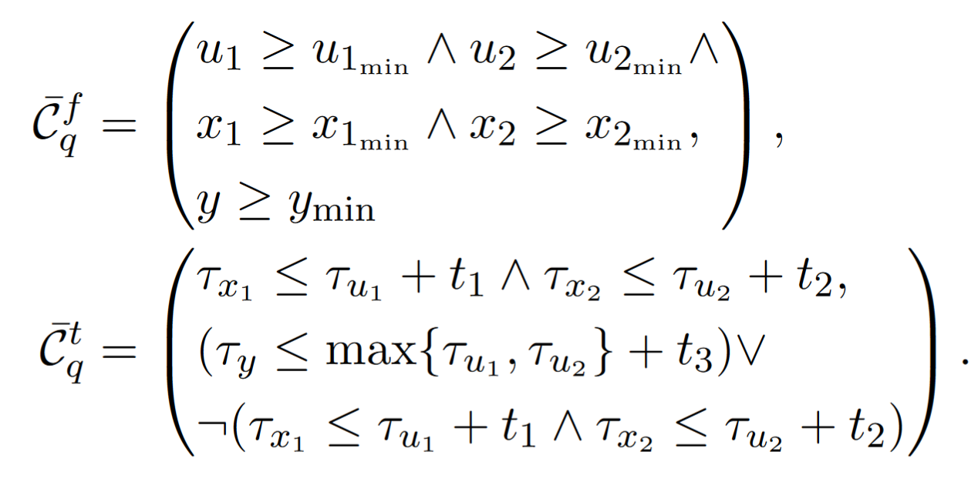
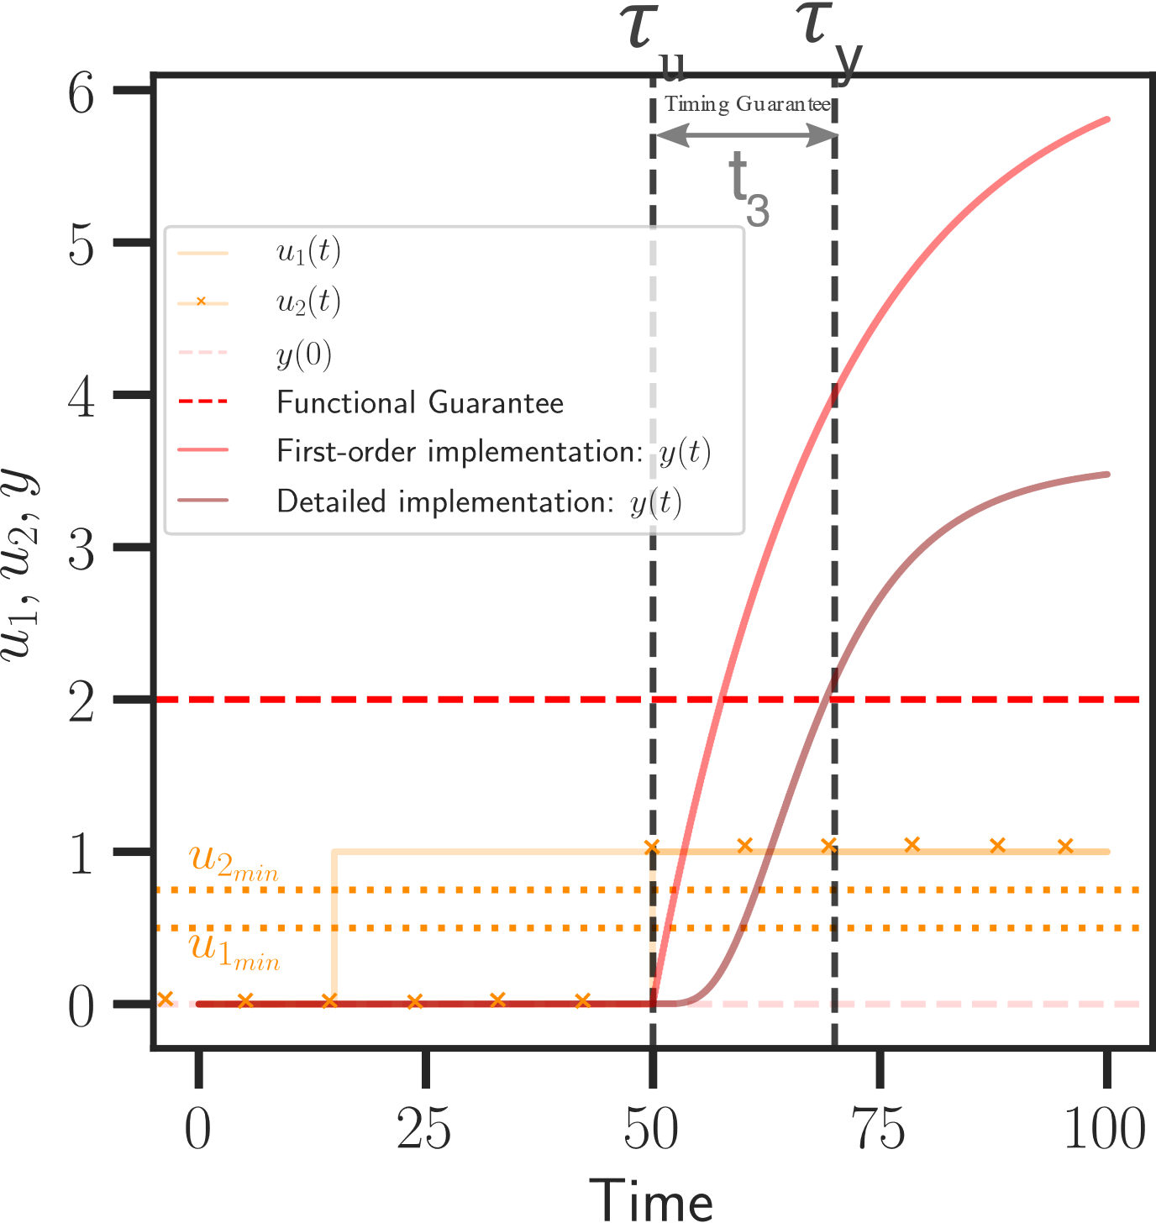
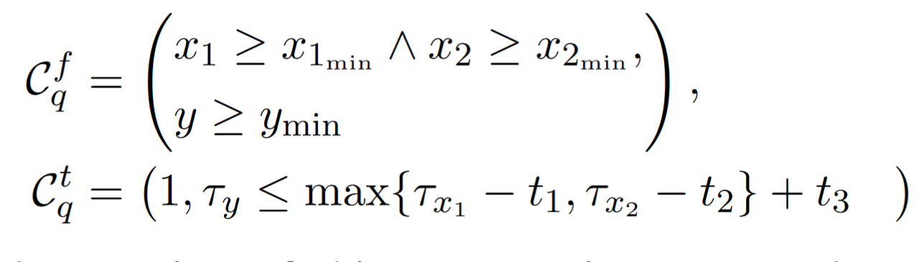
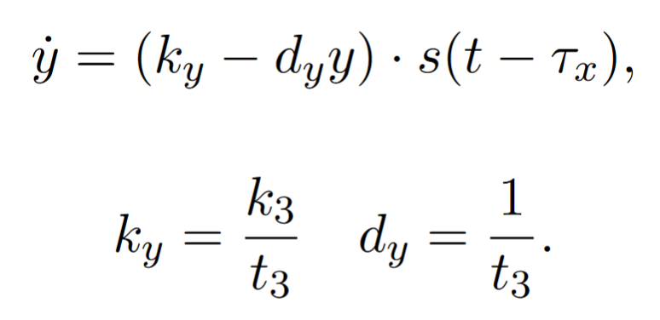
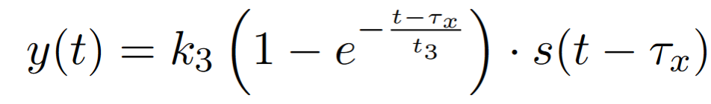
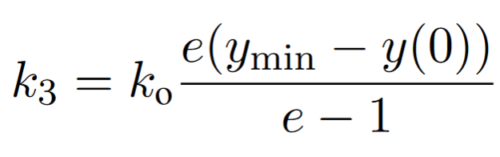

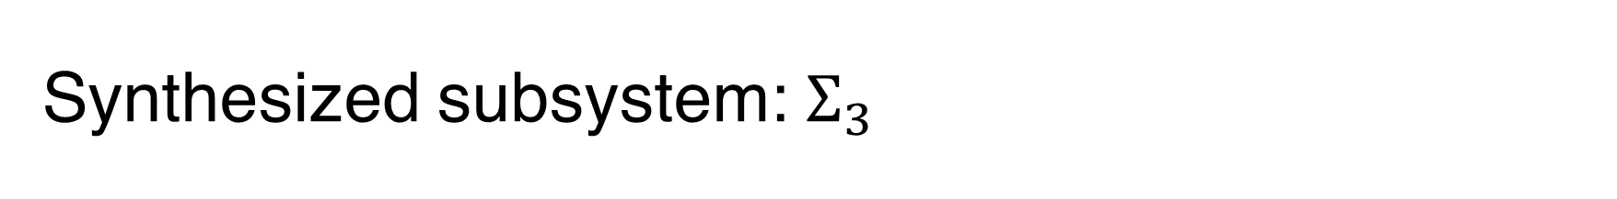
Synthesized subsystem: $Σ_{3}$
Quotient of contracts:
Specifications
Refinement
Detailed implementation
First-order model
Phenomenological Model
ODE
Incer Inigo, et al. "Quotient for assume-guarantee contracts." 2018 16th ACM/IEEE International Conference on Formal Methods and Models for System Design (MEMOCODE). IEEE, 2018

Slide 18
Key takeaways
A formal system design tool decouples specification, interconnections, and logical behavior from implementations.
For scalable design of biological circuits (with order of 1000 components) – a design tool catered for biology that reasons about behaviors, interfaces, and implementations is required.

