Slide 1


Characterization of integrase and excisionase activity in cell-free protein expression system using a modeling and analysis pipeline
Ayush Pandey¹, Makena L. Rodriguez¹, ²William Poole and Richard M. Murray¹
¹California Institute of Technology and ²Altos Labs

Slide 2
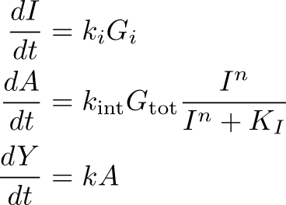
Iterative Python Pipeline for Automated Modeling, Analysis, and
Learning of Biological Circuits
1. White-box modeling: From abstract circuit description to chemical reactions using BioCRNpyler
2. Grey-box modeling: From SBML model to reduced ODE model using AutoReduce
Subsystem #1 and #2
CRN
Conservation Laws
Quasi-steady state assumption
Abstraction and species abundance
Iteration #2
BioCRNpyler
Automated Model Reduction with AutoReduce
Subsystem #1
CRN
Iteration #1
Minimal mathematical model for parameter identification
3. Black-box modeling: Bayesian learning of model parameters using Bioscrape
Mathematical model
Probability
Probability
Iteration #2
Bioscrape Sensitivity Analysis
S2: Param 1
S2: Param 2
Bioscrape Inference
Probability
Probability
Iteration #1
Experimental data
S1: Param 1
S1: Param 2

Slide 3
Characterization Iteration #1: Integrases in cell-free systems – Detailed models
1. White-box modeling: From abstract circuit description to chemical reactions using BioCRNpyler
BioCRNpyler
Iteration #1
Subsystem #1
CRN

Slide 4
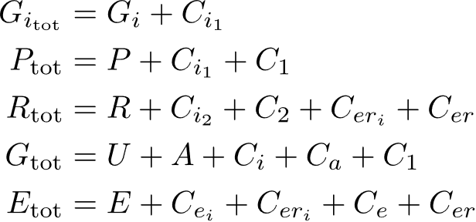
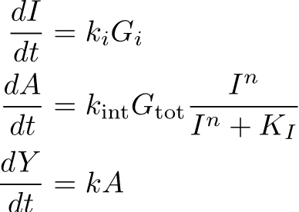
Characterization Iteration #1: Integrases in cell-free systems – Model reduction
1. White-box modeling: From abstract circuit description to chemical reactions using BioCRNpyler
BioCRNpyler
Iteration #1
Subsystem #1
CRN
CRN
Minimal mathematical model obtained using AutoReduce and BioCRNpyler
With AutoReduce:
Total genes are conserved.
Total RNAP, ribosomes, and endonucleases are conserved.
2. Grey-box modeling: From SBML model to reduced ODE model using AutoReduce
Conservation Laws
Quasi-steady state assumption
Abstraction and species abundance
Automated Model Reduction with AutoReduce
Multiple model reduction and model selection steps

Slide 5
Characterization Iteration #1: Integrases in cell-free systems – Experimental data
2. Grey-box modeling: From SBML model to reduced ODE model using AutoReduce
Conservation Laws
Quasi-steady state assumption
Abstraction and species abundance
Automated Model Reduction with AutoReduce
Minimal mathematical model for parameter identification
3. Black-box modeling: Bayesian learning of model parameters using Bioscrape
Mathematical model
Bioscrape Inference
Bioscrape Sensitivity Analysis
Iteration #1
Probability
Probability
S1: Param 1
S1: Param 2
Experimental data

Slide 6
Characterization Iteration #1: Integrases in cell-free systems – Learn from data
2. Grey-box modeling: From SBML model to reduced ODE model using AutoReduce
Conservation Laws
Quasi-steady state assumption
Abstraction and species abundance
Automated Model Reduction with AutoReduce
Minimal mathematical model for parameter identification
3. Black-box modeling: Bayesian learning of model parameters using Bioscrape
Mathematical model
Bioscrape Inference
Bioscrape Sensitivity Analysis
Iteration #1
Probability
Probability
S1: Param 1
S1: Param 2
Experimental data

Slide 7
Iterative Python Pipeline for Automated Modeling, Analysis, and
Learning of Biological Circuits
1. White-box modeling: From abstract circuit description to chemical reactions using BioCRNpyler
2. Grey-box modeling: From SBML model to reduced ODE model using AutoReduce
Subsystem #1 and #2
CRN
Conservation Laws
Quasi-steady state assumption
Abstraction and species abundance
Iteration #2
BioCRNpyler
Automated Model Reduction with AutoReduce
Subsystem #1
CRN
Iteration #1
Minimal mathematical model for parameter identification
3. Black-box modeling: Bayesian learning of model parameters using Bioscrape
Mathematical model
Probability
Probability
Iteration #2
Bioscrape Sensitivity Analysis
S2: Param 1
S2: Param 2
Bioscrape Inference
Probability
Probability
Iteration #1
Experimental data
S1: Param 1
S1: Param 2

Slide 8
Characterization Iteration #1: Integrases and Excisionases in cell-free systems
Experimental data
Predict excisionase and integrase input ratios
Mechanistic model with BioCRNpyler and its reduced models
Fix integrase and cell-free resource parameters

Slide 9
Key Takeaways
Model-guided implementation and experimental validation of integrase and excisionase mediated DNA recombination in a cell-free system.
Accessible, open-source, and ready to use software tools for all your biological modeling and analysis needs:
BioCRNpyler – to build models
AutoReduce – to reduce models
Bioscrape – to simulate models and learn from data

