Slide 1





Auto-Reduce An Automated Model Reduction Tool For Biological Circuits
Detailed full (CRN-level) model
Reduced models
Automated Model Reduction Toolbox
Comparison metrics
@ayush9pandey
Ayush Pandey
California Institute of Technology
GitHub

Slide 2
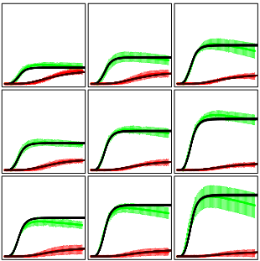
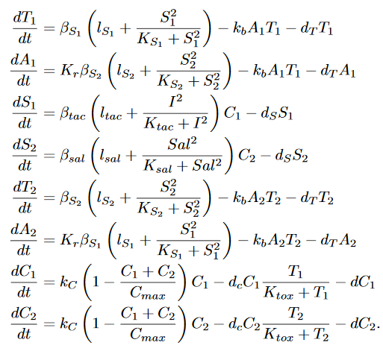
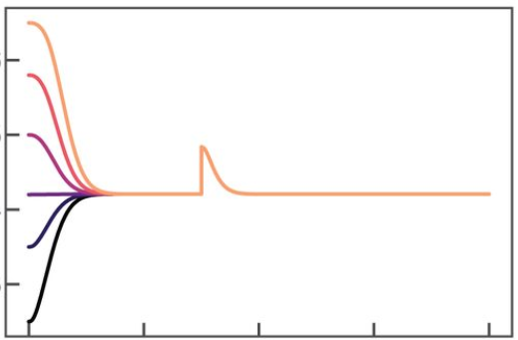



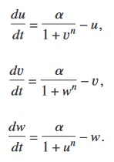
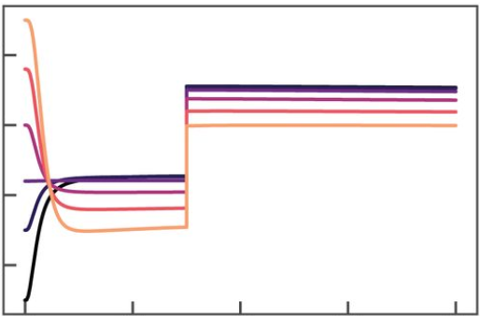
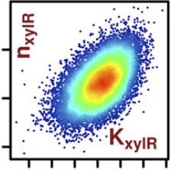
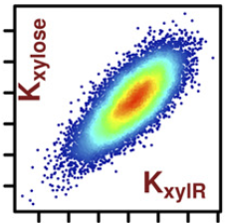
Why do we need reduced models?
Model building
Predictive modeling
Circuit Analysis
When things work
And when they don’t
Toggle switch
Parameter inference from data
Repressilator
Cell population control
Ayush Pandey
California Institute of Technology
2/5
GitHub

Slide 3

The Algorithm
CRN
(full model)
Reduced model
CRN
(full model)
Time-scale separation
Conservation laws
Species abundance
Norm of error in outputs
Sensitivity of error with model parameters
mass-action approximation
Input-output mapping
sys.solve_timescale_separation(fast_states)
sys.set_conservation_laws(list_of_laws)
sys.get_reduced_models()
reduced_sys.get_error_metric()
reduced_sys.get_robustness_metric()
reduced_sys.get_gamma()
sys = load_system(SBML_filename)
Ayush Pandey
California Institute of Technology
3/5
GitHub

Slide 4
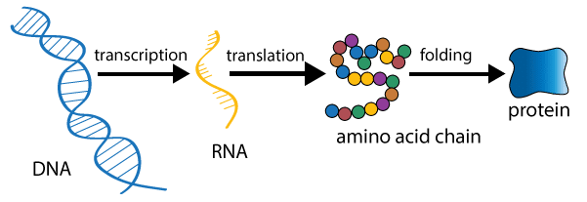
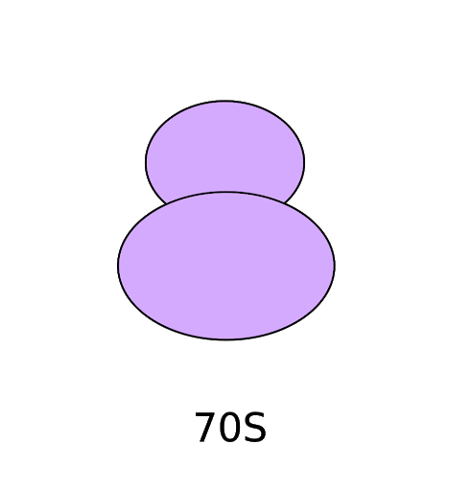


Gene expression
Chemical Reaction Network:
Protein
(X), output
Chemical Reaction Network:
mRNA
Commonly used model:
$$\frac{dT}{dt}=f(G)−d_{T} T$$
$$\frac{dX}{dt}=k T −d_{X} X$$
G + P C₁
C₁ G + P + T
T + R C₂
C₂ T + R + X
T + E C₃
C₃ E
X Ø, T Ø
X
Ribosome
DNA
(G), input
Two-state reduced model:
$$\frac{dT}{dt}=K_{L_{1}}G−d_{T} T−\frac{d_{E}T}{K_{E}+T}$$
$$\frac{dX}{dt}=K_{L_{2}} T −d_{X} X$$
Automated Model Reduction Algorithm
Ayush Pandey
California Institute of Technology
4/5
GitHub

Slide 5
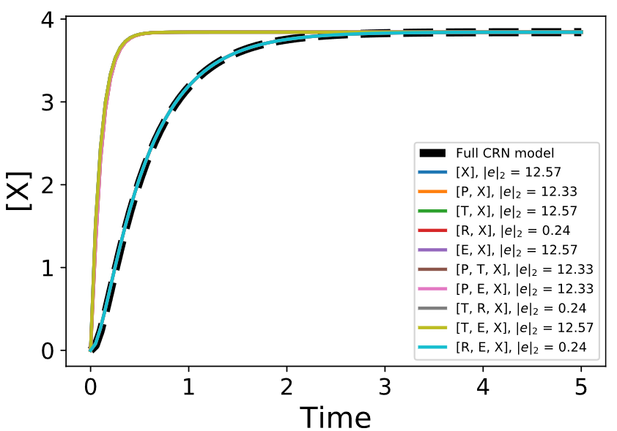
Error metric

Slide 6
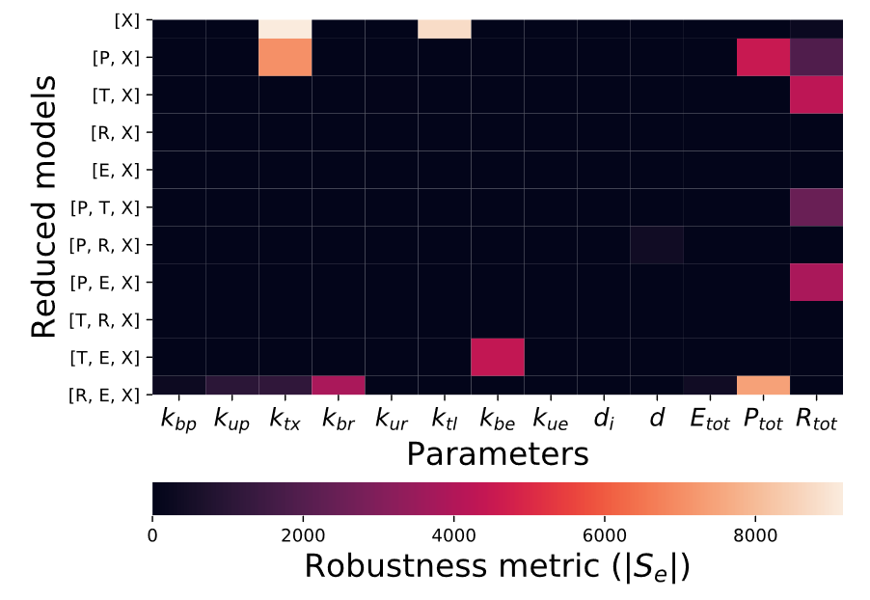
Robustness metric

Slide 7
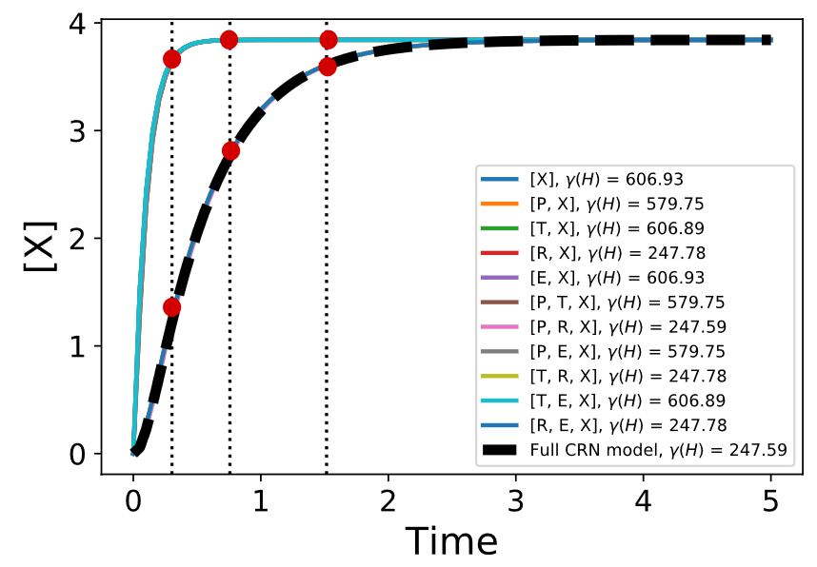
Input-Output mapping metric

Slide 8





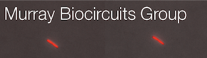
Auto-Reduce An Automated Model Reduction Tool For Biological Circuits
For detailed proofs, methods, and more examples
Detailed full model
Reduced models
Automated Model Reduction Algorithm
Comparison metrics
Poster #14
@ayush9pandey
5/5
GitHub

