Slide 1


Sub-SBML: A Subsystem Interaction Modeling Python Toolbox for SBML Models
Ayush Pandey
Murray Lab, Caltech
Oct 10, 2018

Slide 2
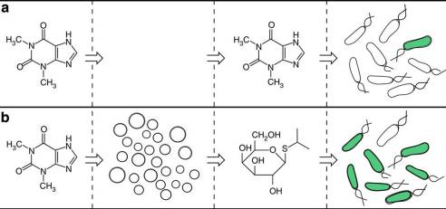
A demonstrative modeling example
Reference : “Integrating artificial with natural cells to translate chemical messages that direct E. coli behavior”, Roberta Lentini, Silvia Perez Santero et al. In: Nature Communications, 2014

Slide 3
How to model this system?
Theophylline generating system
Artificial cell system
E. Coli cell
Theophylline
IPTG
SBML Model
SBML Model
SBML Model
Reference : “Integrating artificial with natural cells to translate chemical messages that direct E. coli behavior”, Roberta Lentini, Silvia Perez Santero et al. In: Nature Communications, 2014

Slide 4
How to model this system?
Theophylline generating system
Artificial cell system
E. Coli cell
Theophylline
IPTG
SBML Model
SBML Model
SBML Model
Create SBML model
Model transport/membranes
Create SBML model
Edit/Make compatible
Fetch SBML model
Model other interactions
Return combined model

Slide 5
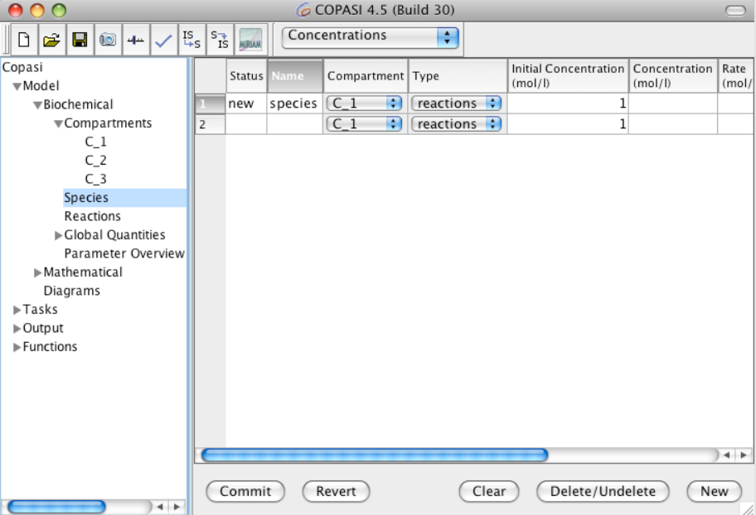
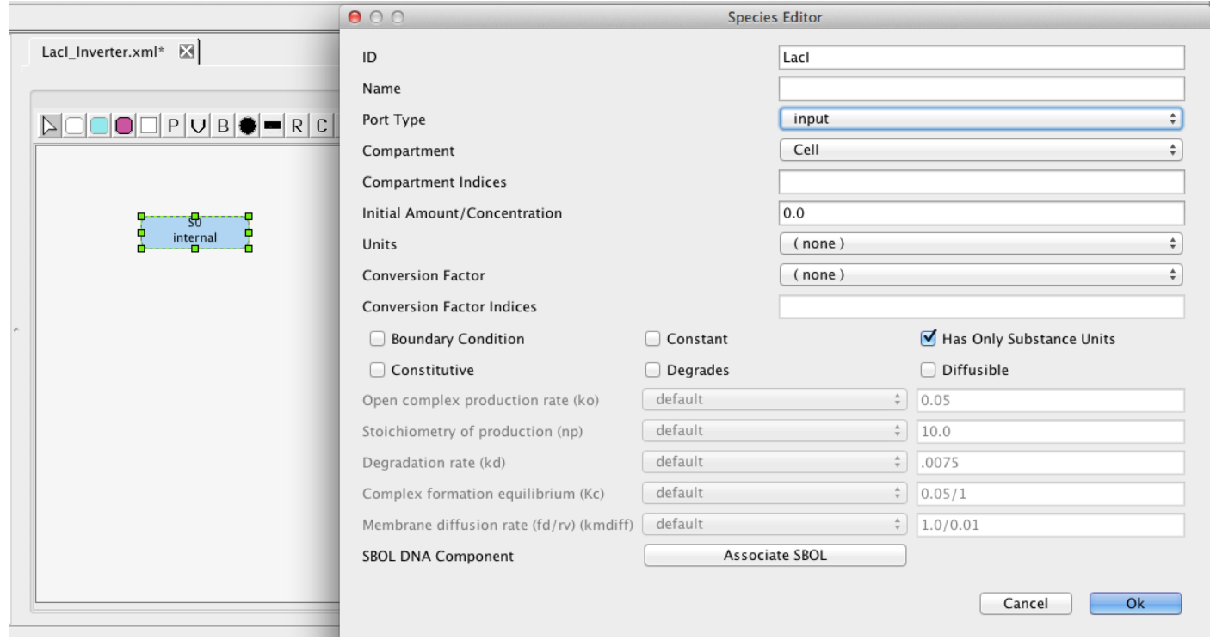
Using existing tools – COPASI, iBioSim

Slide 6
Using Sub-SBML…

Slide 7
Theophylline generating system
Artificial cell system
E. Coli cell
Theophylline
IPTG
SBML Model
SBML Model
SBML Model
Combined Model
2 systems
3 compartments
3 main subsystems
2 membrane models
Combined SBML Model
Notes:
Describe briefly how subsystem framework helps in modeling

Slide 8

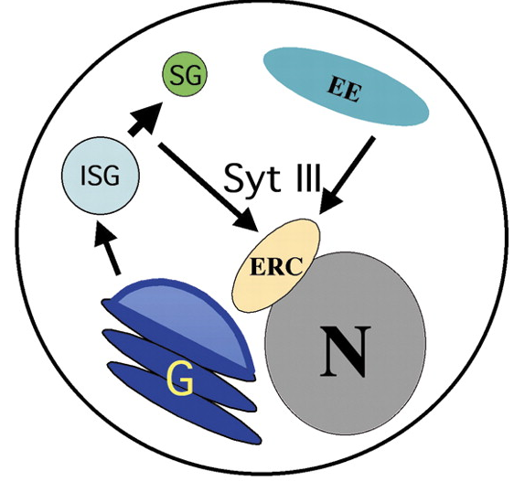
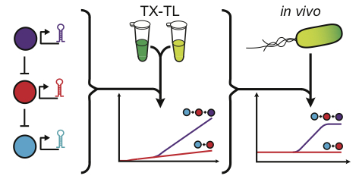
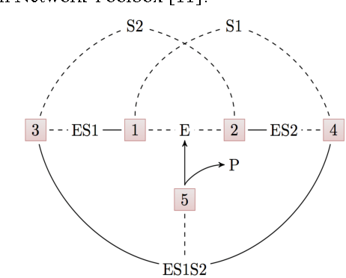
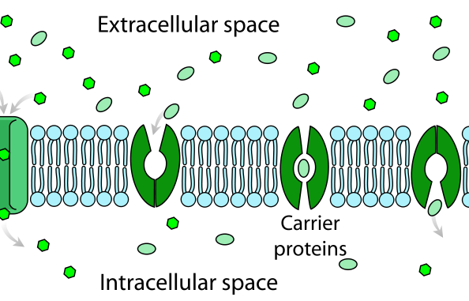

libSBML
Create Models
Compile Models
Model Reduction Sensitivity analysis
System identification Guiding experiments
Analysis with Models
Images taken from - SBML.org, ebi.ac.uk/biomodels, luckslab.org, Wikimedia
Notes:
Model creation
Model editing/

Slide 9
libSBML
Create Models
Compile Models
Model Reduction Sensitivity analysis
System identification Guiding experiments
Analysis with Models
Images taken from - SBML.org, ebi.ac.uk/biomodels, luckslab.org, Wikimedia
Notes:
Model creation
Model editing/

Slide 10
Create Models
Creating SBML models
Use Sub-SBML
… or any other existing tool

Slide 11
Create SBML Subsystems
Artificial cell system
Artificial cell system
E. Coli cell
Theophylline generating system
E. Coli cell
Theophylline generating system
IPTG
Theophylline
IPTG
Theophylline
SBML Model
SBML Model
SBML Model
SBML Model
SBML Model
SBML Model
Create a new Subsystem
Load SBML file into subsystem / Create SBML components from scratch
Use libsbml API directly or simple commands in subsbml

Slide 12
Create SBML Subsystems
Artificial cell system
Artificial cell system
E. Coli cell
Theophylline generating system
E. Coli cell
Theophylline generating system
IPTG
Theophylline
IPTG
Theophylline
SBML Model
SBML Model
SBML Model
SBML Model
SBML Model
SBML Model
artifical_cell = createNewSubsystem(), model = artificial_cell.getModel()
model.createNewSpecies(ListOfSpecies, ListofAmounts, … ) …
OR
artifical_cell = createSubsystem(‘load_model.xml’)

Slide 13
libSBML
Create Models
Compile Models
Model Reduction Sensitivity analysis
System identification Guiding experiments
Analysis with Models
Image taken from - SBML.org, ebi.ac.uk/biomodels, luckslab.org, Wikimedia
Notes:
Model creation
Model editing/

Slide 14
libSBML
Create Models
Compile Models
Model Reduction Sensitivity analysis
System identification Guiding experiments
Analysis with Models
Images taken from - SBML.org, ebi.ac.uk/biomodels, luckslab.org, Wikimedia
Notes:
Model creation
Model editing/

Slide 15
Compile Models
Utility of Subsystems
Combining multiple SBML models
Transport and compartment modeling
Interactions between different compartments
Modeling of transport across membranes

Slide 16
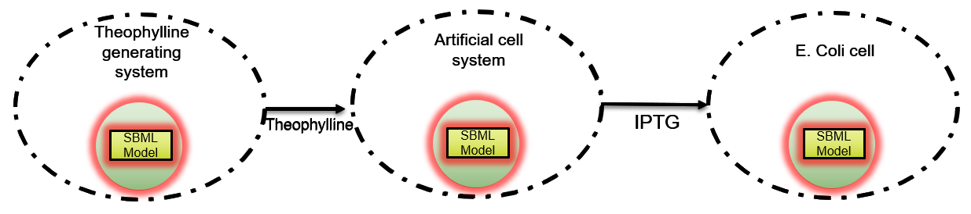
Modeling Subsystems
Contains one SBML model
1 compartment model
Various utility functions available for Subsystems to edit models
Compiling multiple models
Interaction modeling
Simulating variable inputs
Analysis tools
Other applications can be built on top of Subsystem architecture of modeling
SBML Model

Slide 17
Theophylline generating system
Artificial cell system
E. Coli cell
Theophylline
IPTG
SBML Model
SBML Model
SBML Model
Combined Model
2 systems
3 compartments
3 main subsystems
2 membrane models
Combined SBML Model

Slide 18
Combining Subsystems
What about common components?
Shared resources?
Duplicate species?
Duplicate reactions?
Other interactions?
Sub-SBML provides
shareSubsystems
combineSubsystems
connectSubsystems
And builds other tools using these….
Subsystem #1
Subsystem #2
Combined Subsystem

Slide 19
Modeling : Shared Resources
Usage -
cell = System()
cell.createSubsystem(‘SS1.xml’), cell.createSubsystem(‘SS2.xml’)
shared_model = cell.setSharedResources([‘ATP’, ‘RNAP’, ‘Ribo’])
ATP
RNAP-shared
RNAP
ATP
ATP-shared
ATP
SBML Model #1
SBML Model #2
Combined SBML Model
RNAP
RNAP
Ribo-shared
Ribo

Slide 20
“Subsystems” inside a “System”
External
Membrane #1
Membrane #2
Subsystem #3
System #1
System #2
Internal
Internal
Subsystem #1
Subsystem #2
Subsystem #4
Subsystem #5

Slide 21
Theophylline generating system
Artificial cell system
E. Coli cell
Theophylline
IPTG
SBML Model
SBML Model
SBML Model
Combined Model
2 systems
3 compartments
3 main subsystems
2 membrane models
Combined SBML Model

Slide 22
Considering only IPTG transport module…
Notes:
Since we are working on the IPTG transport experiment in the lab, so, we can get data for this module in our lab.

Slide 23
Theophylline generating system
Artificial cell system
E. Coli cell
Theophylline
IPTG
SBML Model
SBML Model
SBML Model
Combined Model
2 systems
3 compartments
3 main subsystems
2 membrane models
Combined SBML Model

Slide 24
Artificial cell system
Cell
IPTG
SBML Model
SBML Model
Combined Model
Combined SBML Model

Slide 25
External Environment :
IPTG reservoir
Cell
IPTG
SBML Model
SBML Model
Combined Model
Combined SBML Model

Slide 26
IPTG transport module
External Environment : IPTG Reservoir
Vesicle
SBML Model
SBML Model
SBML Model
IPTG
Combined Model
Combined SBML Model

Slide 27
IPTG Transport Modeling
Subsystem 1 -
pOR1OR2-alpha-Hemolysin
Subsystem 2 - pLac-deGFP
pOR1OR2-LacI
External -
IPTG reservoir
Membrane -
Allows IPTG transport
Membrane
External
Subsystem #3
Internal
Subsystem #1
Subsystem #2

Slide 28

Modeling using Sub-SBML
Modeling -
sys1 = System(),
SS1 = sys1.createSubsystem(‘SS1.xml’),...and so on
sys1.setInternal([SS1, SS2])
sys1.setExternal(SS3)
sys1.setMembrane(MB1)
model = sys1.getModel()
External
Membrane
IPTG Reservoir
Internal
IPTG
TX-TL
GFP, LacI
TX-TL
αHL

Slide 29
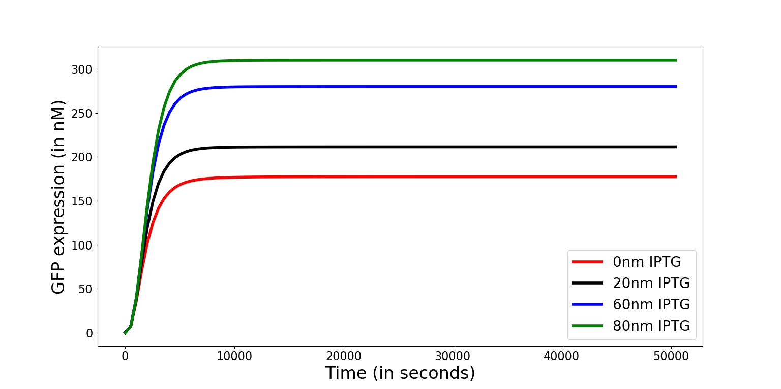
Notes:
Add updated results (and graphically better plots) from subsbml code here.

Slide 30
Now including all other modules…

Slide 31
Theophylline generating system
Artificial cell system
E. Coli cell
Theophylline
IPTG
SBML Model
SBML Model
SBML Model
Combined Model
2 systems
3 compartments
3 main subsystems
2 membrane models
Combined SBML Model

Slide 32
Code in Sub-SBML
ss1 = createSubsystem(‘theophylline.xml’)
ss2 = createSubsystem(‘artificial_cell.xml’)
ss3 = createSubsystem(‘e_coli.xml’)
mb1 = createSubsystem(‘membrane_artificial.xml’)
mb2 = createSubsystem(‘membrane_IPTG.xml’)
sys1 = System(‘cell1’, [ss1,ss2], mb1)
sys2 = System(‘cell2’, ss3, mb2)
combined_model = combineSystems(sys1.getModel(), sys2.getModel())

Slide 33
libSBML
Create Models
Compile Models
Model Reduction Sensitivity analysis
System identification Guiding experiments
Analysis with Models
Image taken from - SBML.org, ebi.ac.uk/biomodels, luckslab.org, Wikimedia
Notes:
Model creation
Model editing/

Slide 34
libSBML
Create Models
Compile Models
Model Reduction Sensitivity analysis
System identification Guiding experiments
Analysis with Models
Image taken from - SBML.org, ebi.ac.uk/biomodels, luckslab.org, Wikimedia
Notes:
Model creation
Model editing/

Slide 35
Summary

Slide 36
Takeaway #1
Helpful functions to model interactions between multiple SBML models developed using a “subsystem” framework
Subsystem #1
Subsystem #2
Combined Subsystem

Slide 37
Takeaway #2
Theophylline generating system
Artificial cell system
E. Coli cell
Structured, and simple modeling of transport across membranes and other interactions between systems.
Important tools for model reduction can be built on this framework.
Theophylline
IPTG
SBML Model
SBML Model
SBML Model
Combined Model
Combined SBML Model

Slide 38
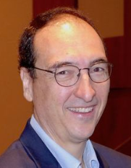
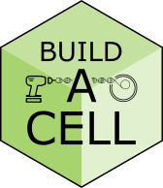

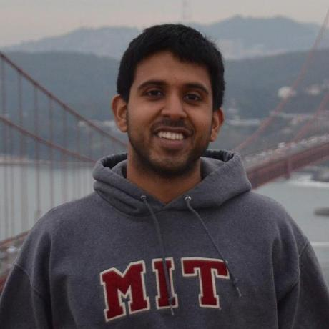
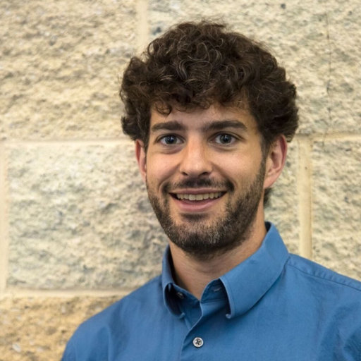
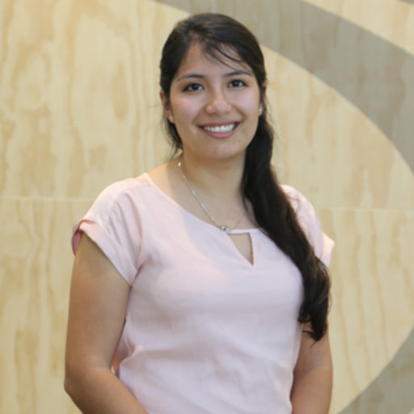
Acknowledgments
Thanks to help and support from:
- Prof. Richard Murray
- Vipul Singhal, Anandh Swaminathan
- William Poole, Zoila Jurado
All code available and open source on –
Github -> BuildACell -> subsbml
https://github.com/BuildACell/subsbml/

Slide 39
Backup slides

Slide 40
Introduction to and need of Sub-SBML
Synthetic biology
Model reduction, sysid, compartmentatlization.
Review of existing tools and their limitations
SBML tools - iBioSim, COPASI, BioUML, libSBMLSim
Wrapper tools - Simplesbml,
Sysid tools - Bioscrape, txtlsim, GNUMCSim, GenSSI
Hardly any tools for model reduction – one tool does not fit all
Transport modeling – Vcell, …

Slide 41
Combine subsystems – example – Biocircuit
Show the connect but don’t go into it
Transport modeling – describe the IPTG transport circuit and spend time on it
Sub-SBML combine
Sub-SBML system class
Sub-SBML setMembrane, setInternal, setExternal
Future work –
Model reduction – QSSA, Singular perturbation…and moving forward.
sysid

Slide 42
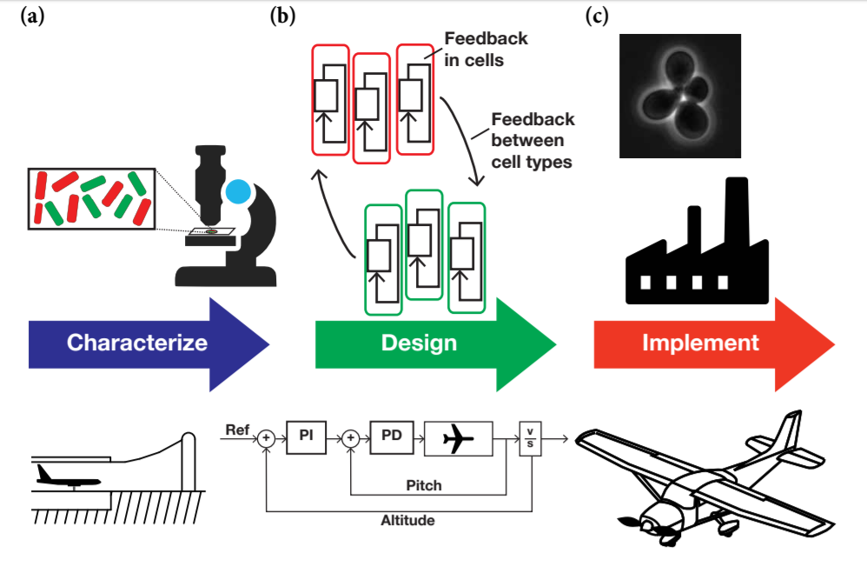
Control Theory for Synthetic Biology
Image taken from - Control Theory for Synthetic Biology, Victoria Hsiao, Anandh Swaminathan, and Richard M. Murray
Notes:
System must be characterized and identified. Controller must be designed, multiple loops, multiple time scales, in biological systems feedback and interactions are not as tractable.Modern aviation is autonomous but biological systems need a controlled and precise growth inorder to get desired results
Traditionally engineered systems
Limitations at all stages -
No real-time measurement
Resource competition
Incomplete knowledge of processes

Slide 43
Project motivation/application slide
TODO slide.
Add details on:
Modeling subsystems
Model reduction
System identification
Compartmentalization
Connect with previous slide and then establish connection with the next slide.

Slide 44
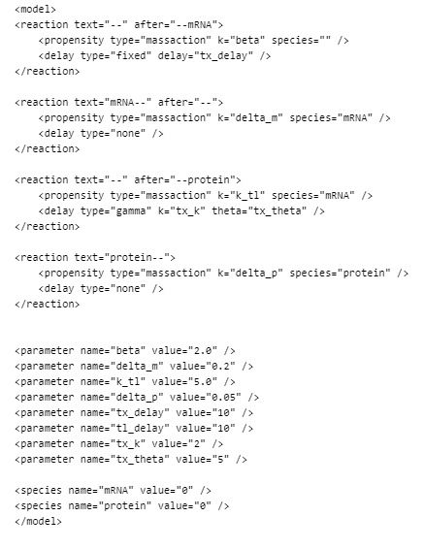
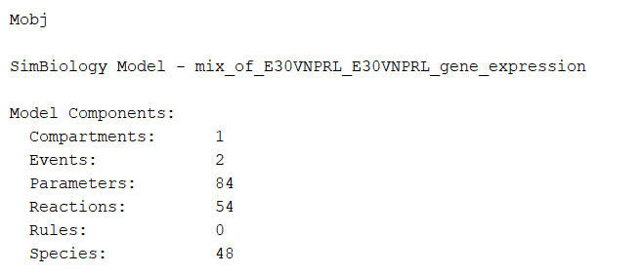
Using existing tools – txtlsim (MATLAB), bioscrape
txtlsim - MATLAB Simbiology
bioscrape XML
Notes:
Point out the limitations and disadvantages

Slide 45
Edit SBML Models
Renaming model components
Using renameSName function
Using renameSId function (provided by libSBML)
Convert SBML models to latest level and version
Changing species amounts, parameter values, etc.
Simulation options
Simulate subsystems with bioscrape
Simulate subsystems with COPASI
Other simulators
Simulating variable input initial amounts to species

Slide 46
Analysis with Models
Steady-state reactions
Model reduction
Sensitivity analysis
System identification
Notes:
Future work

Slide 47



Sub-SBML
1
2
3
4
5
Combined Model

