Slide 1


Scaffolding AI Research Projects Increases Self-Efficacy of High School Students in Learning Neural Networks (Fundamental)
Presenter: Ayush Pandey
Authors: S Shailja¹, Satish Kumar¹, Arthur Caetano¹, Ayush Pandey²
University of California, Santa Barbara¹, and Merced²
Notes:
Thank you so much for the introduction, Ibrahim. Today I will talk about our research on studying the effectiveness of an AI education program for pre-college students. So that we can all easily parse this long and complex paper title, I have prepared a couple of alternative titles.

Slide 2
Can pre-college students comprehend technical details of neural networks?
Educational research question
Presenter: Ayush Pandey
Authors: S Shailja¹, Satish Kumar¹, Arthur Caetano¹, Ayush Pandey²
University of California, Santa Barbara¹, and Merced²
Notes:
Our main educational research question after delivering a course on AI to pre-college students was whether the students were able to comprehend any of the technical details of neural networks. So that’s the main question that I’ll be talking about today and will be presenting our method to study this question.

Slide 3
AI as an ally: using AI to analyze student data
New research method
Presenter: Ayush Pandey
Authors: S Shailja¹, Satish Kumar¹, Arthur Caetano¹, Ayush Pandey²
University of California, Santa Barbara¹, and Merced²
Notes:
So, our method can effectively be summarized as using AI as an ally for us as instructors. I’ll talk about how we used AI to analyze student data, and that’s our new research method that I’ll spend most of my time talking about today.

Slide 4
We’re all preparing for an “AI everywhere” future!
Why AI education for high school students?
The state of AI education programs for young students
building foundational computing knowledge,
stimulating student interest in technology,
broadening participation in CS,
develop problem solving and critical thinking skills.
game-based/plug-and-play/GUI-based education
technical topics are usually skipped
limited diversity of projects suited for high school students
Notes:
Before going any further, it is important to ask and identify the need for AI education at the high school level. As educators, I’m sure all of us have thought about how the quickly developing world of AI tools impact our education practices and our students. Our stakeholders are pushing for integration of AI into the curriculum..and this need has been identified in one of NSF’s grand challenges as well, which identifies the need to find strategies to create more than a million workers in the AI industry by 2028 in the US. It’s fair to say that we are all preparing for an AI everywhere future..In line with that goal, I’ve identified how AI education at the high school level can build student’s foundation knowledge in computing, develop computational thinking, and also broaden the participation in CS areas. But the state of AI education programs for young students is limited to short bootcamps or workshops where students only interact with AI systems superficially. Also, the kinds of projects that students work on is limited to image classification type tasks and does not talk about the broader applications of AI.

Slide 5
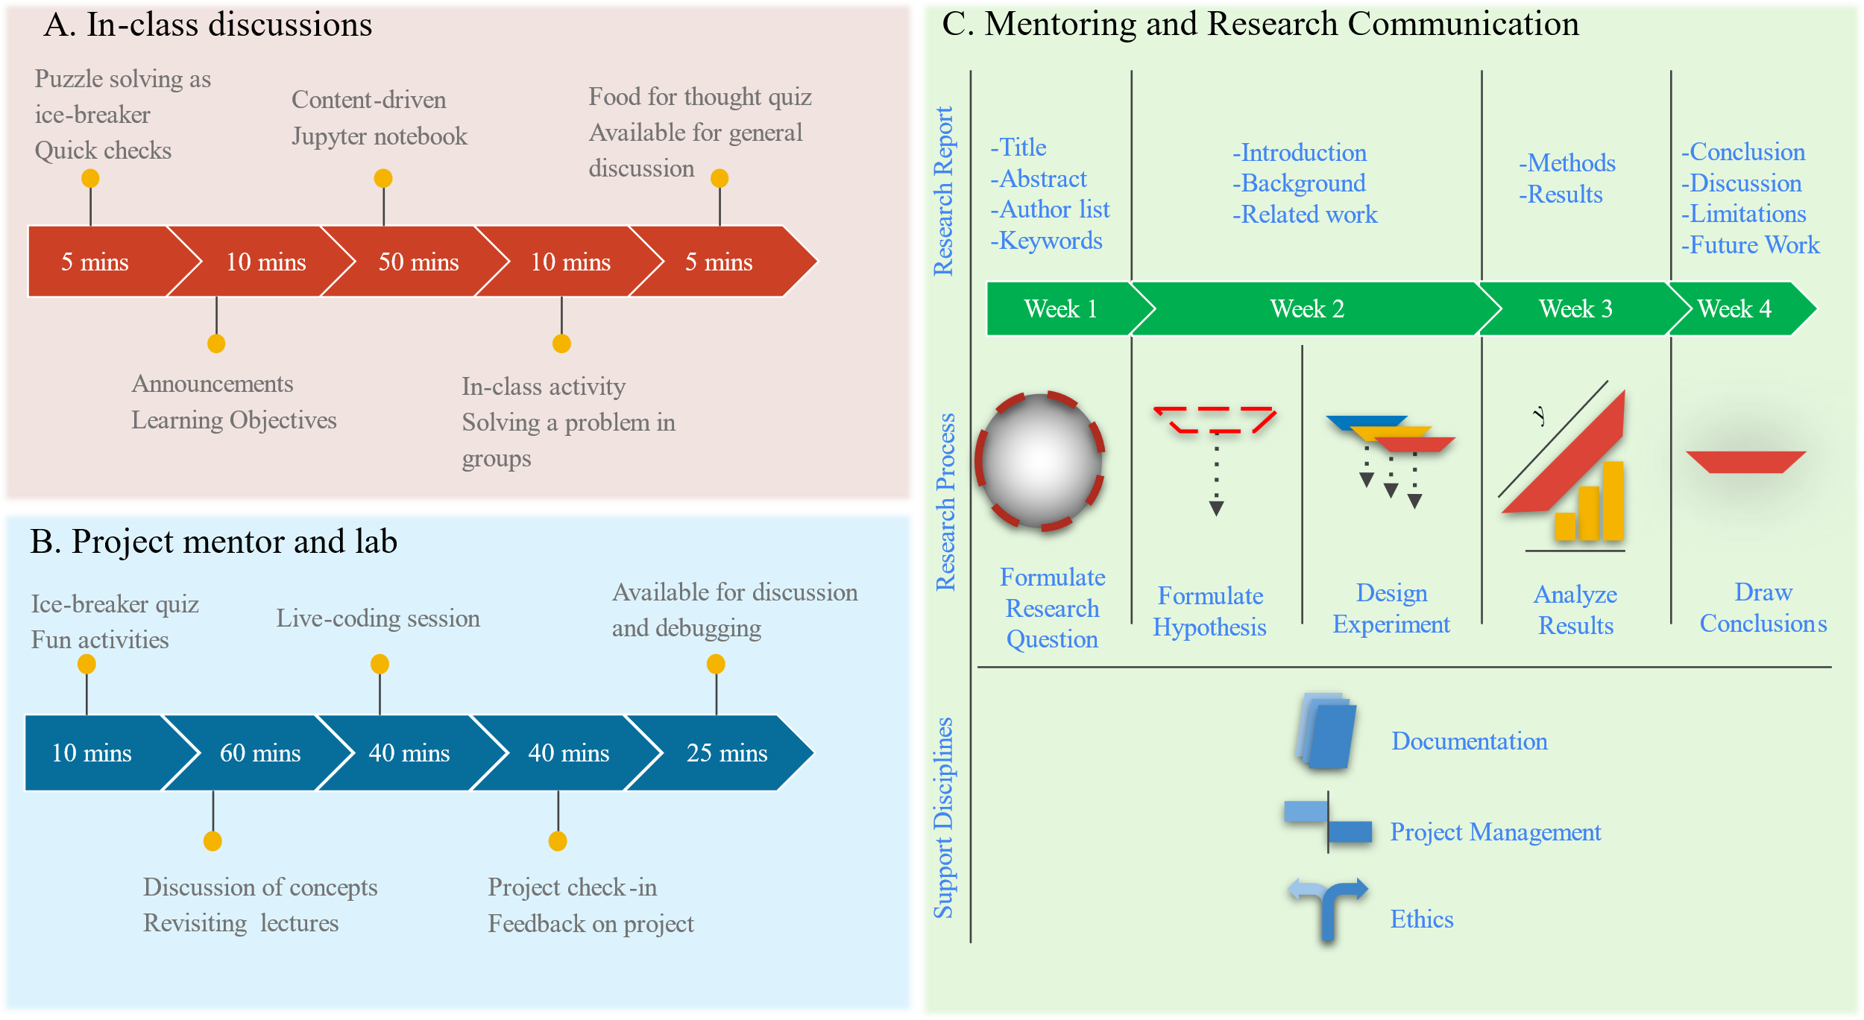
The context of our research project
A four-week summer program with course on “Diagnostic AI” for 30 students
Course design – a dual advising structure
Role | Personnel
Instructor | Dr. S. Shailja, postdoc at Stanford. Instructor at UCSB.
TA | Satish Yadav, grad student at UCSB
Mentor | Arthur Caetano, grad student at UCSB
Support | Dr. Lina Kim, director of Summer Research Academies at UCSB
Data | Pre- and post-course Likert surveys. Open-ended surveys and reflection
Notes:
Context – 4 week. Diagnostic AI. Data. The unique aspect of the course design, a dual advising structure and healthcare focused AI projects. So, as instructors, we strive for continuous improvement of our teaching but also to analyze how much did the students learn from the course. This was even more important for us because we were teaching technical topics in neural networks like backpropagation, and convolution, usually taught at senior undergraduate level. So, most courses lead to a variety of data about student learning and feedback. It is straightforward to analyze Likert scale type quantitative data but how reliably extracting quantitative information from student reflection and open-ended survey is a challenging task. This is the main focus of our paper where we develop a method that scores qualitative data.

Slide 6
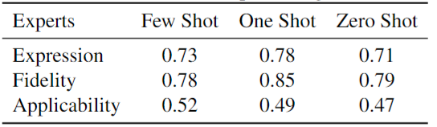
New research method Categorical scoring of qualitative data with AI
Generative AI with a codebook “gets close to” the human expert’s ratings with only a single shot of learning
Question: What do you know about neural networks (write in one sentence without looking it up)?
>> Students respond in pre- and post-course survey
Expert: Rate each response on “Fidelity”: technical depth & accuracy. Evaluate the richness and correctness of the technical details provided in the answer.
Prompt to GPT (one-shot):
Pearson correlation between expert ratings and gpt-3.5 ratings
Example ratings:- Input text: “Neural networks are a series of hidden layers (Conv2D,BatchNorm, MaxPooling, etc.) that each contain a certain number of trainableparameters (neurons), which are updated by using gradient descent after eachiteration when the loss is calculated.” Rating: 0.95

Slide 7
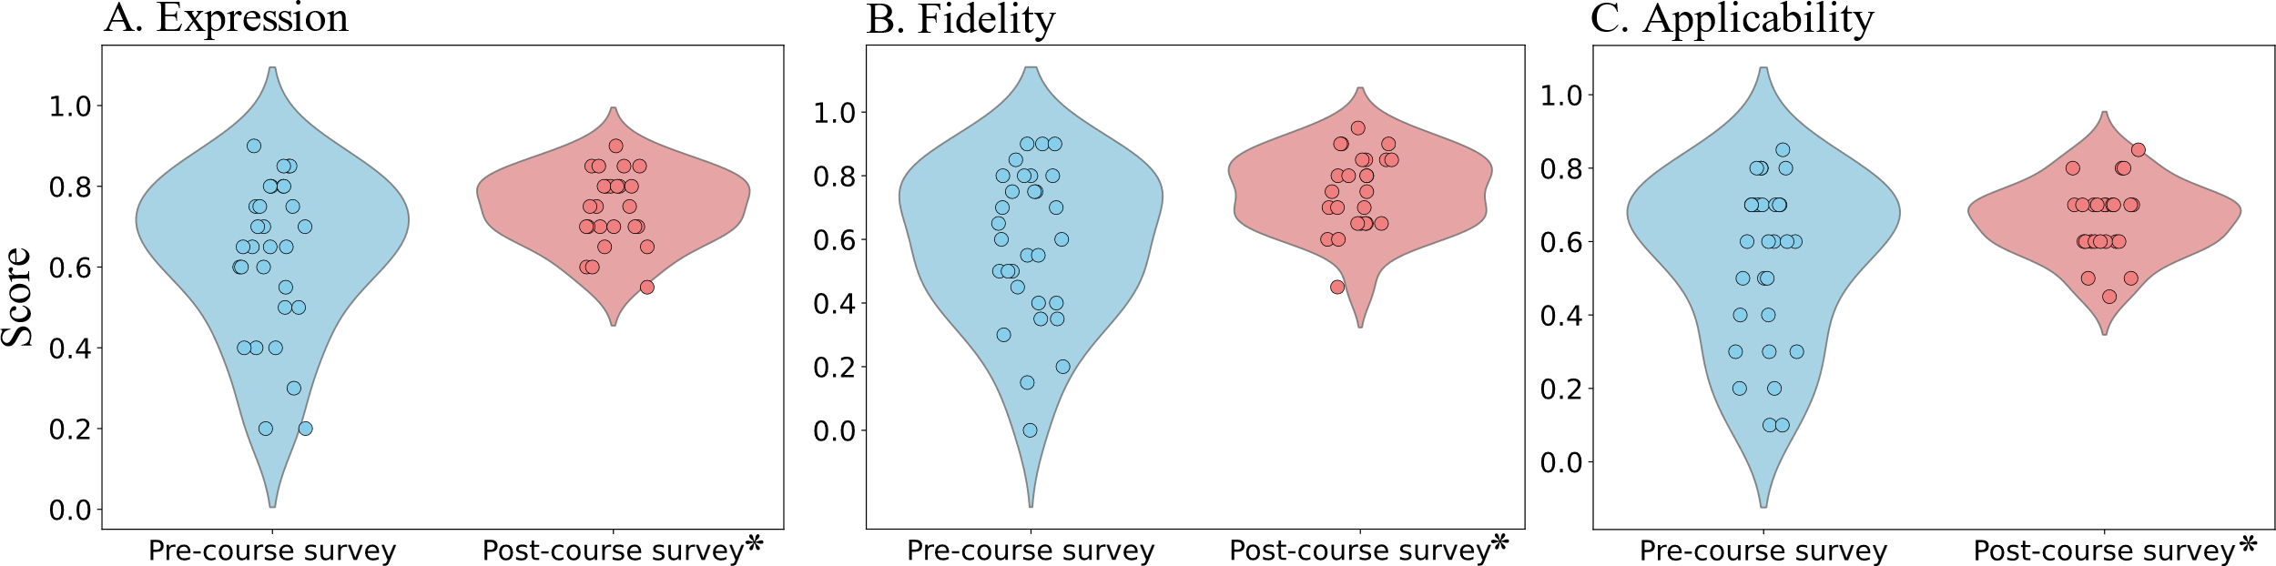
Findings of our research High school students can comprehend neural networks
Our generative AI codebook captures three dimensions of student comprehension of neural networks.
Statistically significant increase in student comprehension of neural networks after the course:

Slide 8
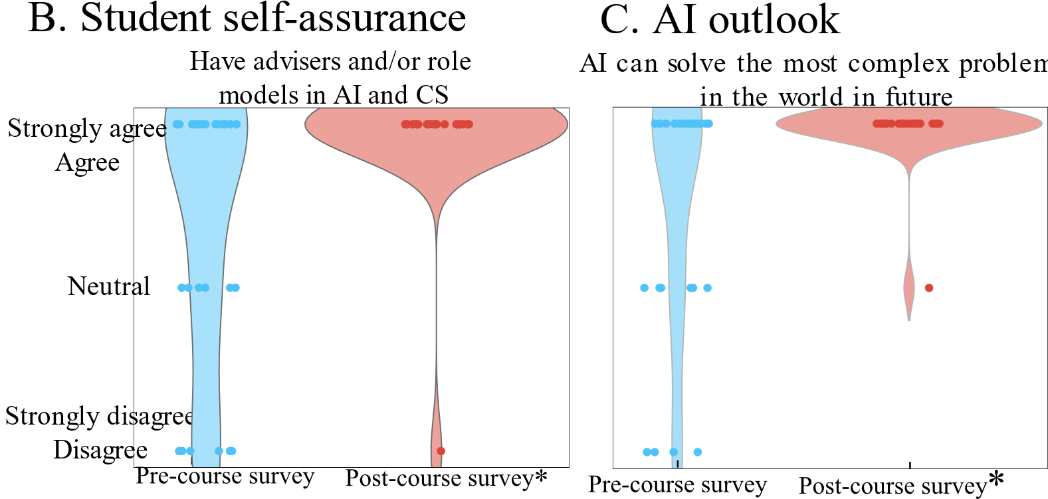
Concluding thoughts
Indirect measures suggest growth in self-efficacy of high school students as we analyzed student reflections using AI
Limitations of our study
Selected students had prior programming experience
Retrospective research
Lack of diversity of participants
But our research method on using an AI codebook to quantify student responses is generally applicable and scalable!

Slide 9
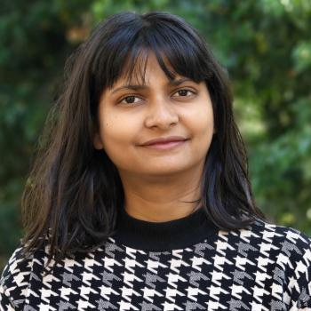
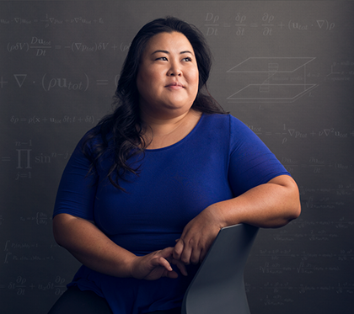
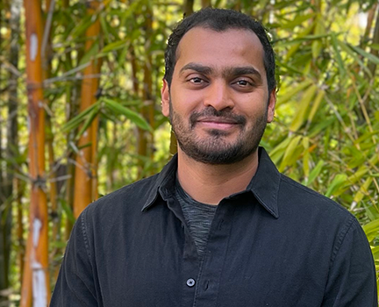

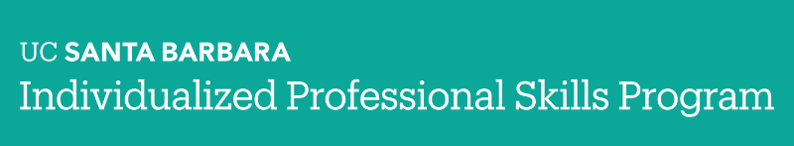
Thank you!
Course TA:
Satish Kumar
Course TA:
Arthur Caetano
Course Instructor:
Dr. S. Shailja (she’s here!)
Summer program director:
Dr. Lina Kim

