Slide 1

Analyze Death Age Difference of Right Handers with Left Handers
Submitted by :
Ayush Pratap SinGH
(Data ANALYST INTERN)
(MED TOUR EASY)

Slide 2
About MedTourEasy
MedTourEasy is a medical tourism company that facilitates international patients seeking medical treatments abroad.
Partnerships with healthcare providers in major medical tourism destinations such as Thailand, India, Turkey, Mexico, and others.
Patients looking for specialized medical procedures not available in their home countries.
Collaborations with top hospitals and clinics across various countries.

Slide 3
TABLE OF CONTENTS
Introduction
Theories on Handedness and Health Impacts
Requirements for Analysis
Methodology
Workflow Diagram
Outcome

Slide 4
Introduction
This project aims to analyze existing data to understand if significant differences in death age exist between these groups, providing insights into the broader impact of handedness on human health and longevity.
Investigates the death age difference between right handers and left handers.
Aims to analyze existing data to determine significant differences in death age.

Slide 5
Theories on handedness
Genetic Factors: Genetic markers linked to left-handedness may also be associated with health conditions that influence lifespan, potentially predisposing left-handers to shorter lifespans.
Brain Hemisphere Theory: Differences in hemispheric specialization between right- and left-handers may affect cognitive aging and neurodegenerative disease risk, impacting lifespan.
Recent Researches: Recent research with large, controlled studies indicates that the lifespan difference between left-handers and right-handers is less significant than previously thought.

Slide 6
Requirements for Analysis: Hardware Requirements
Standard computing equipment (e.g., desktop or laptop computer)
• RAM - 1 GB
• HDD storage - 40GB or more
• Processor – 2GHz
Sufficient processing power to handle data analysis tasks efficiently.

Slide 7
Software Requirements
Statistical analysis software:
• Python programming language
• Libraries such as Pandas for data manipulation and analysis
Data visualization tools:
• Matplotlib for creating statistical plots and visualizations
• Jupyter Notebook or Google Colab for interactive data analysis and visualization

Slide 8
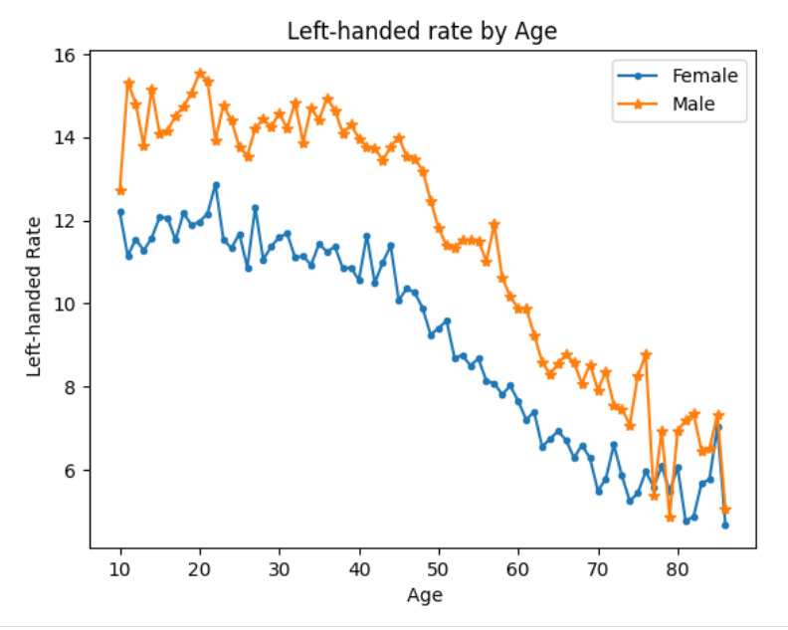
Methodology
1992 left-handedness data from Gilbert and
Wysocki
Death Distribution Data
Load data from a CSV file
Plot left-handedness rates vs. age for females and
males

Slide 9
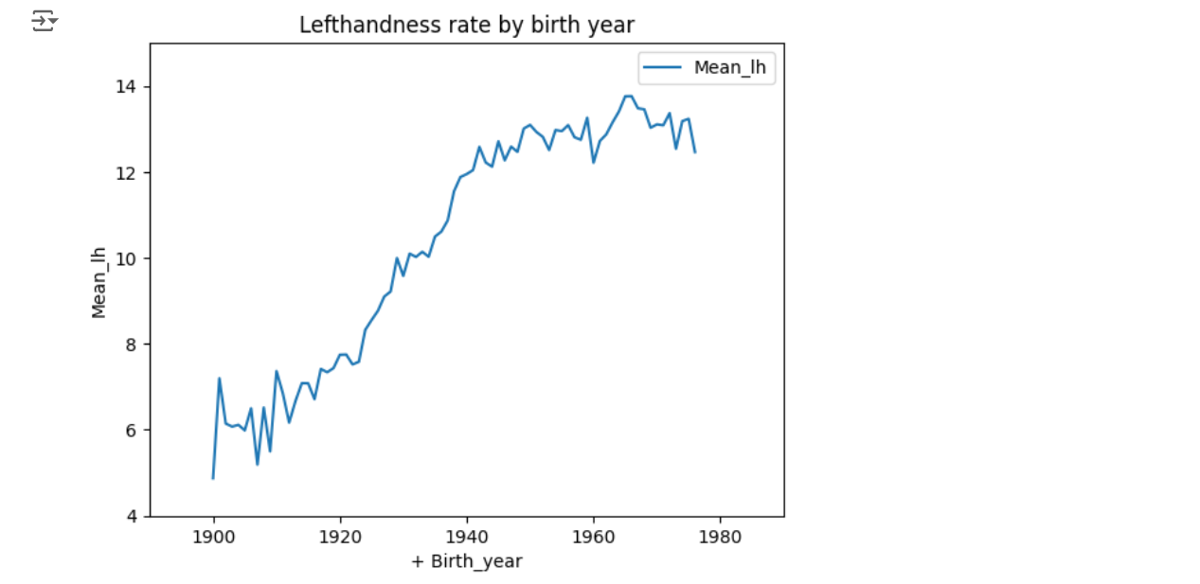
Calculate birth years from ages, computes the mean left-handedness rate (Mean_lh) and plot.
Compute the probability of dying at certain age given that you are left-handed and a study year.
(Bayes Theorem)

Slide 10
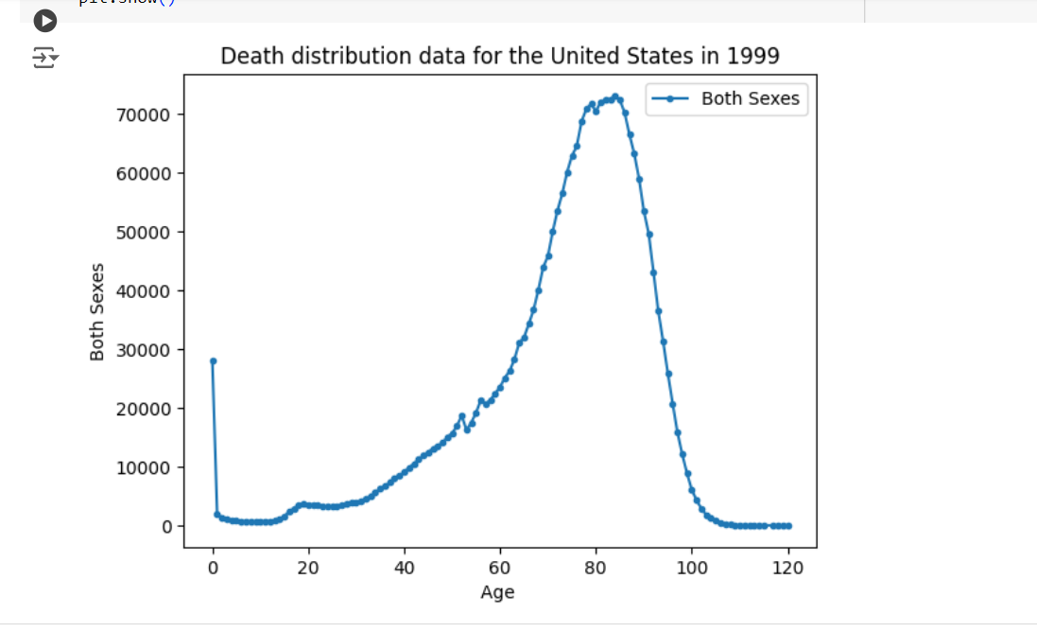
To calculate P(LH|A), mean of early and late 1900s and middle.
To calculate P(A), load death distribution data.
To calculate P(LH), from death distribution data
Clean and plot the number of people who died ('Both Sexes') as a function of age.

Slide 11
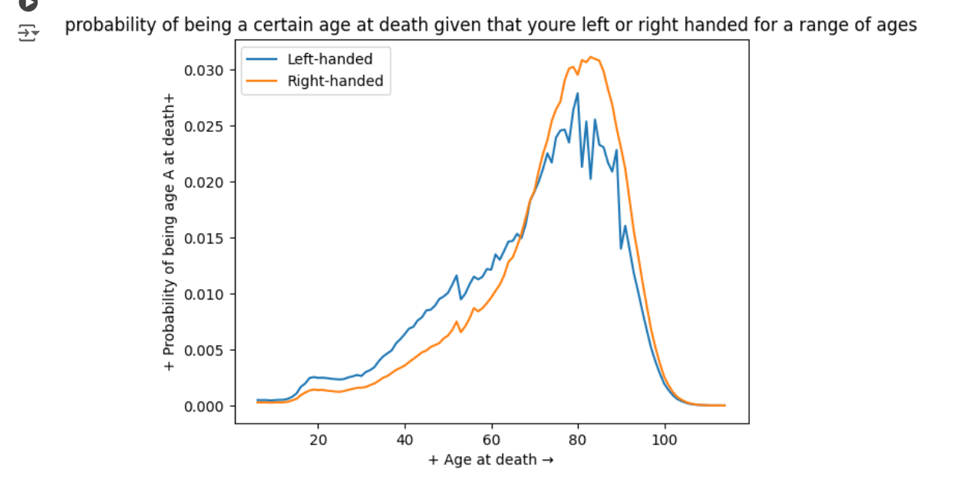
Calculate and plot the probabilities of being left-handed and right-handed for ages of death.
Difference of average ages at death for left-handed and right-handed individuals. (1990)
= 5.5 years
Calculate difference based on death distribution data. (2018)
= 2.3 years

Slide 12
OUTCOME
Stabilizing Differences: The smaller gap in 2018 compared to suggests that differences in life expectancy between left-handers and right-handers may be leveling off.
Historical Impact: The larger gap in 1990 reflects a time when factors related to handedness could have had a bigger influence on life expectancy across different generations.
Health Strategies: These findings can guide health policies to address any potential disparities linked to handedness and promote fairness in healthcare.

Slide 13
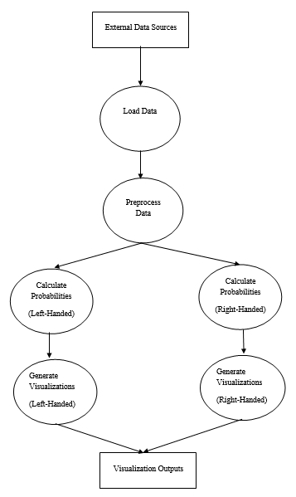
WorkFlow diagram

Slide 14


