Slide 1
MGT-403 DATA PROJECT · RECOMMENDATION TO THE STRATEGY GROUP
Where should we open our next preschools?
Ten metro counties where center-based preschool prices run well above what local childcare wages and rents predict, and have stayed there
+$85 / week
998 → 44 → 10
+$70 / week
Average 2022 premium of our 10 picks over the price their local wages and rents predict ($316 actual vs $231 predicted, +37%)
Metro counties scored, counties passing every screen (persistence, county-specific price, market size), and picks (one per metro)
Back-test: of the 10 counties picked with 2015-18 data, the 6 with 2022 prices were $70 above prediction in 2022 on average; all 6 above it
Lead markets: Stearns, Norfolk, McLean, Howard, DuPage, Champaign counties: the 6 picks that stay in the top 10 under every alternative scoring rule we tried.
Team: Winston Park, Ayush Rajpal, Tobin Gedstad, Wen Ding, Alfred Mordecai
Sources: DOL National Database of Childcare Prices 2015-22, BLS OEWS (SOC 39-9011), Census ACS 5-year; CPI-U, 2022 $ | Code and data: github.com/ayush-rajpal/mgt403-daycare-location
Notes:
Bottom line: we recommend ten metro counties where families pay far more for center-based preschool than local labor and rent costs would predict. "Attractive" means a high price relative to cost, so we model price as a function of childcare-worker wages and median gross rent, and rank counties on the gap. The gap is not a profit figure: it measures pricing power relative to local cost conditions. On average our picks charge $85 a week more than their wages and rents predict. We screened 998 metro counties with 2022 prices; 44 passed every screen; we take the best county in each of ten different metros. A back-test shows the approach would have worked if we had run it in 2018.

Slide 2
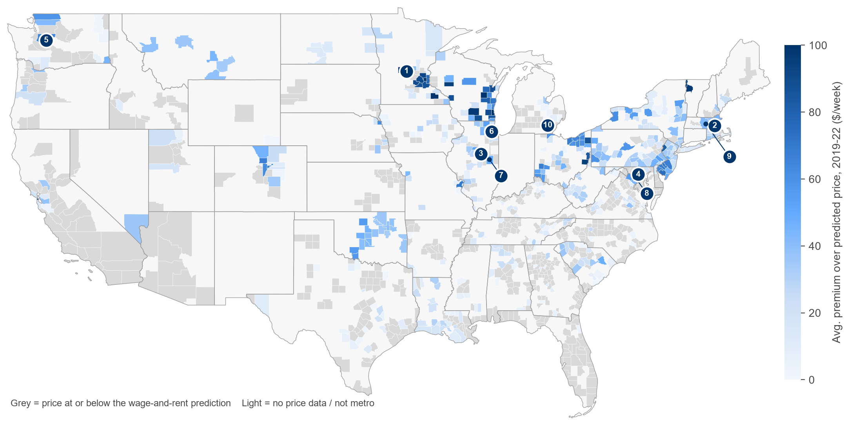
Ten counties where prices exceed what local wages and rents predict
# | County | Metro area | 2022 price | Predicted | Premium | Confi-dence
1 | Stearns, MN | St. Cloud | $337* | $167 | +$170 | High
2 | Norfolk, MA | Boston | $420 | $304 | +$116 | High
3 | McLean, IL | Bloomington | $279* | $168 | +$111 | High
4 | Howard, MD | Baltimore | $336* | $247 | +$89 | High
5 | King, WA | Seattle | $390* | $307 | +$83 | Medium
6 | DuPage, IL | Chicago | $316* | $230 | +$86 | High
7 | Champaign, IL | Champaign | $239* | $174 | +$65 | High
8 | Montgomery, MD | Washington | $336* | $280 | +$56 | Medium
9 | Worcester, MA | Worcester | $285 | $243 | +$42 | Watch
10 | Washtenaw, MI | Ann Arbor | $224 | $193 | +$31 | Watch
Map: average 2019-22 premium over predicted price for each metro county; numbers mark our picks.
Next in line: Missoula, Montana; Multnomah, Oregon; Anchorage, Alaska (ranks 11-13).
Verify-first: Arlington VA, Rochester & Twin Cities MN, Milwaukee & Madison WI show large premiums, but their 2022 prices are shared rate-zone prices or propensity-score estimates, not county-specific.
Premium = actual median weekly center-based preschool price minus the price predicted from local childcare-worker wages and median gross rent: pricing power relative to those cost conditions, not a profit figure. Ranked on the 2019-22 average; table shows 2022. Confidence = stays in the top 10 under all 4 alternative scoring rules (High), 3 of 4 (Medium), or fewer (Watch). * 2022 price is an NDCP estimate between state surveys (7 of 10 picks; latest actual survey 2021): confirm with a field price check.
Notes:
These are our ten recommendations, one per metro area so that we are not betting twice on the same labor and rental market. The gap between the actual price and the predicted price ranges from $31 to $170 a week in 2022. Six counties are 'High' confidence: they stay in the top ten whether we measure the premium in dollars or percent, use 2022 only, use survey years only, or compare only within the same state. Worcester and Washtenaw are weaker and could be swapped for the next in line. Prices marked with an asterisk are NDCP estimates for a year between state surveys; those counties' latest actual surveys (2021) also showed premiums, but they should be confirmed with a field price check. The verify-first list has large premiums but no county-specific price, so we would not commit before a field price survey.

Slide 3
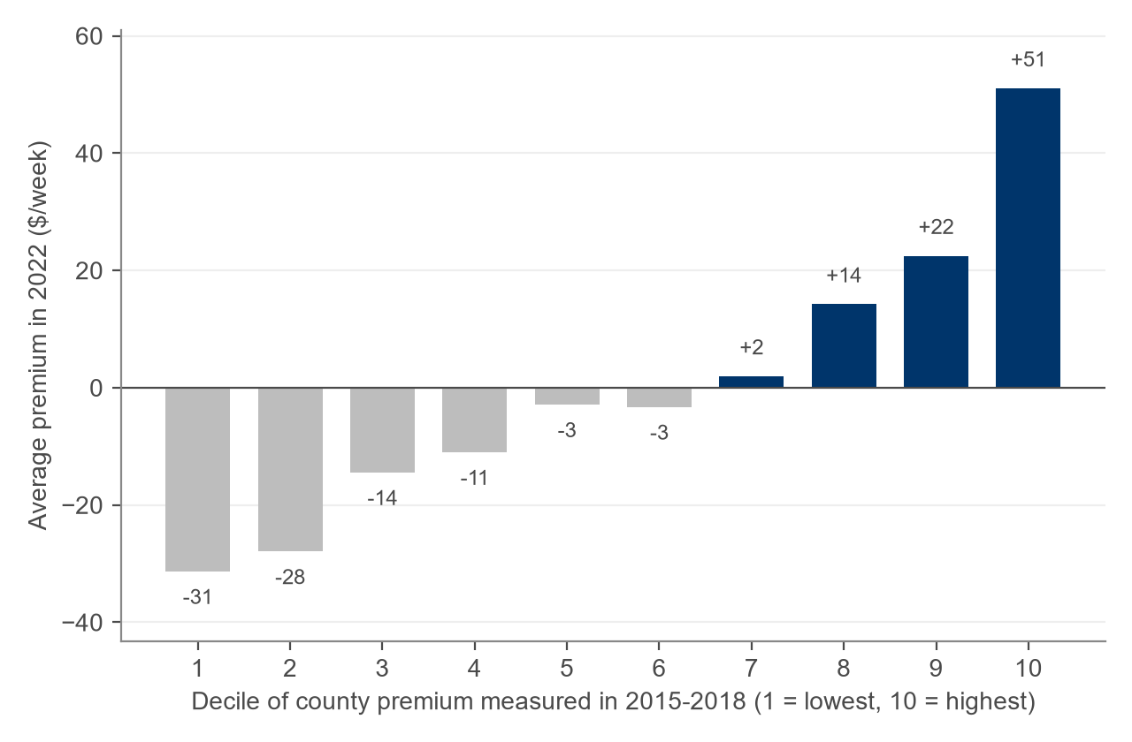
Method: predict price from local wages and rent, then rank the gap
1
Build the panel
Metro counties x 2015-22: NDCP median center-based preschool price, OEWS childcare-worker wage (metro level), ACS rent and demand; all in 2022 dollars. 8,146 county-years.
Back-test: rank with 2015-18 data, check 2022
2
Price model, each year
price = a + b·wage + c·rent (OLS). 2022: price = -88 + 7.1×wage($000) + 5.9×rent($100); R² = 0.61.
3
Score the premium
Premium = actual − predicted price. Score = average premium 2019-22, so one noisy year cannot carry a county.
4
Screen and pick
Above the prediction in every observed year 2019-22 (≥ 3 of 4); a county-specific price (no shared rate-zone price or state-level / propensity-score imputation; NDCP between-survey estimates kept); ≥ 2,000 under-6 kids with working parents. Best county per metro.
0.60 out-of-sample R² (5-fold, whole metros held out) vs 0.61 in sample: little sign of overfitting
+$70 avg 2022 premium of the 2018 picks that still had prices (6 of 10, all above prediction)
9/10 picks unchanged when we drop interpolated years or compare only within each state
Notes:
We fit a simple price model every year: price on childcare-worker wages and median gross rent, both in 2022 dollars. In 2022 it explains 61% of the variation in prices. The residual is the premium: how much more families pay than local wages and rents would predict. It measures pricing power, not actual operating cost or profit. We average it over 2019-22 and apply four screens. Reliability: holding out whole metro areas, the model still explains 60% of prices. The back-test is the key evidence: counties in the top decile of premium in 2015-18 were still about $51 above their predicted price in 2022, while the bottom decile stayed about $31 below it. Of the ten counties our rules would have picked in 2018, the 6 that still had 2022 price data averaged $70 above their predicted price in 2022, and all were above it; the other 4 are in states with no usable 2022 county prices.

Slide 4
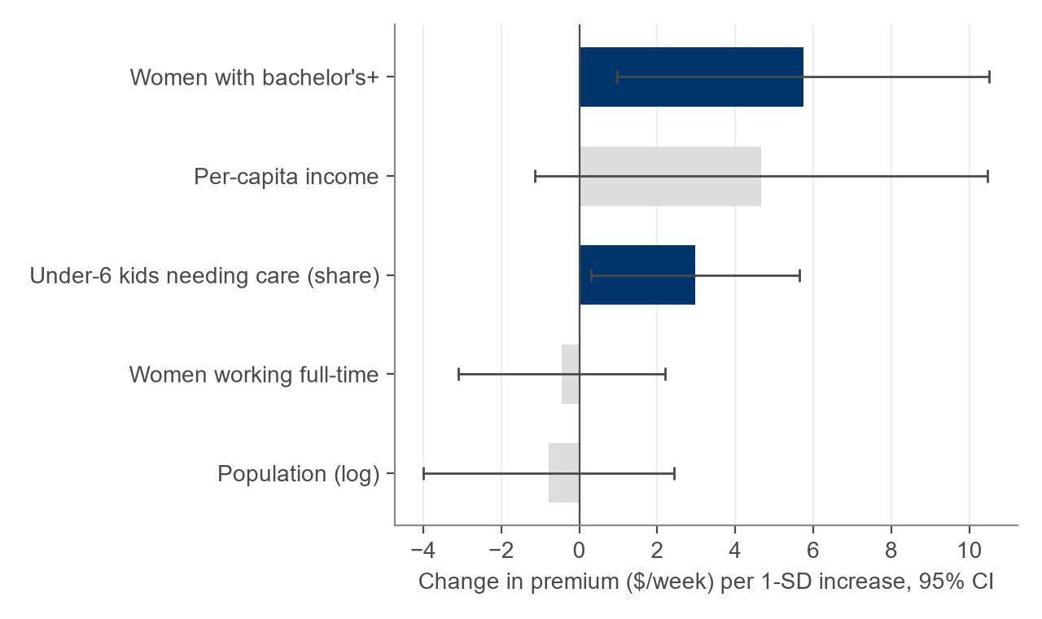
Winning markets: affluent, highly educated, with deep demand
2022 averages | Our 10 picks | All metro counties
Weekly preschool price | $316 | $174
Predicted price (wages + rent) | $231 | $174
Childcare-worker wage | $32,654 | $27,780
Median gross rent / month | $1,480 | $1,106
Per-capita income | $52,332 | $37,859
Women 25+ with bachelor's+ | 51% | 31%
Under-6 kids, all parents working | 31,436 | 11,538
What predicts a premium? (2022 OLS, standardized)
Dark bars are significant at 5% (SEs clustered by metro). Female college share is the most robust signal; it holds within states too. Together these explain only 7% of the premium, so they guide where to look next rather than replace the measured premium.
We screen on: (1) premium over the wage-and-rent price prediction (2) persistence 2019-22 (3) county-specific prices (4) ≥ 2,000 under-6 children with working parents. Next-wave signal: (5) college-educated, higher-income families.
Notes:
Our picks are not just expensive markets; they are expensive relative to what their wages and rents predict. Their average price is $316 vs $174, but their wages and rents predict only $231. They have much higher per-capita income and a much higher share of college-educated women (51% vs 31%), which signals willingness to pay for quality early education. In a regression of the premium on demand characteristics, female college share is positive and significant, and remains so within states; the share of young children who need care is also positive. But these explain only about 7% of the premium, which is why the premium itself is our first screen.

Slide 5
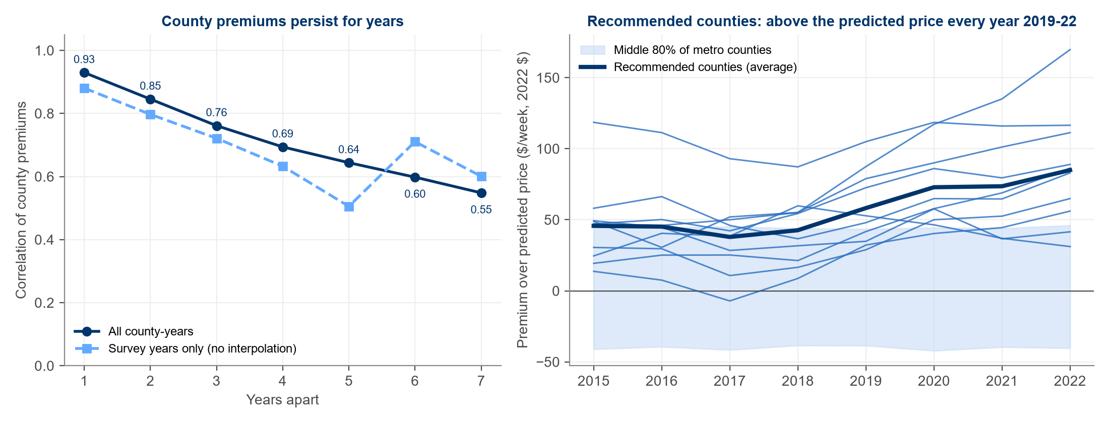
Premiums persist, so today's gap is a reasonable guide to tomorrow's
0.93 → 0.55 correlation of county premiums 1 → 7 years apart; survey years only: 0.88 → 0.60, a similar pattern
67% of top-fifth counties in 2015-18 were still top-fifth in 2019-22 (88% in the top two-fifths)
$46 → $85 average premium of our picks, 2015 → 2022: the gap has widened, not closed
Notes:
Is a high premium a lasting feature of a market or a one-year blip? County premiums are highly persistent: the correlation is 0.93 one year apart and still 0.55 seven years apart. Because NDCP fills in some years between state surveys, we repeated this with survey years only, and persistence is similar. 67% of counties in the top fifth in 2015-18 were still in the top fifth in 2019-22. Our ten picks have been above their predicted price every year since 2019, and their average premium rose from about $46 to $85. One pick dipped slightly below the line in 2017, which is why we score on recent years.

Slide 6
Before committing capital: what our model does not yet see
1
Competition and capacity
2
Public pre-K and subsidies
3
State rules and true labor cost
Number of licensed centers, waitlists and vacancies. A premium can signal a shortage that rivals are already moving to fill.
Expanding state pre-K and CCDF voucher rates can cap what families pay, especially for 4-year-olds.
Staff-to-child ratios, licensing and benefits differ by state. 43% of the premium's variation is between states, partly rules and partly survey methods.
4
Commercial real estate
5
Price data quality
6
Demand trajectory
We use residential rent as a proxy. Lease rates, build-out cost, zoning and outdoor-space rules need site-level quotes.
NDCP prices come from state market-rate surveys. 7 of our 10 picks' 2022 prices are between-survey estimates (Stearns MN's from its 2021 survey).
Births and under-5 population trends, in-migration, return-to-office patterns and income growth. We see levels, not momentum.
Next step: a field price survey and competitor scan in the 10 picks plus the verify-first metros, then site-level lease quotes, before final selection.
Notes:
Our screen is a strong first cut but deliberately simple. Six things matter for final selection that the data do not capture. Most important: competition and capacity, because a high premium may mean undersupply that others will fill, and public pre-K expansion, which competes directly with paid preschool. Costs beyond wages and residential rent differ by state, and 43% of the premium's variation is between states, so part of it may reflect regulation or survey methods rather than real pricing power. Finally, price data quality: we excluded shared rate-zone prices and state-level or propensity-score imputations, but kept NDCP's estimates for years between state surveys. 7 of the ten picks' 2022 prices are such estimates. In Illinois and Maryland the latest surveys also carry an imputed-percentile flag, and the last fully reported surveys showed smaller premiums (McLean +$55 (2018), Howard +$42 (2017), DuPage +$21 (2018), Champaign +$17 (2018), Montgomery −$7 (2017)). So the field price check should start there and with Stearns County.

