Slide 1






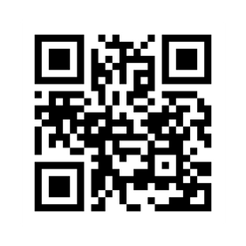

CAN’T FIND
YOUR CLASS ??
TRY
NAVIT
( COMPLETE MAP OF GEHU )
navit.vercel.app
REAL TIME ROOM OCCUPANCY DISPLAY
COMING SOON.....
Only for Gehu campus
At least for now

Slide 2

Sample QR Codes
Room
Name
Main QR
Data format :
Room Type
https://navit.vercel.app/home?source=1001
https://navit.vercel.app/home?destination=1001

Slide 3
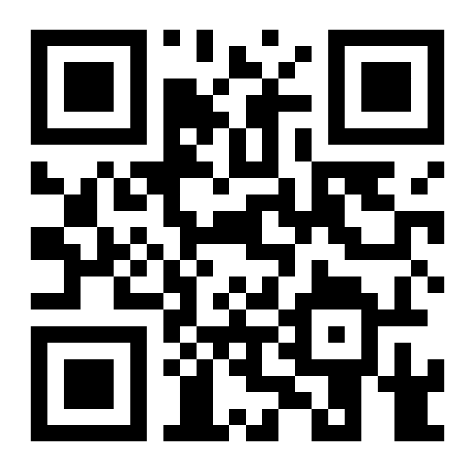
Ubuntu Lab 1
LAB
navit.vercel.app
GEHU

Slide 4
CR101
CLASS ROOM
navit.vercel.app
GEHU

Slide 5
LT301
HALL
navit.vercel.app
GEHU

Slide 6
GEHU Bus Stop
AMENITY
navit.vercel.app
GEHU

