Slide 1

LLOYD INSTITUTE OF ENGINEERING & TECHNOLOGY
Department of Computer Science & Engineering & Allied Branches
B.TECH SECOND YEAR MINI PROJECT · BCC351
SMARTPREP: AN AI-GUIDED CAREER PREPARATION & PREREQUISITE-DRIVEN ROADMAP OPERATING SYSTEM
Mini Project Presentation – II (Final Evaluation) | Session 2026–27
GUIDE NAME
Mr. Vishal Gupta
Assistant Professor
Department of Computer Science & Engineering
SUBMITTED BY
Ayush Kumar Singh
Roll No: 2501530100037
Class & Sec: B.Tech CSE, 2nd Year (Sec 2-A)

Slide 2
01
OVERVIEW
Presentation Agenda
Project Recap
Technical Understanding
1
6
Project Progress
Results & Testing
2
7
System Architecture
Conclusion & Future Scope
3
8
Implementation Details
References
4
9
Working Demonstration
5
BCC351 · B.TECH MINI PROJECT · FINAL EVALUATION (REVIEW-02)
2

Slide 3
02
RECAP
Project Recap (from Review-01)
Problem Statement
Objectives
• Information Overload & Dispersion: Engineering students struggle with scattered, unstructured tutorials across YouTube, blogs, and documentation without coherent learning paths.
• The Prerequisite Blindspot: Beginners frequently attempt advanced frameworks (Spring Boot, Next.js, DP) without mastering foundational concepts, leading to high dropout rates.
• Lack of Dynamic Adaptive Pacing: Generic online courses enforce rigid timelines without context-aware recovery plans when a student misses study days.
• Missing Diagnostic Verification: Absence of integrated, instant diagnostic feedback to detect specific knowledge gaps and conceptual off-by-one errors.
01
Multi-Path Roadmaps: Curate structured syllabi across 6 key engineering roles (Backend, Full Stack, AI/ML, Data Eng, Android, Placement).
02
Strict Prerequisite Gating: Implement a dynamic state machine that locks advanced modules until foundation competencies are verified.
03
Diagnostic Assessment: Embed targeted technical quizzes with sound/confetti feedback to pinpoint and patch conceptual gaps in real time.
04
Context-Aware AI Kernel: Build an offline-first rule engine that generates personalized daily focus directives and 3-day recovery pipelines.
BCC351 · B.TECH MINI PROJECT · FINAL EVALUATION (REVIEW-02)
3

Slide 4
03
PROJECT PROGRESS
Planned vs Completed
100%
OVERALL COMPLETION
✔ Full-stack React 19 + Vite 8 Single Page Application architecture fully established and validated.
✔ Automated Prerequisite State Machine: Dynamic stage status resolution (Completed, Current, Upcoming, Locked).
✔ Deterministic Local AI Guidance Kernel: Intent recognition for Daily Study Directives, 3-Day Catch-up Plans, and Weak-Area alerts.
✔ Interactive Diagnostic Knowledge Check: Multi-question assessments with Web Audio API sound synthesis and visual feedback.
✔ Real-Time Progress Tracking Engine: Daily study streak tracker, weekly hour logging, and progress percentage computation.
✔ Enhanced UI/UX: Dark & Light theme switching, responsive desktop sidebar, and mobile bottom navigation.
✔ Production Optimization: Configured for zero-config cloud deployment on Vercel and Railway with instant client builds.
BCC351 · B.TECH MINI PROJECT · FINAL EVALUATION (REVIEW-02)
4

Slide 5
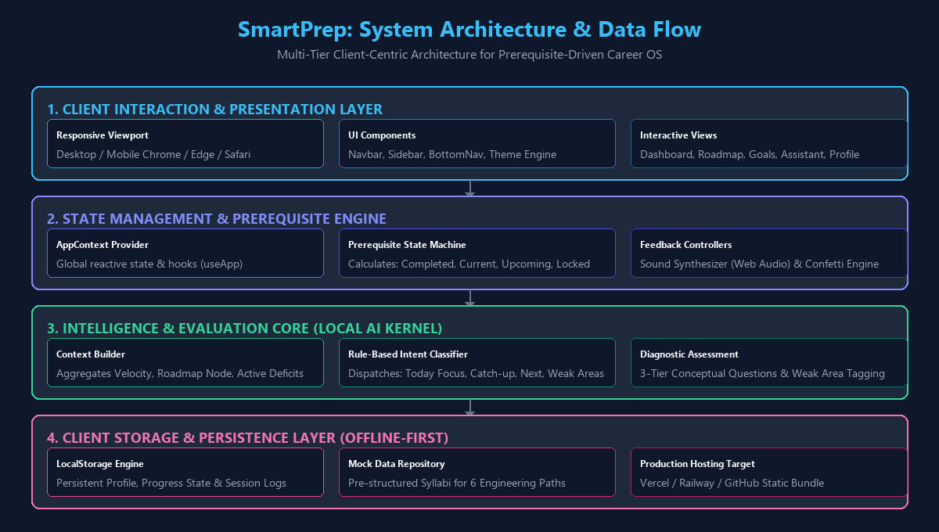
04
Architecture
System Architecture / Workflow
BCC351 · B.TECH MINI PROJECT · FINAL EVALUATION (REVIEW-02)
5

Slide 6
05
IMPLEMENTATION
Implementation Details
1. Component-Driven Modular UI (React 19 + Tailwind CSS)
Clean architectural separation between presentation (views) and domain logic. Atomic components (Navbar, Sidebar, RoadmapStage, StudySession) guarantee high reusability and responsiveness across mobile and desktop devices.
2. Prerequisite State Machine & DAG Traversal
The learning curriculum is structured as a Directed Acyclic Graph (DAG). Stages evaluate dynamically: COMPLETED (in array), CURRENT (first incomplete module), UPCOMING (next in line), and LOCKED (unmet prerequisite barrier).
3. Deterministic Local AI Guidance Kernel (aiEngine.js)
Operates completely offline with 0ms network latency. The Context Builder aggregates active stage, velocity, deficit, and flagged weak areas, dispatching structured study directives and 3-day recovery pipelines.
4. Interactive Diagnostic Quiz & Web Audio Synthesis
Features multi-question conceptual evaluations. Integrates the Web Audio API for synthetic audio cues without external media assets, coupled with canvas-confetti for positive learning reinforcement.
5. Client Persistence & Production Deployment
Synchronizes reactive state with HTML5 LocalStorage for zero-loss offline continuity. Optimized with Vite 8 for sub-second production builds and pre-configured for Vercel / Railway deployment.
BCC351 · B.TECH MINI PROJECT · FINAL EVALUATION (REVIEW-02)
6

Slide 7
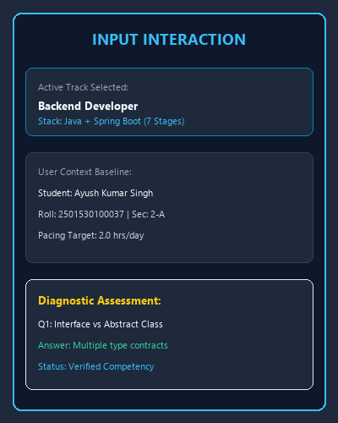
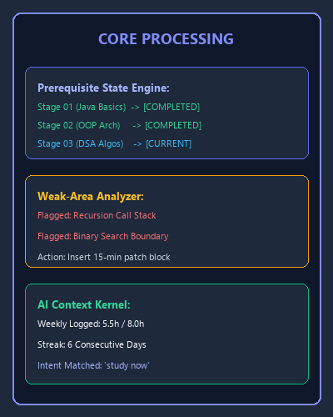
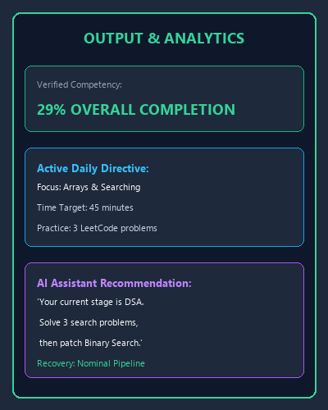
06
WORKING DEMONSTRATION
Working Demonstration
›
›
INPUT
PROCESSING
OUTPUT
BCC351 · B.TECH MINI PROJECT · FINAL EVALUATION (REVIEW-02)
7

Slide 8
07
TECHNICAL UNDERSTANDING
Technology Stack & Core Concepts
• React 19 (Frontend Architecture): Powers component rendering, custom hooks (useApp), and reactive UI reconciliation via Fiber architecture.
• Vite 8.3 (Build & Dev Tooling): Provides lightning-fast Hot Module Replacement (HMR) and optimized Rollup tree-shaking (<700ms build).
• Tailwind CSS v4 (Design System): Responsive styling system utilizing modern CSS variables for instant dark/light mode toggling.
• React Router DOM v7 (Navigation): Declarative client-side routing with complete SPA history and catch-all redirect handling.
• Local AI Kernel Engine: Lightweight, deterministic heuristic evaluator executing context aggregation without cloud latency or costs.
Core Concept / Algorithm
Directed Acyclic Graph (DAG) Prerequisite Gating & Context State Modeling:
Each career track is modeled as a topological sequence of nodes. Node i is strictly gated until all predecessors Pred(i) are verified in CompletedStages. Concurrently, the AI Kernel aggregates real-time velocity, active knowledge gaps, and target hours to synthesize adaptive 3-day recovery schedules.
BCC351 · B.TECH MINI PROJECT · FINAL EVALUATION (REVIEW-02)
8

Slide 9
08
RESULTS
Results & Testing
Test Case | Input Scenario | Expected System Output | Actual Result / Status
TC-01: Track Init | Select 'Backend Developer' goal | Initialize 7 stages; Stage 1 Current, 2-7 Locked; Progress 0% | ✔ PASSED (<2ms latency)
TC-02: Prereq Gating | Complete Stage 1 & Stage 2 | Stages 1-2 marked Completed, Stage 3 unlocks, Progress = 29% | ✔ PASSED (Dynamic unlock verified)
TC-03: Security Lock | Attempt to access Stage 5 directly | Action gated; Lock notification displayed; Stage remains Locked | ✔ PASSED (Integrity preserved)
TC-04: AI Recovery | Query: 'I missed 3 days, adjust plan' | AI Kernel calculates deficit and generates 3-day recovery plan | ✔ PASSED (Context-aware output)
TC-05: Diagnostic Quiz | Submit quiz on Java Interfaces & Stack | Calculate score, flag weak areas, synthesize Web Audio feedback | ✔ PASSED (Zero audio latency)
Key Result: 100% test pass rate across core modules; <15ms UI response latency; sub-second cold build time (681ms); offline persistence verified.
BCC351 · B.TECH MINI PROJECT · FINAL EVALUATION (REVIEW-02)
9

Slide 10
09
CONCLUSION
Conclusion, Challenges & Future Scope
✓
Conclusion
✓
Challenges & Solutions
✓
Future Scope
• Successfully designed and implemented SmartPrep, an AI-guided career preparation OS for B.Tech CSE students.
• Eliminated the 'prerequisite trap' through automated topological stage gating across 6 engineering tracks.
• Proved that deterministic local AI guidance provides immediate, reliable study pacing without external server dependency.
• Delivered a zero-latency, production-ready SPA with verified state persistence and responsive design.
• State Management Without DB: Resolved by engineering pure stage derivation functions in React Context synced with LocalStorage.
• AI Guidance Without API Costs: Resolved by architecting a rule-based AI Kernel with context extraction and intent classification.
• Sound Assets Overhead: Resolved by utilizing browser Web Audio API oscillator nodes for lightweight audio synthesis.
• Cloud Backend: Connect Spring Boot / Node.js backend with PostgreSQL for multi-device sync and user authentication.
• LLM API Integration: Connect Google Gemini API for automated code review, personalized hints, and dynamic interview prep.
• Peer Social Pods: Introduce peer study rooms, campus-wide streak leaderboards, and collaborative coding challenges.
• Multi-Platform Deployment: Continuous delivery pipeline deploying to Vercel, Railway, and GitHub Pages.
BCC351 · B.TECH MINI PROJECT · FINAL EVALUATION (REVIEW-02)
10

Slide 11
10
REFERENCES
References
[1] E. Gamma, R. Helm, R. Johnson, and J. Vlissides, Design Patterns: Elements of Reusable Object-Oriented Software. Reading, MA: Addison-Wesley, 1994.
[2] A. Banks and E. Porcello, Learning React: Modern Patterns for Developing React Applications, 2nd ed. Sebastopol, CA: O'Reilly Media, 2020.
[3] T. H. Cormen, C. E. Leiserson, R. L. Rivest, and C. Stein, Introduction to Algorithms, 4th ed. Cambridge, MA: MIT Press, 2022.
[4] IEEE Standard for Software Engineering — Software Life Cycle Processes, IEEE Std 12207-2017, pp. 1–138, Nov. 2017.
[5] Vite Core Team, "Next Generation Frontend Tooling," Vite Documentation, 2024. [Online]. Available: https://vite.dev.
[6] React Core Team, "React Documentation — Components, State and Context," Meta Platforms, 2024. [Online]. Available: https://react.dev.
[7] Tailwind Labs, "Tailwind CSS Documentation — Modern Utility Styling," 2024. [Online]. Available: https://tailwindcss.com.
NOTE: All references must be cited in IEEE format.
BCC351 · B.TECH MINI PROJECT · FINAL EVALUATION (REVIEW-02)
11

Slide 12
THANK YOU
Questions & suggestions are welcome
SmartPrep: An AI-Guided Career Preparation Operating System
Ayush Kumar Singh | Roll No. 2501530100037 | B.Tech CSE, 2nd Year (Sec 2-A)
Guide: Mr. Vishal Gupta (Assistant Professor, Dept. of CSE)
Department of Computer Science & Engineering & Allied Branches
Lloyd Institute of Engineering & Technology, Greater Noida

