Slide 1

INTERNET GOVERNANCE
Managing the Global Digital Landscape
Name: Khunt Ayush P. Enroll No: 23ss02it094

Slide 2
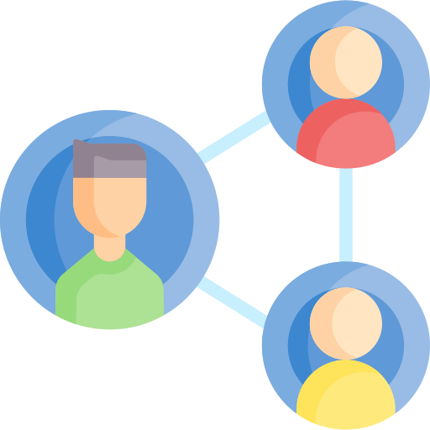
Introduction
• Rules and policies shaping the internet.
• Involves governments, companies, and users.
• Ensures a secure and open network.

Slide 3

Why It Matters
• Maintains privacy and security.
• Promotes freedom of expression.
• Helps manage cybercrime threats.

Slide 4

Key Stakeholders
• Governments: Create regulations.
• Private Sector: Tech companies.
• Technical Community: Engineers.

Slide 5

Core Principles
• Openness: Free flow of information.
• Security: Protection from threats.
• Stability: Reliable infrastructure.

Slide 6

Major Organizations
• ICANN: Domain names and IPs.
• ITU: Telecom standards.
• IGF: Global discussion forum.

Slide 7

Governance Issues
• Cybersecurity threats.
• Data privacy concerns.
• Digital divide and censorship.

Slide 8

Privacy & Security
• Protection of personal data.
• GDPR and data regulations.
• Rise in hacking and phishing.

Slide 9
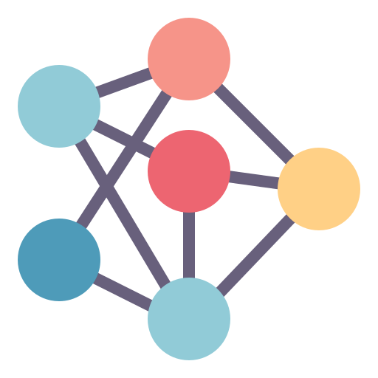
The Future
• Growing role of AI.
• Global digital rights focus.
• Expanding worldwide access.

Slide 10
Conclusion
• Ensures a safe digital world.
• Requires multi-stakeholder effort.
• Essential for communication.

Slide 11

Any Questions?
Presenter: Khunt Ayush P.

