Slide 1

Introduction to Big Mart Sales Prediction
Explore the power of machine learning in forecasting sales for the Big Mart retail chain. Uncover hidden patterns, optimize inventory, and drive strategic decision-making with cutting-edge predictive models.
Dataset & Project File: https://drive.google.com/drive/folders/1DtEKw6KDTdI0IPCoqfX4X2Hsi4KimapT?usp=drive_link
By: Ayush Yadav

Slide 2
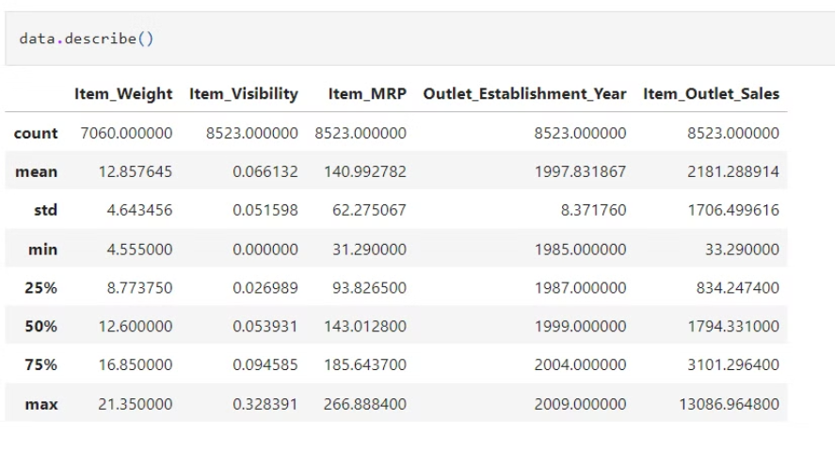
Get Information About Our Dataset Like Total Number Rows, Total Number of Columns, Datatypes of Each Column And Memory Requirement
These statistics provide a comprehensive overview of the distribution and central tendencies of the numerical variables in the dataset. They can be useful for understanding the characteristics of the data and for making informed decisions during data analysis and modeling.

Slide 3
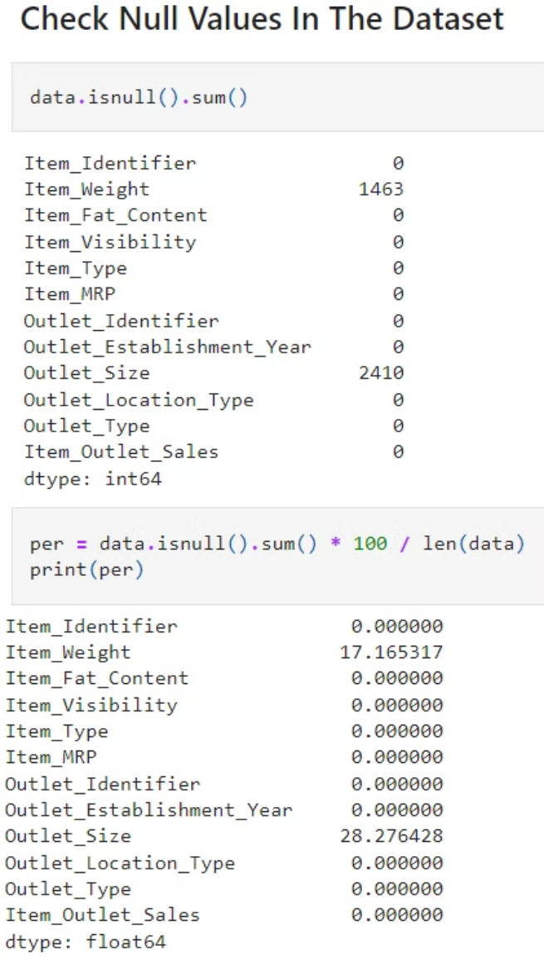
Check Null Values In The Dataset
Identify Null Values
Thoroughly inspect the dataset to detect any missing or null values that could impact the analysis.
Understand Data Structure
Examine the data types and structure of the dataset to determine the best approach for handling null values.
Visualize Null Patterns
Use data visualization techniques to identify the distribution and patterns of null values across the dataset.

Slide 4
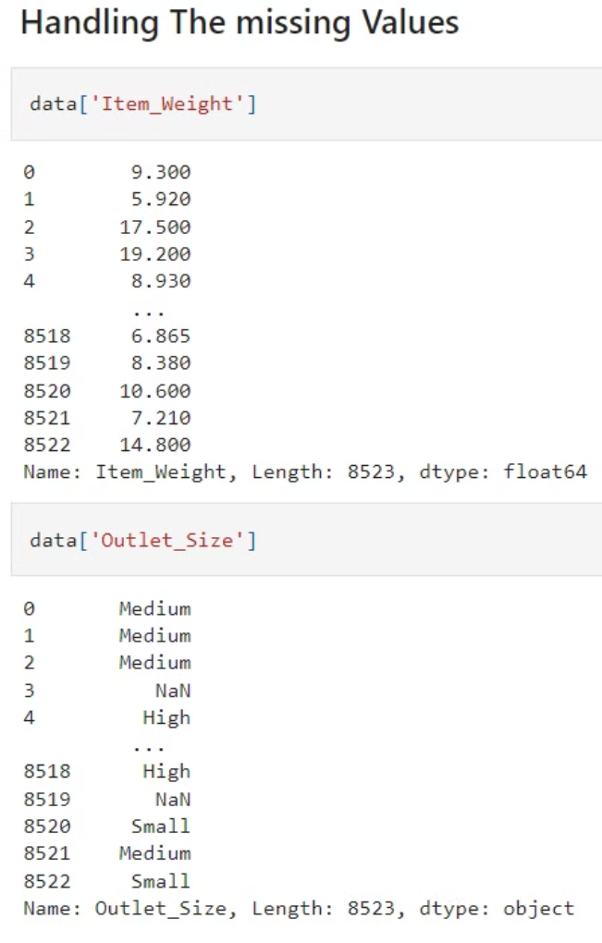
Handling The missing Values
Missing values in a dataset can have a significant impact on the performance of machine learning models. It is crucial to handle these missing values effectively to ensure accurate predictions. Some common techniques for handling missing values include:
Data Imputation: Replacing missing values with estimated values based on the available data, such as the mean, median, or mode of the feature.
Interpolation: Estimating missing values based on the values of neighboring data points, using techniques like linear interpolation or spline interpolation.
Advanced Imputation: Utilizing more sophisticated imputation methods, such as k-nearest neighbors (KNN) imputation or multiple imputation by chained equations (MICE), to capture complex relationships in the data and improve the accuracy of the imputed values.

Slide 5
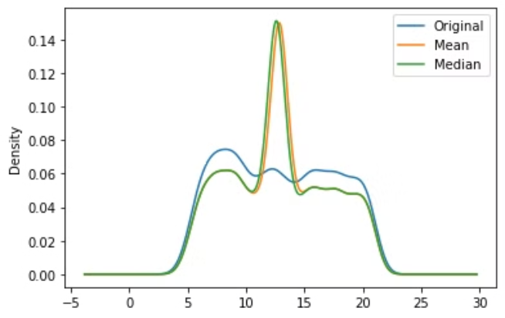
Univariate Imputation
1
Identifying Missing Values
Carefully examine the dataset to identify the variables with missing values. Understand the patterns and reasons behind the missing data.
2
Simple Imputation Methods
Apply basic univariate imputation techniques such as filling missing values with the mean, median, or most frequent value of the variable.
3
Evaluating Imputation Quality
Assess the impact of the imputation on the data distribution and relationships between variables. Ensure the imputed values are reasonable and do not introduce bias.

Slide 6
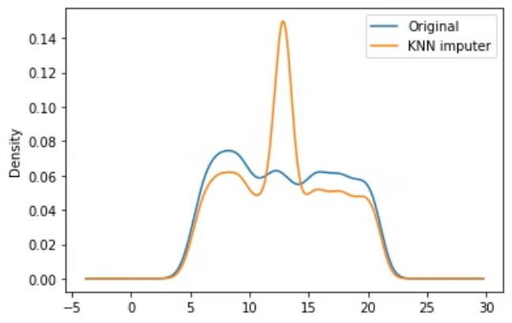
Multivariate Imputation
When dealing with missing values in a dataset, multivariate imputation leverages the relationships between multiple variables to estimate the missing data points. This approach considers the interdependencies and patterns in the data, leading to more accurate and robust imputations compared to univariate methods.
Multivariate imputation techniques, such as multiple imputation by chained equations (MICE), can handle complex missing data structures and preserve the statistical properties of the original dataset.

Slide 7



Feature Engineering
Identify Relevant Features
Analyze the dataset to determine which features are most relevant for predicting sales. Focus on variables that have a strong correlation with the target variable.
Create New Features
Combine and transform existing features to generate new, more informative features. This could include creating ratios, differences, or other calculated values.
Handle Categorical Variables
Encode categorical variables using techniques like one-hot encoding or label encoding to prepare them for use in the machine learning models.

Slide 8
Random Forest Regressor
1
Hundreds of
2
50
3
20M+
Trees
Ensembles
Predictions
Random Forest Regressor is a powerful machine learning algorithm used for sales prediction in the Big Mart problem. It combines the predictions of multiple decision trees to make accurate sales predictions.
The Random Forest model consists of hundreds of individual decision trees, each trained on a random subset of the training data. At each split, only a random subset of features is considered. This ensemble approach helps to reduce overfitting and improve the overall performance of the model.

Slide 9
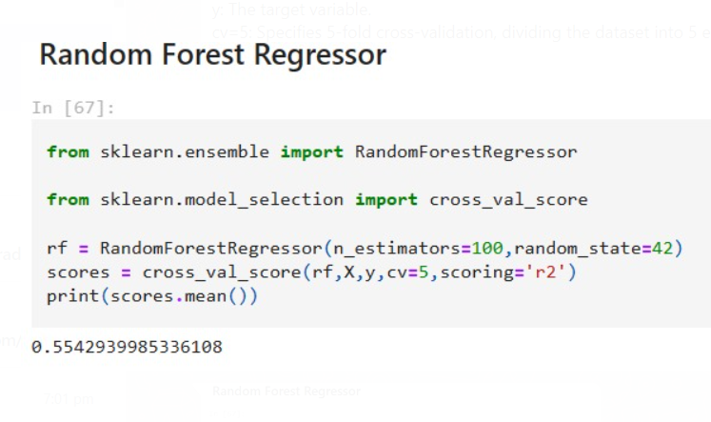
Here's a breakdown of each part of the code:
rf = RandomForestRegressor(n_estimators=100, random_state=42): This line creates an instance of the RandomForestRegressor class with n_estimators set to 100, which specifies the number of trees in the forest. random_state is set to 42 to ensure reproducibility of the results.
scores = cross_val_score(rf, X, y, cv=5, scoring='r2'): This line computes the cross-validated R-squared scores for the Random Forest model.
In this case, the mean R-squared score obtained from cross-validation is 0.5542939985336108, which suggests that the model explains approximately 55.43% of the variance in the target variable based on the input features.

Slide 10
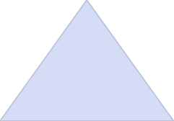
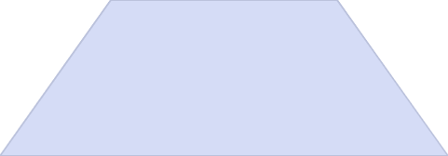
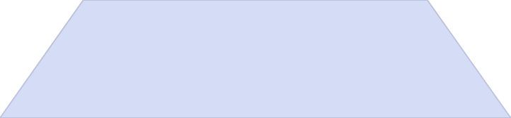
XGBRFRegressor
Data Preprocessing
1
Handle missing values, encode categorical features
Feature Engineering
2
Create new features to improve model performance
Model Training
3
Fit XGBRFRegressor to the preprocessed data
The XGBRFRegressor combines the power of XGBoost with the flexibility of Random Forest. It can handle non-linear relationships and is robust to outliers. By leveraging the strengths of these two algorithms, XGBRFRegressor can produce highly accurate sales predictions for the Big Mart dataset.

Slide 11
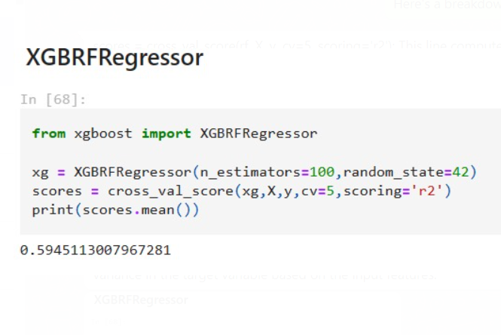
Here's a breakdown of each part of the code:
xg = XGBRFRegressor(n_estimators=100, random_state=42): This line creates an instance of the XGBRFRegressor class with n_estimators set to 100, which represents the number of trees to be used in the random forest. random_state is set to 42 for reproducibility. scores = cross_val_score(xg, X, y, cv=5, scoring='r2'): This line computes the cross-validated R-squared scores for the XGBoost random forest model print(scores.mean()): This line prints the mean of the R-squared scores obtained from cross-validation. In this case, the mean R-squared score is 0.5945113007967281, which indicates that the XGBoost random forest model explains approximately 59.45% of the variance in the target variable based on the input features.

Slide 12
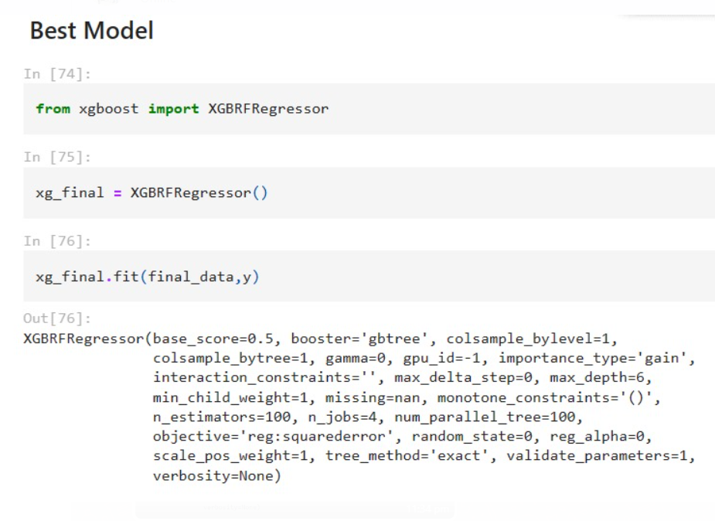
BEST MODEL:
xg_final = XGBRFRegressor(): This line creates an instance of the XGBRFRegressor class with default hyperparameters. xg_final.fit(final_data, y): This line fits the XGBoost Random Forest Regression model to the final_data (input features) and y (target variable). This is where the model learns the patterns in the data.

Slide 13
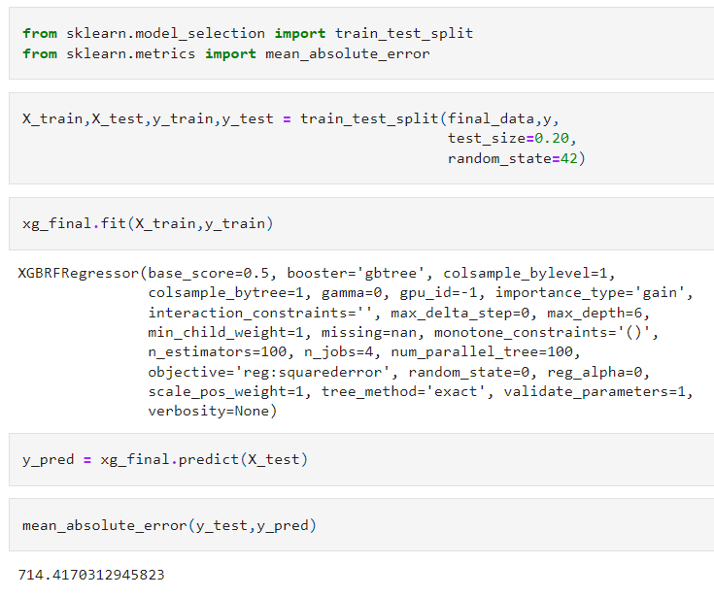
TRAINING THE MODEL:
X_train, X_test, y_train, y_test = train_test_split(final_data, y, test_size=0.20, random_state=42): This line splits the dataset (final_data and y) into training and testing sets.final_data: The input features.y: The target variable.test_size=0.20: Specifies that 20% of the data will be used for testing, while the remaining 80% will be used for training.random_state=42: Sets the random seed for reproducibility.
y_pred = xg_final.predict(X_test): This line makes predictions on the test data (X_test) using the trained model (xg_final).
mean_absolute_error(y_test, y_pred): This line computes the mean absolute error between the true target values (y_test) and the predicted values (y_pred). Mean absolute error (MAE) is a metric used to evaluate the performance of regression models. It measures the average absolute difference between the predicted and true values. In this case, the MAE is approximately 714.417.

Slide 14
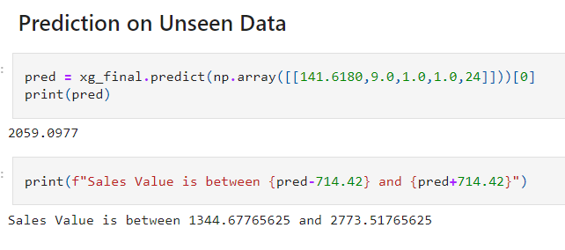
PREDICTING FINAL SALES VALUES:
pred = xg_final.predict(np.array([[141.6180,9.0,1.0,1.0,24]]))[0]: This line makes a prediction on a single sample of unseen data represented as a numpy array. The input features for the prediction are [141.6180, 9.0, 1.0, 1.0, 24]. The prediction is obtained by calling the predict method on the xg_final model. The [0] is added to extract the actual prediction value from the array returned by predict. print(f"Sales Value is between {pred-714.42} and {pred+714.42}"): This line calculates a range for the predicted sales value based on the mean absolute error (MAE) obtained from the evaluation on the test set.

Slide 15
Conclusion and Recommendations
1
Key Findings
2
Recommendations
3
Future Outlook
The analysis of Big Mart sales data using Random Forest Regressor and XGBRFRegressor models uncovered valuable insights about the factors driving sales performance.
Based on the insights gained, it is recommended to focus on optimizing product pricing, store location, and inventory management to boost overall sales revenue.
With continued refinement of the machine learning models and incorporation of additional data sources, the accuracy of sales predictions can be further improved to support more informed business decisions.

Slide 16
THANK YOU

