Slide 1
DoF Guided Reflection Removal
DIP Team 001 (Repo Link)
Mentor TA : Karandeep Singh Juneja
Members: Ayush Singhania(20171031)(ECE)
Siddharth Gaur(20171198)(ECE)
Gaurav Aswani(20171107)(CSD)

Slide 2

Problem Statement
What happens when you click a picture through a window? Annoying reflections ruin your beautiful picture.

Slide 3

Proposed Solution
The given paper proposes a method to do away with this problem and remove the unwanted reflections by making DoF confidence maps for both the background and the foreground.

Slide 4
Major Assumptions
Photographers always focus on the background in a particular depth when they take photos.
Reflections in different depth layers would be blurred in the images.
DoF, the distance between the nearest and farthest objects in a scene that appears reasonably sharp and can be used as an important feature to distinguish background and reflection edges.
Images with different resolution can exhibit different levels of details in the DoF map.

Slide 5
Phases of the Project
Our project has three main phases:
1. Background Edge map generation : To create a map that will be used to separate out the background image.
2. Reflection Edge map generation : To create a map that will be used to separate out the reflection image.
3. Layer Reconstruction : To reconstruct the reflection and background images using the maps generated before.

Slide 6
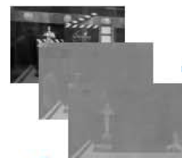

Background Edge Map Generation
The steps followed are as follows:
The input image is first converted to the Lab color space.
For each channel we build three reference image(b_{r}) each with a different resolution.
For each reference image, we build three blurred images (b_{k,} k={3,5,7}) with kxk Gaussian blurring filters.

Slide 7
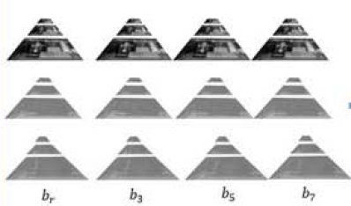
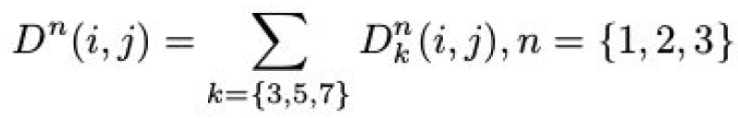
Background Edge Map Generation
We calculate the KL divergence of each of the blurred images with their corresponding reference image and denote it as D^{n}_{k.}
The DoF confidence map for each resolution is then computed as :

Slide 8


Background Edge Map Generation
The DoF confidence maps D² and D³ are upscaled to the same size as D¹.
The final DoF confidence map for each channel is obtained by combining the three DoF map as follows:
Then, we rule out the pixels belonging to reflection components in the DoF maps and the salient edges for layer reconstruction are determined by:
where H is the Heaviside step function and τ s is a threshold to determine the salient edges belonging to the background components.

Slide 9
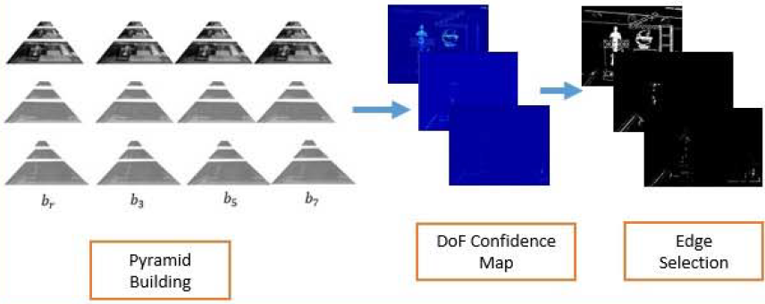
Background Edge Map Generation

Slide 10

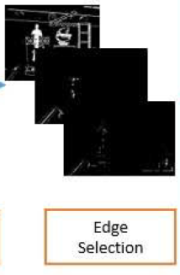
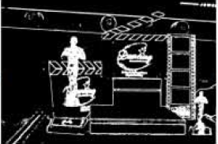
Background Edge Map Generation
Finally, the edge map of the background can be generated as follows:

Slide 11
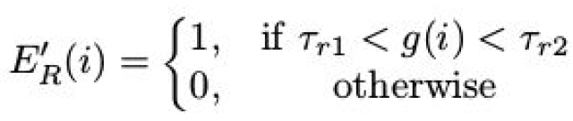
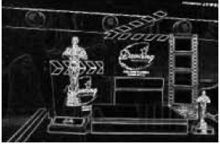
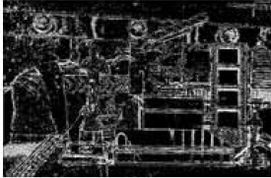


Reflection Edge map generation
The following steps are followed:
We compute the gradient of the input image to get the initial reflection edges.
In the gradient domain , we obtain an initial reflection edge map based on the following threshold :

Slide 12

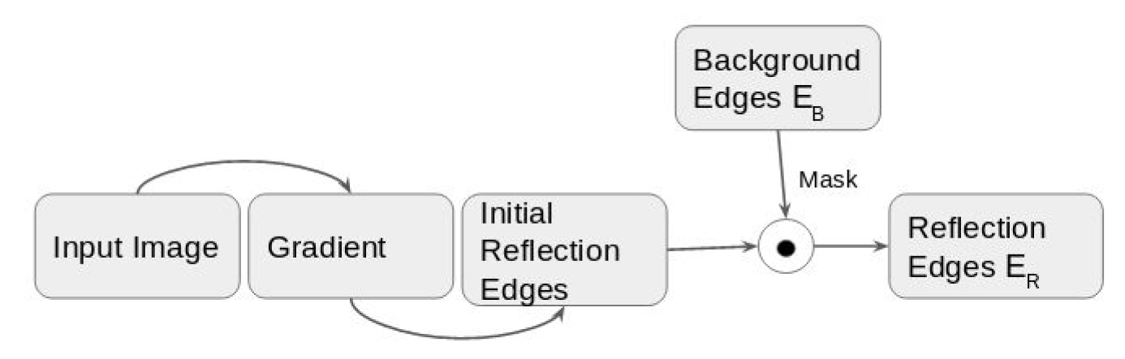
Reflection Edge map generation
We reduce the artifacts in the initial reflection edge map as
follows:
where M’ is the complement of the background edge map and E_{R}’ is the initial reflection map.

Slide 13
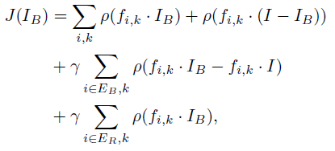
Layer Reconstruction
With the background and reflection edge maps generated before, the reflection and background layers can be separated based on the following objective function :
We use the Iterative Reweighted Least Square(IRLS) method for minimising the cost function.
We fix the number of iterations to 3(experimental observation) and use Gaussian priors for initialisation.

Slide 14
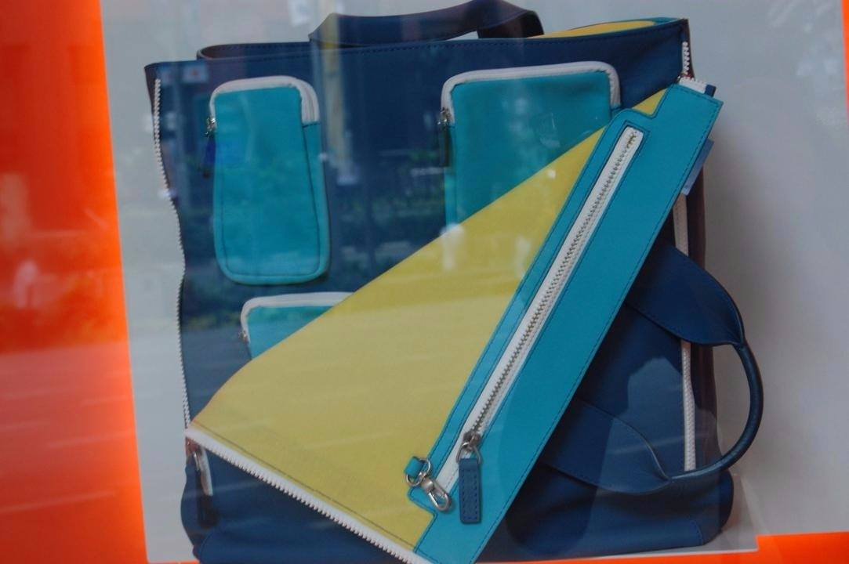
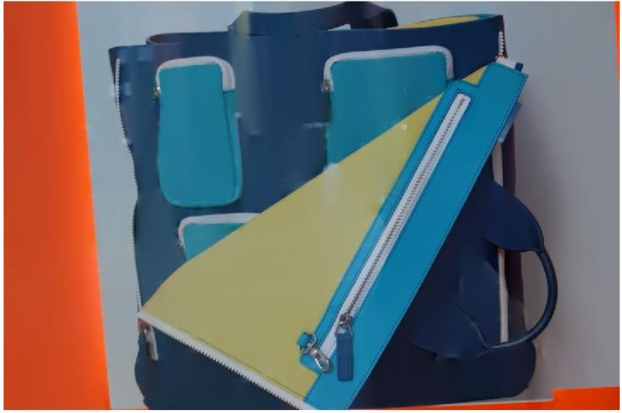
Results
We ran the implemented code on a variety of images. Some of the results are as follows:

Slide 15



Slide 16



Slide 17
Division of Work
Project Proposal : Siddharth
Data Collection : Gaurav
Background Edge Map:
Gradient calculation and pyramid building : Ayush
Pyramid fusion and edge map generation: Siddharth
Reflection Edge Map : Gaurav
Layer Reconstruction : Ayush
Code Integration and Final debugging : Siddharth
Presentation Preparation : Ayush
Documentation and Github maintainence : Gaurav

Slide 18
Thank You!

