Slide 1
Empirical Mode Decomposition To Find Instantaneous Frequency
Ayush Singhania(20171031)
Kunal Lahoti(2018122002)

Slide 2
Introduction
Instantaneous frequency is necessary for understanding the detailed mechanisms for non linear and non stationary processes.
In real world situations LTI signals rarely come into play. Most of the real world signal are non-linear and non-stationary in nature. Conventional methods like Fourier Transforms and wavelet decomposition are ineffective in analyzing such situation.
EMD is a method of breaking down a signal without leaving the time domain. The process is useful for analyzing natural signals, which are most often non-linear and non-stationary.

Slide 3
An Intrinsic Mode Function (IMF) is a function that satisfies two conditions: (1) In the whole data set, the number of extrema and the number of zero crossings must either equal or differ at most by one; and (2) At any point, the mean value of the envelope defined by the local maxima and the envelope defined by the local minima is zero.
EMD filters out functions which form a complete and nearly orthogonal basis for the original signal. Completeness is based on the method of the EMD; the way it is decomposed implies completeness. The functions, known as Intrinsic Mode Functions (IMFs), are therefore sufficient to describe the signal, even though they are not necessarily orthogonal.

Slide 4

Algorithm
The procedure of extracting an IMF is called sifting. The sifting process is as follows:
Identify all the local extrema in the test data.
Connect all the local maxima by a cubic spline line as the upper envelope.
Repeat the procedure for the local minima to produce the lower envelope.
The upper and lower envelopes should cover all the data between them. Their mean is m₁. The difference between the data and m₁ is the first component h₁: X(t) - m₁ = h₁.
Ideally, h₁ should satisfy the definition of an IMF, since the construction of h₁ described above should have made it symmetric and having all maxima positive and all minima negative. After the first round of sifting, a crest may become a local maximum. New extrema generated in this way actually reveal the proper modes lost in the initial examination. In the subsequent sifting process, h₁ can only be treated as a proto-IMF. In the next step, h₁ is treated as data:h₁- m₁₁ = h₁₁.
After repeated sifting up to k times, h₁ becomes an IMF, that is h_{1(k-1)}-m_{1k}=h_{1k}
Then, h_{1k} is designated as the first IMF component of the data: C₁ = h_{1k.}
The stoppage criterion determines the number of sifting steps to produce an IMF.
Standard Deviation: It is similar to the Cauchy convergence test, and we define a sum of the difference, SD, as
Then the sifting process stops when SD is smaller than a pre-given v<<<0.3

Slide 5
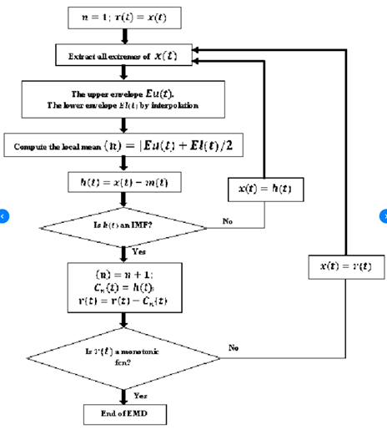
Block Diagram of the Algorithm

Slide 6
Applications And Final Evaluation
Applications:
Financial : To analyze non-stationary financial time series data.
Speech Recognition : Used for speech pitch detection.
Biomedical : Analyzing EEG, ECG and other signals.
Final Evaluation:
Decomposing a sample ECG data into component IMFs.
Finding instantaneous frequency from the IMFs.
Verifying validity by regenerating the ECG signal from the component IMFs.

Slide 7
Instantaneous Frequency(IF)
In order to calculate the IF, a complex signal has to be obtained from each IMF for which envelope and phase signals can be defined. From a practical point of view , the analytic signal is the appropriate method for generating a unique complex signal from a real one. Analytic signal can be represented as, z(t):
z(t) = s(t) + j*H[s(t)] = a(t)*e^{j*ɸ(t)}

Slide 8
where s(t) is the real signal (an IMF), H[*] is Hilbert transform, a(t) is the absolute value of z(t), and Φ(t) is the phase of z(t).
Then, instantaneous frequency (f_{i}) and envelope (e_{i}) can be defined as the phase derivative and envelope of the analytic signal respectively:
f_{i}(t) = (1/(2*π))*(dɸ/dt)
e_{i}(t) = |z(t)| = a(t)
According to the definition, positive IF values will only
result if the phase of the analytic signal is monotonically
increasing.

Slide 9
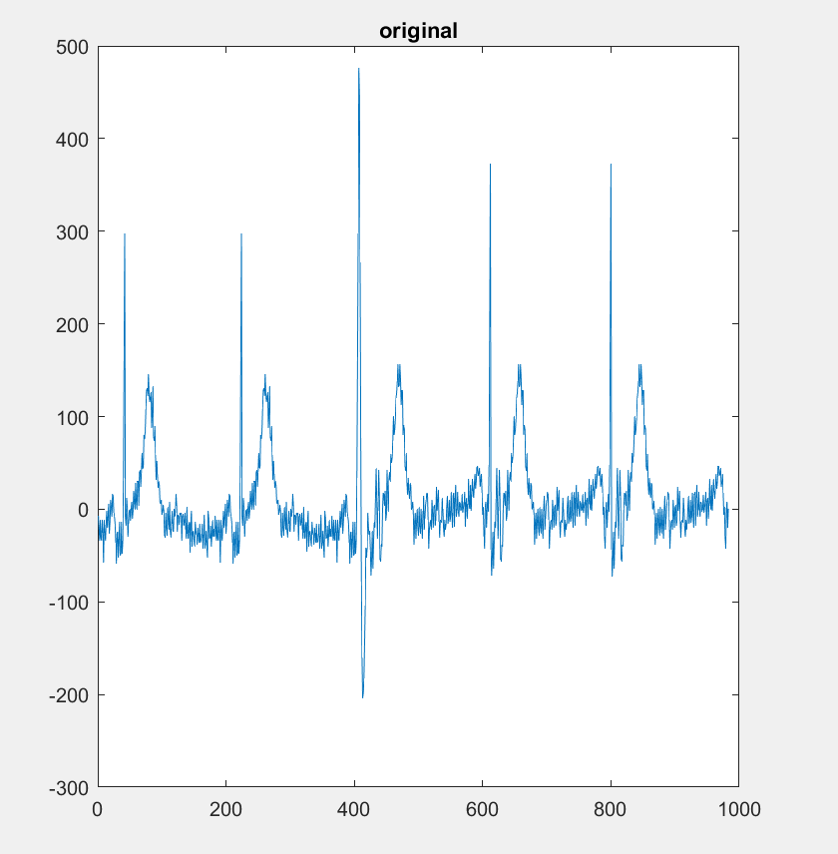
Results : Input Signal

Slide 10
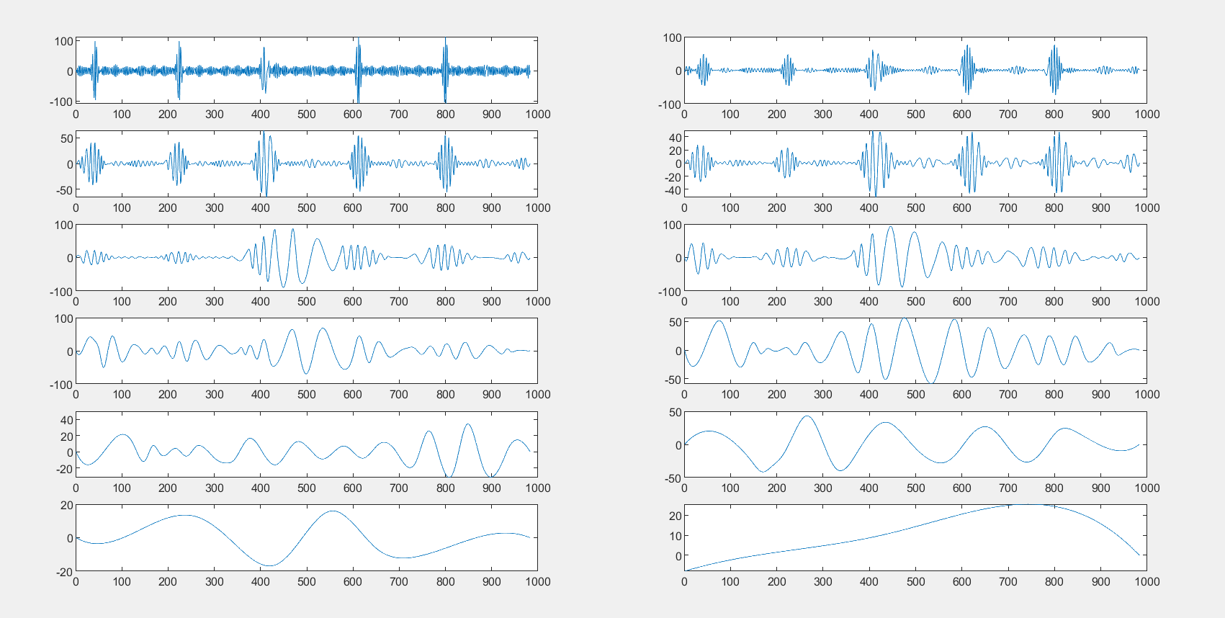
Results : Component IMFs

Slide 11
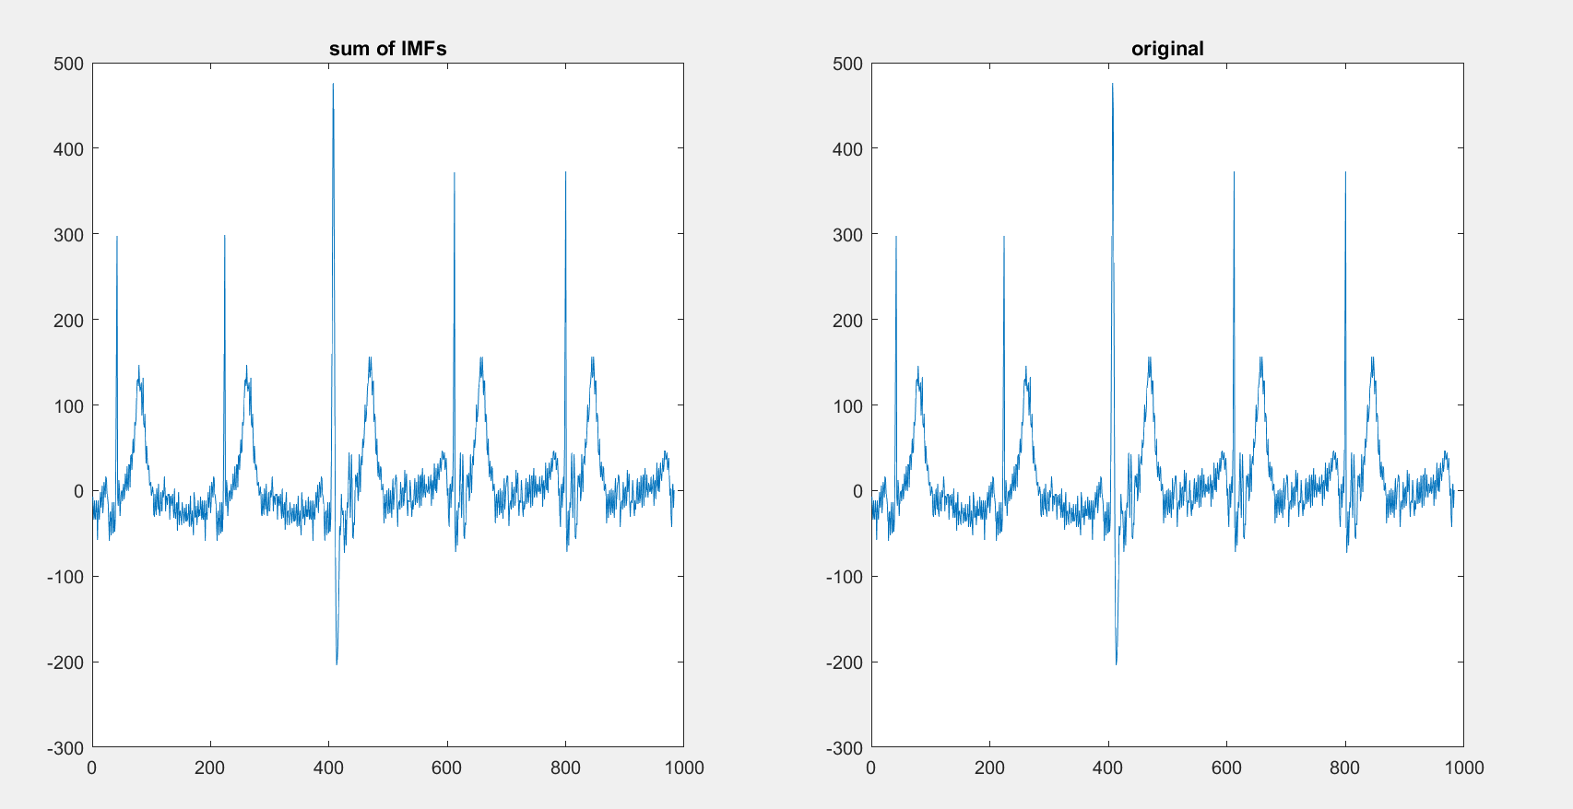
Results : Sum of IMFs

Slide 12
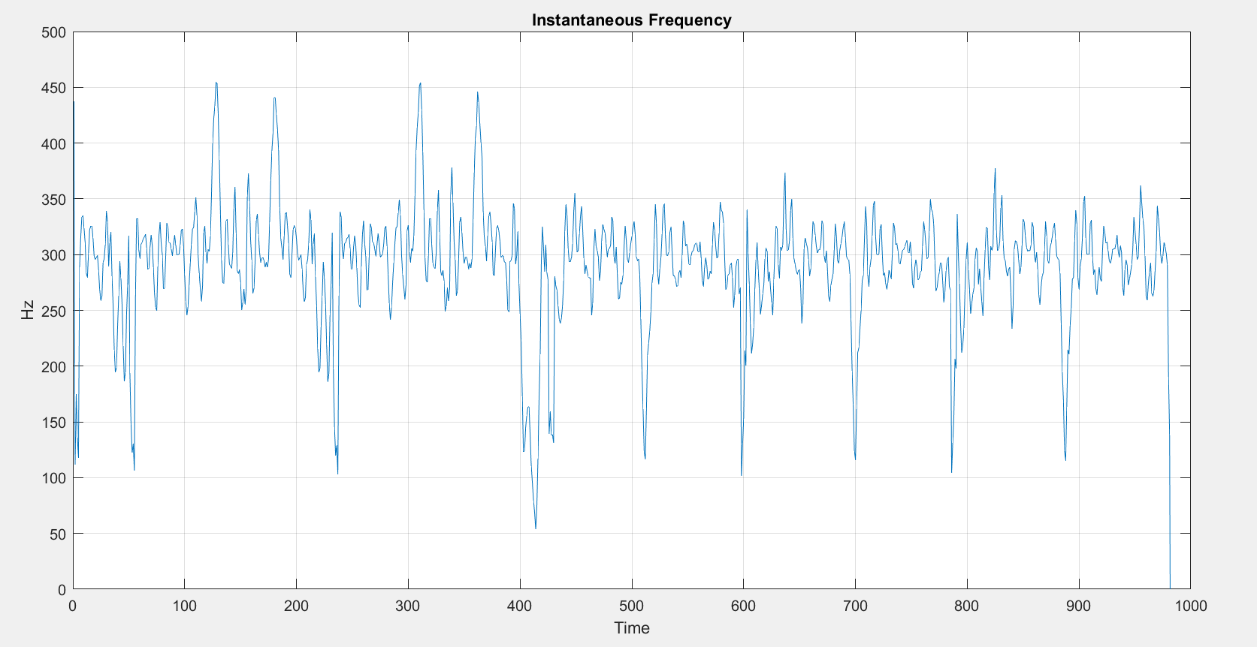
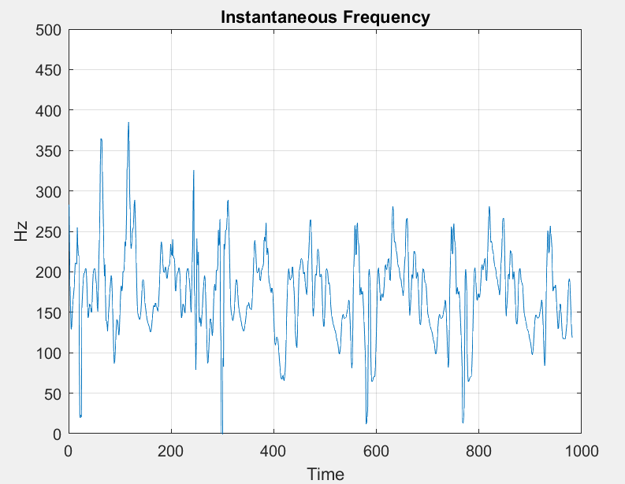
Instantaneous frequency components
Frequency = 300 Hz
Frequency = 160 Hz

Slide 13
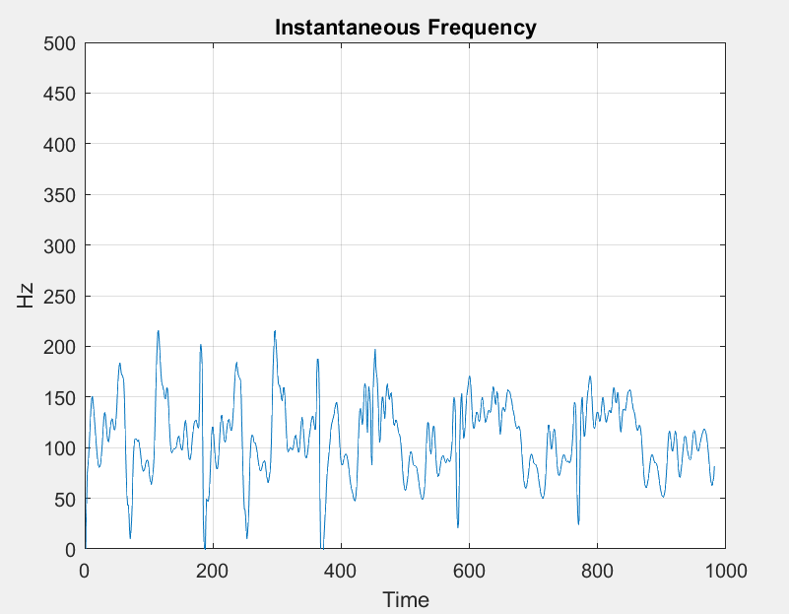
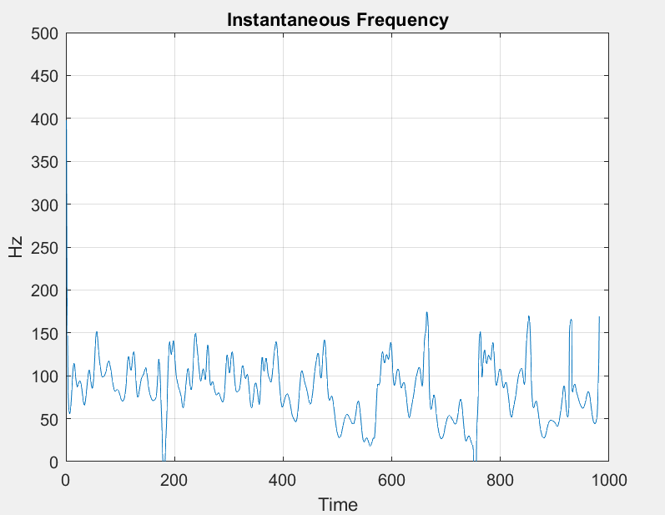
Instantaneous frequency components
Frequency = 100 Hz
Frequency = 80 Hz

Slide 14
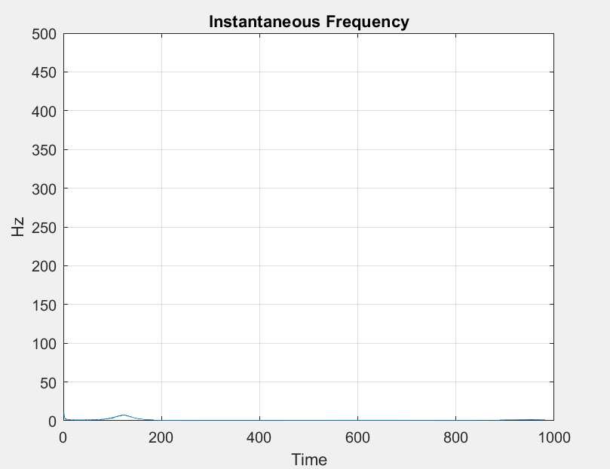
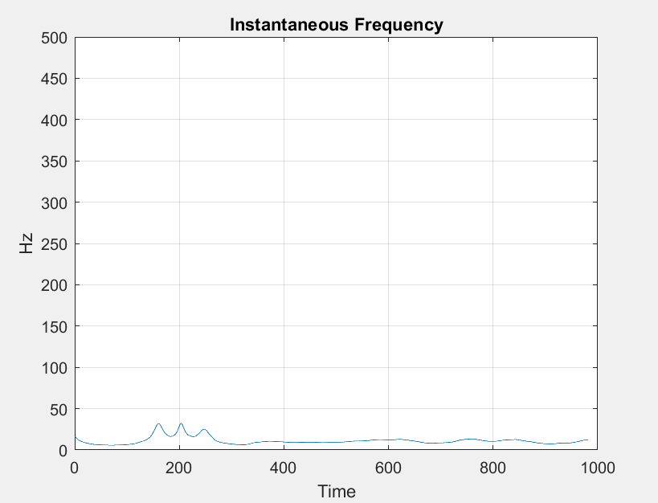
Instantaneous frequency components
Frequency = 5 Hz
Frequency = 20 Hz

