Slide 1
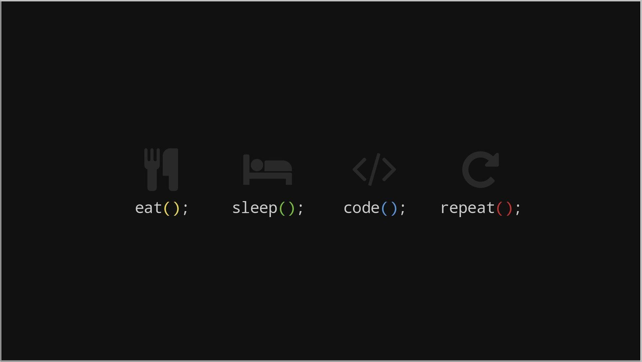
HELLO AMAZING PEOPLE
Aayush Dangol
BCT (A) SECOND YEAR
06

Slide 2
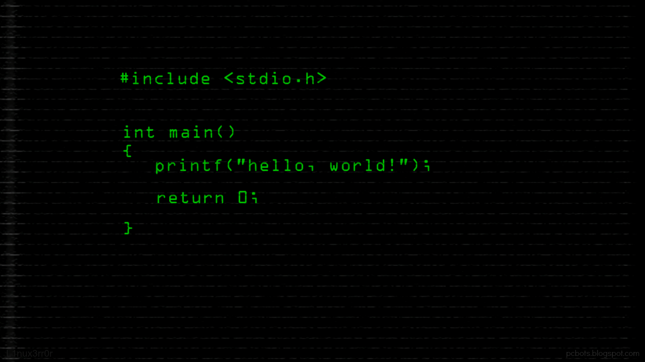
TYPES OF CONVERSION
CONVERSION FROM BASIC TYPE TO CLASS TYPE
CONVERSION FROM CLASS TYPE TO BASIC TYPE
CONVERSION FROM CLASS TYPE TO CLASS TYPE

Slide 3

CONVERSION FROM BASIC TYPE TO CLASS TYPE
Constructor can be used to convert basic data type to class type
Constructor function takes a single argument of basic data type

Slide 4
Syntax:
class class_name
{
private:
//...
public:
class_name(data_type)
{
//conversion
}
};

Slide 5
#include <iostream>
using namespace std;
class Celsius
{
private:
float temp;
public:
celsius()
{
temp=0;
}
celsius(float t)
{
temp=(t-32)*(5/9);
}
void showtemp()
{
cout<<"Temperature in celsius: "<<temp;
}
};
int main()
{
celsius cel;
float fer;
cout<<"Enter Temp in Fahrenheit: ";
cin>>fer;
cel=fer;
cel.showtemp();
return 0;
}

Slide 6
CONVERSION FROM CLASS TYPE TO BASIC TYPE
constructor function does not support this operation
C++ allow us to define an overloaded casting operator that could be used to convert a class
type data to basic type.
The casting operator function should satisfy following conditions
It must be a class member
It must not specify return type
It must not have any arguments

Slide 7
Syntax:
Operator type_name()
{
//body…
}

Slide 8
#include <iostream>
using namespace std;
class celsius
{
private:
float temp;
public:
celsius()
{
temp=0;
}
operator float()
{
float fer;
fer=temp*(9/5)+32;
return fer;
}
void gettemp()
{
cout<<"Enter Temperature in celsius: ";
cin>>temp;
}
};
int main()
{
celsius cel;
float fer;
cel.gettemp();
fer=cel;
cout<<"Temperature in Fahrenheit: "<<fer;
return 0;
}

Slide 9
CONVERSION FROM CLASS TYPE TO CLASS TYPE
It is perform using either
One argument constructor (Destination class)
Overloaded casting operator(Source class)

Slide 10
Using overloaded casting operator(Source class)
Syntax:
Operator destination_class_name()
{
//body…
}

Slide 11
#include<iostream>
#include<math.h>
using namespace std;
class rectangular
{
private:
float x,y;
public:
rectangular()
{
x=0;
y=0;
}
rectangular(float a,float b)
{
x=a;
y=b;
}
void display()
{
cout<<x<<y;
}
};
class polar
{
private:
float radius,angle;
public:
polar()
{
radius=0;
angle=0;
}
polar(double r,double a)
{
radius=r;
angle=a;
}
void display()
{
cout<<radius<<angle;
}
operator rectangular()
{
float x,y;
x=radius*cos(angle);
y=radius*sin(angle);
return rectangular(x,y);
}
};
int main()
{
rectangular r;
polar p(70.0,0.79);
r=p;
p.display();
r.display();
return 0;
}
}

Slide 12
USING ONE ARGUMENT CONSTRUCTOR(DESTINATION CLASS)
Syntax:
Destination_Class_name(source_class_name variable)
{
//….
}

Slide 13
#include<iostream>
#include<math.h>
using namespace std;
class polar
{
private:
float radius,angle;
public:
polar()
{
radius=0;
angle=0;
}
polar(double r,double a)
{
radius=r;
angle=a;
}
void display()
{
cout<<radius<<angle;
}
float getr()
{
return radius;
}
float geta()
{
return angle;
}
};
class rectangular
{
private:
float x,y;
public:
rectangular()
{
x=0;
y=0;
}
rectangular(float a,float b)
{
x=a;
y=b;
}
rectangular(polar p)
{
float r,a;
r=p.getr();
a=p.geta();
x=r*cos(a);
y=r*sin(a);
}
void display()
{
cout<<x<<y;
}
};
int main()
{
rectangular r;
polar p(70.0,0.79);
r=p;
p.display();
r.display();
return 0;
}
}

Slide 14
SUMMARY
Conversion Required | Conversion Take Place In
 | Source class | Destination Class
Basic -> Class | NA | Constructor
Class -> Basic | Casting Operator | NA
Class -> Class | Casting Operator | Constructor

Slide 15
THANK YOU

