Slide 1
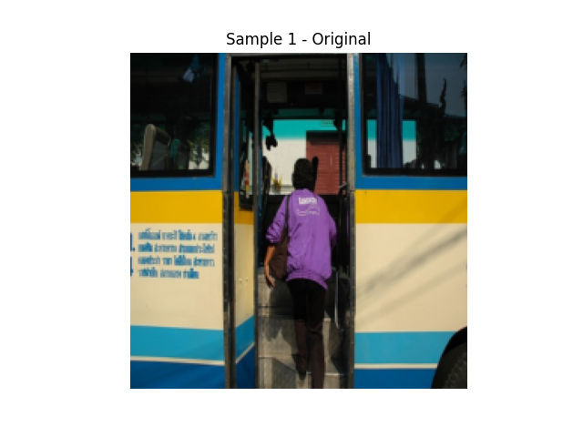
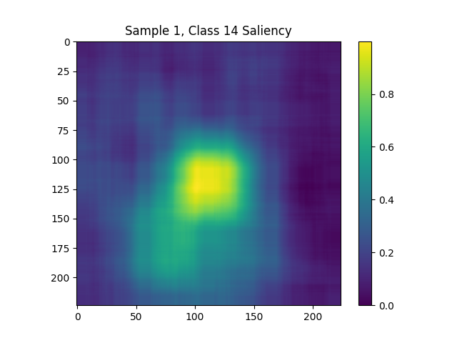
Motivation & Metrics: Explainability with Grad-CAM
Brief motivation:
Deep models are black-boxes — explainability bridges the gap between accuracy and trust.
We chose Grad-CAM for its spatial and class-specific saliency visualization.
Classification Metrics
Explainability Metrics
Test Accuracy | Test Auroc | Test Map
0.978 | 0.984 | 0.901
Grad-CAM iAUC | Mean IoU | Pointing Game:
0.730 | 0.293 | 0.535
Saliency maps localize key evidence supporting predictions.
AUROC reflects prediction ranking quality across thresholds. Grad-CAM iAUC measures how well saliency aligns with important image regions.

Slide 2
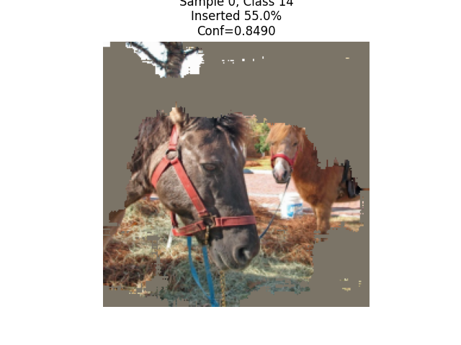
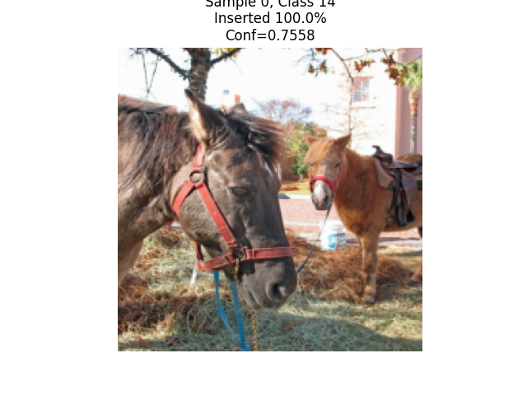
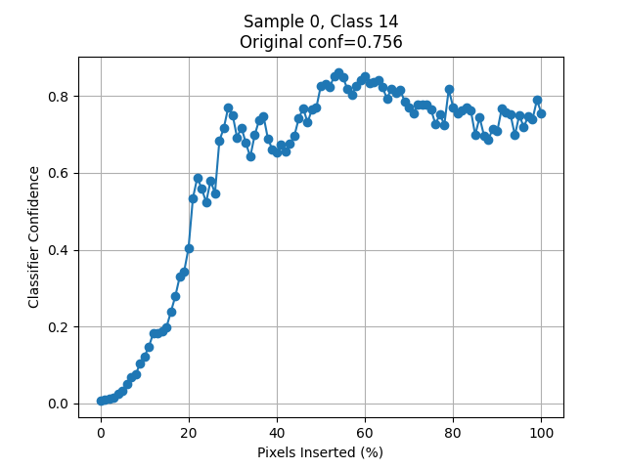
Evaluating Explanation Quality
Why Grad-CAM? Grad-CAM highlights class-specific regions in the image that strongly influence the model’s decision.
How do we evaluate it? : We use insertion curves and masked visualizations to test how much the explanation affects model confidence.
More pixels inserted →
Grad-CAM boosts confidence as relevant pixels are added
— higher confidence with fewer pixels indicates better focus.
Masked regions reveal focus of Grad-CAM.

Slide 3
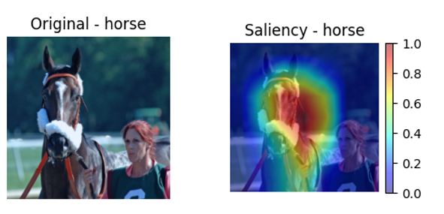
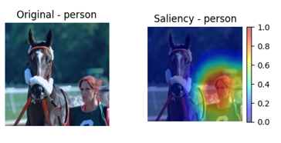
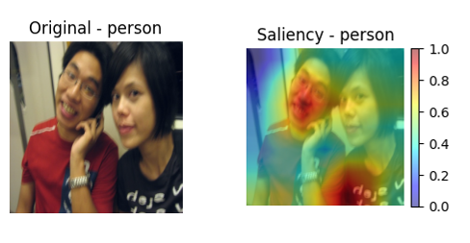
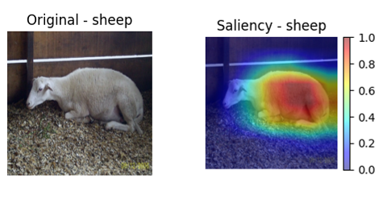
Exploring Class-Specific Saliency
Grad-CAM enables per-class saliency maps in multi-label predictions.
Same image → distinct saliency focus for different classes.
Example:
For “person”, Grad-CAM highlights facial regions..
For “sheep” or “horse”, attention is correctly on the animal.
Model correctly identifies both person and horse — Grad-CAM shows class-specific attention.
Helps explain why the model predicted a label.
Reveals potential failure modes or spurious correlations in predictions.
Sheep → Full-body saliency
Horse → Head-focused saliency
Person → Face-focused saliency
Person → Focus on facial regions

