Slide 1

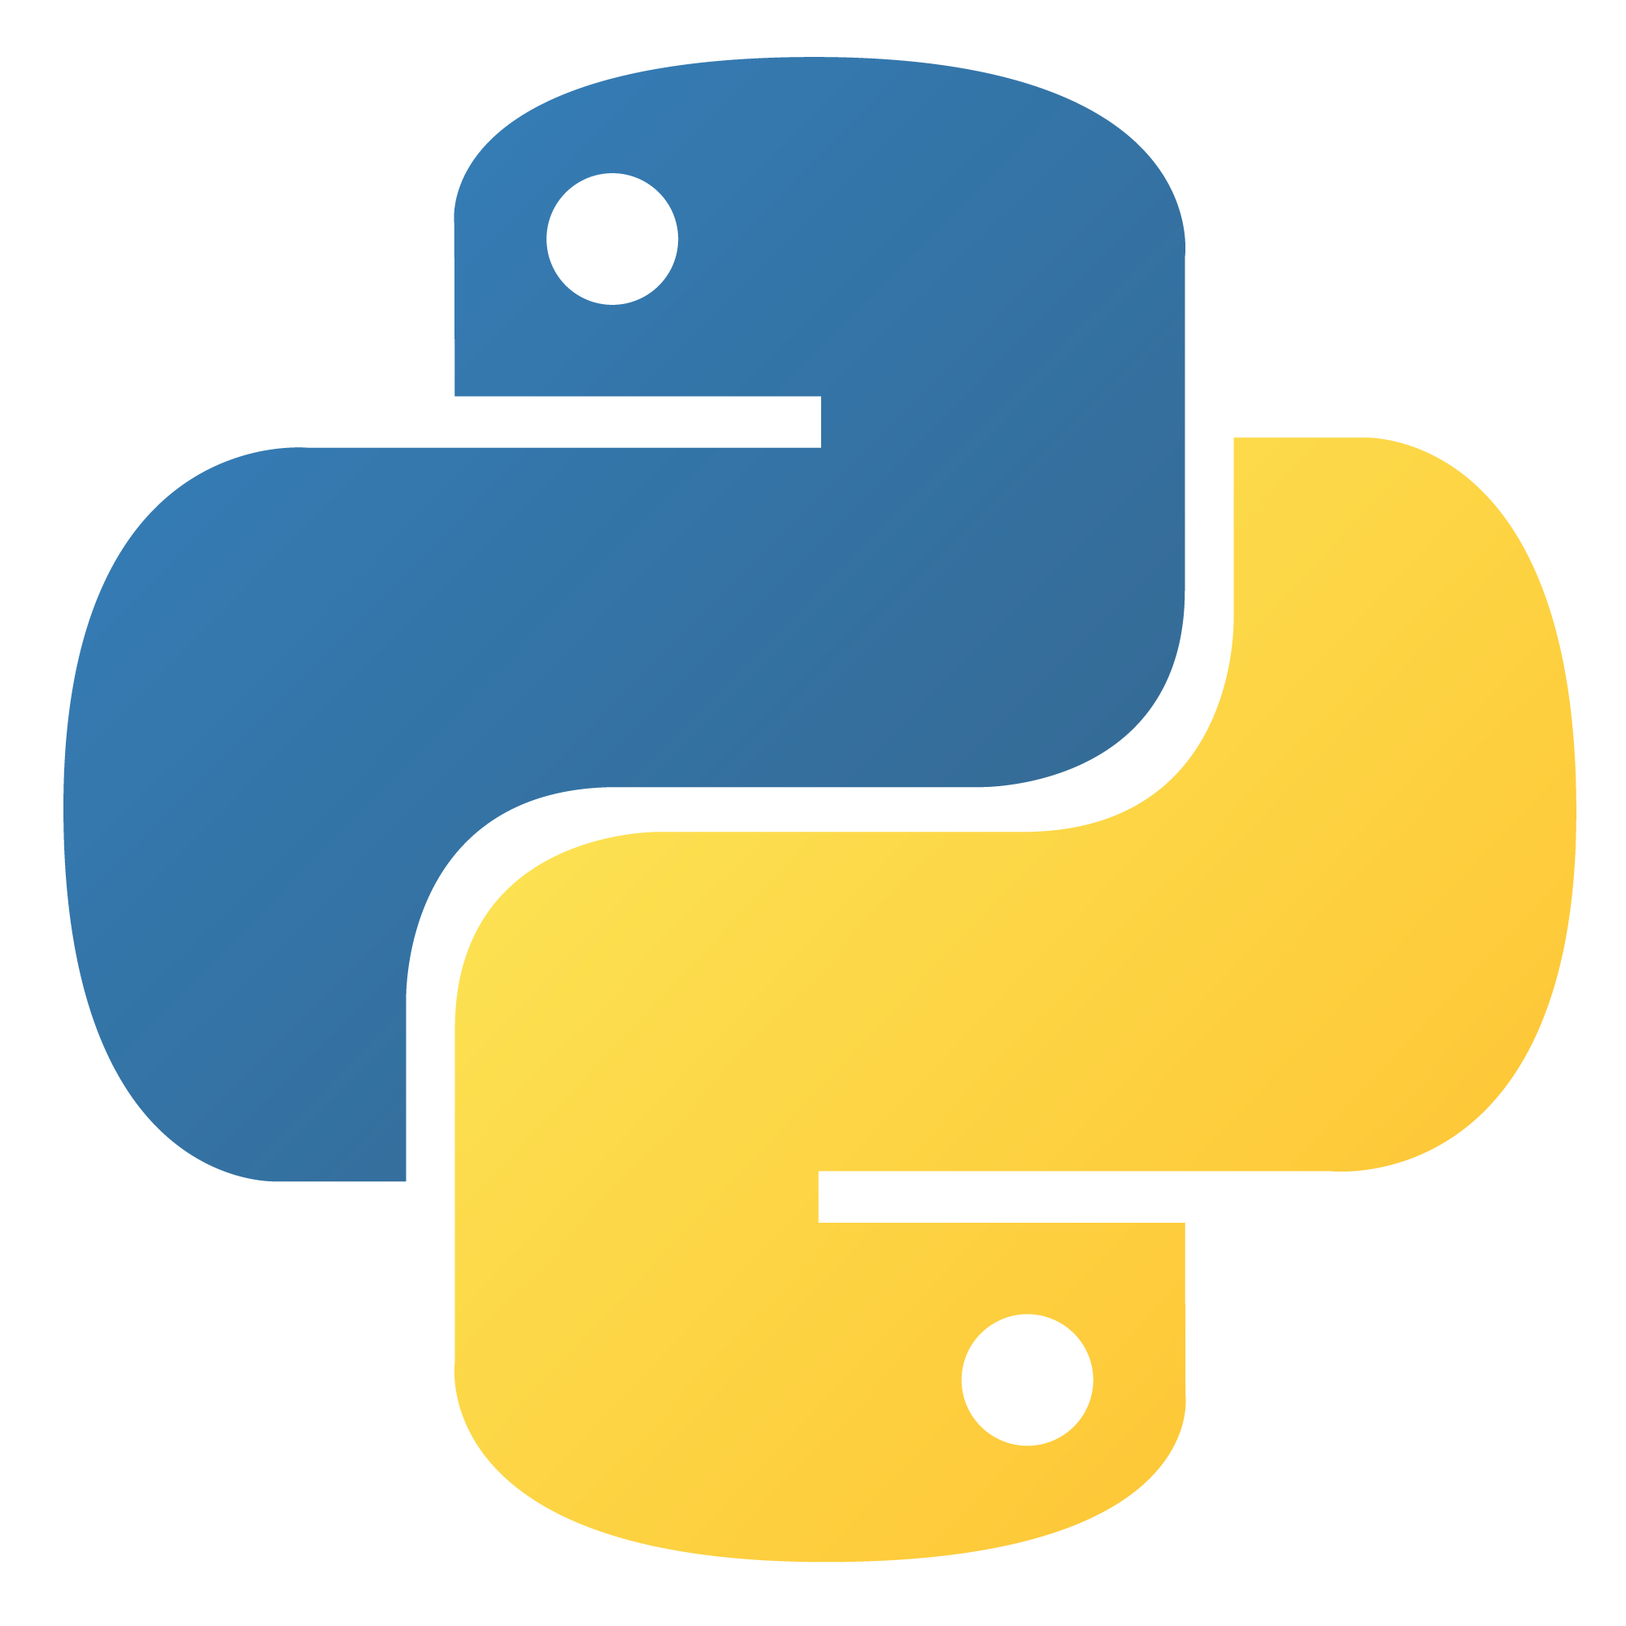
Advanced Python Libraries
Name : Moradiya Aayush
E.No : 2302031000136
Batch : 2

Slide 2
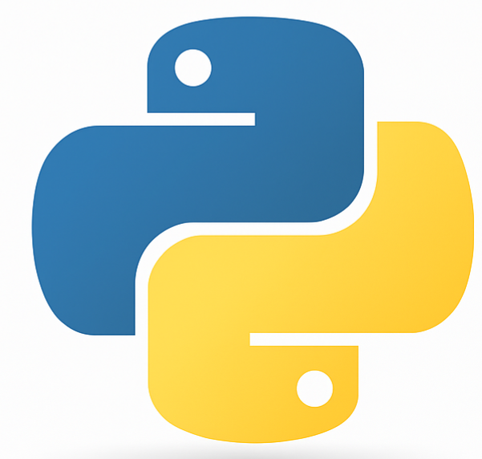
Introduction
Python is widely used for its simplicity and powerful libraries.
Advanced libraries enable developers to handle complex tasks.
Key areas: data analysis, machine learning, automation, computer vision.
Helps reduce development time and improve performance.
Focus on real-world applications.

Slide 3
Why Use Advanced Libraries?
Save development time through reusable code.
Perform complex computations efficiently.
Access to optimized algorithms and data structures.
Integrate easily with other tools (e.g., databases, APIs, UI).
Strong community support and documentation.

Slide 4
NumPy – Numerical Computing
Core library for array-based computing.
Supports multi-dimensional arrays and matrices.
Vectorization speeds up operations.
Offers math, logical, linear algebra, and FFT tools.
Essential for scientific computing.

Slide 5
Pandas – Data Analysis and Manipulation
Ideal for structured data like CSV, Excel, SQL.
DataFrame and Series for tabular data.
Powerful tools for grouping, filtering, merging.
Handles missing data and time-series well.
Widely used in data science and finance.

Slide 6
Matplotlib & Seaborn – Visualization
Matplotlib: Basic plots (line, bar, scatter, etc.).
Seaborn: Cleaner syntax and better visuals.
Great for exploring datasets visually.
Advanced visualizations like heatmaps and pairplots.
Integrates well with Pandas.

Slide 7
Scikit-learn – Machine Learning
Built on NumPy, SciPy, and Matplotlib.
Algorithms for classification, regression, clustering.
Preprocessing: scaling, encoding, imputation.
Model evaluation: cross-validation, ROC curves.
Good for beginners and rapid prototyping.

Slide 8
TensorFlow & PyTorch – Deep Learning
TensorFlow: Graph-based, production-ready.
PyTorch: Dynamic graph, intuitive and debug-friendly.
Supports GPU acceleration and autograd.
Used for NLP, vision, generative models.
Ecosystems include Keras, TorchVision, TensorBoard.

Slide 9
OpenCV – Image Processing
Real-time image and video processing.
Includes filters, detection, tracking tools.
Face and object recognition support.
Integrates with deep learning models (e.g., YOLO).
Used in surveillance, OCR, AR applications.

Slide 10
Requests & BeautifulSoup – Web Scraping
Requests: Easy HTTP requests (GET, POST, etc.).
Handles headers, sessions, cookies.
BeautifulSoup: Parse and navigate HTML/XML.
Extract tags, attributes, text content.
Often used with Selenium and Scrapy.

Slide 11
SQLAlchemy – Database Toolkit
Python ORM for SQL databases.
Maps Python classes to database tables.
Supports SQLite, MySQL, PostgreSQL, etc.
Prevents SQL injection with parameterized queries.
Supports migrations and schema generation.

Slide 12
Conclusion
Advanced Python libraries unlock high-level capabilities.
Choose libraries based on project scope and domain.
Build real-world projects and explore documentation.
Stay updated: Python evolves rapidly.
Keep exploring to become a powerful Python developer.

Slide 13
GITHUB LINK

