Slide 1
COA Lab Project (2016-17) The LNMIIT, Jaipur
LOSAS (Locker Security And Access System)
Ayush Shrivastava (15UCC009)
Nikhil Paliwal (15UCC045)
Rajat Chandiwala (15UCC046)
Apurva Pusalkar (15UCS023)

Slide 2
Introduction
This project consists of designing a user-friendly access and control/security system for bank lockers.
The locker holder can access and control his locker (change password, get receipt of belongings) anytime in a secure manner using our security functions like PIR motion detector, automatic threat-alarm, manual-biometric password check, and automatic system locker etc.

Slide 3
Functions
SYSTEM TIMER() – Provides a gateway of 10 minutes.
PASSWORD CHECK() – Checks whether password entered is correct.
UNIQUE ID()– Provides unique user ID to a new user for accessing their locker.
LOCKER ASSIGNMENT() – Checks availability of lockers and assigns an empty one.
MAILING() – Sends a mail to the user.
INVOLUNTARY ALARM() – Alarm is activated whenever there is any activity when bank is closed(PIR sensor).
THREAT() – Sets off the alarm and closes the opened locker.

Slide 4
Functions
RESET PASSWORD() – Allows user to change password. Requires admin's password also.
RECEIPT() – Gives user the weight of items and no. of visits of the user.
FREQUENCY OF VISIT() – Maintains count for no. of visits of a user in a month/year.
DISPLAY() – Will display the details of user and locker number.
OPEN & CLOSE() - Opens and closes the locker.
SENSOR() – Detects whether doorway of the locker is clear.

Slide 5
Memory Model
As we have a 16 bit machine, word is of 2 bytes. So 2 bytes will be read/stored at a time.
In the memory, a cell is comprised of 16 bits, i.e., each word has an address.
We are using an aligned memory model for our machine.
We have little endian memory arrangement.
Single linear address space (Data +Instructions) is being used.
We are using linear addressing instead of natural memory index

Slide 6
Registers
1. SPECIAL PURPOSE REGISTERS
Reload Register(RR)
Current Register(CR)
Time Register(TR)
Program Status Word (PSW) (OV, Z, N)
Correct Password Register(CP)
Mailing Register (MR)
Alarm Register(AR)
Program Counter(PC)

Slide 7
Registers
Instruction Register(IR)
Locker Sensor Register(LR)
Passive IR Register (PIR)
Locker Status Register(LS)
2. GENERAL PURPOSE REGISTERS
25 general purpose registers.

Slide 8
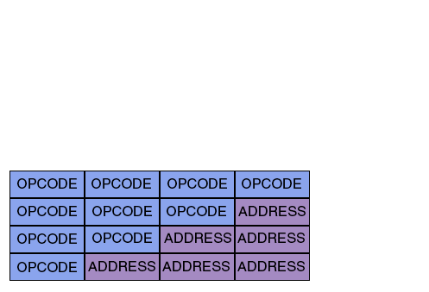
Instruction Format
1> Zero-Address Instruction
2>One -Address Instruction
3>Two-Address Instruction
4>Three-Address Instruction
1>Zero-Address Instructions: ALRM,IL_ALRM,DSPLY,RET
2>One-Address Instructions : JNE,JGE,JLE,MSF,LABEL,JMP,MAIL,
OPEN,CLOSE,RECEIPT
3>Two-Address Instructions: MOV,ADD,SUB,IN,OUT,CMP,LOGIN,
FGTPASS
4>Three-Address Instructions : RESET

Slide 9
Instruction Design
We will use Zero, One and Two address instructions(as shown in previous slide).
Zero address instructions will use all 16-bits as its opcode.
Three address instructions will use 12-bits,
Two address instructions will use 8-bits and
One address instructions will use 4-bits for
addressing and remaining will for opcode.

Slide 10
Instruction Design
MOV: 1000 XXXXXX YYYYYY
ADD: 1001 XXXXXX YYYYYY
SUB: 1010 XXXXXX YYYYYY
IN: 1011 XXXXXX YYYYYY
OUT: 1100 XXXXXX YYYYYY
CMP: 1101 XXXXXX YYYYYY
ULOGIN: 1110 XXXXXX YYYYYY
JNE: 1111 0000 XXXXXXXX
JGE: 1111 0011 XXXXXXXX
JLE: 1111 0010 XXXXXXXX

Slide 11
Instruction Design
MSF: 1111 0011 XXXXXXXX
JMP: 1111 0100 XXXXXXXX
MAIL: 1111 0101 XXXXXXXX
OPEN: 1111 0110 XXXXXXXX
CLOSE: 1111 0111 XXXXXXXX
ALRM: 1111 1111 00000000
DSPLY: 1111 1111 00000001
HLT: 1111 1111 00000010

Slide 12
Instruction Types
Data Transfer Instruction: MOV,LOAD
Control Transfer Instruction: MSF,RET,JMP,JGE,JLE,JNE,LABEL,RESET
Comparison Instruction: CMP
Arithmetic Instruction: ADD,SUB
I/O Instruction: IN,OUT,DSPLY,MAIL,RECEIPT
Miscellaneous: OPEN,CLOSE,LOGIN,FGTPASS

Slide 13
Data Types
We are using both numeric and nonnumeric data types.
Numeric data types will be of integer type signed 16 bit value.
Non-Numeric data types will be of 16-bit UNICODE character.
2’s compliment will be used to store negative values

Slide 14
Addressing Modes
Register Addressing Mode : here a register is specified for a memory location which contains the value eg: opcode <reg>, where reg contains any value
CMP
ADD SUB
IN OUT
Immediate Addressing Mode : here operand for the address part actually contains the value
MOV r00,#5;
Direct Addressing Mode : here instruction directly access the memory to load or store data.

Slide 15
Flow of Control Handling
Login()->password check()->open(if correct)->system timer()->sensor()->close()->receipt()
Login()->password check()->Mailing(if 3 times wrong)
Reset password()->Login()->password check()->mailing()
Instructions are successively fetched and decoded from consecutive memory locations. Procedure call will cause the flow of control to be altered, stopping the procedure currently executing and starting the called procedure.
The current address of the instruction where procedure call is made is transferred to top of stack register through msf and when ret statement is encountered in called procedure the control is transferred to the memory location present in top of stack.

Slide 16
DATAPATH
A data-path is a collection of functional units, such as arithmetic logic units or multipliers, that perform data processing operations, registers, and buses. Along with the control unit it composes the central processing unit.

Slide 17
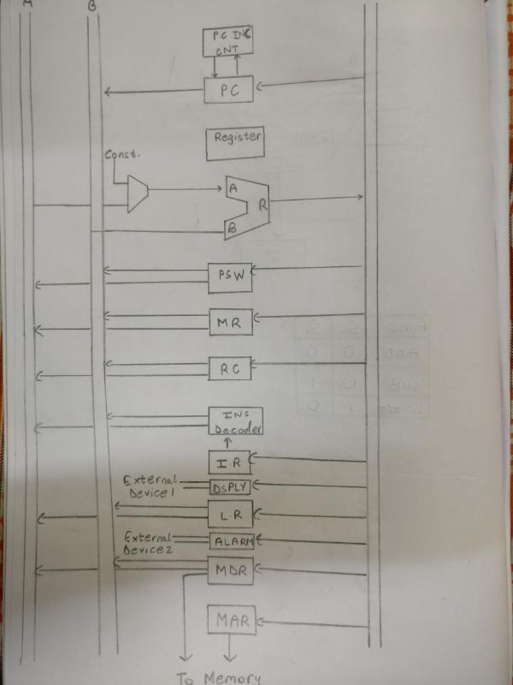

Slide 18
ALU
An arithmetic logic unit (ALU) is a digital circuit used to perform arithmetic and logic operations. It represents the fundamental building block of the central processing unit (CPU) of a computer. Modern CPUs contain very powerful and complex ALUs

Slide 19
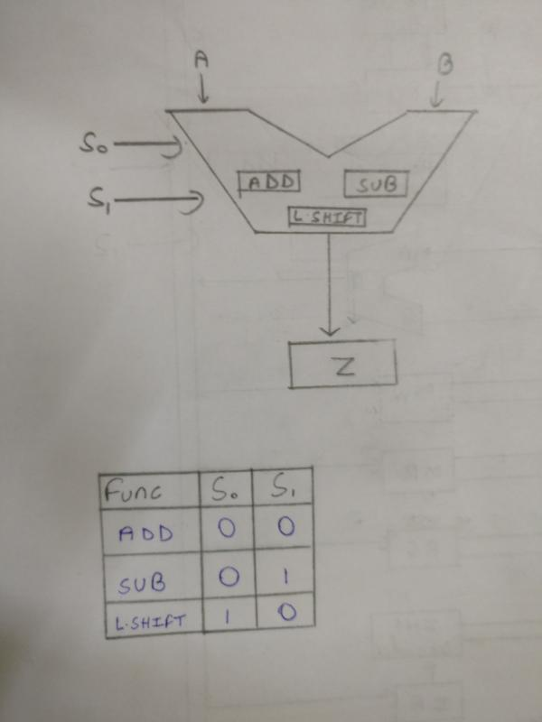

Slide 20
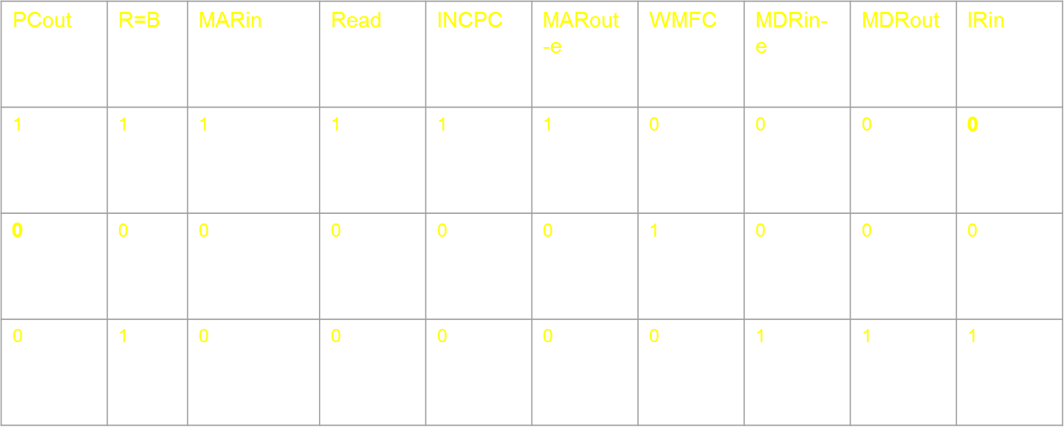
MICROINSTRUCTIONS
1. FETCH CYCLE
PC_{out} , R=B , MAR_{in} , Read , IncPC
WMFC
MDR_{outB} , R=B , IR_{in}

Slide 21
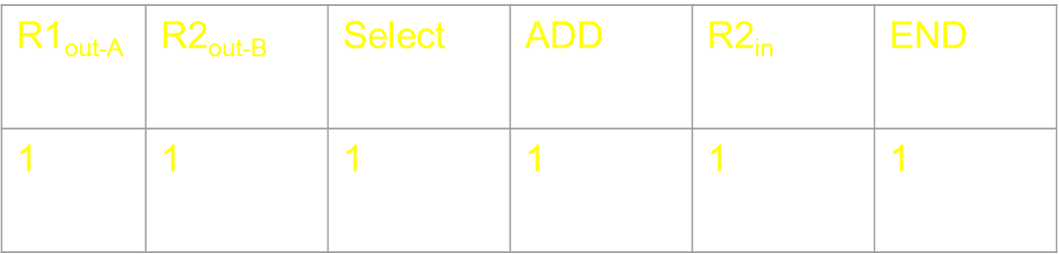
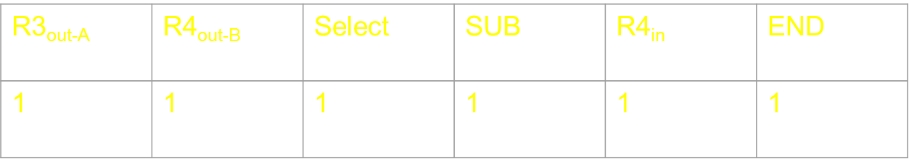
2. ADD R1,R2, R1_{out-A,} R2_{out-B,} SELECT A, ADD, R2_{in,} END Micro programmed control signal:-
3. SUB R3,R4, R3_{out-A,} R4_{out-B,} SELECT A, SUB, R4_{in,} END

Slide 22
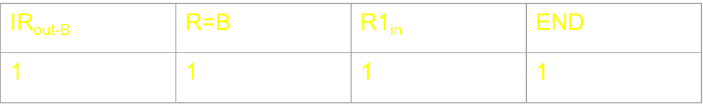
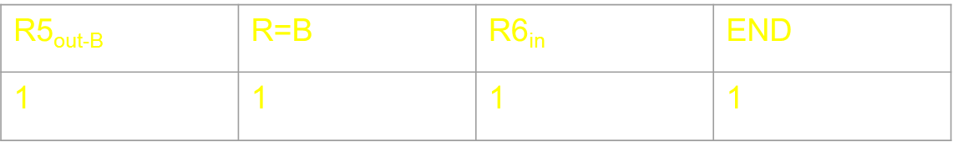
4. MOV R5, #K (value), Immediate value of IR_{out-B,} R=B, R1_{in,} END
5. MOV R5,R6, R5_{out-B,} R=B, R6_{in,} END

Slide 23
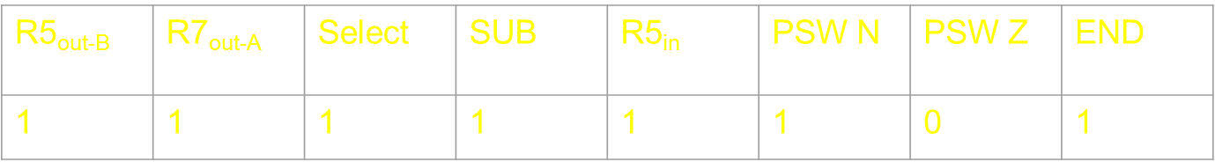
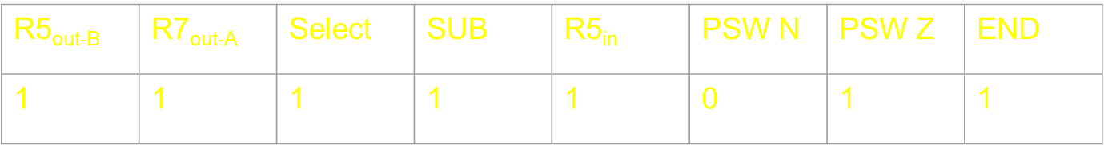
6.CMP R5,R7,
R5_{out-B,} R7_{out-A,} SELECT A, SUB, R5_{in}, END If R5 < 0 then PSW(N) = 1 If R5 = 0 then PSW(Z) = 1

Slide 24
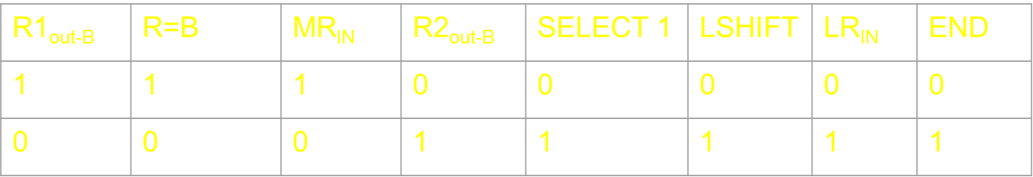
6. ULOGIN R1,R2,
R1_{out-B,} R=B, MR_{IN}
R2_{out-B,} SELECT 1, LSHIFT, LR_{IN,} END

Slide 25
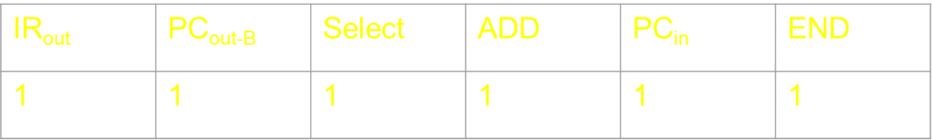
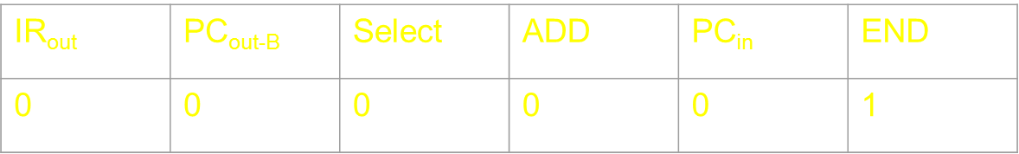
8. JMP L0
Offset field of IR_{out-A}(L0), PC_{out-B}, SELECT A, ADD, PC_{in} , END
9. JNE L0
IF Z = 1 END IF Z = 0 Offset field of IR_{out-A}(L0), PC_{out-B}, SELECT A, ADD, PC_{in} , END

Slide 26
10.JLE L0 IF N = 0 AND Z = 0 THEN END IF N = 1 OR Z = 1 THEN
Offset field of IR_{out-A}(L0), PC_{out-B}, SELECT A, ADD, PC_{in} , END

Slide 27
11.JGE L0
IF N = 1 THEN END
IF N = 0 THEN Offset field of IR_{out-A}(L0), PC_{out-B}, SELECT A, ADD, PC_{in} , END

Slide 28
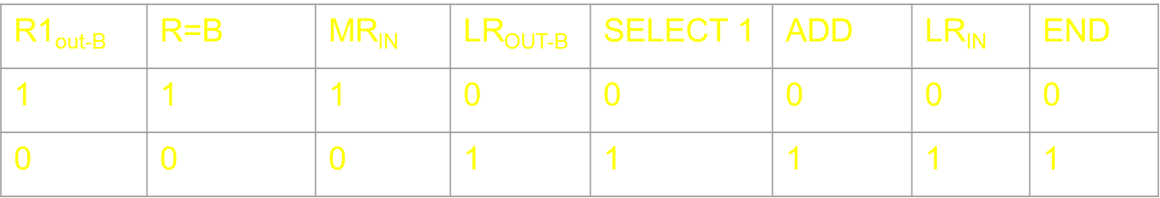
13. OPEN R1,
R1_{OUT-B}, R=B, MR_{IN}
LR_{OUT-B}, SELECT 1, ADD, LR_{IN}, END
12. MAIL R1,
PC_{out-B} , Offset IR_{out-A ,} SELECT A, ADD, MAR_{IN-E},
MR_{OUT}, R=B, MDR_{IN},MDR_{OUT-E}, END
PCout-B | IR_{OUT-A} (OFFSET) | SELECT A | ADD | MARIN-E | MR_{OUT} | R=B | MDRIN-E | MAR_{OUT-E} | END
1 | 1 | 1 | 1 | 1 | 0 | 0 | 0 | 0 | 0
0 | 0 | 0 | 0 | 0 | 1 | 1 | 1 | 1 | 1

Slide 29
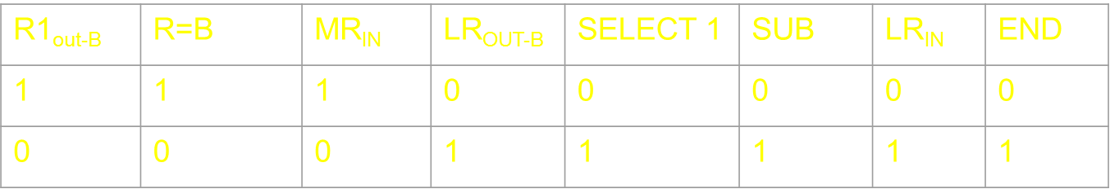
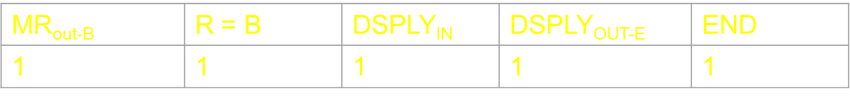
13. CLOSE R1,
R1_{OUT-B}, R=B, MR_{IN}
LR_{OUT-B}, SELECT 1, SUB, LR_{IN}, END
13. DSPLY
MR_{OUT-B}, R=B, DSPLY_{IN ,} DSPLY_{OUT-E}, END

Slide 30
13. ALARM
ALARM, END
ALARM | END
1 | 1
14. HLT
END
END
1

Slide 31
THE END

