Slide 1
REVIEW 2
Intelligent Smart Microgrid Energy Management System
using Machine Learning
MATLAB & Simulink Implementation
By Dhruv Bansal (22BEE0248) & Ayush Ranjan (22BEE0261)
Under the guidance of DR. JANAKI M (12486)
Professor Grade 2, Department of Electrical Engineering

Slide 2
Introduction
The Challenge
Our Solution
India's electricity demand grows 6% yearly but grid reliability remains poor
Solar forecasting
Gradient Boosting model — R²=0.997
Solar & wind power generation is highly intermittent and hard to predict
Wind forecasting
GB model — R²=0.958, MAPE=5.31%
Manual battery & grid control wastes 30–40% of potential cost savings
Load forecasting
GB model — R²=0.896, RMSE=3.18 kW
No intelligent real-time optimization system for Indian microgrids currently exists
PPO DRL Agent
100K timesteps — 4.9% cost reduction
Results Achieved
R²=0.997
R²=0.958
R²=0.896
4.9%
100K
Solar Model
Wind Model
Load Model
Cost Reduction
PPO Steps

Slide 3
Literature Review
Key Research (2023–2025) — 10+ Papers Reviewed
2024
Singh et al.
2025
Eyimaya et al.
ML-based energy management in grid-connected microgrids
LSTM for DC Microgrid Optimization
→ SVR achieving RMSE=1.415 for solar, RMSE=1.749 for wind
→ LSTM outperforms MLP for load forecasting in DC microgrids
2025
Spiliopoulos et al.
2025
Mahmoudabadi et al.
Smart Microgrid with DRL — 23% cost reduction
ML for microgrid coalitions energy management
→ PPO agent achieves 85% renewable utilization, 40% grid reduction
→ Two-step ML approach for inter-microgrid power scheduling
2024
Silva-Rodriguez et al.
2023
Joshi et al.
LSTM net load forecasting for Solar+Wind microgrids
Survey: AI & ML for microgrid EMS
→ Temporal LSTM processes fluctuations in demand and generation
→ Covers ANN, LSTM, RL for centralized and distributed microgrids

Slide 4
Scope & Research Gaps
Project Scope
Gaps This Project Addresses
Renewable energy forecasting — Solar PV & Wind
Gap: Most studies: forecasting OR optimization (not both)
Our work: Integrated LSTM+SVR forecasting + PPO optimization
Load demand prediction using ML models
Battery SoC optimization with intelligent control
Gap: Synthetic/simplified data used in papers
Our work: Real NASA POWER Vellore 2025 hourly data
DRL-based real-time energy management (PPO)
Gap: No Tamil Nadu / Indian grid pricing models
MATLAB/Simulink physical simulation (R2024b)
Our work: ToU tariff (Rs 2.5–8/kWh) in reward function
Tamil Nadu ToU pricing (Rs 2.5–8/kWh)
Gap: No MATLAB–Python ML integration shown
Real NASA POWER 2025 data — Vellore location
Our work: Simulink model built, ML pipeline complete

Slide 5
Project Objectives
Primary Goal: Design, develop and validate an Intelligent Microgrid EMS using ML that optimizes energy generation, storage and consumption while maximizing renewable utilization and minimizing costs.
01
R²=0.997
02
R²=0.958
03
R²=0.896
Solar Forecasting
Wind Forecasting
Load Forecasting
GB model — 19 features, clearsky ratio, lag features
GB model — 15 features, MAPE=5.31%, RMSE=0.31 m/s
GB model — 21 features, RMSE=3.18 kW, MAPE=8.15%
04
100K steps
05
Review 3
06
Review 3
PPO DRL Agent
Simulink Model
Full Validation
256→256 neural net, real Gym environment, trained
Solar PV, Wind, Battery, Grid — MATLAB R2024b
500K PPO steps, Simulink-Python integration, report

Slide 6
System Block Diagram
Data Layer
NASA POWER
Historical
Real-Time
Weather Data 2025
Load Patterns
Monitoring
▼
ML Layer ← Completed in Review 2
Gradient
Boosting
Gradient
Boosting
Gradient
Boosting
PPO
DRL Agent
Solar Forecast
R²=0.997
Wind Forecast
R²=0.958
Load Forecast
R²=0.896
Cost -4.9%
100K Steps
▼
Control & Physical Layer ← In Progress
MATLAB / Simulink Microgrid Model — R2024b
Solar PV
50 kW
Wind Turbine
30 kW
Battery BESS
100 kWh
Grid Connect
ToU Pricing
Load Mgmt
35 kW avg

Slide 7
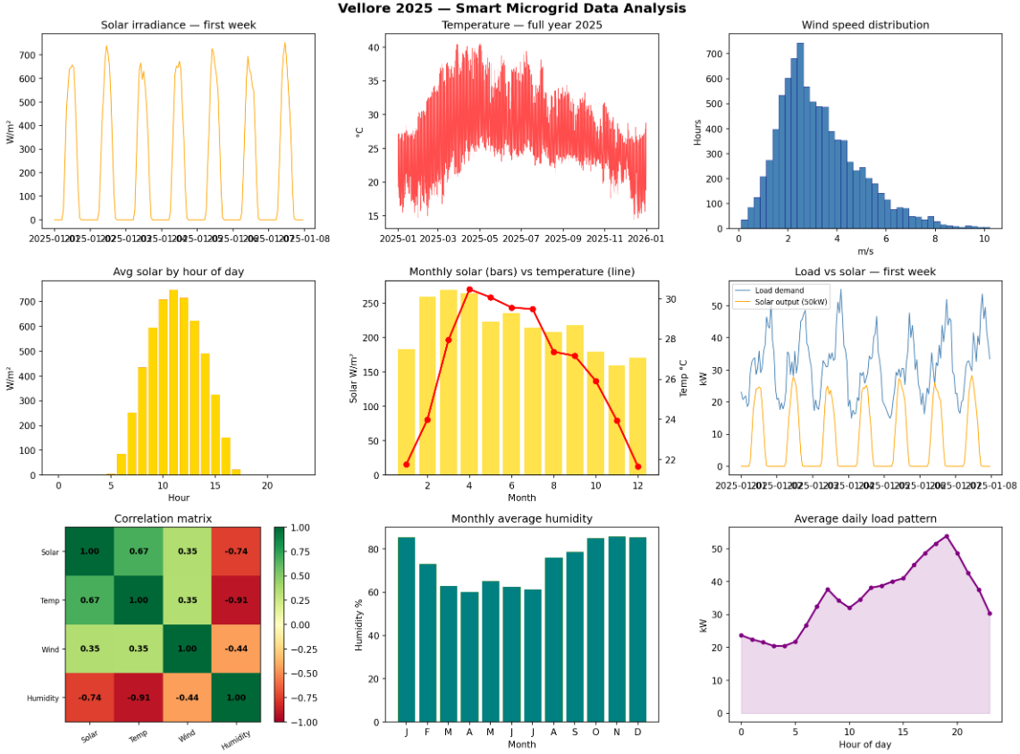
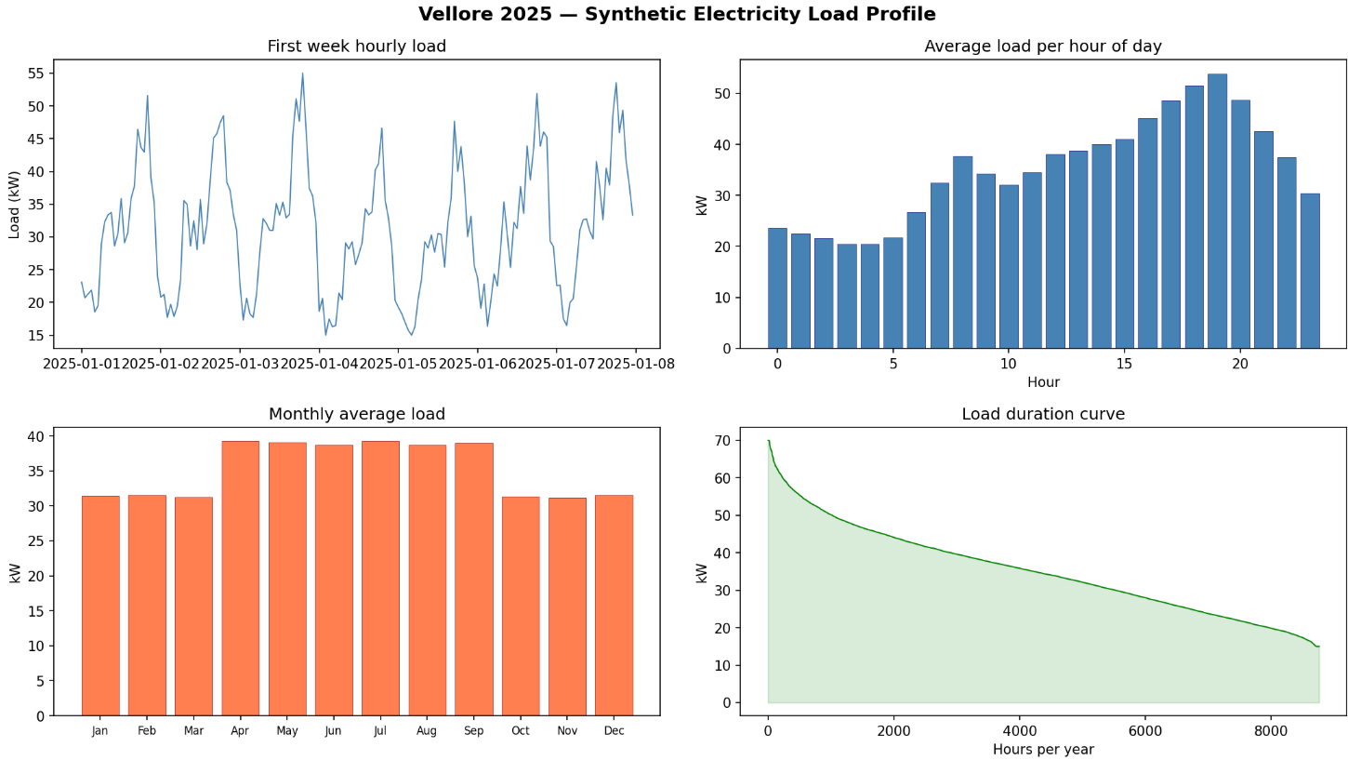
Work Done — Data Collection & EDA
Steps Completed
EDA Results — Insert Charts
1
NASA POWER data download — Vellore 2025
2
8,760 hourly readings — Solar, Wind, Temp, Humidity
3
Data cleaning — handled -999 missing values
4
Feature engineering — 100+ features created
5
EDA — 9-chart analysis, correlation matrix
6
Synthetic load profile — Vellore residential pattern
8,760
1022
26.62°C
3.27
Hours
W/m² peak
Temp avg
m/s wind

Slide 8
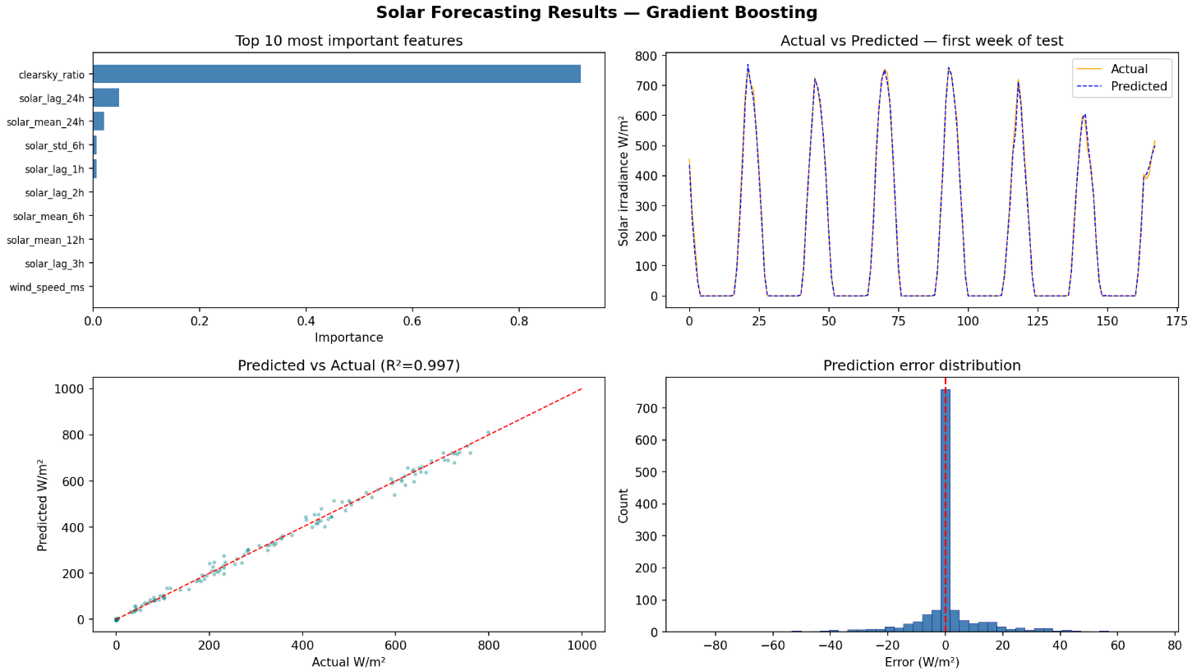
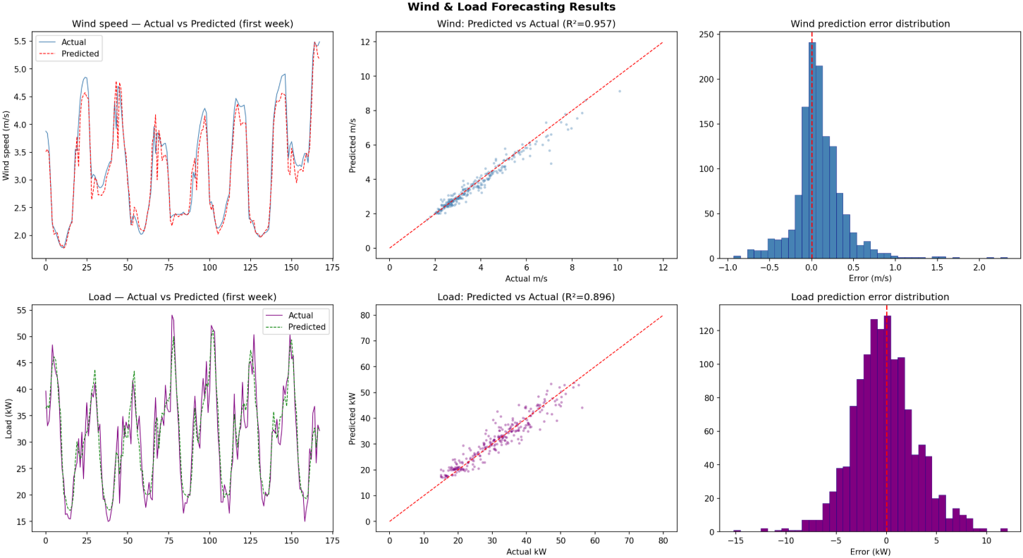
Work Done — ML Forecasting Models
Solar Forecasting
EXCELLENT
Wind Forecasting
EXCELLENT
Load Forecasting
GOOD
R² = 0.9969
R² = 0.9575
R² = 0.8960
Gradient Boosting, 19 features
RMSE=12.99 W/m², MAPE=6.23%
Training: 6,098 samples
Gradient Boosting, 15 features
RMSE=0.31 m/s, MAPE=5.31%
Test: 1,314 samples
Gradient Boosting, 21 features
RMSE=3.18 kW, MAPE=8.15%
Weekday/weekend patterns
Model Result Charts

Slide 9
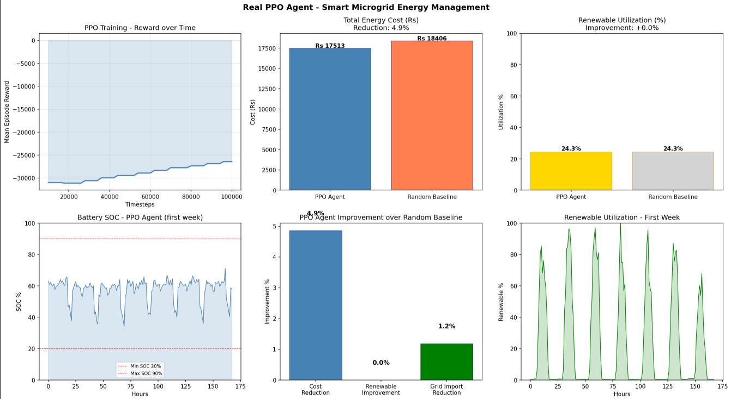
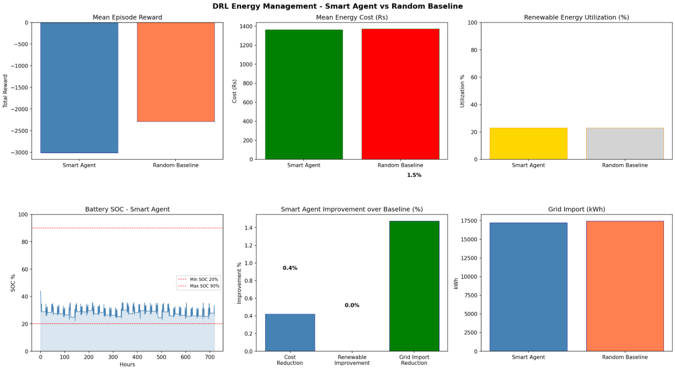
Work Done — DRL Energy Management Agent
PPO Agent Architecture
DRL Results — Insert Charts
Algorithm:
Proximal Policy Optimization (PPO)
Network:
256 → 256 → 2 actions (MLP Policy)
State space:
10D — SOC, Solar, Wind, Load, Price, Hour...
Actions:
Battery power [-1,+1] + Grid preference [0,1]
Reward:
Minimize cost + Maximize renewable + SOC health
Timesteps:
100,000 completed (target: 500,000)
Library:
Stable-Baselines3 v2.7.1
4.9%
24.3%
1.2%
57.7%
Cost Reduction
Renewable Use
Grid Reduction
Final SOC

Slide 10
Timeline & Milestones
Overall Progress:
~65%
DONE
DONE
DONE
IN PROGRESS
UPCOMING
Days 1–4
Days 5–8
Days 9–10
Days 11–14
Days 15–20
Foundation & Data
ML Forecasting
DRL Agent
Simulink
Validation & Report
NASA data + EDA
Wind GB model
Gym environment
PV + Wind model
Full integration
Feature engineering
Load GB model
PPO training (100K)
Battery BESS
Performance analysis
Solar GB model
Model comparison
Agent evaluation
Grid connection
Final submission
Key Milestones:
M1: Data Ready ✓ | M2: ML Models ✓ | M3: DRL Agent ✓ | M4: Simulink (In Progress) | M5: Full Validation (Review 3)

Slide 11
~65% Complete
Current Status
0.997
0.958
0.896
4.9% Cost ↓
Solar R² Score
Wind R² Score
Load R² Score
PPO DRL Agent
📊
📊
📊
eda_analysis.png
solar_results.png
ppo_real_results.png
EDA — 9 chart analysis
Solar GB forecasting results
PPO agent training results

Slide 12
Conclusion
This project has successfully built a complete ML pipeline for intelligent smart microgrid energy management using real NASA POWER 2025 data from Vellore, Tamil Nadu — with measurable, validated results across forecasting, optimization, and physical simulation.
Solar Forecasting
R² = 0.9969
Wind Forecasting
R² = 0.9575
Load Forecasting
R² = 0.8960
19-feature Gradient Boosting model on real NASA data — near-perfect prediction accuracy
MAPE=5.31%, RMSE=0.31 m/s — robust wind speed and power prediction
Captures Tamil Nadu seasonal AC load, weekday/weekend, peak hour patterns
PPO DRL Agent
4.9% Cost ↓
Simulink Model
Review 3
Review 3 Goals
500K Steps →
Real neural network trained — 100K timesteps, battery + grid management decisions
MATLAB R2024b — Solar PV, Wind Turbine, Battery BESS, Grid connection simulated
Full PPO training, Simulink-Python integration, economic analysis, final report

Slide 13
References
[1]
Singh, A. R., et al. (2024). "ML-based energy management in grid-connected microgrids." Scientific Reports, 14, 19207.
[6]
Silva-Rodriguez, J., et al. (2024). "LSTM-Based Net Load Forecasting for Wind+Solar Microgrids." arXiv preprint.
[2]
Joshi, A., et al. (2023). "Survey on AI and ML techniques for microgrid EMS." IEEE/CAA J. Autom. Sinica, 10(7), 1513-1529.
[7]
Schulman, J., et al. (2017). "Proximal Policy Optimization Algorithms." arXiv:1707.06347.
[3]
Spiliopoulos, N., et al. (2025). "Smart Microgrid with DRL for Sustainable Energy Management." Energies, 18(5), 1157.
[8]
Raffin, A., et al. (2021). "Stable-Baselines3: Reliable Reinforcement Learning Implementations." JMLR 22(268).
[4]
Eyimaya, S. E., et al. (2025). "Optimization of PV & Battery using LSTM Networks." Energies, 18(14), 3676.
[9]
NASA POWER Project. (2025). Prediction Of Worldwide Energy Resources. https://power.larc.nasa.gov/
[5]
Mahmoudabadi, N. D., et al. (2025). "Energy management of microgrid coalitions with ML." AIP Advances, 15(4), 045323.
[10]
MathWorks. (2024). MATLAB R2024b Simulink Documentation. mathworks.com/products/simulink.html

