Slide 1
UIDAI Hackathon
Team Reference ID :rNPggL9LO9
Team Member Details
Sl No | Name | E Mail ID
1 | Mustafa | mustafa.ali.lohawala@gmail.com
2. | Ayush Singhal | f20170605@pilani.bits-pilani.ac.in

Slide 2
About the Problem Statement
Theme : Address Update
Problem Statement 3:Address Formatting API

Slide 3
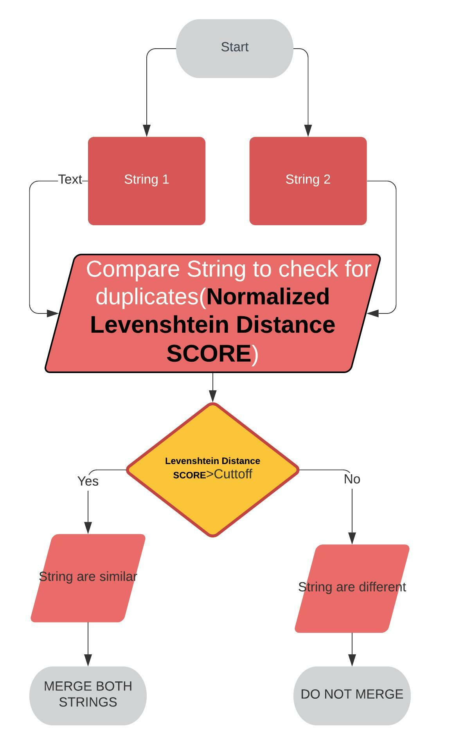
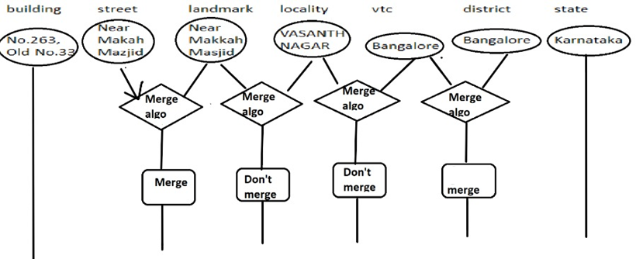
Approach
MERGE ALGORITHM
No.263, Old No.33 | Near Makkah Masjid | VASANTH NAGAR | Bangalore | Karnataka

Slide 4
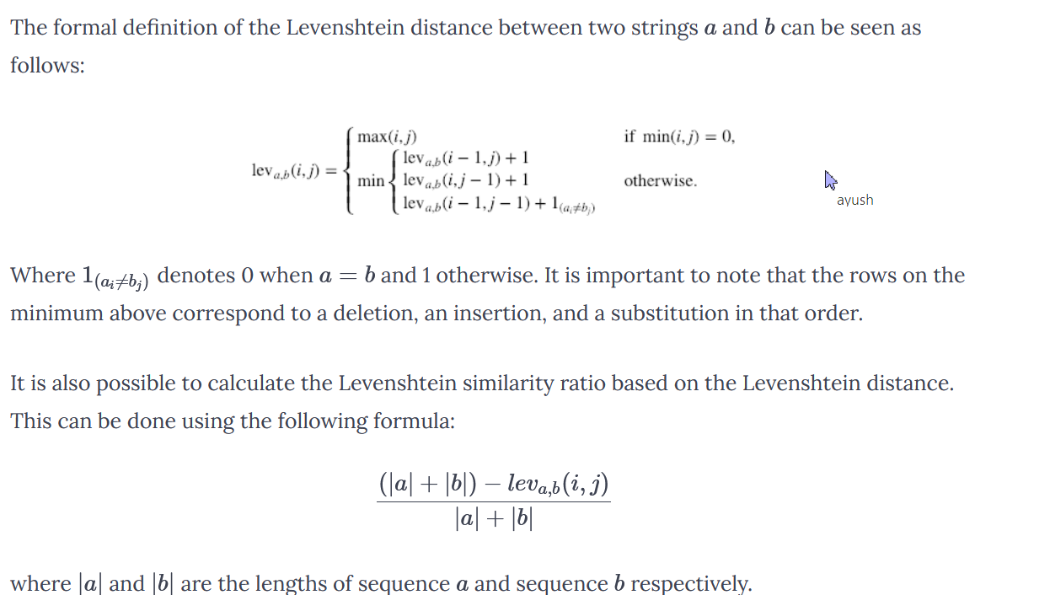
The Levenshtein Distance Score(Used FUZZ SCORE IN FUZZY WUZZY LIBRARY PYTHON )
The Levenshtein distance is a metric to measure how apart are two sequences of words. In other words, it measures the minimum number of edits that you need to do to change a one-word sequence into the other. These edits can be insertions, deletions or substitutions.

Slide 5
Integrated Local Language Support
Used Google’s Translate API for testing.
Before Comparing scores Algo converts Local language into English Using Translate API. But results comes out in Local language it self
Tested for Local Languages.
For Full scale usage google’s API subscription needs to be taken.

Slide 6
LANGUAGE | LANGUAGE CODE
Assamese | 01
Bengali | 02
Gujarati | 05
Hindi | 06
Kannada | 07
Malayalam | 11
Manipuri | 12
Marathi | 13
Oriya | 15
Punjabi | 16
Tamil | 20
Telugu | 21
Urdu | 22
Google translate API was used in our project which doesn’t support red highlighted languages

Slide 7
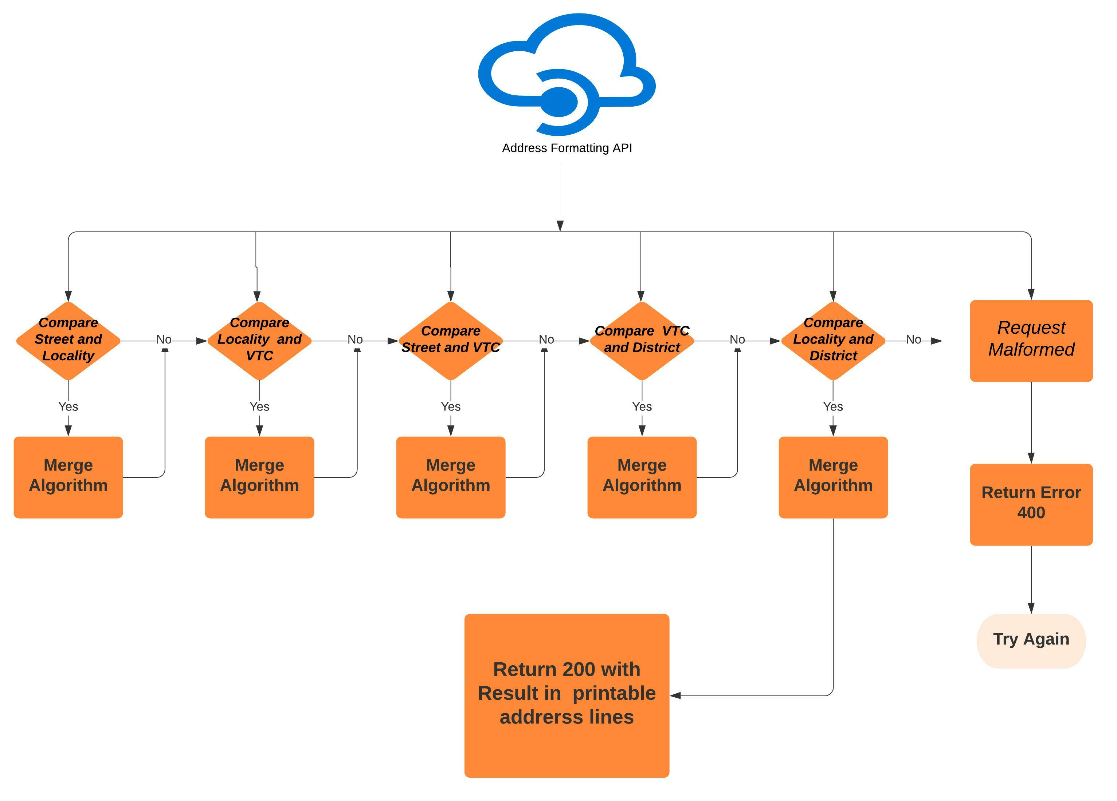
Architectural Diagram

Slide 8
API
For translation googletrans was used which uses google translate API
API was written in python using Flask
The API has two POST method one with /address as endpoint and other with /addressLang as endpoint. The /addressLang endpoint Formats the address for the input by considering language code as well (It expects langcode in JSON. If langcode is not provided then it considers it as english).

