Slide 1

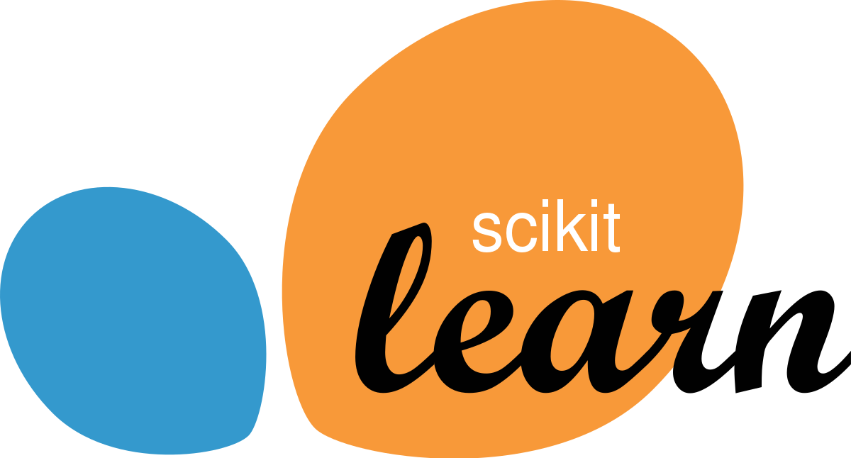
Blood Donation Prediction
Project Id:- PRCP-1011-BloodDonaPred
Project Team Id:- 1107
Team Members:-
Ayush Mehta
Ali Hasan

Slide 2
INTRODUCTION
The model will predict that the person will donate blood for the next time of not.
It is a classification type problem.
To perform blood donation prediction, some basic knowledge on supervised learning methods, data balancing methods and mainly Logistic regression and Random forest algorithms is needed.

Slide 3
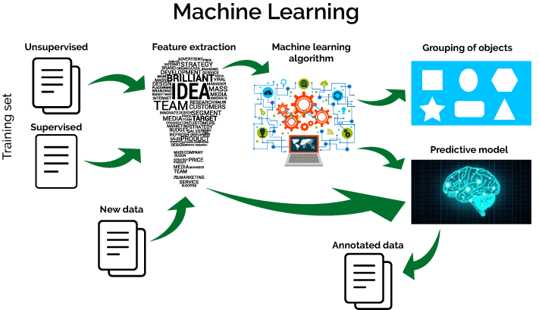
Machine Learning
Machine Learning (ML) is all about algorithms that can tell you something about a set of data without you having to write any custom code specific to the problem; i.e., instead of writing code, you feed data to the generic algorithm and it builds its own logic based on the data.

Slide 4
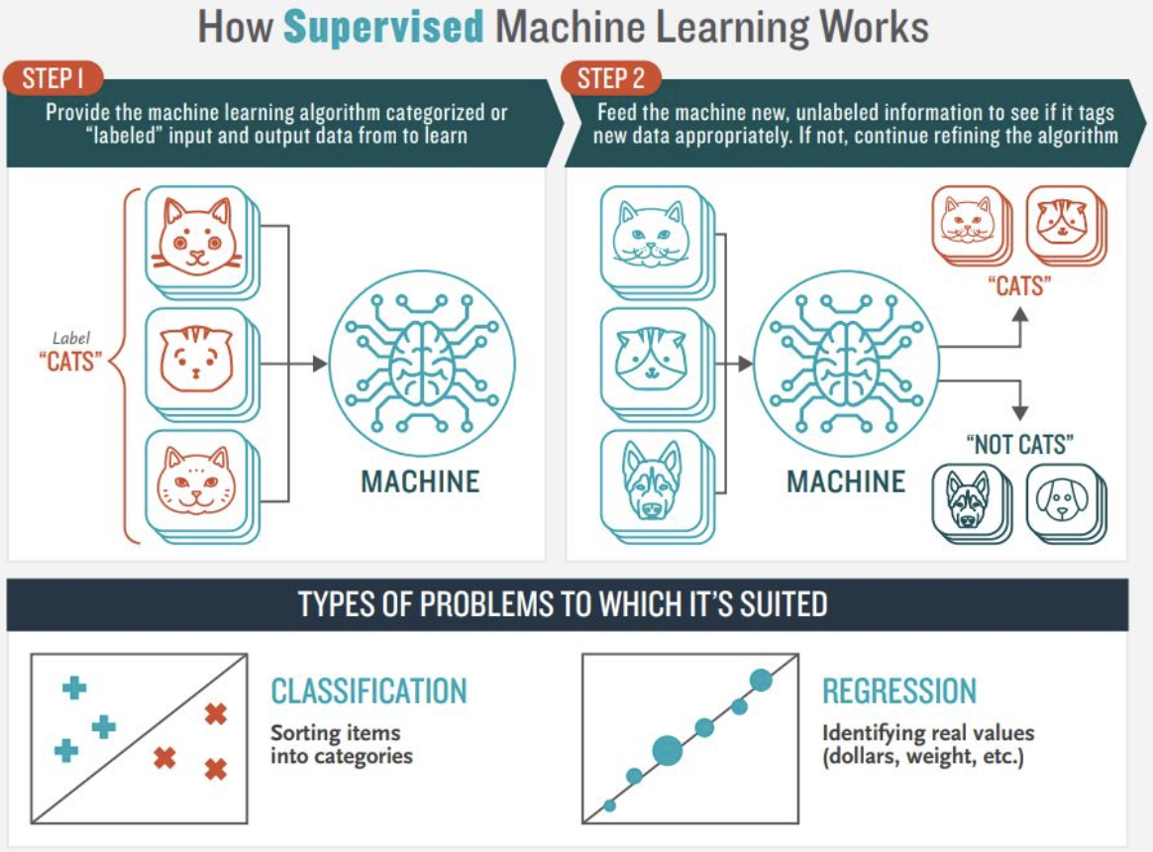
Supervised Learning
Supervised Learning is done using a ground truth, i.e., we have prior knowledge of what the output values for our samples should be. Hence, the goal of supervised learning is to learn a function that, given a sample of data and desired outputs, best approximates the relationship between input and output observable in the data.

Slide 5

Random Forest
Random Forest is a popular machine learning algorithm that belongs to the supervised learning technique. It can be used for both Classification and Regression problems in ML. It is based on the concept of ensemble learning, which is a process of combining multiple classifiers to solve a complex problem and to improve the performance of the model.
Random Forest is a classifier that contains a number of decision trees on various subsets of the given dataset and takes the average to improve the predictive accuracy of that dataset.

Slide 6
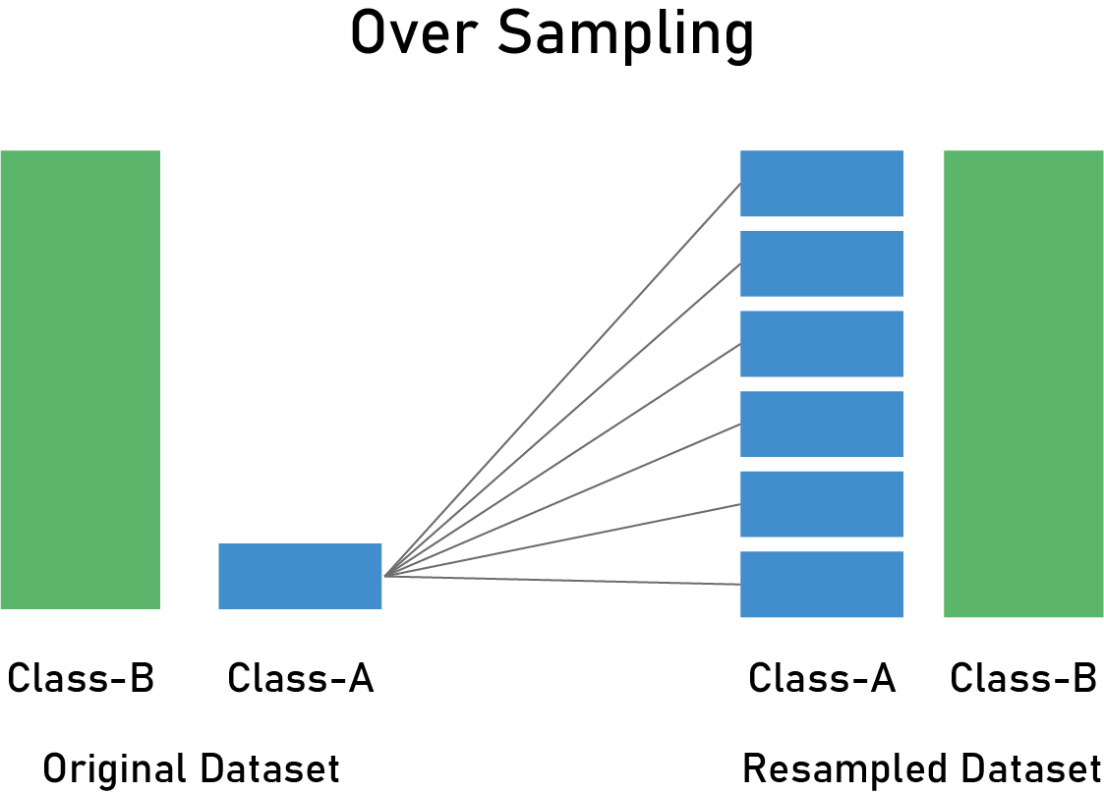
Resampling
There are multiple ways to handle the issue of imbalanced datasets. The techniques we’re going to use in this tutorials is called resampling.
Resampling is a widely-adopted technique for dealing with imbalanced datasets, and it is often very easy to implement, fast to run, and an excellent starting point.
Resampling changes the dataset into a more balanced one by adding instances to the minority class or deleting ones from the majority class, that way we build better machine learning models.
Oversampling: This method adds copies of instances from the under-represented class (minority class) to obtain a balanced dataset. There are multiple ways you can oversample a dataset, like random oversampling.

Slide 7
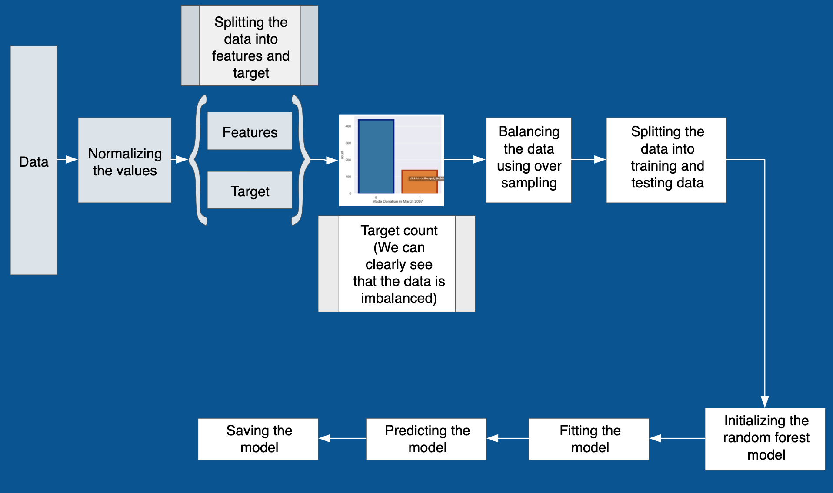
Our Model

Slide 8
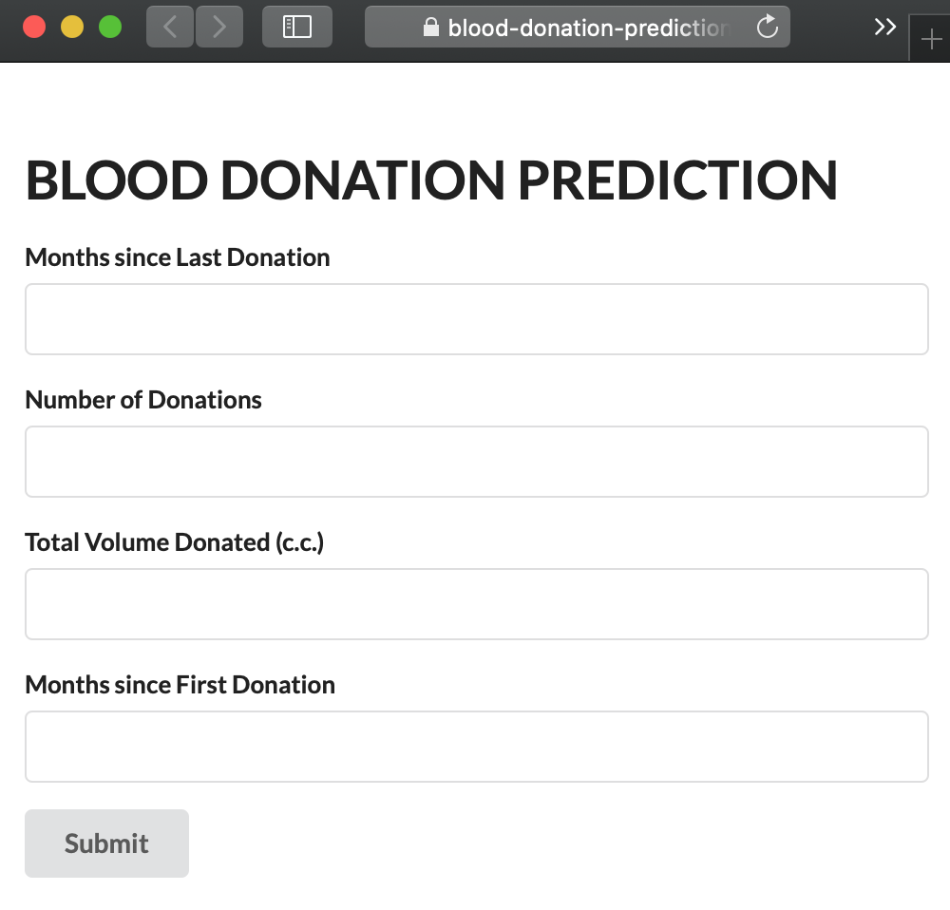
Model Deployment
https://blood-donation-prediction-1.herokuapp.com

Slide 9
Thank You

