Slide 1




Vaccine Prediction
Project Id:- PRCP-1014-VaccinePred
Project Team Id:- 1107
Team Members:-
Ayush Mehta
Ali Hasan

Slide 2
INTRODUCTION
The dataset contains the respondents information about the pandemic survey where they answered if they had received the H1N1 and seasonal flu vaccines.
The goal is to predict how likely individuals are to receive their H1N1 and seasonal flu vaccines.
In specific, the target is to predict two probabilities: one for h1n1_vaccine and one for seasonal_vaccine.

Slide 3
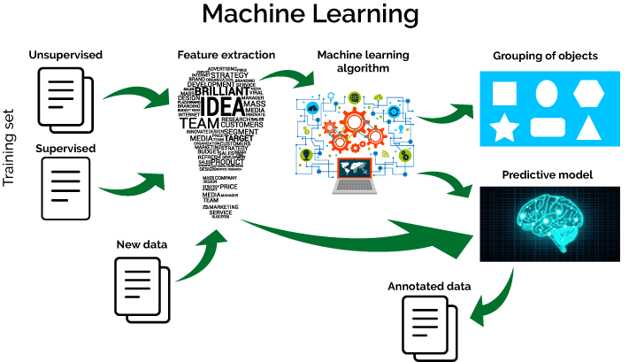
Machine Learning
Machine Learning (ML) is all about algorithms that can tell you something about a set of data without you having to write any custom code specific to the problem; i.e., instead of writing code, you feed data to the generic algorithm and it builds its own logic based on the data.

Slide 4
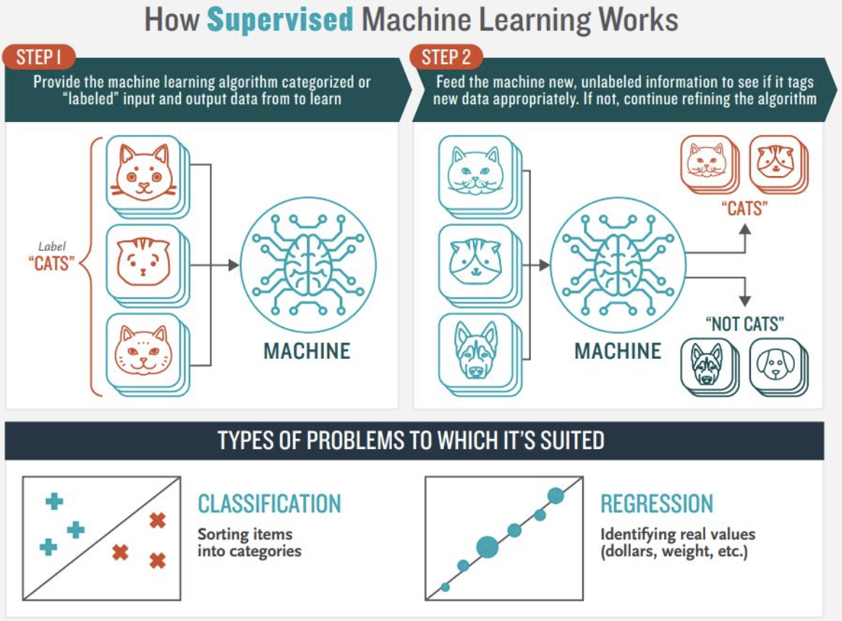
Supervised Learning
Supervised Learning is done using a ground truth, i.e., we have prior knowledge of what the output values for our samples should be. Hence, the goal of supervised learning is to learn a function that, given a sample of data and desired outputs, best approximates the relationship between input and output observable in the data.

Slide 5
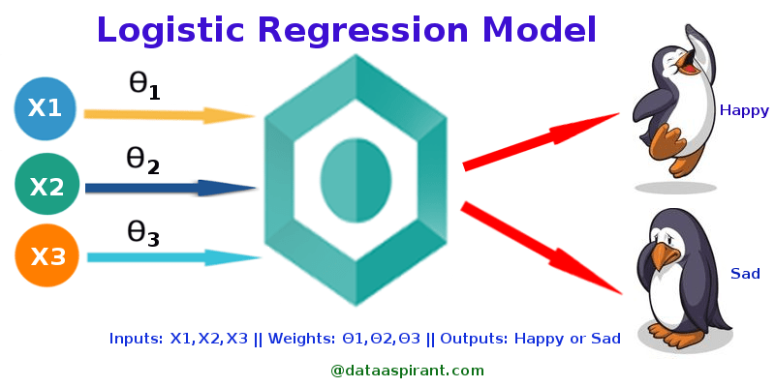
Logistic regression
Logistic regression is a statistical model that in its basic form uses a logistic function to model a binary dependent variable, although many more complex extensions exist.
In regression analysis, logistic regression (or logit regression) is estimating the parameters of a logistic model (a form of binary regression).
Logistic Regression is used when the dependent
variable(target) is categorical.
For example,
To predict whether an email is spam (1) or (0)
Whether the tumour is malignant (1) or not (0)

Slide 6
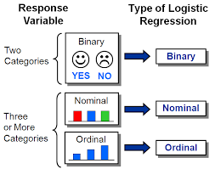
Types of Logistic Regression
1. Binary Logistic Regression
The categorical response has only two 2 possible outcomes. Example: Spam or Not
2. Multinomial Logistic Regression
Three or more categories without ordering. Example: Predicting which food is preferred more (Veg, Non-Veg, Vegan)
3. Ordinal Logistic Regression
Three or more categories with ordering. Example: Movie rating from 1 to 5

Slide 7
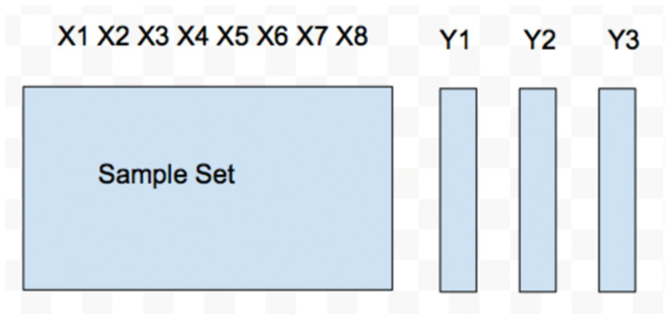
Multi-Output Regression Models
Multioutput regression are regression problems that involve predicting two or more numerical values given an input example.
An example might be to predict a coordinate given an input, e.g. predicting x and y values.
8 Features
and 3 targets

Slide 8
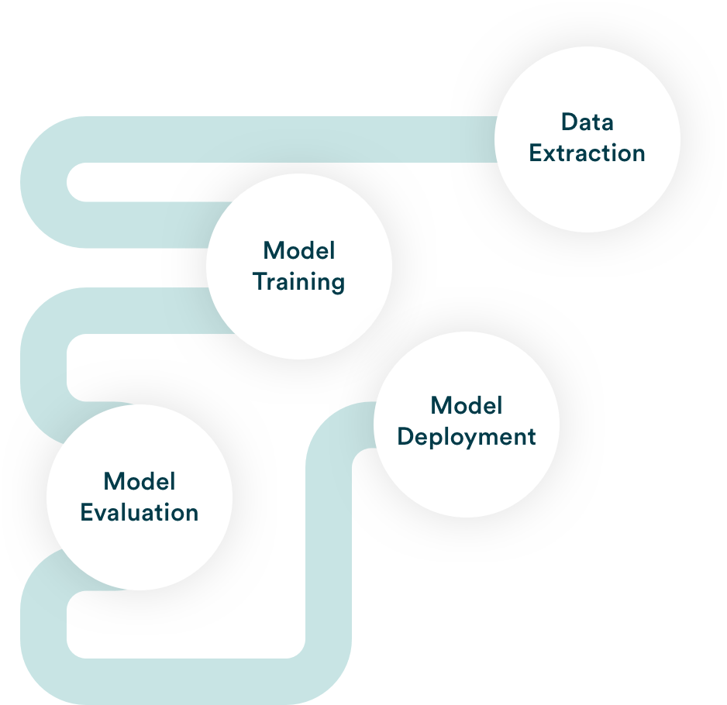
Pipeline
One definition of an ML pipeline is a means of automating the machine learning workflow by enabling data to be transformed and correlated into a model that can then be analysed to achieve outputs. This type of ML pipeline makes the process of inputting data into the ML model fully automated.
Another type of ML pipeline is the art of splitting up your machine learning workflows into independent, reusable, modular parts that can then be pipelined together to create models. This type of ML pipeline makes building models more efficient and simplified, cutting out redundant work.

Slide 9
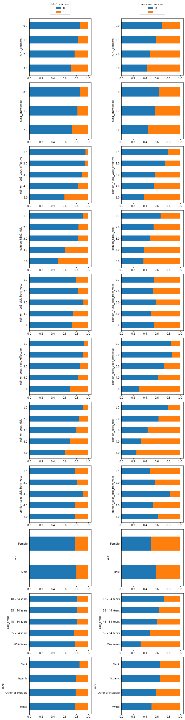
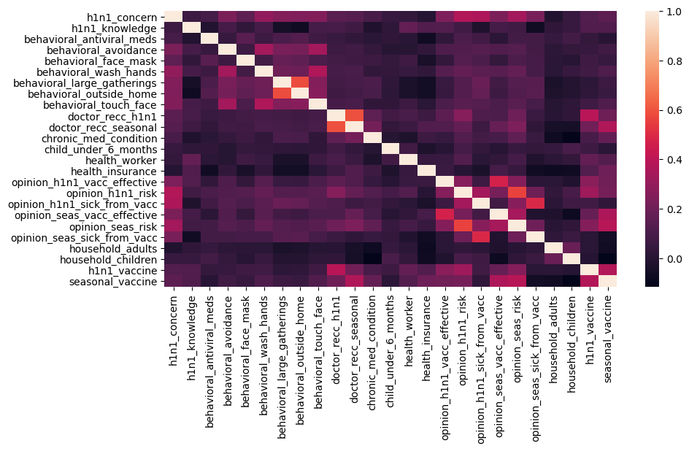
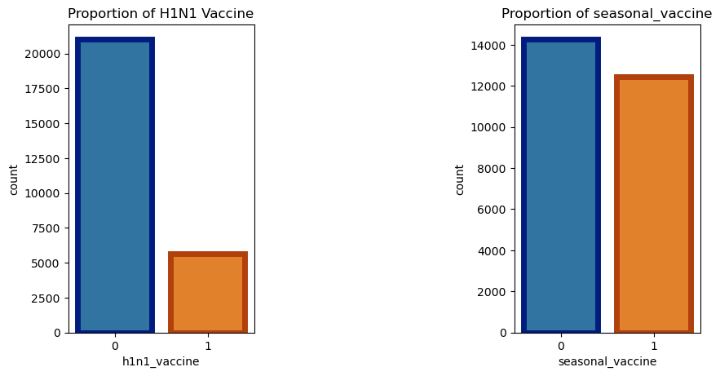
EDA
Finding relationship between features and the labels.
Finding correlations between the features.
Finding the count of the labels.

Slide 10
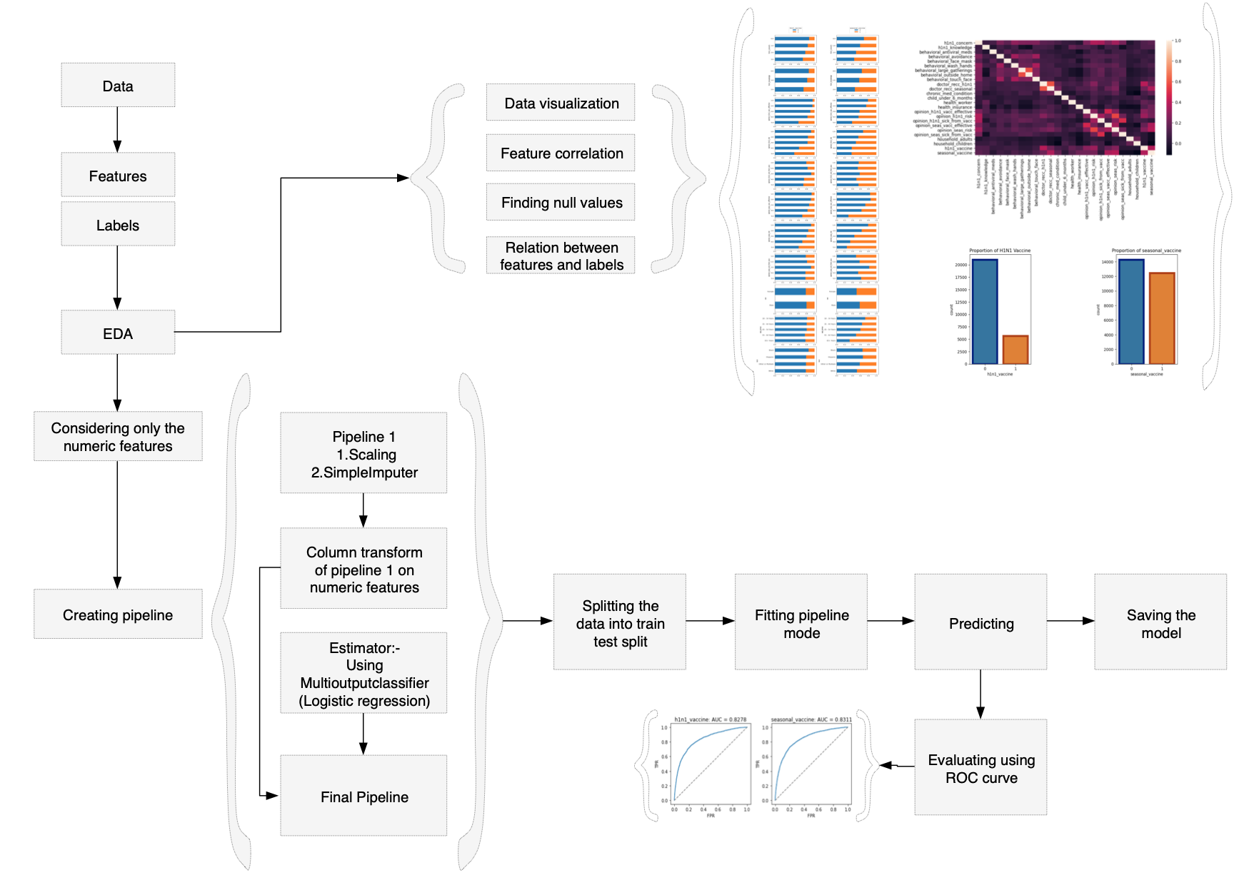
Our Model

Slide 11
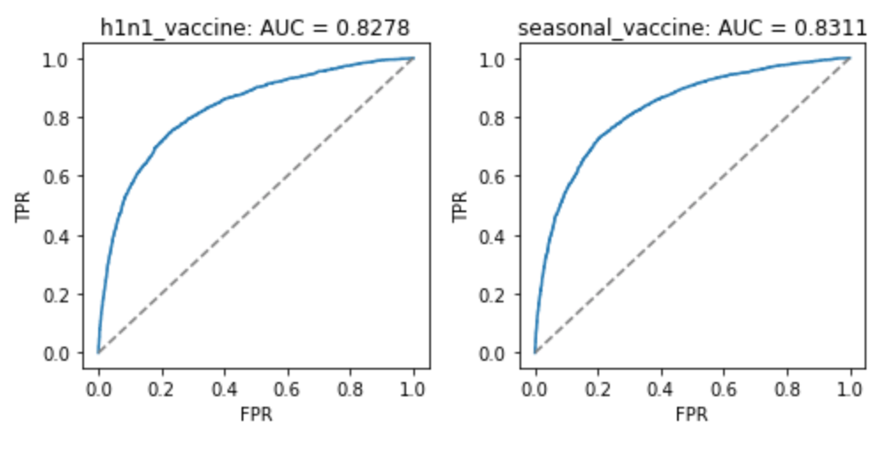
ROC Curve

Slide 12
Thank You

