Slide 1

smart Attendance system using face recognition
Ayush Gupta (22EC01057) Sreekar Vetsa (22EC01058) Rohan Rudra (22EC01055)

Slide 2
Project Overview
Face Detection Used a custom-trained YOLO 11l model on the WIDER FACE dataset to detect faces in images.
01
Feature Extraction Employed InsightFace (Buffalo_L model) to generate 512-dimensional embeddings for each detected face.
02
Face Matching Compared extracted embeddings with precomputed reference embeddings using cosine similarity to identify known individuals.
03

Slide 3
YOLO 11l (You Only Look Once)
What is YOLO?
YOLO is a real-time object detection algorithm that detects and classifies objects in images using a single neural network pass.
How does YOLO work?
The input image is divided into a grid. Each grid cell predicts bounding boxes, confidence scores, and class probabilities for objects whose centers fall inside the cell. All predictions are made simultaneously in one forward pass, making YOLO extremely fast.
Key Features:
Single-stage detection: Unlike older methods that use multiple steps, YOLO predicts all bounding boxes and classes in one go, which greatly improves speed.
Speed and real-time performance: YOLO can process images at high frame rates (up to 45 FPS or more), making it suitable for real-time applications like surveillance and autonomous vehicles.
Accuracy: YOLO achieves high accuracy and low false positives by considering the entire image context during detection

Slide 4
WIDER FACE Dataset
WIDER FACE is a benchmark face detection dataset that contains 32,203 images and 393,703 labeled faces with varying scales, poses, and occlusions.
The dataset is split into training, validation, and testing sets with annotations provided for training and validation.
It includes a wide variety of challenging face detection scenarios, including extreme lighting, expressions, and crowded backgrounds.
Each face is annotated with a bounding box and attributes such as blur, expression, occlusion, and pose.
We used WIDER FACE to train YOLO for robust and accurate face detection across real-world conditions.

Slide 5
Training Steps for Face Detection
Parse WIDER FACE Annotations
Converted WIDER FACE bounding boxes into YOLO format (x_center, y_center, width, height).
Organize Images and Labels
Created separate folders for images and corresponding label text files (for both training and validation sets).
Generate YOLO YAML Config
Defined dataset paths and class names (face) in a YAML file for YOLO training.
Train YOLO Model
Used the YOLO 11l architecture with our dataset, training it for 15 epochs using the Ultralytics YOLO library.
Validate Model on WIDER FACE Val Set
Evaluated the trained model using the validation set and measured metrics like Precision, Recall, AP@0.5, and AP@0.5:0.95

Slide 6
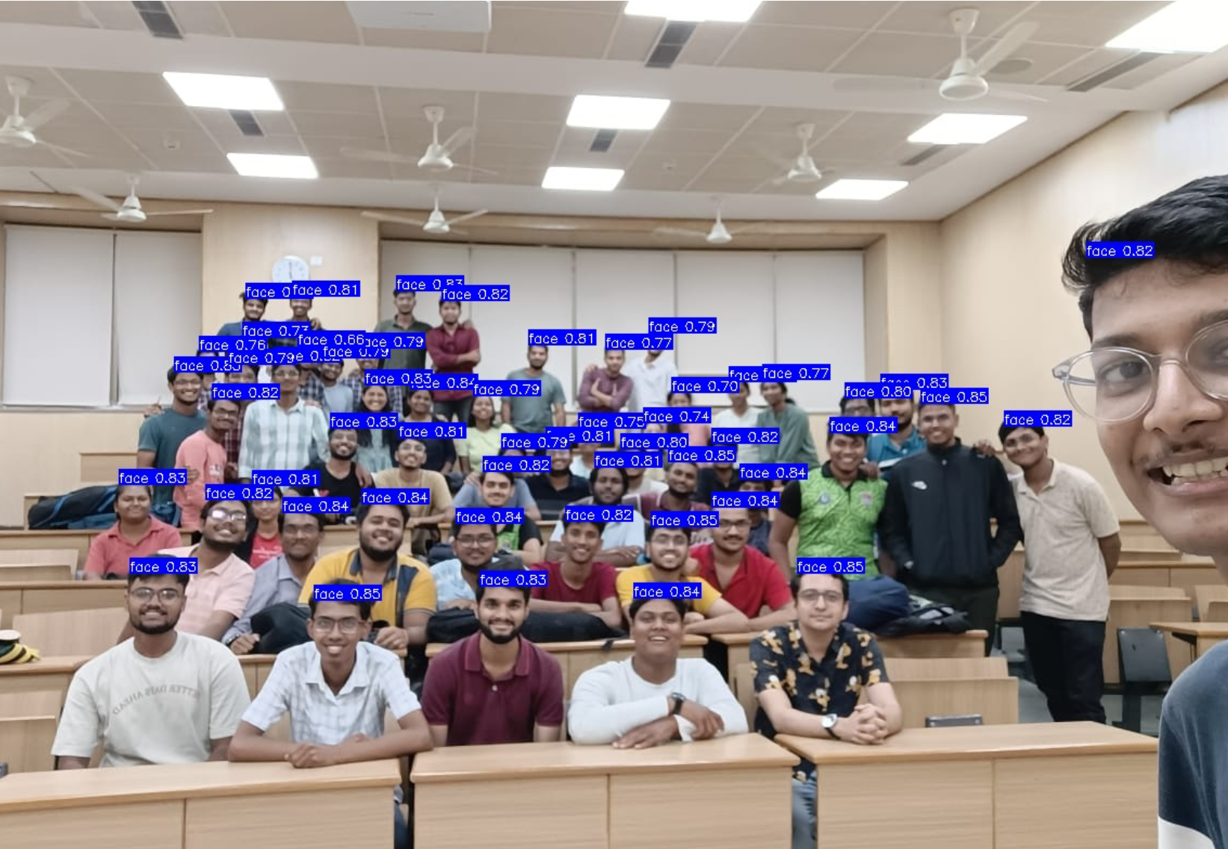
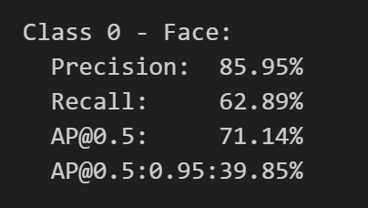
Fig 2: Results from Validation Dateset
Fig 1: Sample Image used for detecting faces

Slide 7
InsightFace – Deep Face Recognition Framework
What is InsightFace?
InsightFace is an open-source deep face analysis toolkit based on state-of-the-art deep learning models. It provides high accuracy, fast performance, and is widely used in research and commercial applications for facial recognition tasks.
Core Capabilities:
Includes face detection, alignment, face recognition (embedding extraction), and age/gender prediction.
Face Embeddings:
Converts faces into 512-dimensional normalized vectors that represent facial features uniquely and compactly.
Models Used:
We used the buffalo_l model from InsightFace which provides accurate embeddings even for cropped or misaligned faces.

Slide 8
Steps for Feature Extraction
Load and Preprocess Image: Read the image using OpenCV and convert it to RGB for processing.
Face Detection using YOLO: Use the custom-trained YOLO model to detect all faces present in the image.
Crop Detected Faces: Extract individual face regions from the image based on YOLO’s bounding boxes.
Initialize InsightFace Model: Set up the buffalo_l model for generating 512-dimensional face embeddings.
Extract Face Embeddings: For each cropped face, compute the normalized face embedding using InsightFace.
Optional Visualization: Optionally display detected face crops for verification and debugging.

Slide 9
Steps for Face Matching
Load Reference Embeddings: Load precomputed embeddings of known individuals from a .pkl file.
Convert to Matrix Format: Convert embeddings into a NumPy array for efficient similarity computation.
Extract Test Image Embeddings: Detect and extract embeddings of all faces from a test image.
Compute Cosine Similarity: Multiply the reference matrix with test embeddings to get similarity scores.
Normalize Similarities: Optionally normalize the similarity matrix for better interpretability.
Threshold-Based Matching: For each reference identity, find the most similar face if it exceeds a set threshold
Display Matching Results: Print which face matched with which identity along with confidence scores.

Slide 10
