Slide 1
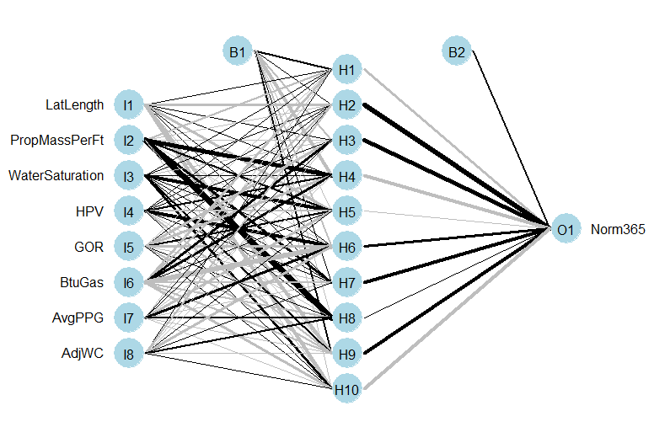
ANN Model DJ Dataset – Inner Core
Ayush Rastogi
Liberty Oilfield Services

Slide 2
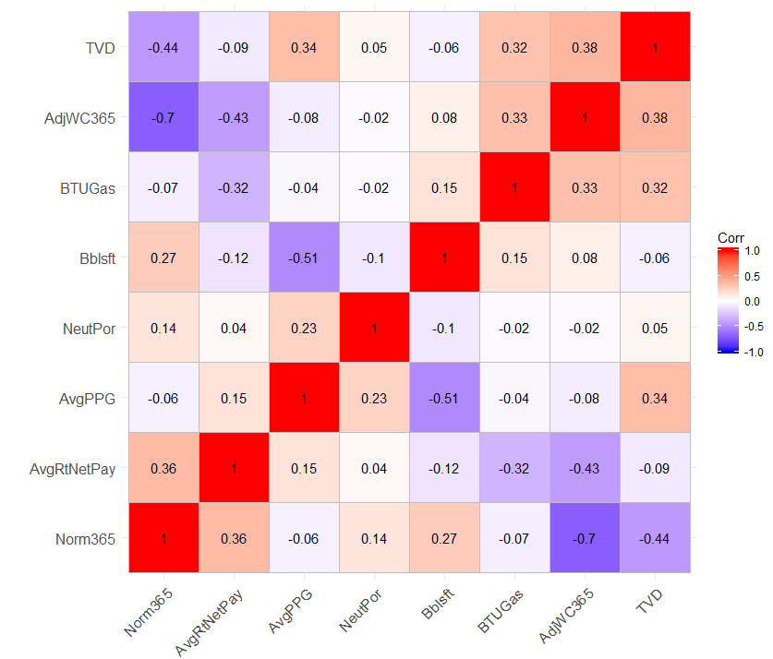
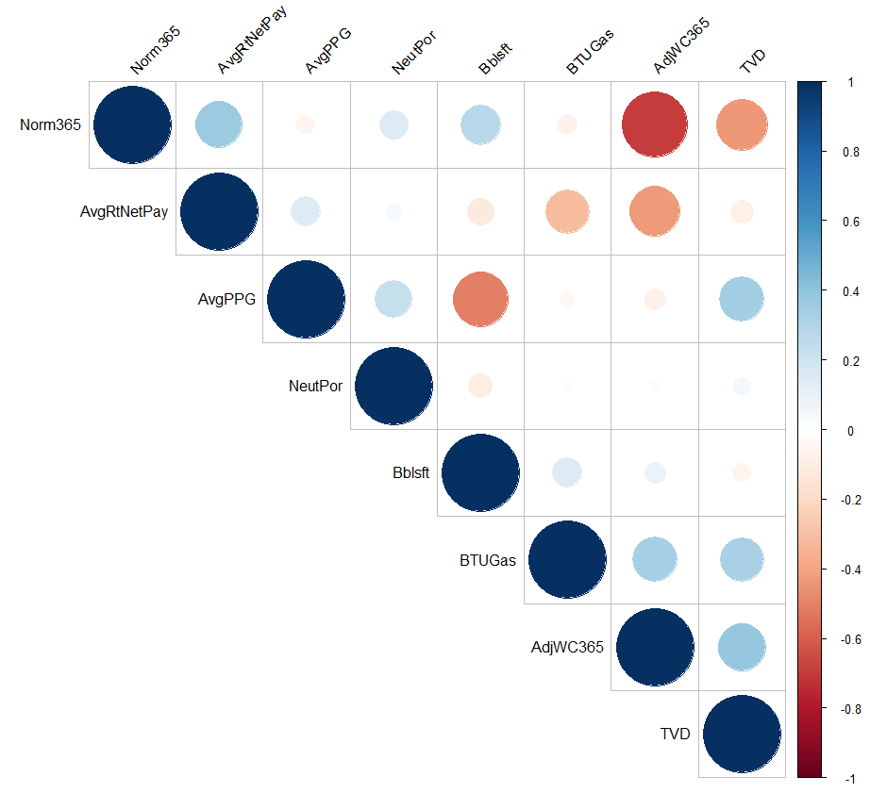
Exploratory Data Analysis Feature Extraction: Correlation Plot
Variable Selection: Starting point is MVA Analysis conducted on the Niobrara wells in December 2015
Response Variable
Norm365 Production (BOE/ft)
Predictor Variables
Bbls/ft
AvgPPG
Adj 365 Water Cut
TVD
BTUGas
NeutronPorosity
AvgRt*NetPay

Slide 3
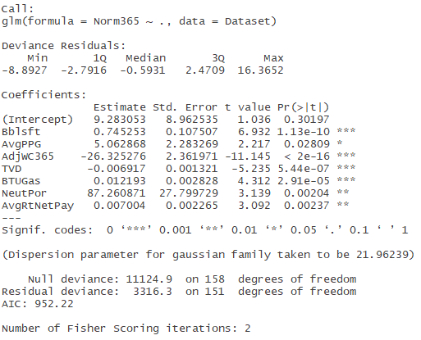
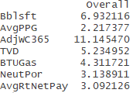
Feature Extraction: Linear Model Fit

Slide 4
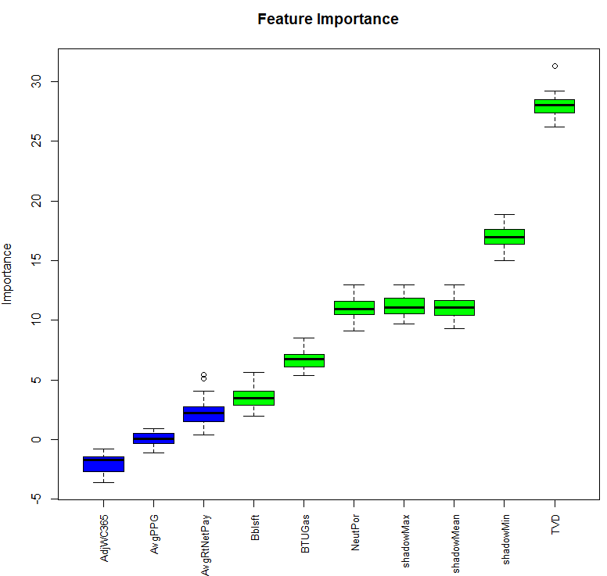
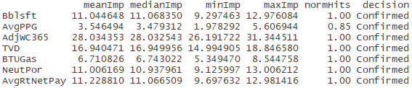
Feature Extraction: Boruta Algorithm

Slide 5
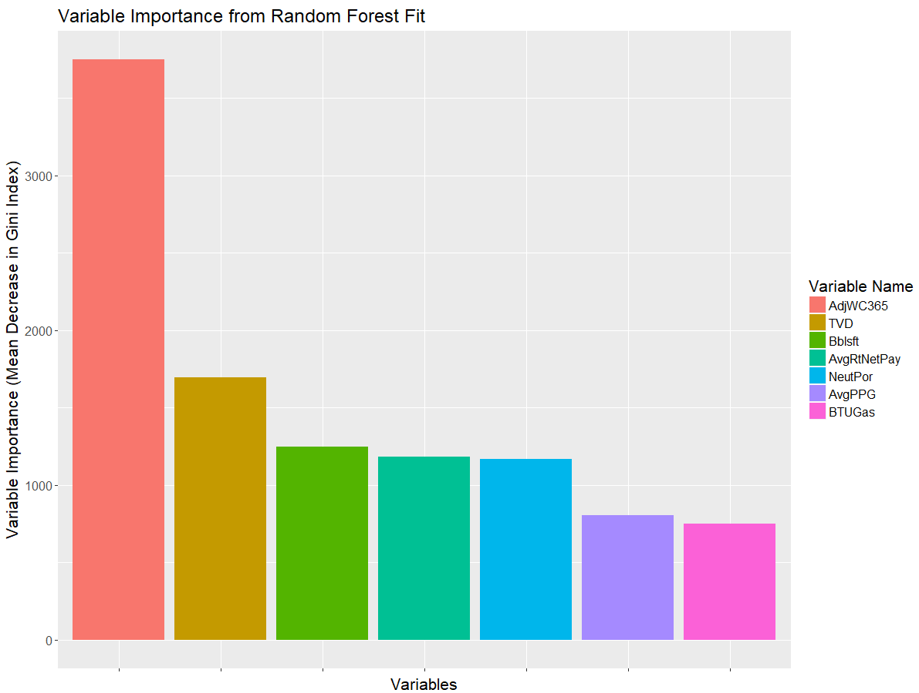
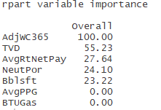
Feature Extraction
Random Forest Method
Caret Package Classification and Regression Training

Slide 6
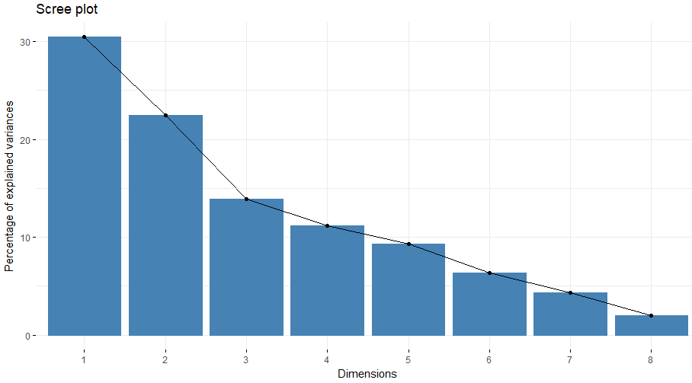
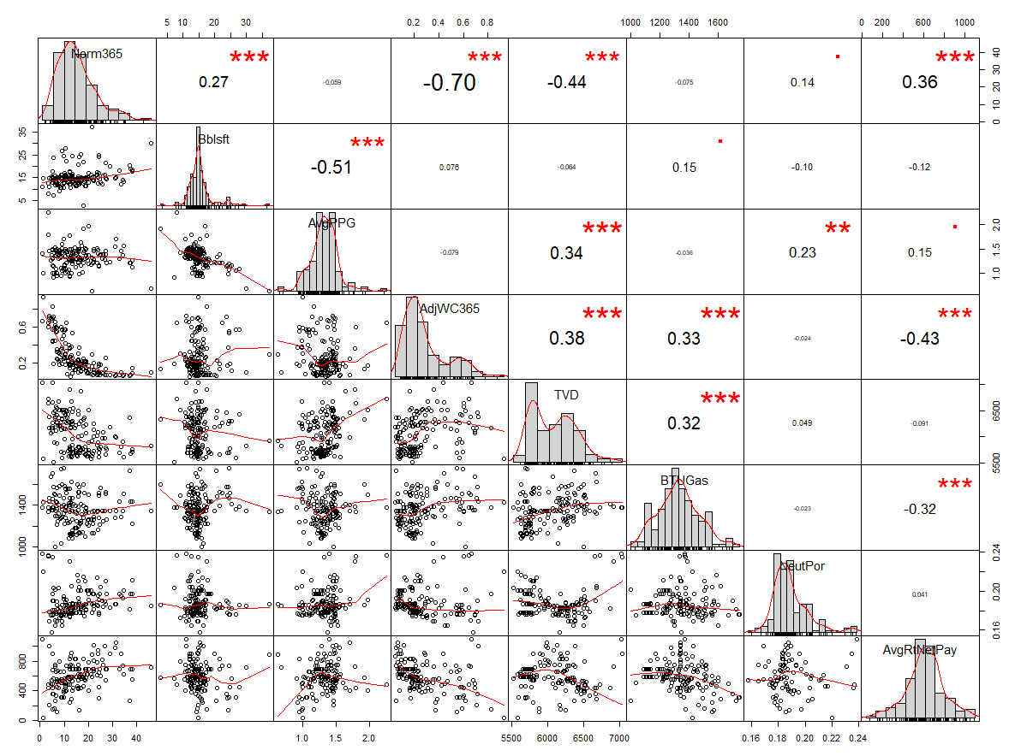
Feature Extraction: PCA

Slide 7
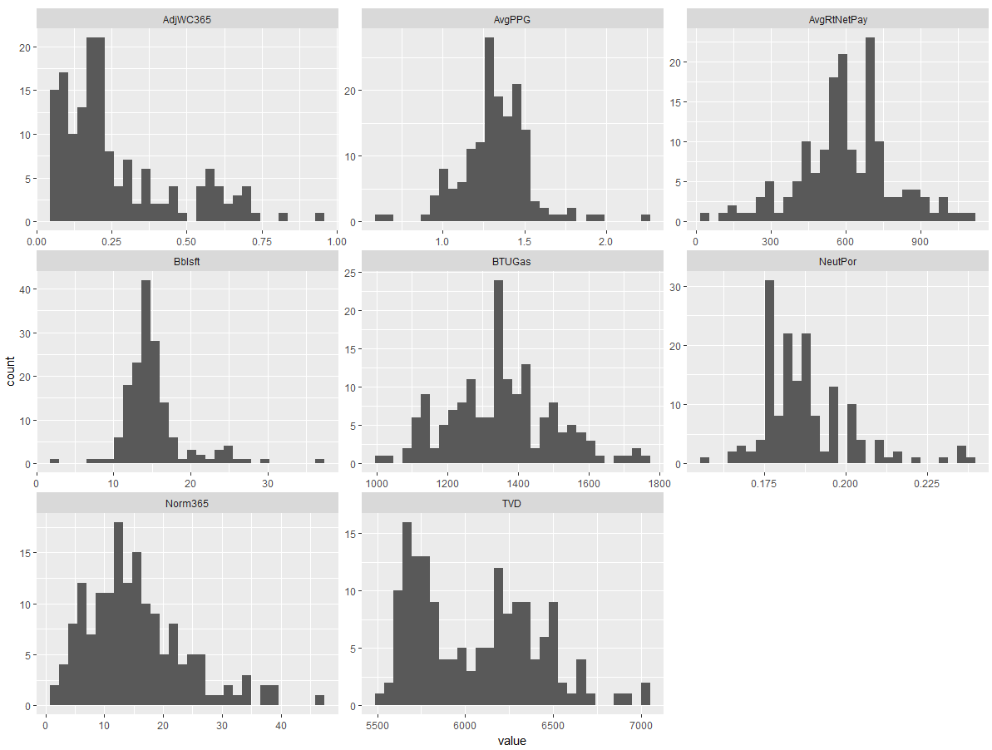
Data Processing

Slide 8
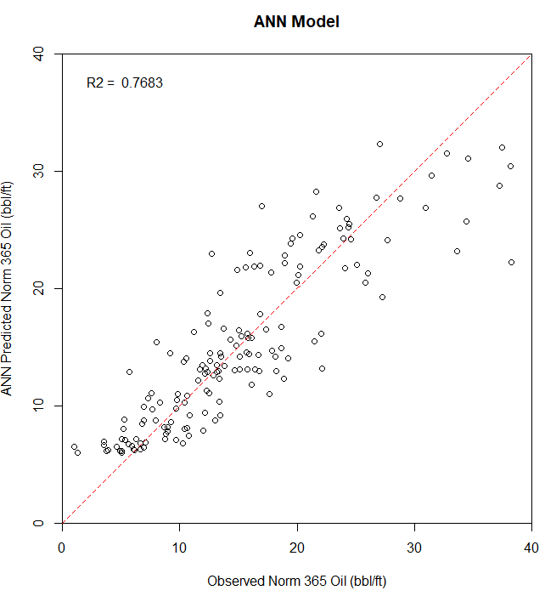
ANN Model Results

Slide 9
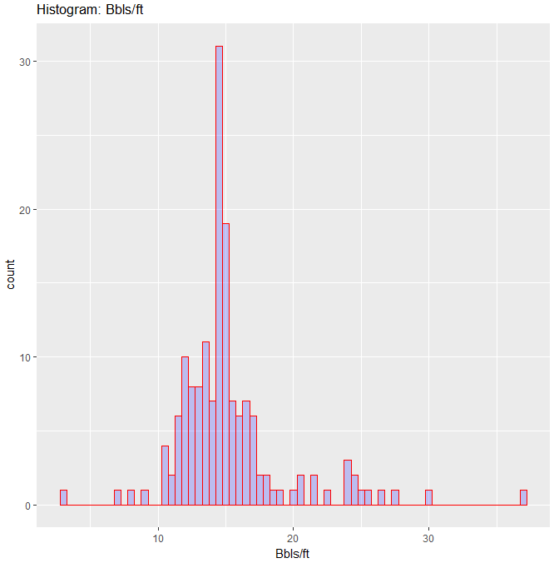
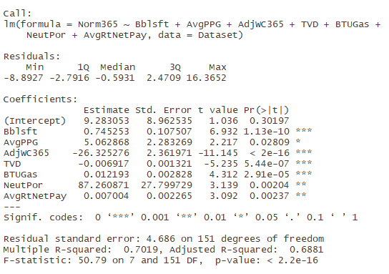
Linear Model Results – MVA, Dec 2015

Slide 11
Sensitivity Analysis
The following variables were removed for the analysis based on the results obtained above
TVD
Neutron Porosity
BTUGas
AdjWC
 | Feature Selection
 | GLM | Boruta (Least Imp) | RF | Caret
1 | NeutronPor | AdjWC | NeutronPor | LatLength
2 | TVD | Avg PPG | TVD | AdjWC
3 | AdjWC | AvgRtNetPay | AdjWC | NeutronPor
4 | WaterSaturation |  | LatLength
5 | BTUGas

Slide 12
Scaling for ANN Input – 2 Methods
Min-Max Scaling (Values lie between 0-1)
Standardizing the input – caret R library
Conclusion: The two methods ‘range’ and ‘scale’ lead to same results. Multiple other methods are available. Also tried ‘pca’ with max pca components = 9 but a lower R2 obtained

Slide 13
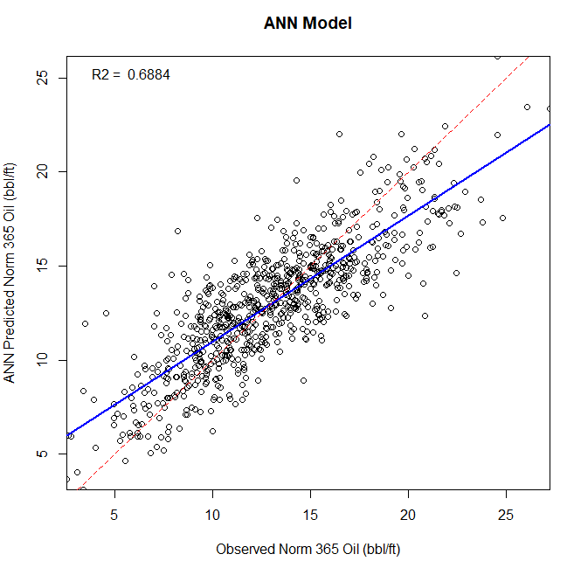
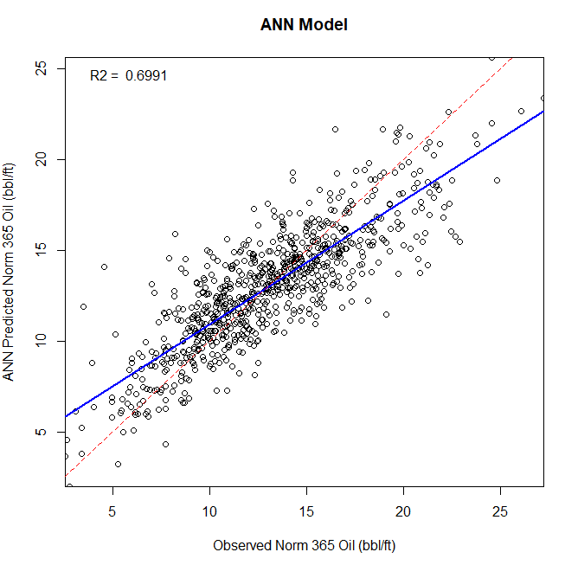
Run 1
Run 2

Slide 14
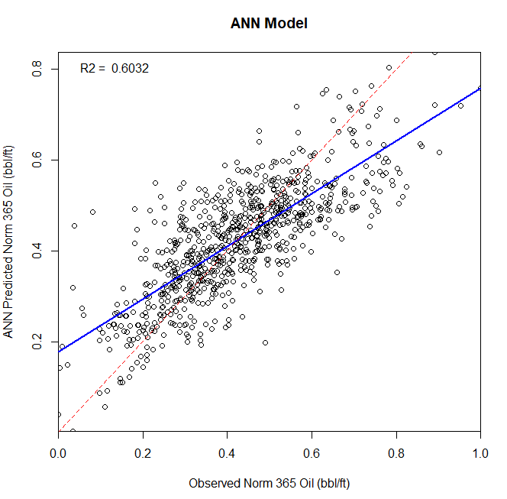
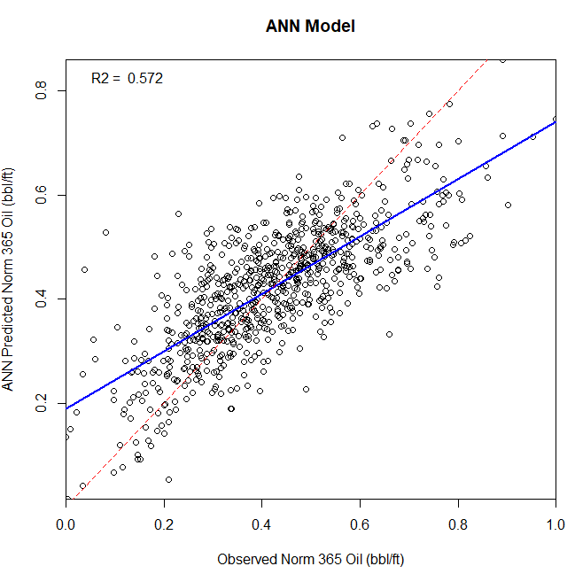
Run 3
Run 4

Slide 15
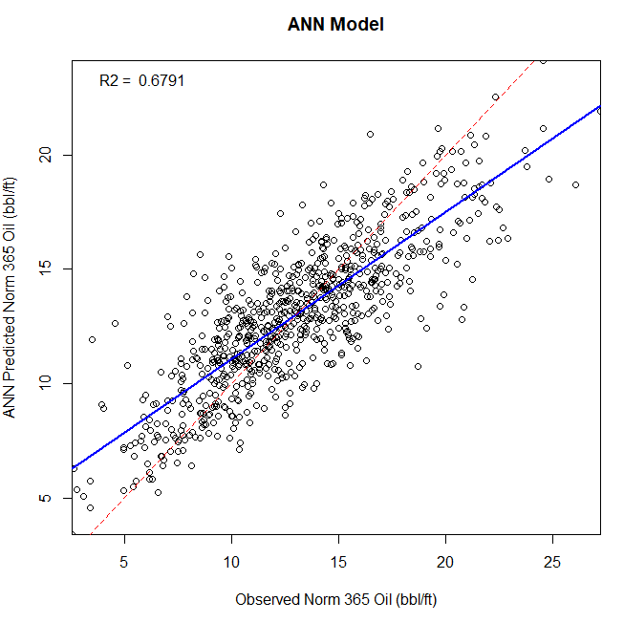
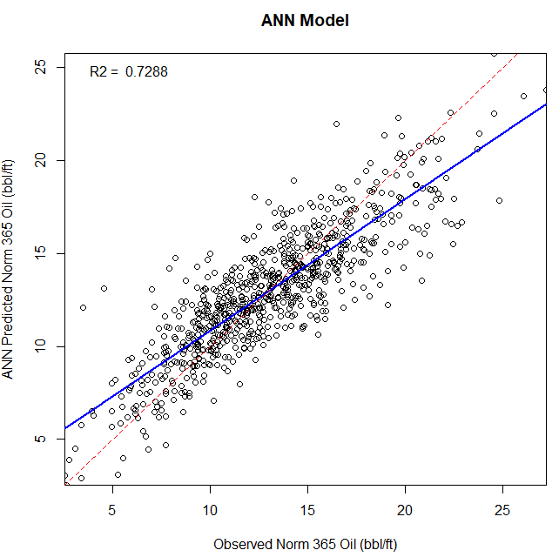
Run 5
Run 6

Slide 16
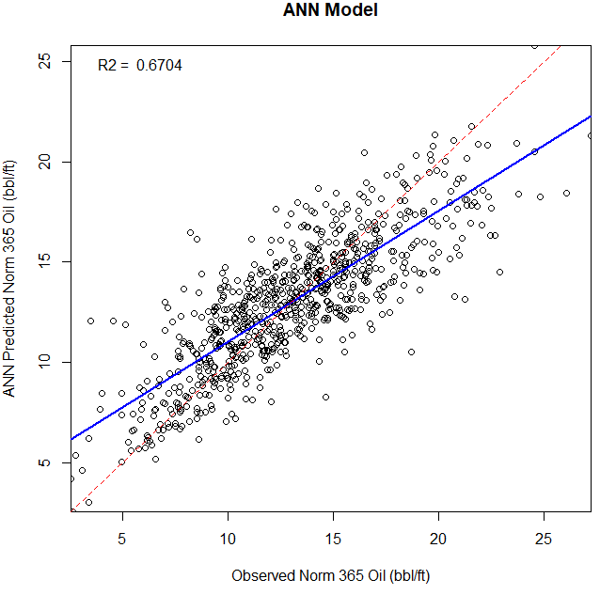
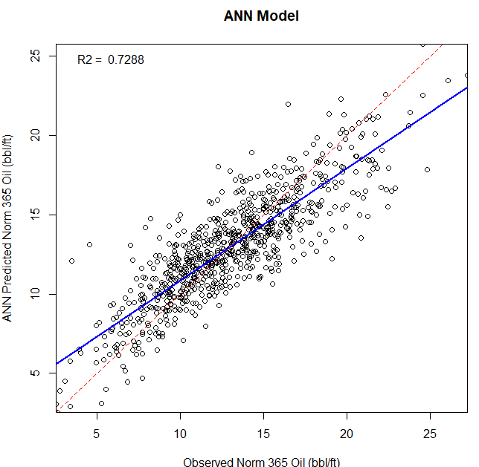
Run 7
Run 8

Slide 17
 |  |  |  |  |  |  | nnet package |  |  | Notes
 |  | Response | Test RMSE | Test AAE | Best Decay | Best Size | R2 | Train RMSE | Train AAE
Not Scaling Response | Run 1 | Norm365 | 3.3342 | 2.0626 | 0.1000 | 10 | 0.6884 | 2.2738 | 1.7587 | AdjWC Included, 9 Predictors, iter = 200
Not Scaling Response | Run 2 | Norm365 | 3.3270 | 2.2009 | 0.1000 | 14 | 0.6991 | 2.2346 | 1.7023 | AdjWC also removed, 8 Predictors, iter = 200
Scaling Response | Run 3 | Norm365 | 0.1650 | 0.0990 | 0.0100 | 14 | 0.6031 | 0.1040 | 0.0799 | AdjWC Included, 9 Predictors, iter = 200
Scaling Response | Run 4 | Norm365 | 0.1649 | 0.1033 | 0.0100 | 14 | 0.5719 | 0.1080 | 0.0828 | AdjWC also removed, 8 Predictors, iter = 200
pca response, no response scaling | Run 5 | Norm365 | 2.8911 | 1.8667 | 2.0000 | 14 | 0.6791 | 2.3129 | 1.7652 | AdjWC also removed, 8 Predictors, iter = 1000
Not Scaling Response | Run 6 | Norm365 | 3.3270 | 2.2009 | 0.1000 | 14 | 0.7288 | 2.1226 | 1.6214 | Repeated Run 2 with 1000 iter
Not Scaling Response | Run 7 | Norm365 | 3.3184 | 2.0530 | 0.1000 | 14 | 0.6703 | 2.3385 | 1.7731 | Run 6 without Water Saturation
Not Scaling Response | Run 8 | Norm365 | 3.3284 | 1.7262 | 0.1000 | 14 | 0.7287 | 2.1226 | 1.6214 | 1000 iterations for size and decay
Not Scaling Response | Run 9 | Norm366 | 3.3926 | 2.0092 | 0.1000 | 8 | 0.6195 | 2.5100 | 1.9407 | 200 iter (scale/decay), Remove WatSat and AvgPPG

