Slide 1
Quantum safe cryptography: Mitigating vulnerabilities in post-quantum era
ICT Capstone Project Presentation
Group: PG-15 Unit: COIT20265/COIT13236
Project Mentor: Mohammed Mohammed Term: 2024 Term 2
Students: Ayush Keshar Prasai (12198371)
Ronit Maheshwori (12179419)
Jalay shah (12232969)
Virajsinh jeetendra sinh rahevar (12198387)
Notes:
Replace PROJECTITLE should be the title of your project, e.g. Internet-of-Things Network Design for Gladstone Regional Council. Move the title up if space is needed.
Replace NUMBER with your group number.
Give the NAME of your Project Mentor.
List the full names of all students (if less than 5 students, delete the remaining lines).
Give the campus (in brackets) for each student.
If all students are in the same unit (e.g. COIT20265), delete the unit code for the other (e.g. delete COIT13236). If your group has a mix, leave both unit codes.

Slide 2

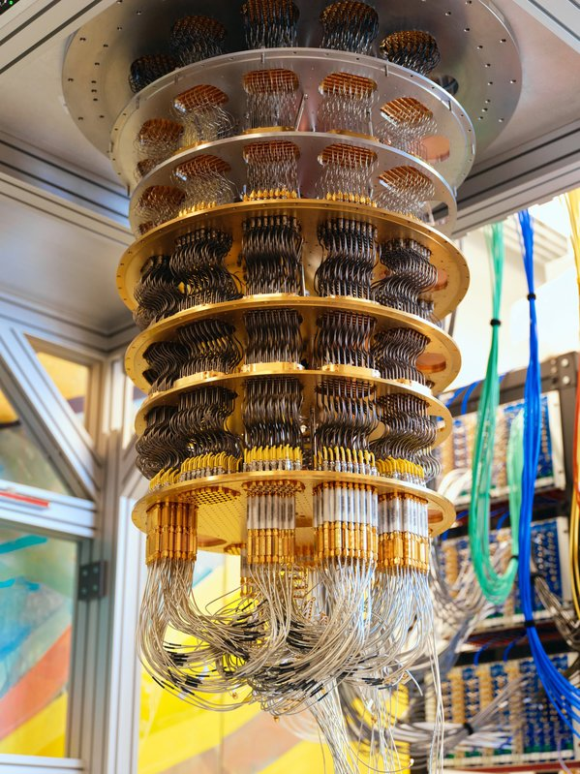
Introduction
The approach of quantum computing is changing the field of computation, with the potential to illuminate complex issues much quicker than classical computers.
However, quantum computers have their possess vulnerabilities, and there's a critical need to create algorithms that can ensure cryptography from quantum attacks.
Source: Google
Notes:
Edit the Footer and replace NUMBER with your Group number and replace PROJECTTITLE with your title (use a shorter title if it doesn’t fit on the line), e.g. “IoT Network for Gladstone Regional Council” instead of “Internet-of-Things Network Design for Gladstone Regional Council”.

Slide 3

What is the purpose of undertaking this project?
Comprehensive review of existing literature on quantum safe cryptography
Analytical report preparation on key findings.
Comparison of various cryptographic techniques.
Identifying future research directions.
Purpose recommendations on being quantum-safe organization
Implementation of quantum safe cryptography through systems.
Source: istockphoto.com
Notes:
Edit the Footer and replace NUMBER with your Group number and replace PROJECTTITLE with your title (use a shorter title if it doesn’t fit on the line), e.g. “IoT Network for Gladstone Regional Council” instead of “Internet-of-Things Network Design for Gladstone Regional Council”.

Slide 4

What this project achieves?
Reports the key findings from reviews of existing literature.
Studies the modern cryptographic techniques
Analyses the vulnerabilities with post-quantum cryptography
Implements the vulnerabilities into a system.
Tests new system for post-quantum cryptography
Proposes a transition for organizations.
Source: Dreamstime.com
Notes:
Edit the Footer and replace NUMBER with your Group number and replace PROJECTTITLE with your title (use a shorter title if it doesn’t fit on the line), e.g. “IoT Network for Gladstone Regional Council” instead of “Internet-of-Things Network Design for Gladstone Regional Council”.

Slide 5
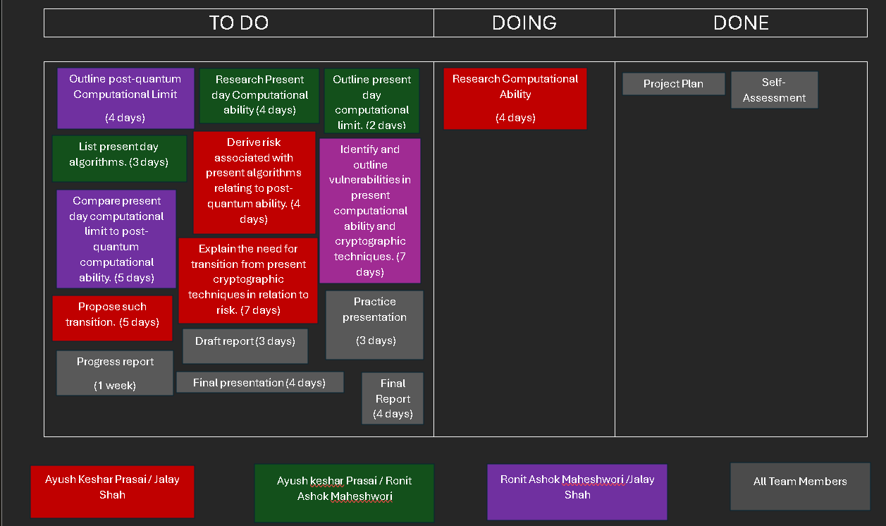
Differentiation of tasks and comprehensive reviews:
Notes:
Edit the Footer and replace NUMBER with your Group number and replace PROJECTTITLE with your title (use a shorter title if it doesn’t fit on the line), e.g. “IoT Network for Gladstone Regional Council” instead of “Internet-of-Things Network Design for Gladstone Regional Council”.

Slide 6
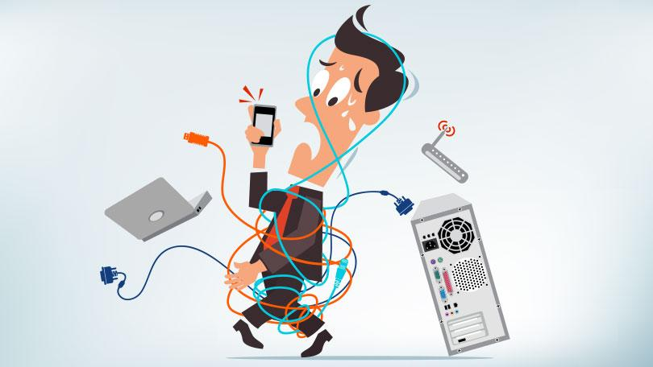
Technical aspects of this project:
Use of methodologies to deliver and document the project.
Use of tools to implement systems, document reports and simulate any form of data to the audience.
Use of technology such as qubits and its extensive research and purpose in the system implementation.
Various algorithms research in modern cryptographic techniques with series of vulnerabilities showcased.
Post-quantum cryptographic techniques such as Shor's and Grover's algorithm implementation into a system to signify post-quantum vulnerabilities for modern cryptographic techniques.
Source: PCmag
Notes:
Edit the Footer and replace NUMBER with your Group number and replace PROJECTTITLE with your title (use a shorter title if it doesn’t fit on the line), e.g. “IoT Network for Gladstone Regional Council” instead of “Internet-of-Things Network Design for Gladstone Regional Council”.

Slide 7

Tasks at hand:
Define and explain post quantum era.
Introduce post-quantum computational abilities.
List modern day cryptographic techniques (algorithms, hardware and software).
Assess risk and vulnerabilities of modern cryptographic techniques in comparison to post-quantum computers.
Literature review of quantum-safe cryptography.
Explain what is quantum-safe cryptography.
Notes:
Edit the Footer and replace NUMBER with your Group number and replace PROJECTTITLE with your title (use a shorter title if it doesn’t fit on the line), e.g. “IoT Network for Gladstone Regional Council” instead of “Internet-of-Things Network Design for Gladstone Regional Council”.

Slide 8

More tasks:
Study of existing algorithms such as Shor's and Grover's algorithm.
Effects and vulnerability assessment of such algorithms with risk assessment to modern cryptographic techniques.
Study and implementation of such systems to portray such vulnerabilities.
Comprehensive review of quantum safe algorithms.
Implantation of quantum safe algorithms.
Report the results from the system implemented to signify the need for transition from modern cryptography to post-quantum cryptographic techniques.
Propose such transition.
Notes:
Edit the Footer and replace NUMBER with your Group number and replace PROJECTTITLE with your title (use a shorter title if it doesn’t fit on the line), e.g. “IoT Network for Gladstone Regional Council” instead of “Internet-of-Things Network Design for Gladstone Regional Council”.

Slide 9
Post-Quantum Computational Limit
Quantum computing uses Qubits for multiple tasks
It can also be used for breaking encryption with Shor’s algorithm
QC is sensitive to environmental factors and may require advanced error correction
With emergence of technology, cryptographic standards and algorithms will emerge
There are still various ethical concerns around data privacy
Notes:
Edit the Footer and replace NUMBER with your Group number and replace PROJECTTITLE with your title (use a shorter title if it doesn’t fit on the line), e.g. “IoT Network for Gladstone Regional Council” instead of “Internet-of-Things Network Design for Gladstone Regional Council”.

Slide 10
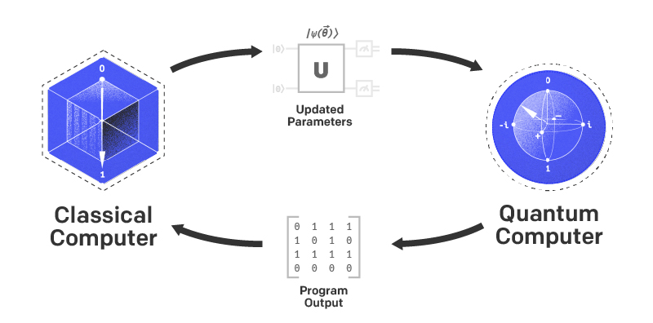
Classical vs. Quantum Computation
Classical Computers:
Binary Handling: Classical computers handle information in bits (0 or 1).
Deterministic Logic:
Takes after strict coherent groupings, performing operations one at a time.
Adaptability Issues:
Battle with understanding certain complex issues (e.g., figuring expansive numbers, optimization issues).
Source: IonQ
Notes:
Edit the Footer and replace NUMBER with your Group number and replace PROJECTTITLE with your title (use a shorter title if it doesn’t fit on the line), e.g. “IoT Network for Gladstone Regional Council” instead of “Internet-of-Things Network Design for Gladstone Regional Council”.

Slide 11
Quantum Computers:
Qubits: Utilize quantum bits that can exist in superpositions of and 1, permitting them to handle more states at the same time.
Superposition: A qubit can be both and 1 at the same time, expanding parallelism in computation.
Entanglement: Quantum computers use entanglement for quicker, interconnected computations.
Quantum Speedup: For a few issues (like figuring by means of Shor's algorithm), quantum computers can be exponentially quicker than classical machines.
Shor's Algorithm:
A quantum algorithm for calculating huge integrability in polynomial time, which may break classical cryptographic frameworks like RSA and ECC.
Grover's Algorithm:
Can look unsorted databases in O(√N) time, advertising a quadratic speedup over classical algorithms.
Optimization:
Quantum computers are profoundly efficient in tackling optimization problems utilizing quantum strengthening or variational quantum algorithms.
Notes:
Edit the Footer and replace NUMBER with your Group number and replace PROJECTTITLE with your title (use a shorter title if it doesn’t fit on the line), e.g. “IoT Network for Gladstone Regional Council” instead of “Internet-of-Things Network Design for Gladstone Regional Council”.

Slide 12

Vulnerabilities of Quantum Computers
1. Decoherence:
Quantum states are delicate and inclined to environmental unsettling influences, driving to misfortune of data over time.
Quantum computations must be completed before the framework decoheres, restricting the viable computation time.
2. Noise and Error Rates:
Quantum noise can present noteworthy blunders, and mistake redress is more complex than in classical frameworks.
Requires quantum error correction codes, which are resource-intensive.
Notes:
Edit the Footer and replace NUMBER with your Group number and replace PROJECTTITLE with your title (use a shorter title if it doesn’t fit on the line), e.g. “IoT Network for Gladstone Regional Council” instead of “Internet-of-Things Network Design for Gladstone Regional Council”.

Slide 13
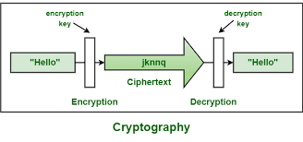
Vulnerabilities of Classical Cryptography in the Quantum Era
Decoherence:
Quantum states are fragile and inclined to natural unsettling impacts, driving to misfortune of information over time.
Quantum computations must be completed some time recently the system decoheres, limiting the practical computation time.
Noise and Error Rates:
Quantum noise can display critical blunders, and mistake change is more complex than in classical systems.
Requires quantum error redress codes, which are resource-intensive.
Notes:
Edit the Footer and replace NUMBER with your Group number and replace PROJECTTITLE with your title (use a shorter title if it doesn’t fit on the line), e.g. “IoT Network for Gladstone Regional Council” instead of “Internet-of-Things Network Design for Gladstone Regional Council”.

Slide 14
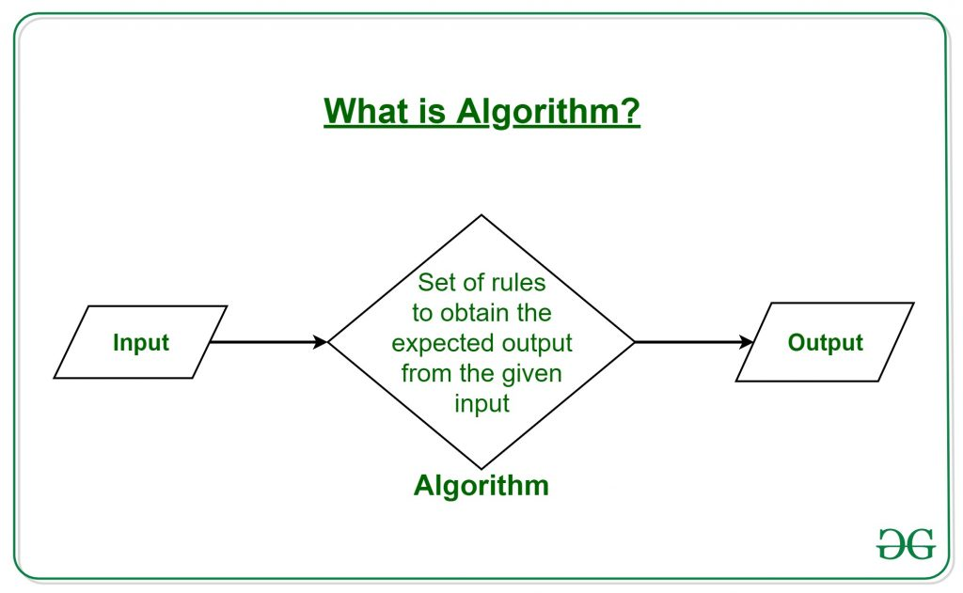
Algorithms to Protect Against Quantum Attacks
Lattice-Based Cryptography:
Mathematical Foundation: Based on the hardness of cross section issues, which are safe to both classical and quantum assaults.
Algorithms: Incorporates plans like Learning With Mistakes (LWE) and Ring-LWE, which give solid encryption and secure key trade.
Example: NTRU (a lattice-based encryption conspire) is one such quantum-resistant calculation.
Notes:
Edit the Footer and replace NUMBER with your Group number and replace PROJECTTITLE with your title (use a shorter title if it doesn’t fit on the line), e.g. “IoT Network for Gladstone Regional Council” instead of “Internet-of-Things Network Design for Gladstone Regional Council”.

Slide 15
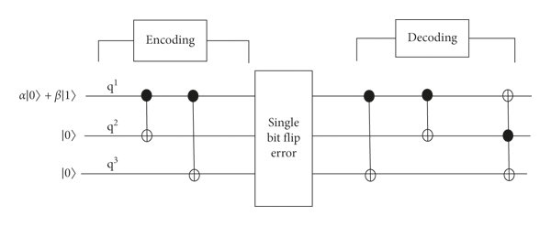
Quantum Error Correction and Mitigation
Quantum Error-Correcting Codes (QECCs):
These are basic to create quantum computers dependable by adjusting errors from decoherence and commotion.
Surface codes and Shor codes are cases of quantum error-correction plans.
Fault-Tolerant Quantum Computing:
Quantum computers got to run in a fault-tolerant way to handle mistakes effectively. Inquire about is continuous to move forward these frameworks.
Notes:
Edit the Footer and replace NUMBER with your Group number and replace PROJECTTITLE with your title (use a shorter title if it doesn’t fit on the line), e.g. “IoT Network for Gladstone Regional Council” instead of “Internet-of-Things Network Design for Gladstone Regional Council”.

Slide 16
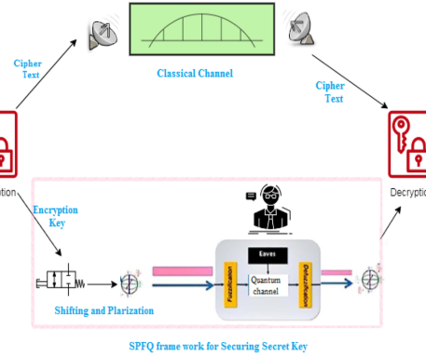
Algorithms to Protect Against Quantum Attacks
Multivariate Quadratic Cryptography:
Rainbow: A framework based on solving multivariate quadratic conditions, an NP-hard issue that quantum computers discover difficult to solve.
Rainbow is particularly productive for computerized marks, advertising assurance against quantum assaults.
Symmetric Key Frameworks with Larger Key Sizes:
AES-256 and SHA-3:
Whereas Grover's calculation can reduce the successful security of symmetric key frameworks, utilizing bigger key sizes (e.g., AES-256) gives adequate security indeed within the quantum age.
Notes:
Edit the Footer and replace NUMBER with your Group number and replace PROJECTTITLE with your title (use a shorter title if it doesn’t fit on the line), e.g. “IoT Network for Gladstone Regional Council” instead of “Internet-of-Things Network Design for Gladstone Regional Council”.

Slide 17
Aspects | Present Day Computational Limit | Post-Quantum Computational Limit
Cryptographic Security | The cryptographic security relies over RSA, ECC and other related algorithm, however, these algorithms are sometimes susceptible to classical attacks. | On the other hand, it mainly requires post-quantum cryptography i.e. lattice-based and code based which helps in resisting all types of quantum related attacks.
Algorithm Efficiency | There are various tasks that are computationally infeasible such as factorizing of large numbers. | The use of Shor’s algorithm could be done in such a way that it will be able to make factorization feasible.
Hardware Scalability | The hardware scalability is also possible in the current era with Moore’s law that is approaching physical limits in the coming years. | The quantum computing hardware is still in early stages which means there would be significant challenges faced when qubits are to be scaled up.
Application Scope | The wide range of application are supported followed by optimization, machine learning and data processing | Higher complex tasks like optimization, natural science simulations and cryptographic operations
Development Stage | It is well established and continuous increments are being made | Various challenges for quantum computing hardware, algorithms and software in the future
Ethical Considerations | The privacy and security could be maintained easily with current cryptographic standards available in the market. | The privacy and security could not be maintained easily with cryptographic standards as it can break currently available encryptions easily.
Future Outlook | In the future, the incremental improvements are approaching physical and theoretical limits for the classical computing. | Herein, the paradigm shift is seen for various advancements in the field of science and it can compete with classical computing easily.
Notes:
Edit the Footer and replace NUMBER with your Group number and replace PROJECTTITLE with your title (use a shorter title if it doesn’t fit on the line), e.g. “IoT Network for Gladstone Regional Council” instead of “Internet-of-Things Network Design for Gladstone Regional Council”.

Slide 18
VULNERABILITIES IN PRESENT COMPUTATIONAL ABILITY
Scalability related issues
Algorithmic Efficiency
Processing Speed
Implementation Flaws
Notes:
Edit the Footer and replace NUMBER with your Group number and replace PROJECTTITLE with your title (use a shorter title if it doesn’t fit on the line), e.g. “IoT Network for Gladstone Regional Council” instead of “Internet-of-Things Network Design for Gladstone Regional Council”.

Slide 19
The list of vulnerabilities that have been found in present day computational limit are provided below.
Scalability Related Issues: In the coming years, the transistor size is likely to approach the atomic scale which means the Moore’s law will no longer will applicable.
Algorithmic Efficiency: There are multiple problems classified like NP-hard and NP-complete which does not have polynomial time solutions. As a result of this absence, it is likely to limit solvability with classical methods available
Processing Speed: There are multiple problems classified like NP-hard and NP-complete which does not have polynomial time solutions. As a result of this absence, it is likely to limit solvability with classical methods available.
Implementation Flaws: There are various vulnerabilities in cryptographic software and it can be exploited. For example, Heartbleed vulnerability
Notes:
Edit the Footer and replace NUMBER with your Group number and replace PROJECTTITLE with your title (use a shorter title if it doesn’t fit on the line), e.g. “IoT Network for Gladstone Regional Council” instead of “Internet-of-Things Network Design for Gladstone Regional Council”.

Slide 20
NTRU ALGORITHM
NTRU is a is a public-key cryptosystem
Operates using polynomial rings and modular arithmetic
Focusses on computational simplicity and robustness
NTRU is essential and aims to make sure quantum attacks are mitigated
Notes:
Edit the Footer and replace NUMBER with your Group number and replace PROJECTTITLE with your title (use a shorter title if it doesn’t fit on the line), e.g. “IoT Network for Gladstone Regional Council” instead of “Internet-of-Things Network Design for Gladstone Regional Council”.

Slide 21
Kyber (Quantum Algorithm)
Kyber is a post-quantum cryptographic algorithm
Specially designed for resisting attacks
Works on lattice based cryptography
Proposes secure key encapsulation mechanisms
Is also a part of NIST framework
Notes:
Notice the title has been moved up a little to fit in.

Slide 22
WORKING OF KYBER
Key Generation
Encryption/Encapsulation
Decryption/Decapsulation
Notes:
Notice the footer has been edited to include group number and shortened title

Slide 23
kYBER KEY SIZES
Variant | Public Key Size | Cipher Text Size | Secret Key Size | Approx./ Security Level
Kyber512 | 800 bytes | 768 bytes | 1632 bytes | 128-bit, level 1
Kyber768 | 1184 bytes | 1088 bytes | 2400 bytes | 192-bit, level 3
Kyber1024 | 1568 bytes | 1568 bytes | 3168 bytes | 256-bit, level 5

Slide 24
Quantum-Safe Cryptography: Mitigating Vulnerabilities in Post-Quantum era
Quantum-Safe Cryptography poses a threat to RSA and ECC
Shor Algorithm a new type of algorithm
Comprises of techniques like lattice-based, hash-based and code based cryptography
Aims to secure data in quantum computers
Assures long term security for encrypted communications

Slide 25
Challenges and Constraints in Quantum Computing Technologies
Cost Constraint
Very high due to specialized material
Requires extremely low temperature
Time Constraint
Noisy Intermediate Scale Quantum
Broad Quantum Advantage
Technological Constraint
Have stability and coherence issues
Require complex algorithms
Full scale Fault tolerance

Slide 26
References
Baker, M. A. (2023, June 26). The environmental impact of Quantum Computing - Maher Asaad Baker - Medium. Medium. https://maher-asaad-baker.medium.com/the-environmental-impact-of-quantum-computing-386386990785
Desdentado, E., Calero, C., Moraga, M. Á., Serrano, M., & García, F. (2024). Exploring the trade-off between computational power and energy efficiency: An analysis of the evolution of quantum computing and its relation to classical computing. Journal of Systems and Software, 112165. https://doi.org/10.1016/j.jss.2024.112165
Gökce, N.Y., Gökce, A.B. and Cenk, M. (2024) 'A fast NTRU software implementation based on 5-way TMVP,' Journal of Information Security and Applications, 81, p. 103688. https://doi.org/10.1016/j.jisa.2023.103688.
Notes:
Edit the Footer and replace NUMBER with your Group number and replace PROJECTTITLE with your title (use a shorter title if it doesn’t fit on the line), e.g. “IoT Network for Gladstone Regional Council” instead of “Internet-of-Things Network Design for Gladstone Regional Council”.

Slide 27
He, S. et al. (2024) 'A lightweight hardware implementation of CRYSTALS-Kyber,' Journal of Information and Intelligence, 2(2), pp. 167–176. https://doi.org/10.1016/j.jiixd.2024.02.004.
Klas, G. (2023) CRYSTALS-Kyber for Post Quantum Cryptography demystified. https://www.linkedin.com/pulse/crystals-kyber-post-quantum-cryptography-demystified-guenter-klas.
Sood, V., & Chauhan, R. P. (2024). Quantum computing: Impact on energy efficiency and sustainability. Expert Systems With Applications, 255, 124401. https://doi.org/10.1016/j.eswa.2024.124401
Yu, J. Y., Sim, W. S., Jung, J. Y., Park, S. H., Kim, H. S., & Park, Y. R. (2024). Evaluation of conventional and quantum computing for predicting mortality based on small Early-Onset Colorectal Cancer data. Applied Soft Computing, 111781. https://doi.org/10.1016/j.asoc.2024.111781

